Slide 1

Welcome to
VCE Food Studies
2023
Teacher:
Email:

Slide 2
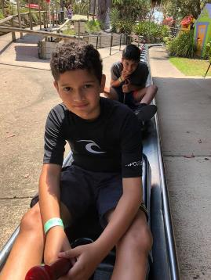


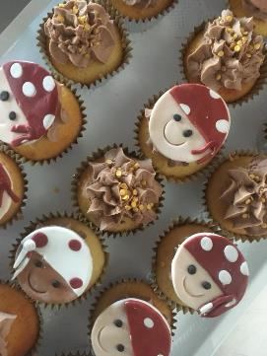

About your teacher…
Write your name here:
Provide a brief outline of yourself here, a little bit about your teaching experience or teaching philosophy.
Write your goal for this year here.

Slide 3


VCE Food Studies: Unit 1 - Food Origins
Area of Study One
Food Around the World
Area of Study Two
Food in Australia
Outcome 1 Assessment
A range of practical activities with records that reflect on two of the practical activities that use ingredients found in earlier cultures.
One additional task.
Outcome 2 Assessment
A range of practical activities with records that reflect on two of the practical activities that use ingredients indigenous to Australia and/or ingredients introduced through migration.
One additional task

Slide 4


VCE Food Studies: Unit 2 - Food Makers
Area of Study One
Australia’s Food Systems
Area of Study Two
Food in the Home
Outcome 1 Assessment
Design and develop a practical food solution in response to an opportunity or a need in the food industry or school community.
Outcome 2 Assessment
Design and develop a practical food solution in response to an opportunity or a need in a domestic or small-scale setting.

Slide 5

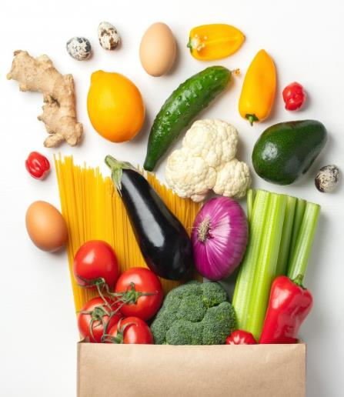
VCE Food Studies: Unit 3 – Food in Daily Life
Area of Study One
The Science of Food
Area of Study Two
Food Choices, Health and Wellbeing
Outcome 1 Assessment
Three practical activities and records of two practical activities related to nutritious foods to examine specific dietary needs.
Two records of practical activities
One additional task.
Outcome 2 Assessment
Three practical activities and records of two practical activities related to healthy meals for children and families to evaluate factors influencing food choices.
One additional task.

Slide 6


VCE Food Studies: Unit 4 – Food Issues, Challenges and Futures
Area of Study One
Navigating Food Information
Area of Study Two
Environment and Ethics
Outcome 1 Assessment
Three practical activities and records of two practical activities related to healthy food choices based on recommendations of the Australian Dietary Guidelines.
One additional task.
Outcome 2 Assessment
A research inquiry report that includes a selected food-related topic based on a range of practical activities, explanation of concerns related to ethics, sustainability and/or food sovereignty, analysis of work being done to solve problems and support solutions, and a conclusion outlining major findings and suggested set of practical guidelines for consumers.

Slide 7

Summary of Marks
Unit 3 and 4 | Marks | Percentage of Total Score
Unit 3 Outcome 1 | 50 | 30% of the total score
Unit 3 Outcome 2 | 50
Unit 4 Outcome 1 | 40 | 30% of the total score
Unit 4 Outcome 2 | 60
Examination | 100 | 40% of the total score
Note: The VCAA applies the statistical moderation process to all school-based assessments. Statistical moderation is a process applied by the Victorian Curriculum and Assessment Authority (VCAA) to the scores awarded by teachers for school-based assessments.

Slide 8








Cross-study Specifications
The following concepts underpin VCE Food Studies.
Students need to develop the ability to use and apply these concepts when framing questions, and discussing, interpreting, analysing and evaluating issues related to the food system.
Aboriginal and Torres Strait Islander
knowledge, culture and history
Healthy Eating: Eat for Health Program
Food Citizenship
Innovations and Technologies
Food Security and Food Sovereignty
Issues in Food
Food Systems
Sustainability
(Environmental, Economic & Social)

Slide 9
Practical Activities
Practical activities must be planned according to key knowledge and key skills specific to an area of study. They enable students to apply and demonstrate key knowledge and key skills in practical ways.
Comparative Food Testing
Cooking
Product Analysis
Nutritional Analysis
Creating and Responding to Design Briefs
Dietary Analysis
Demonstrations
Scientific Experiments
Sensory Analysis

Slide 10

What are our expectations?
Be Safe
What might these expectations look like in the classroom?
Be Responsible
Be Respectful
Be Prepared
Be Positive

Slide 11
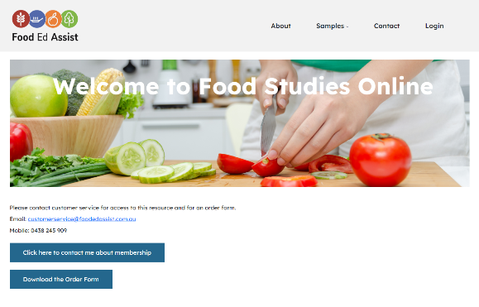

Key to Success in Food Studies
What do I bring to class?
What resources do I need?
Theory and Practical Classes*
Computer
Note taking book
Pens and highlighter
Positive attitude
OneNote
All students will submit their work via OneNote.
You must use the folder system established by your teacher.
Hard-copy Folders
You may wish to keep a hard-copy folder of your work.
Divide your folder into four sections for each outcome. Please upload any handwritten tasks to your OneNote folder.
*Please bring a 2-litre container, knife, fork and spoon to all practical classes.
Food Studies Online Textbook
Edrolo
VCAA Food Studies
Click Here

Slide 12

Food Studies Pathways
The information below provides details of some of the course related to VCE Food Studies.
Certificate I to IV
Commercial Cookery, patisserie and/ or hospitality Personal Trainer – Nutrition Certificate in Allied Health (Nutrition & Dietetics) Weight Management Natural Health and Business Sports Nutrition
Diploma
Diploma in Nutrition Science Diploma of Hospitality Management Diploma of Nutrition Diploma of Food Science and Technology
Advanced Diploma/ Associate Degree
Diploma in Nutrition Science Diploma of Hospitality Management Associate Degree in Health Sciences
Bachelor Honours Degree Graduate Certificate or Diploma
Food & Nutrition Sciences Graduate Certificate of Human Nutrition Health Sciences Sports Nutrition Bachelor of Food Studies Bachelor of Culinary Mgt Bachelor of Food & Nutrition Bachelor of Education – Home Economics
Masters
Masters of Dietetics

Slide 13
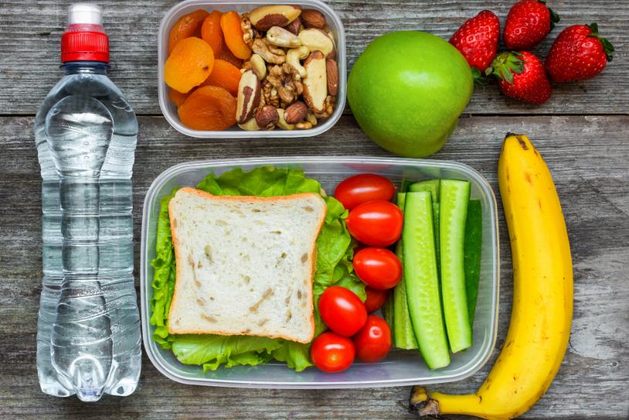
Eating for VCE Success!
Research suggests that what we eat not only impacts physical health, but it also affects mental health. Eating a nutritious diet can improve memory and help people focus more which improves overall academic performance.
Following these eating tips may help you achieve VCE success:
Drink water regularly. Dehydration can lead to tiredness, headaches, reduced alertness and diminished concentration
Eat fish, seafood, nuts and seeds, they contain omega 3 fats which are essential for improving memory and mental wellbeing.
Eat foods high in fibre. Fibre helps to slow down digestion and release energy slowly into the body.
Eat more iron-rich foods. This includes lean meats, nuts, beans, lentils, dark leafy vegetables, and fortified breakfast cereals.

Slide 14
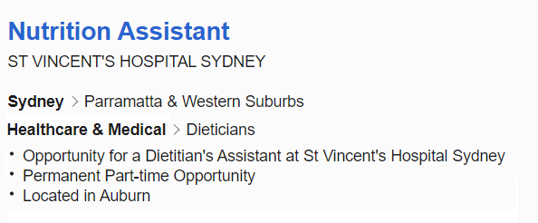
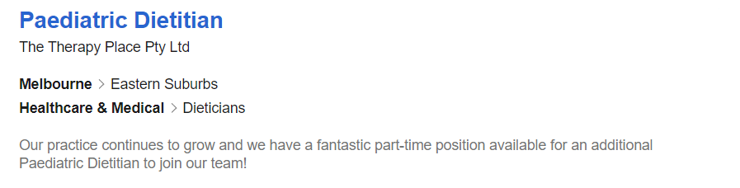

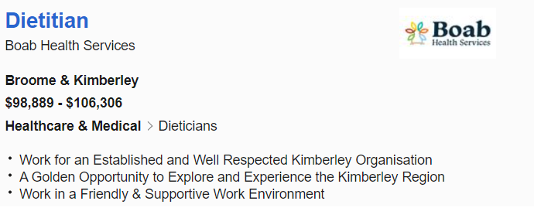
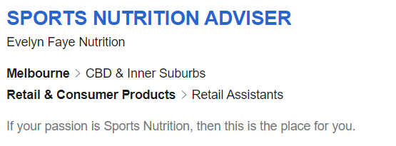
Careers in Nutrition

Slide 15

