Slide 1
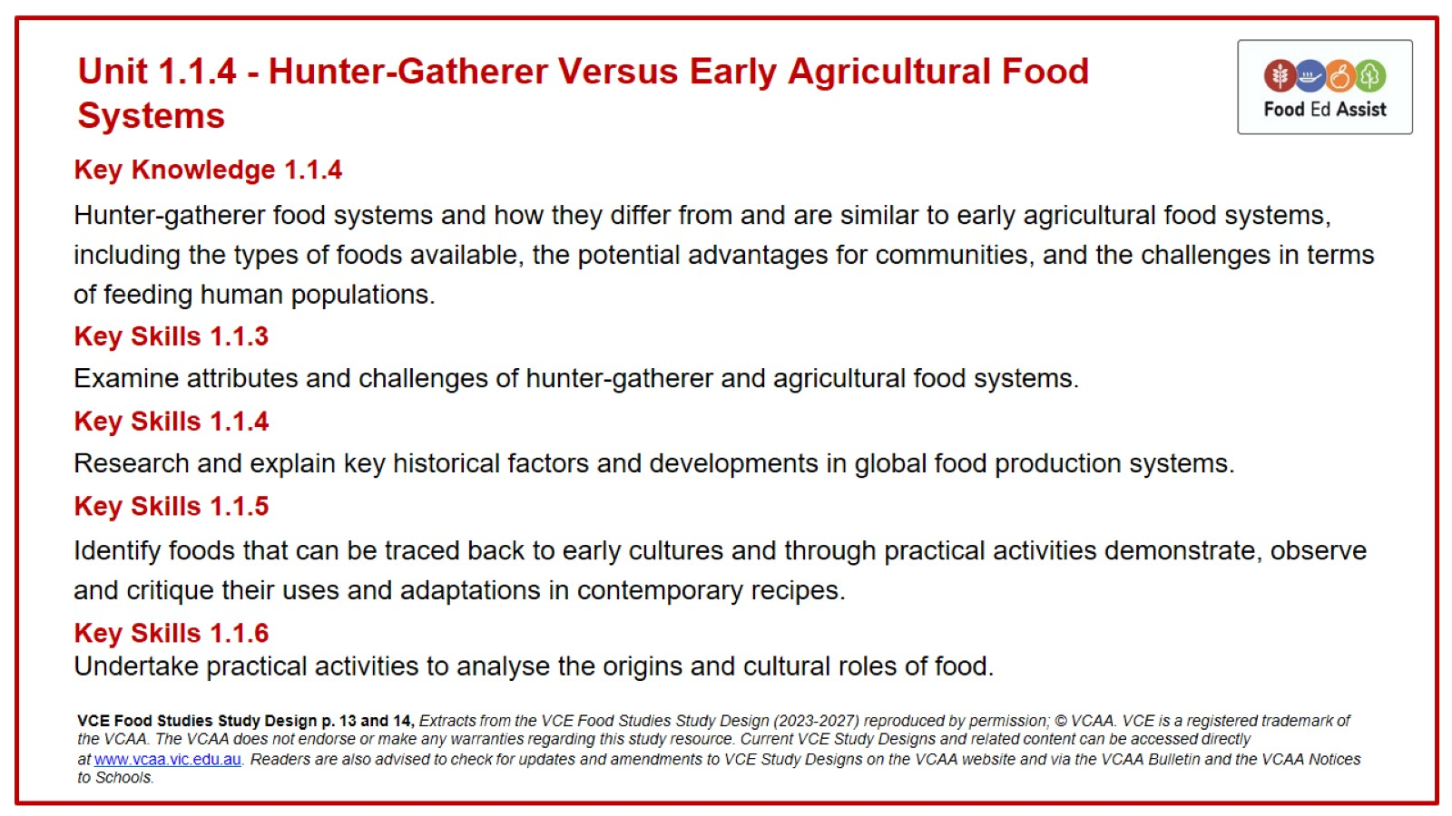
Unit 1.1.4 - Hunter-Gatherer Versus Early Agricultural Food Systems

Slide 2
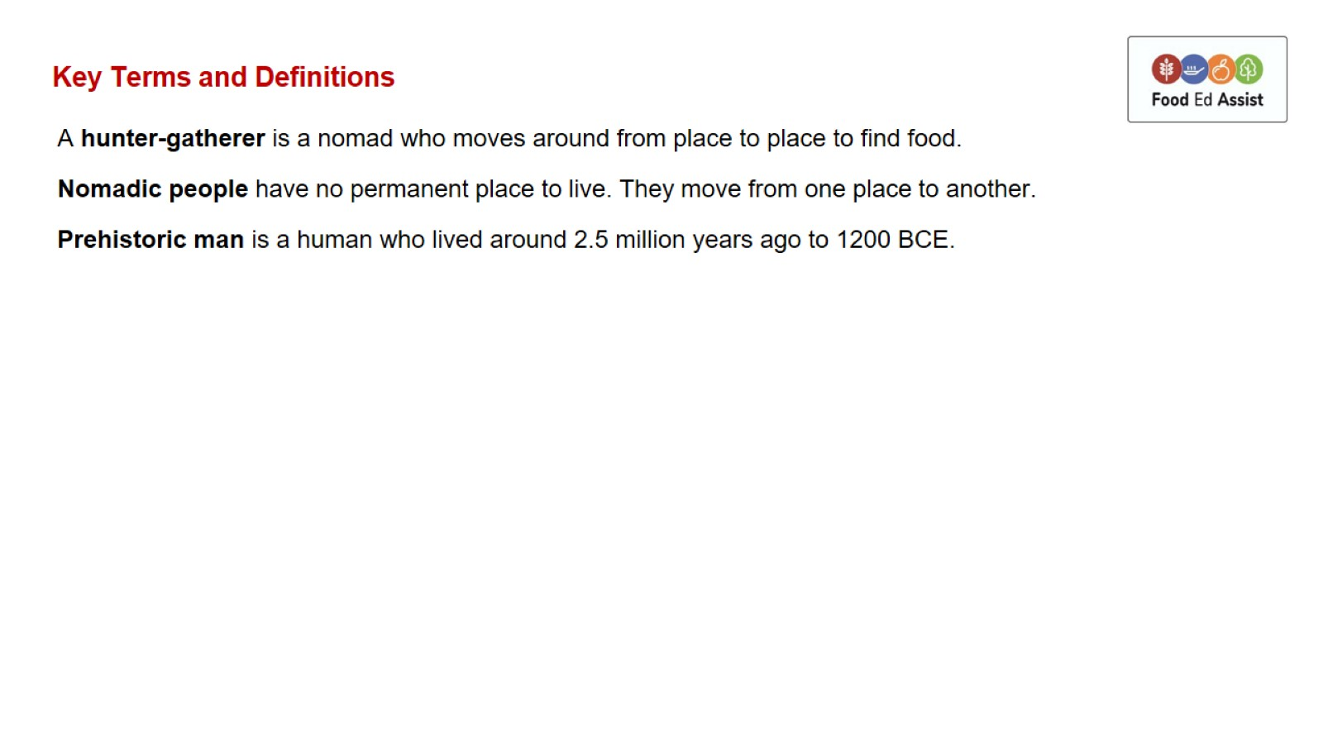
Key Terms and Definitions

Slide 3
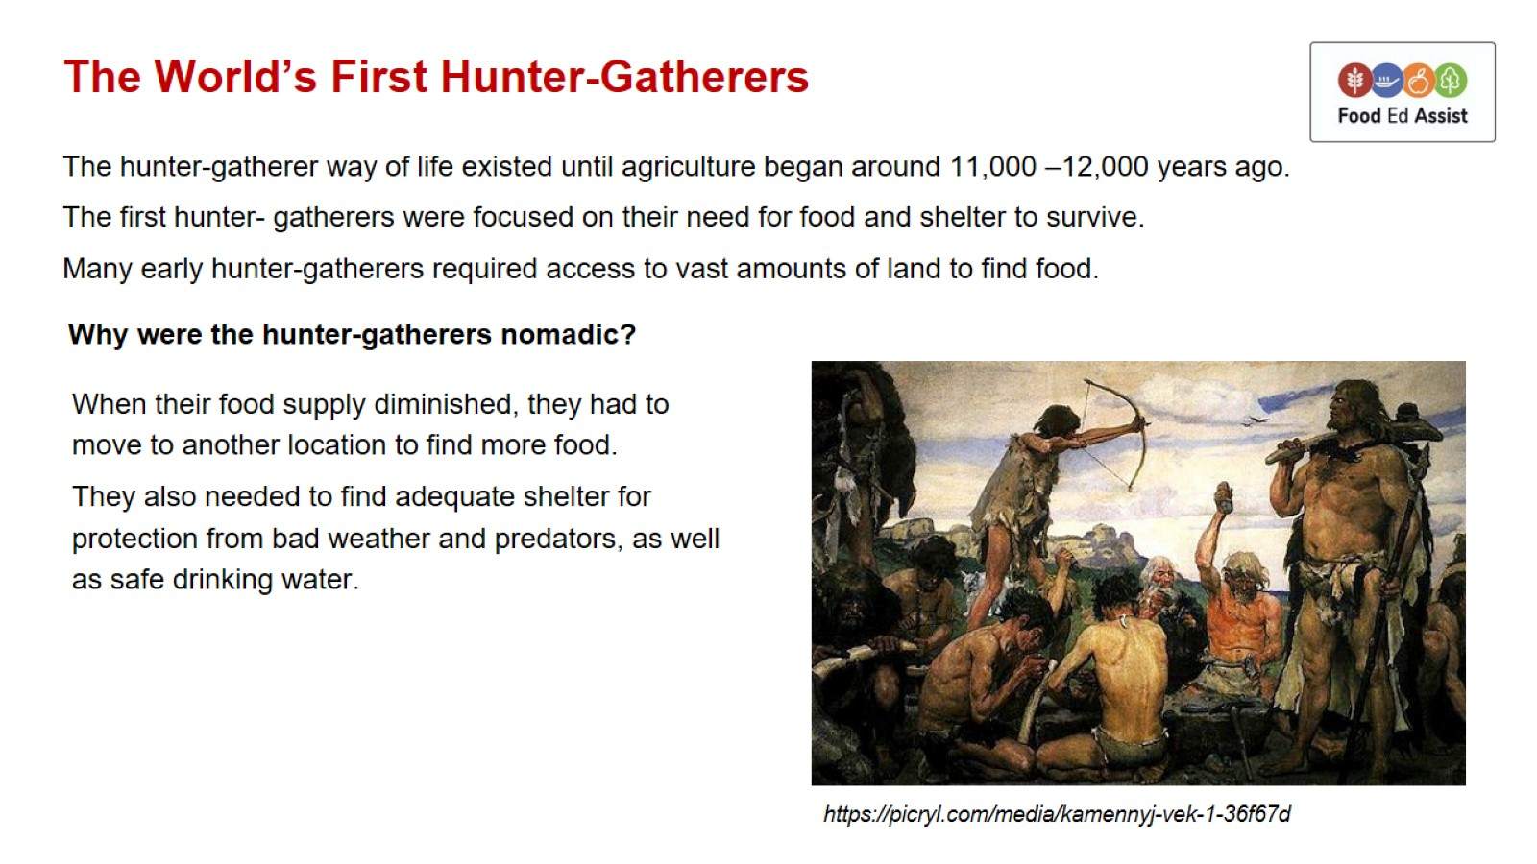
The World’s First Hunter-Gatherers

Slide 4
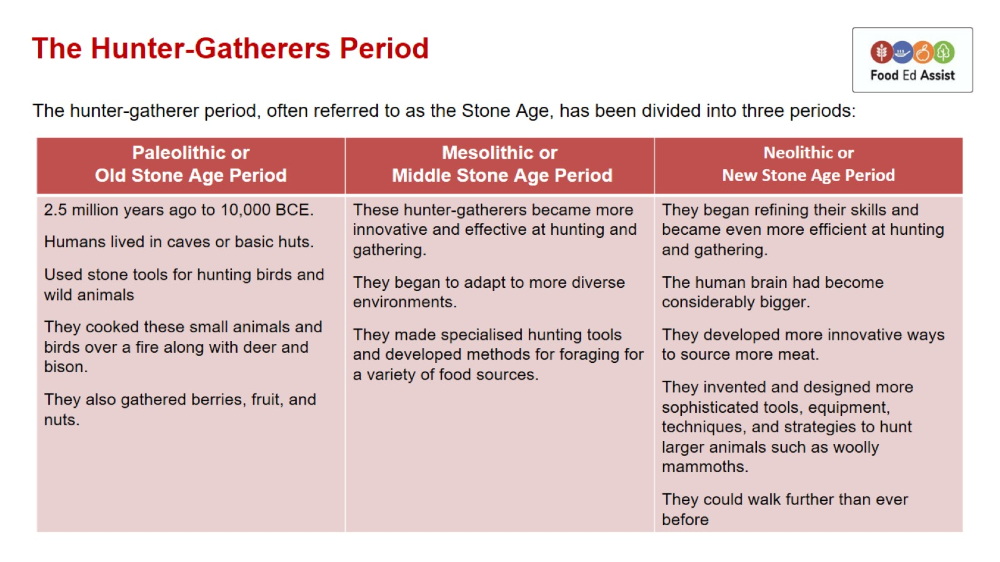
The Hunter-Gatherers Period

Slide 5
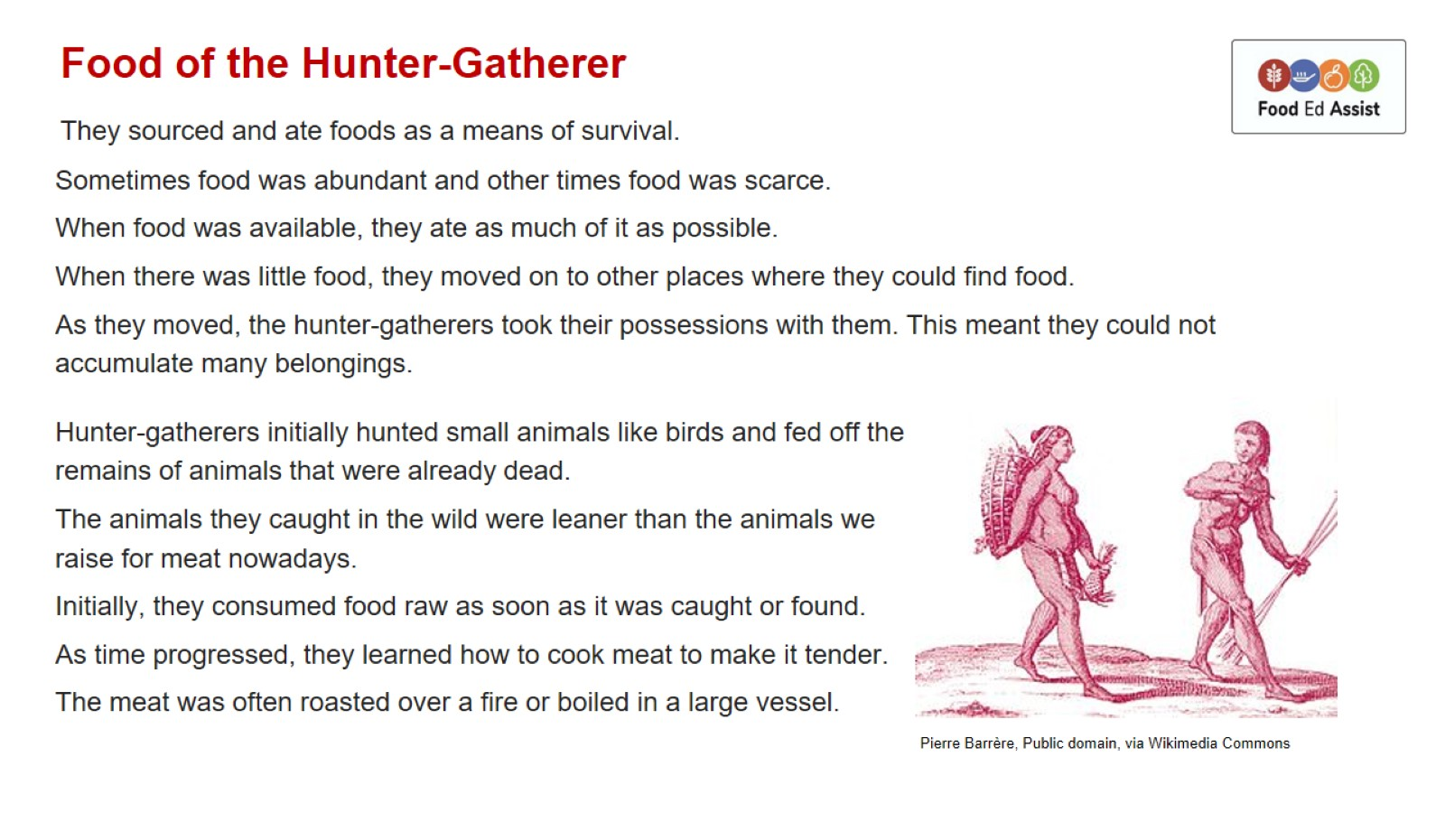
Food of the Hunter-Gatherer

Slide 6
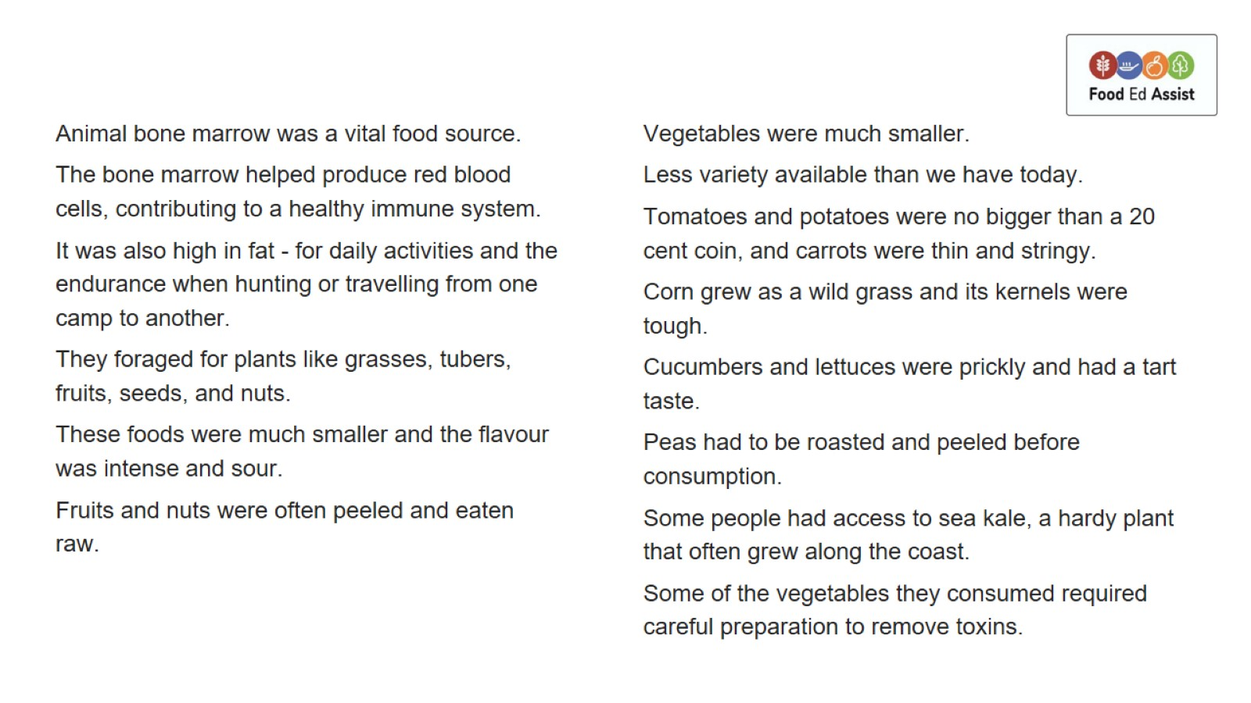

Slide 7
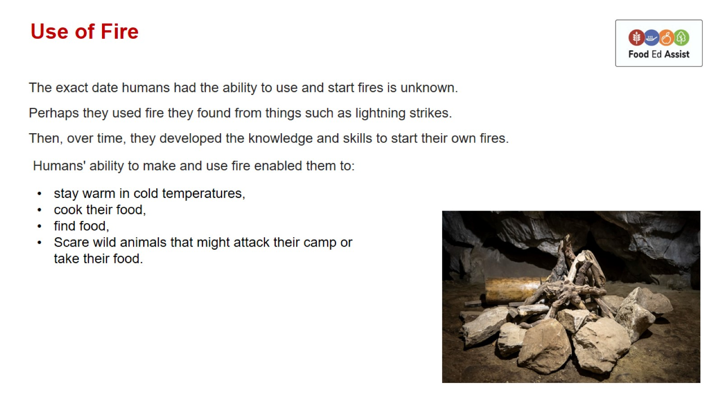
Use of Fire

Slide 8
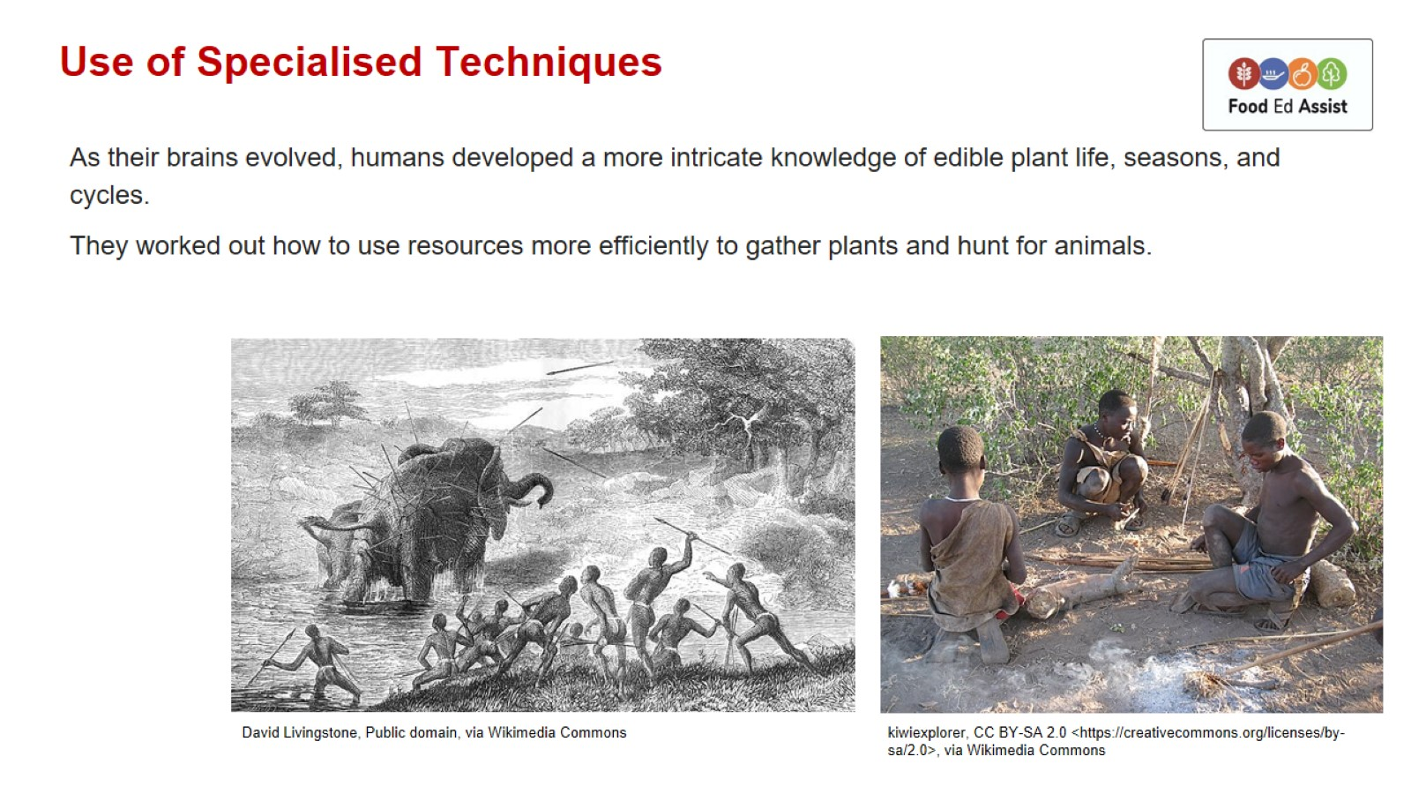
Use of Specialised Techniques

Slide 9
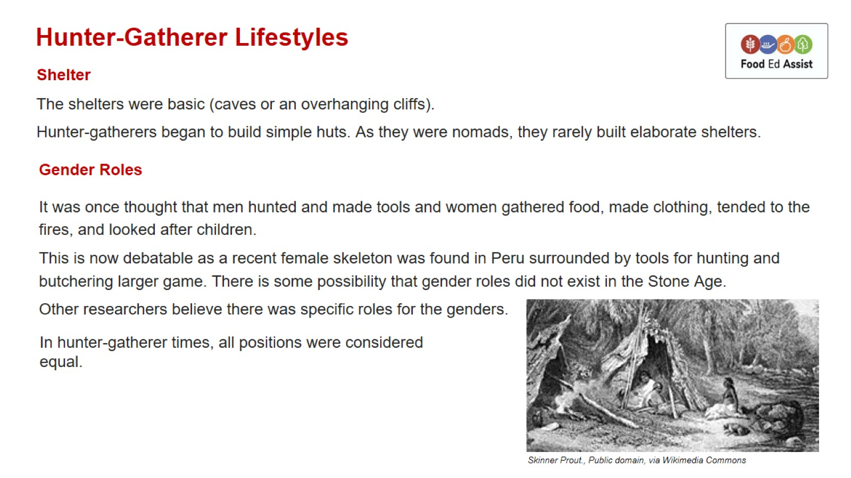
Hunter-Gatherer Lifestyles

Slide 10
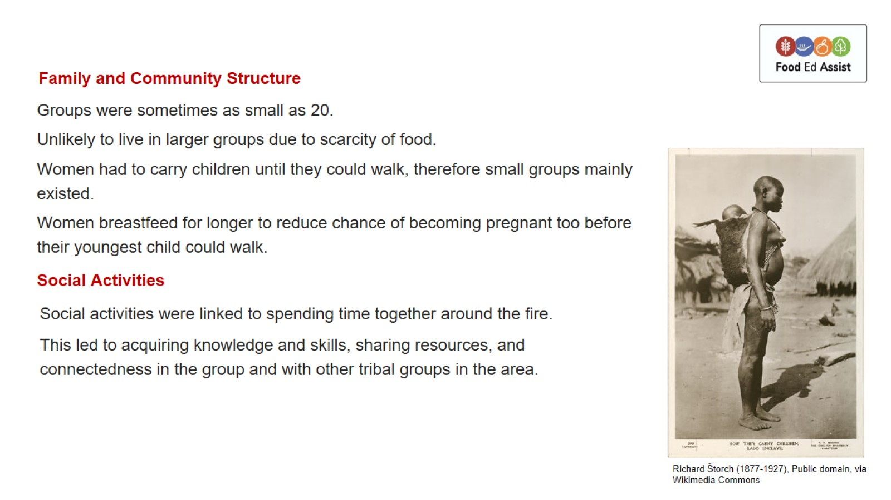

Slide 11
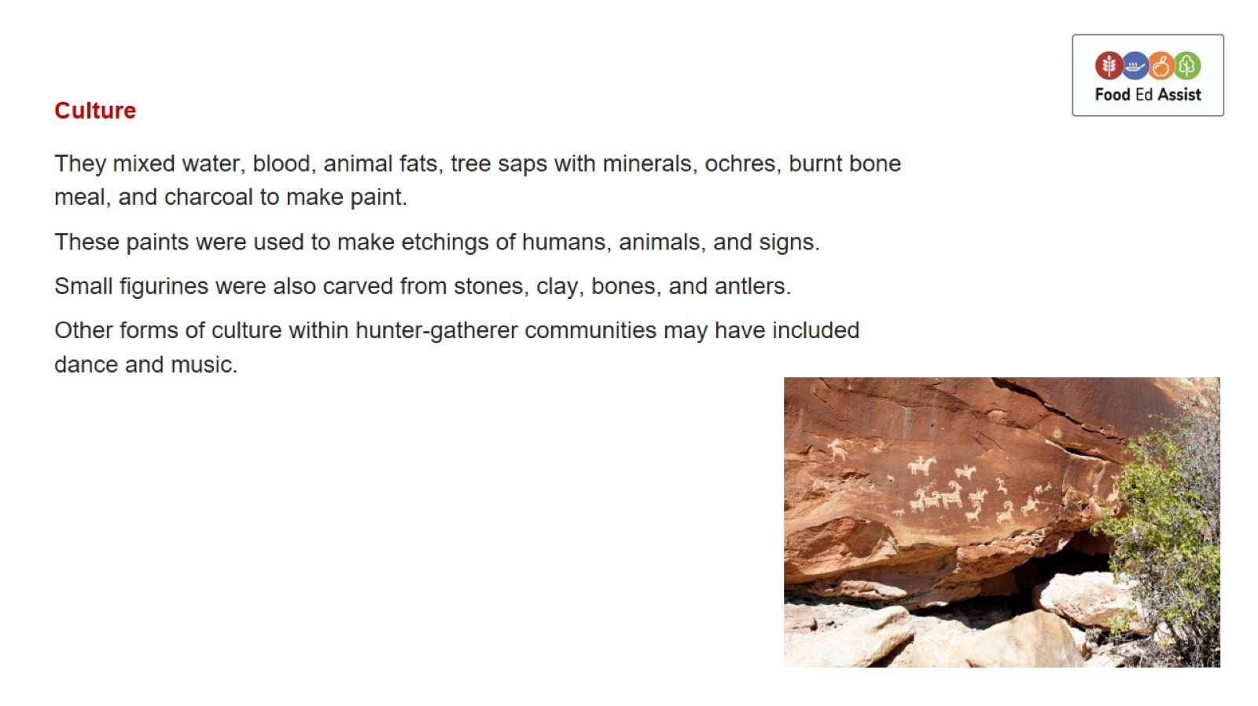

Slide 12
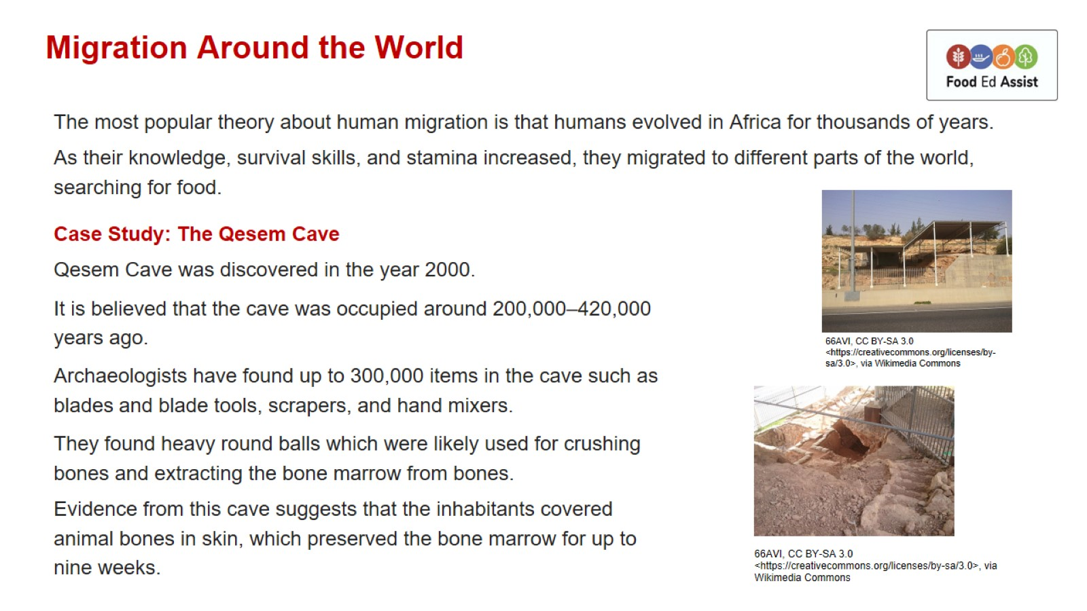
Migration Around the World

Slide 13
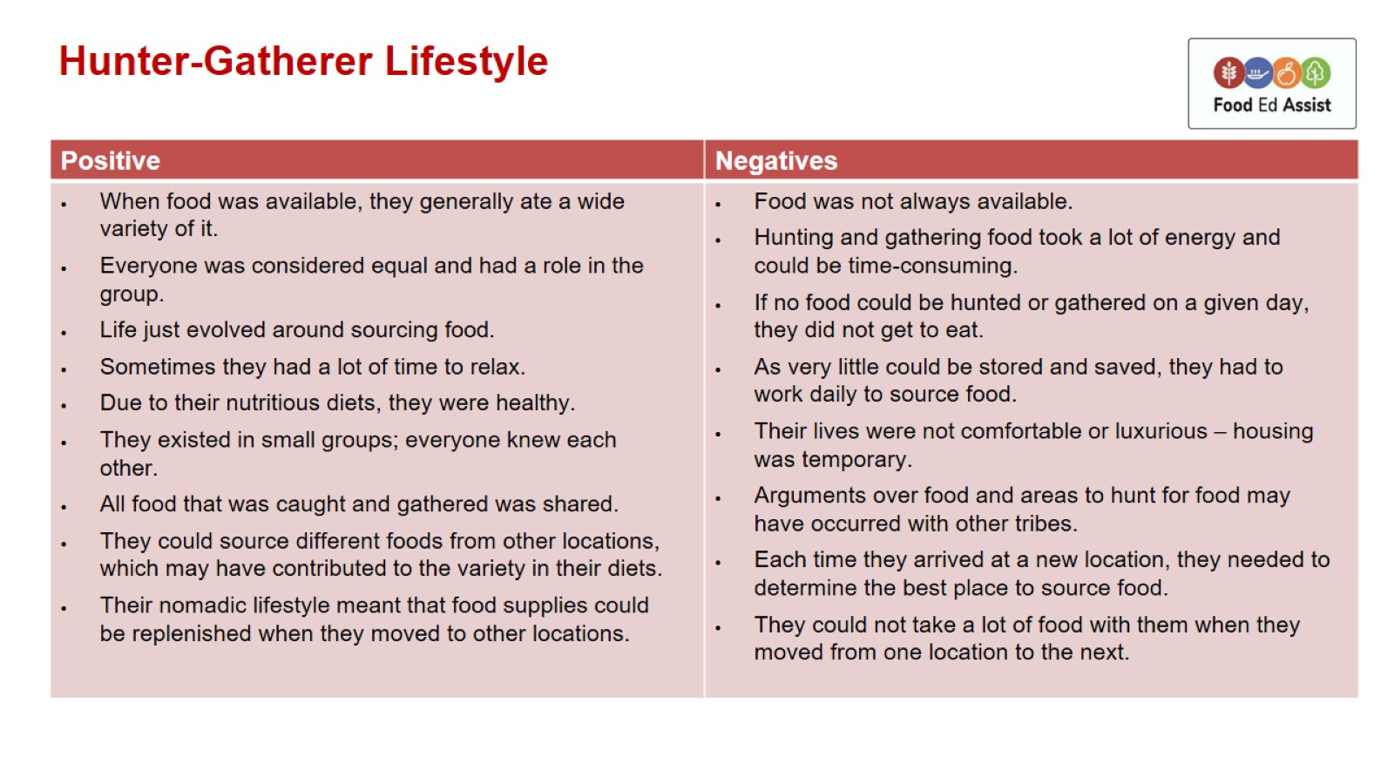
Hunter-Gatherer Lifestyle

Slide 14
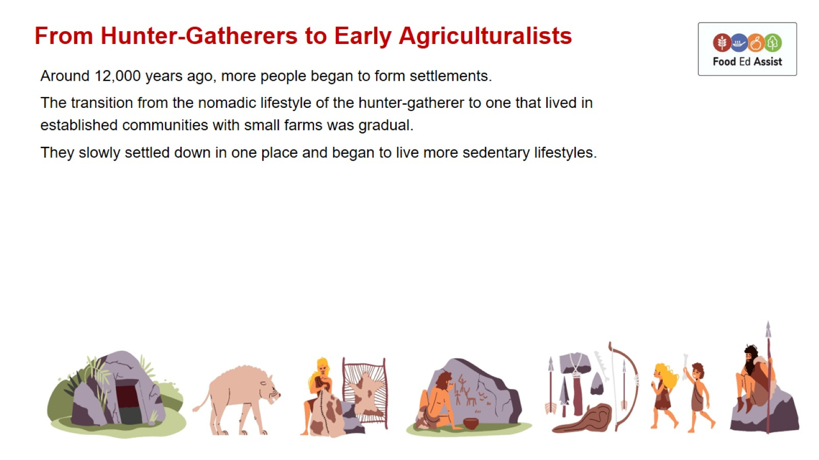
From Hunter-Gatherers to Early Agriculturalists

