Slide 1
Unit 3.1.1
Appetite, Satiety, and the Sensory Appreciation of Food
Key Knowledge 3.1.1
The physiology and conditioning of appetite, satiety, and the sensory appreciation of food.
Key Skills 1.1.1
Explain appetite, satiety, and the sensory appreciation of food.
Key Skills 1.1.6
Apply the healthy eating recommendations of the Australian Dietary Guidelines and Australian Guide to Healthy Eating to the planning of daily food intake and, through practical activities, create nutritious meals to cater for a diverse range of needs.
VCE Food Studies Study Design p. 20 and 21, Extracts from the VCE Food Studies Study Design (2023-2027) reproduced by permission; © VCAA. VCE is a registered trademark of the VCAA. The VCAA does not endorse or make any warranties regarding this study resource. Current VCE Study Designs and related content can be accessed directly
at www.vcaa.vic.edu.au. Readers are also advised to check for updates and amendments to VCE Study Designs on the VCAA website and via the VCAA Bulletin and the VCAA Notices to Schools.

Slide 2
Key Terms and Definitions
Appetite is the desire for food.
Conditioning is a behavioural process whereby a response becomes predictable and expected due to increased exposure.
Physiology is the branch of biology that deals with the normal functions of living organisms and their parts, the physical component.
Satiety is the feeling of fullness or satisfaction after eating food.
Sensory appreciation refers to how we use our senses to determine how we feel about a particular food.

Slide 3
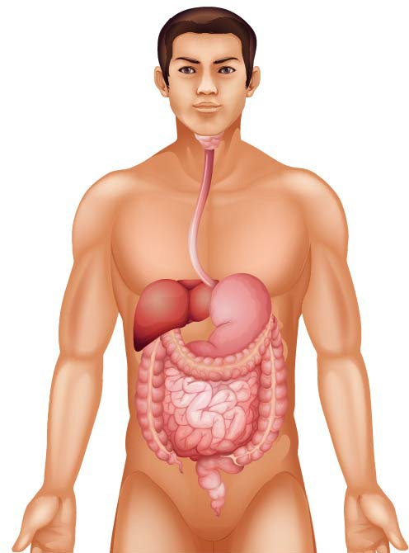
Appetite
The two main factors that influence whether we eat are hunger and appetite.
Appetite is defined as the desire for food, even when the body is not hungry.
The Physiology of Appetite
Our eyes, ears, and nose send messages to our brain that food is available to eat.
Release saliva in the mouth
Appetite can be triggered by the:
sight of appealing food,
the aroma of food, or
even talking about food.
Tingling sensation in the pit of stomach occurs that encourages people to eat.
Stomach contracts and produces digestive chemicals in the intestinal glands.
Ghrelin is an appetite-enhancing (increasing) hormone.
Mainly secreted by the stomach.
The stomach can make a growling sound when it produces ghrelin.
Watch this video about appetite: https://youtu.be/IXiG1_OrPS4

Slide 4




The Conditioning of Appetite
If the image of a chocolate chip cookie makes your mouth water (salivate), you have learned that when you see or smell food like this, you usually get to eat it!
This type of learning is called ‘conditioning.’
Your mouth salivating is a physiological response to appetite and your learned behaviour is a conditioned response.
Some people are conditioned to keep eating when they have an appetite and when they are satisfied.
https://www.freepik.com/premium-
photo/eat-please-loving-young-father- asking-his-son-eat-his-breakfast-while- boy-turning-his-face-away-showing- his- reluctance_10287054.htm#query=pick y%20eater&position=47&from_view=s earch&track=sph
https://www.freepik.com/free-
photo/woman-eats-piece- chocolate-cake- closeup_31432307.htm#page= 2&query=eating%20cake%20p arty&position=21&from_view= search&track=sph
https://www.freepik.com/f
ree-photo/yummy- pie_5403709.htm#query=o ffering%20food%20party& position=4&from_view=sea rch&track=sph
https://www.freepik.com/premium- photo/cinema-entertainment-people- concept-happy-friends-watching- movie- theater_30844475.htm#query=teenag e%20boy%20eating%20popcorn%20m ovies&position=13&from_view=search &track=sph
Watch this video about conditioning: https://youtu.be/lWdR87Qnb3g

Slide 5
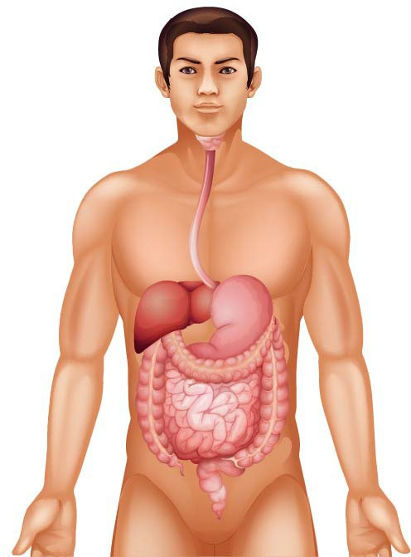
Satiety
Feeling a sense of fullness in the absence of hunger is called satiety.
Fat cells release leptin (satiety hormone) when someone is satisfied.
This process can take around 20 minutes and is our body’s physical response to feeling full/satiety.
As blood glucose levels increase, the pancreas and liver send signals to the brain to tell the person to stop eating.
The main role of leptin is to suppress appetite and hunger and control energy intake.
The more a person eats, the more leptin is released.
The more appetite is suppressed.
This results in less food being consumed.

Slide 6
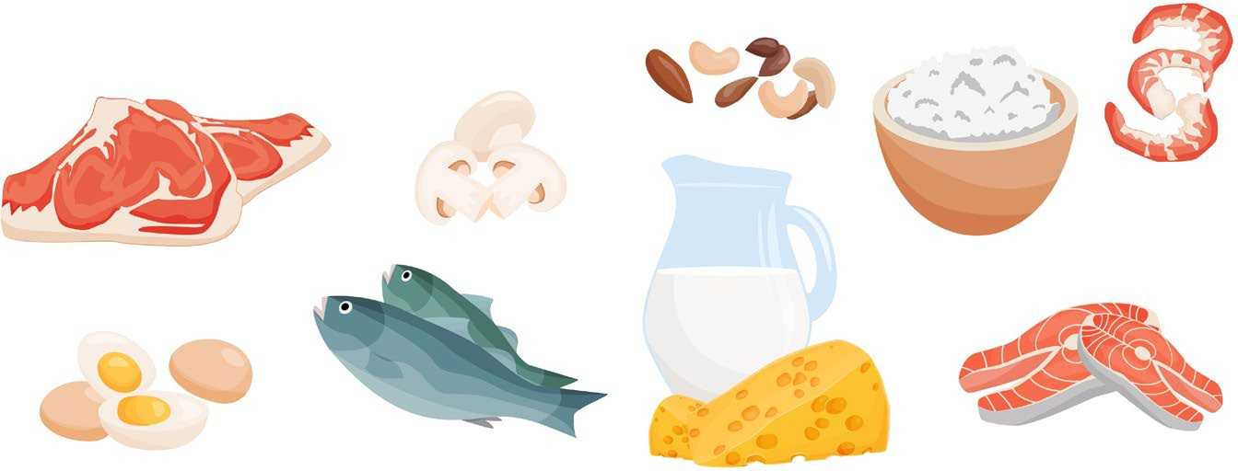
Foods that Provide Satiety
The nutrients food contains and how food is processed determine how satisfying it will be, not the amount of kilojoules in the food.
Filling foods are often high in protein, low in glycaemic index (GI), high in fibre and unprocessed.
Foods High in Protein
Protein is the most filling macronutrient as it may supress the hormone ghrelin, which activates hunger.
Protein increases the levels of hormones that signal satiety:
Protein stays in the stomach longer than carbohydrates and for this reason may be more likely to contribute to feelings of fullness.
Lean meats, poultry, legumes and beans, fish and seafood, eggs, dairy foods, nuts, and seeds are all excellent protein sources.
Cholecystokinin is a gut hormone released after eating; it helps digestion and reduces appetite.
Adiponectin is a molecule secreted mainly by the body’s fat cells.
Leptin is the body's satiety hormone that tells you when you've eaten your fill.

Slide 7
Foods High in Fibre
Low GI Foods
Carbohydrates with a low GI value (55 or less) keep you feeling full for longer because they are more slowly digested, absorbed, and metabolised.
They cause a lower and slower rise in blood glucose and, usually, insulin levels.
Fibre provides bulk and helps you feel full for longer.
Fibre may slow down the emptying of the stomach and increase digestion time.
Low GI foods include some high-fibre breads and cereals, pasta, basmati, low GI rice, quinoa, barley, legumes, low-fat dairy products, and some fruit.
High amounts of fibre can be found in fruits and vegetables, wholegrain foods, oat bran, barley, seed husks, flaxseed, psyllium, beans, and legumes.
Watch this video about low GI foods: https://youtu.be/xm2T2LXZLtU
Watch this video about satiety: https://youtu.be/80m7sElfNgc

Slide 8


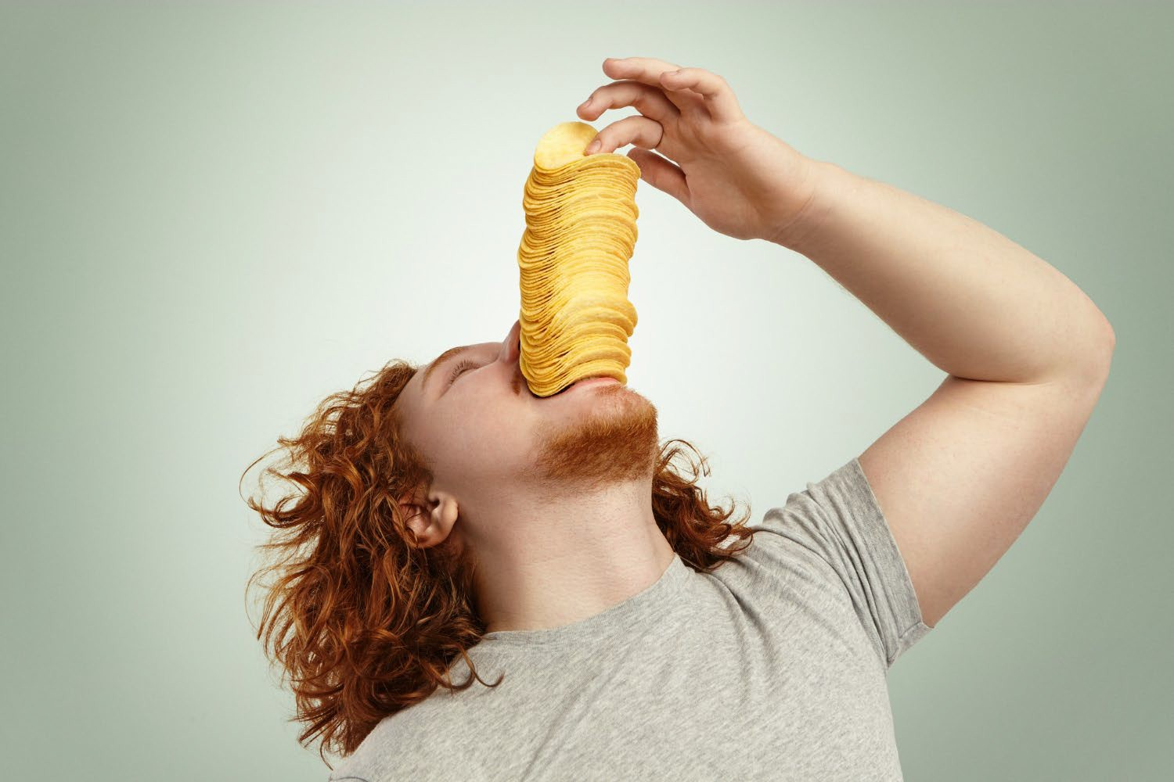
Foods that Do Not Provide Satiety
The way nutrients in the food are digested and utilised by the body influences satiety.
While fats still provide some degree of satiation, protein and carbohydrates are better choices for longer-term satiety.
In contrast, foods containing high amounts of sugar only stimulate satiety and reduce food intake in the short term.

Slide 9
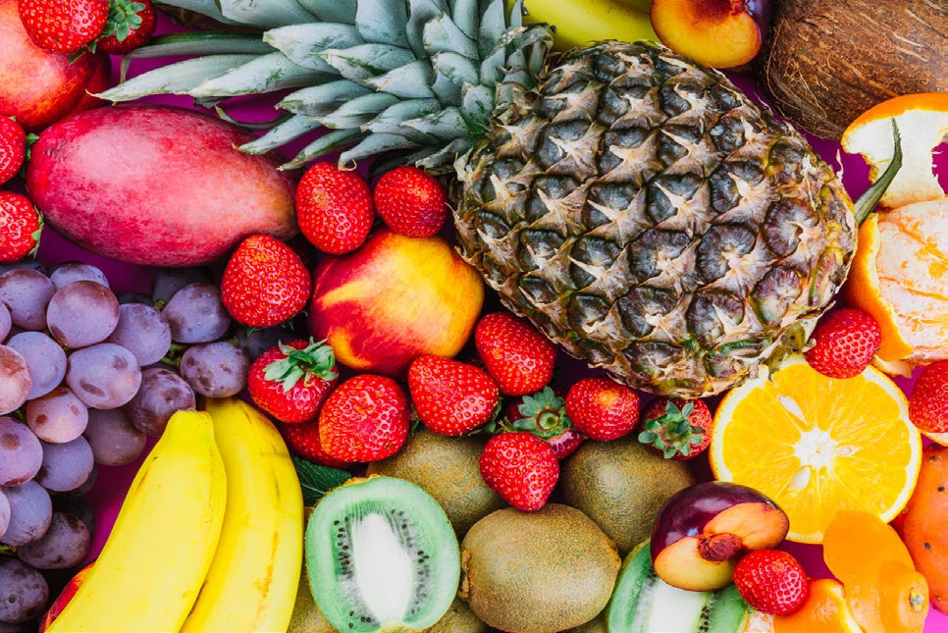

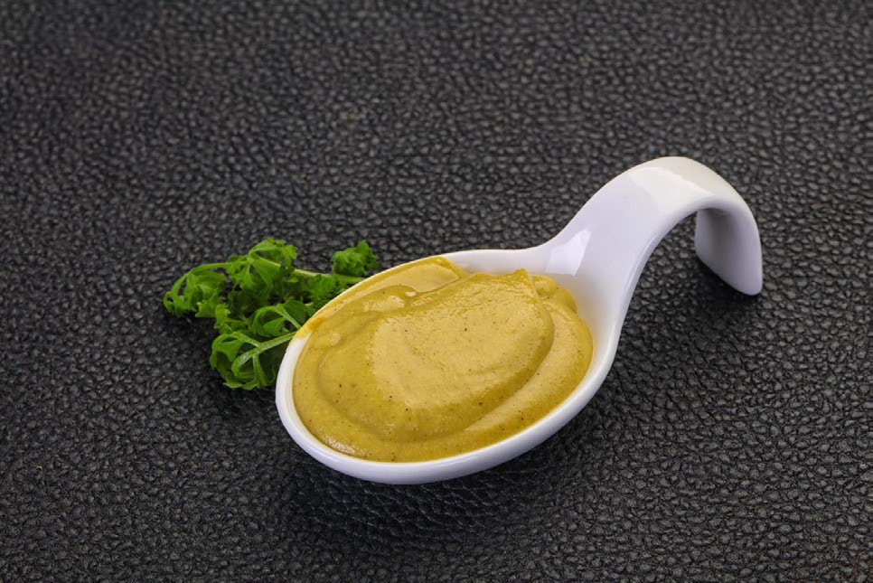
The Sensory Appreciation of Food
Sensory properties of food play a very important role in how people select their food and how much they eat.
All senses (hearing, sight, smell, taste, and touch) contribute to an individual’s appetite and satiety. The senses influence how we feel about food and determine how much we want to eat.
Appearance
Appearance is important if we want our food to be enjoyed. We often associate particular colours with certain flavours, for example, when we see a pink food product, we often assume it has a strawberry flavour. Also, the stronger the colour, the more intense we imagine the flavour to be.
Colourful and bright
Golden brown
Flat and dull

Slide 10
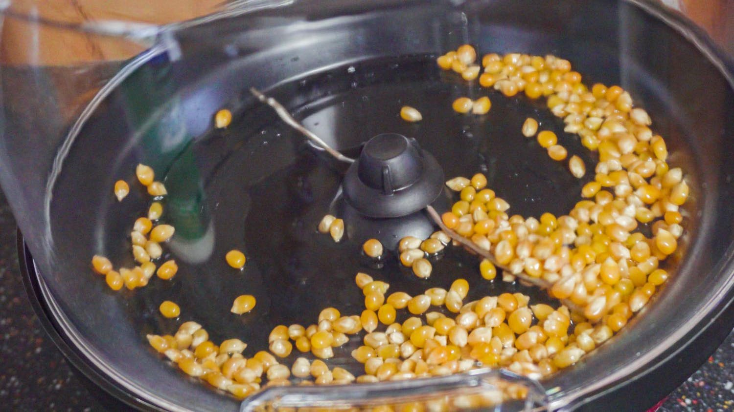
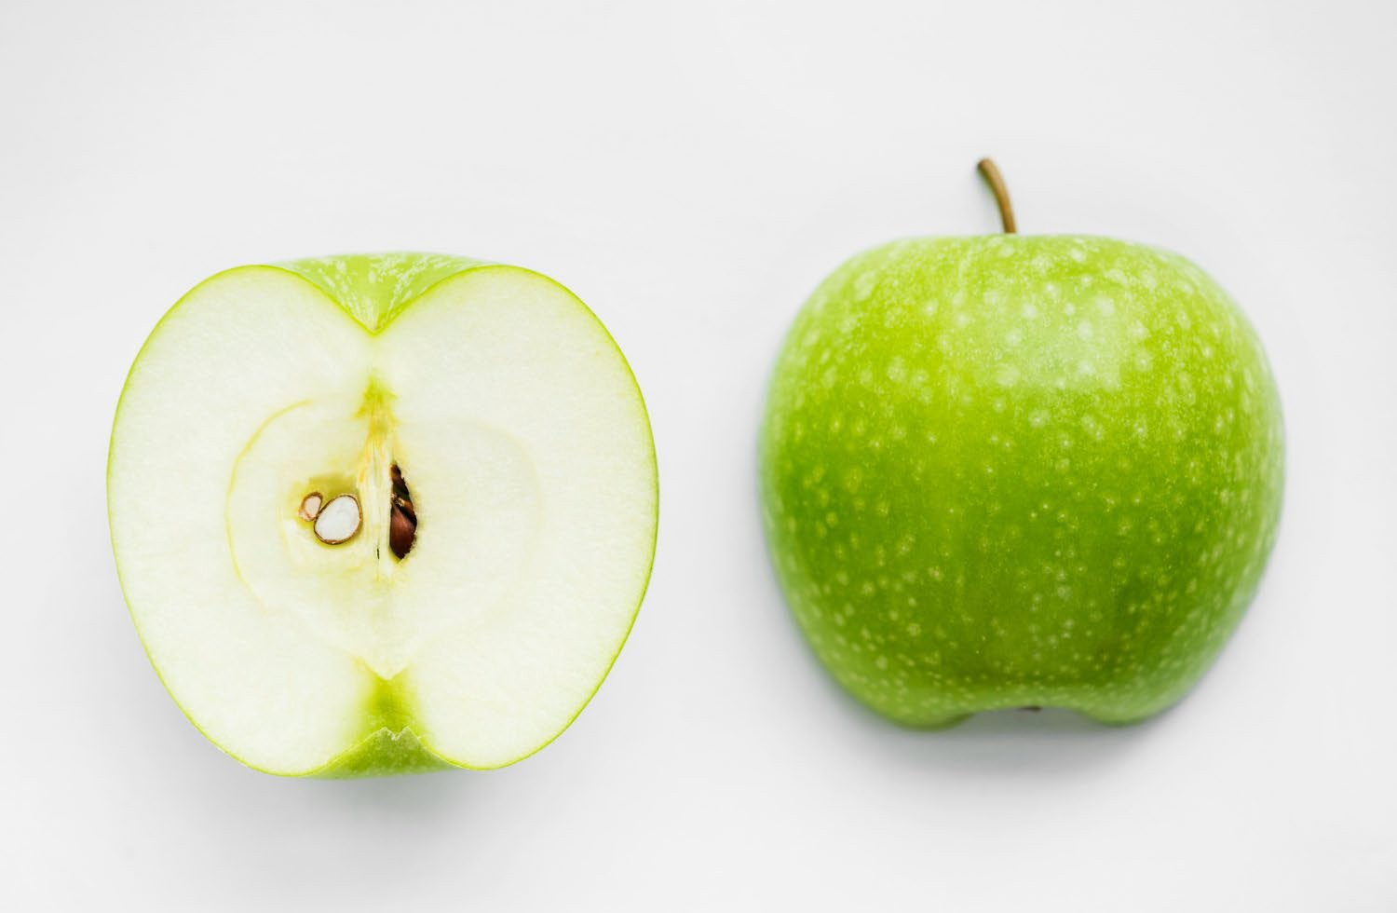

Sound
Texture
The sounds of food being prepared, cooked, served, and eaten all help influence our preferences and sensory appreciation of food.
When we look, touch, and chew food, we evaluate how it feels.
Mouthfeel - When food is placed in the mouth, the surface of the tongue and other sensitive skin reacts to the feel and texture.
Popping
Viscosity refers to thickness of a liquid and its resistance to flow.
Crisp Smooth
Fizzy Bubbly

Slide 11
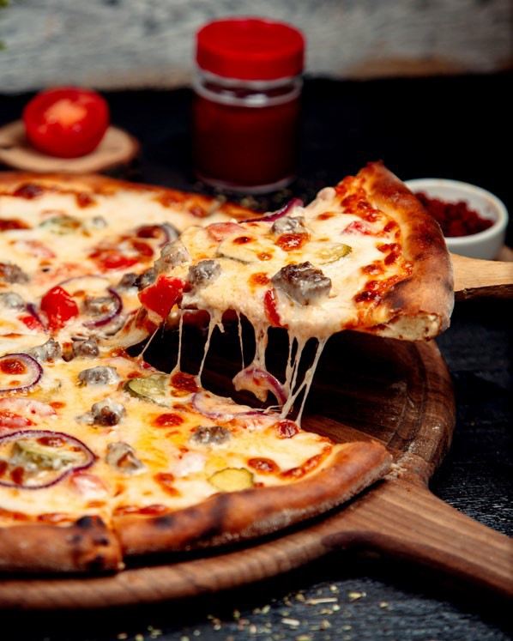
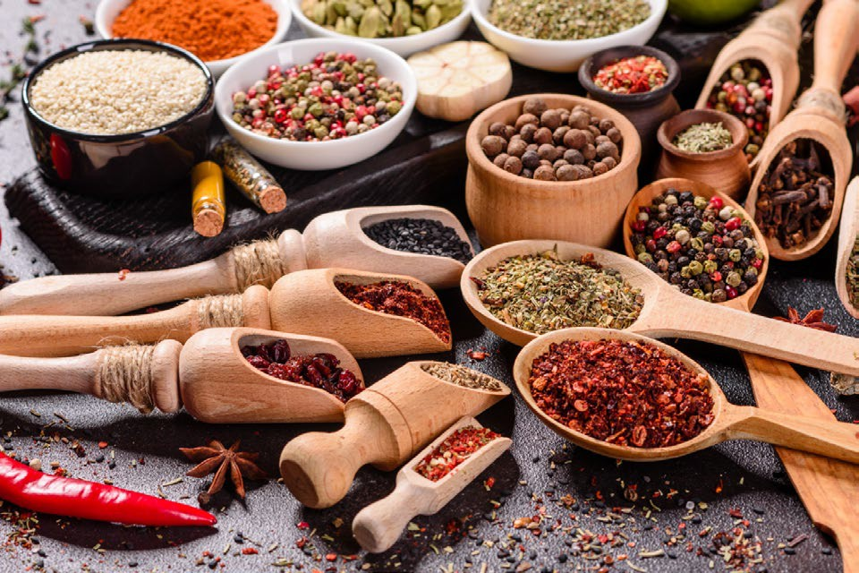
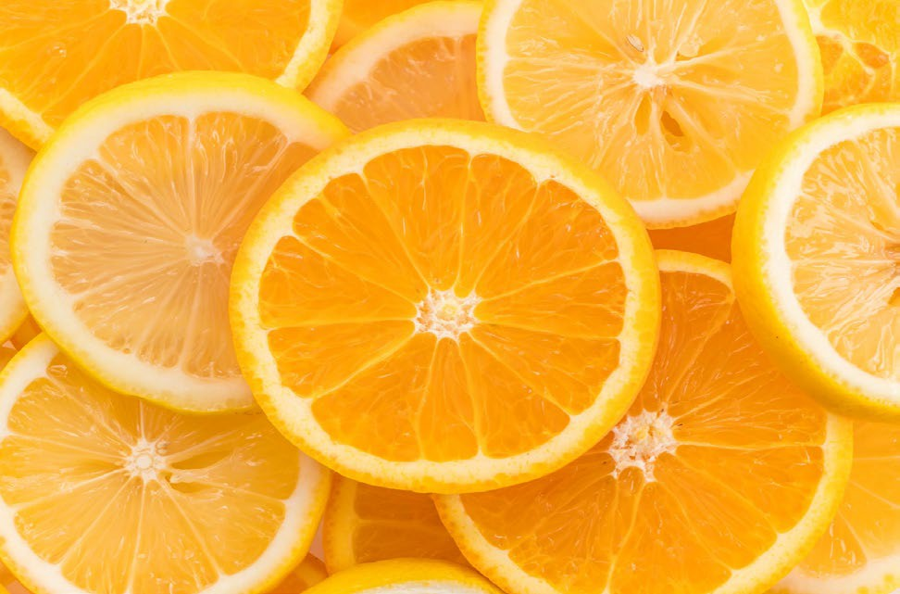

Aroma/smell
Taste
The olfactory receptor cells in the nose detect aromas released from food and send messages about the smells to the brain.
Taste and smell work in unison and the term we use to describe this is flavour. Taste receptors in the mouth send messages to the brain that a particular flavour has been detected.
The sense of smell works with taste to identify the flavours of food. Aroma and taste work together to produce flavour.
The tongue can detect five tastes: bitter, salt, sour, sweet, and umami. Umami is a savoury taste associated with ripe tomatoes, vegemite and cheese.
Herby and spicy
Strong
Citrus and sour
Spicy

