Slide 1
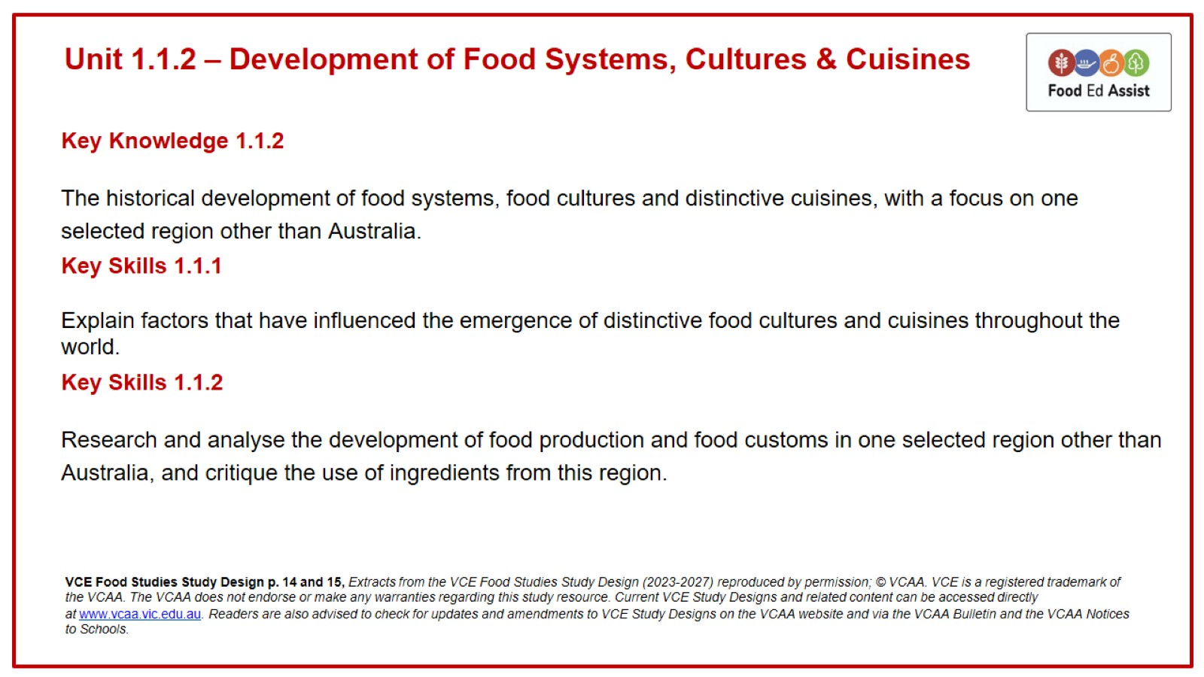
Unit 1.1.2 – Development of Food Systems, Cultures & Cuisines

Slide 2
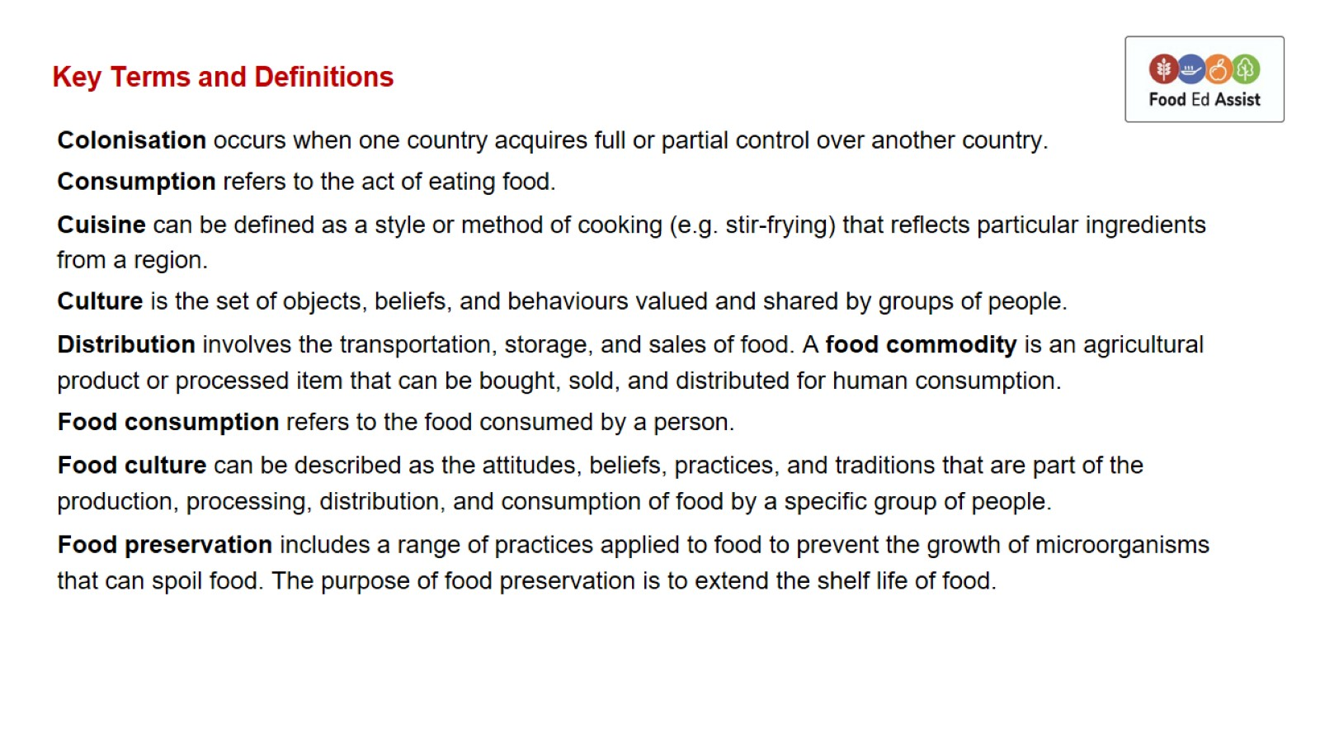
Key Terms and Definitions

Slide 3
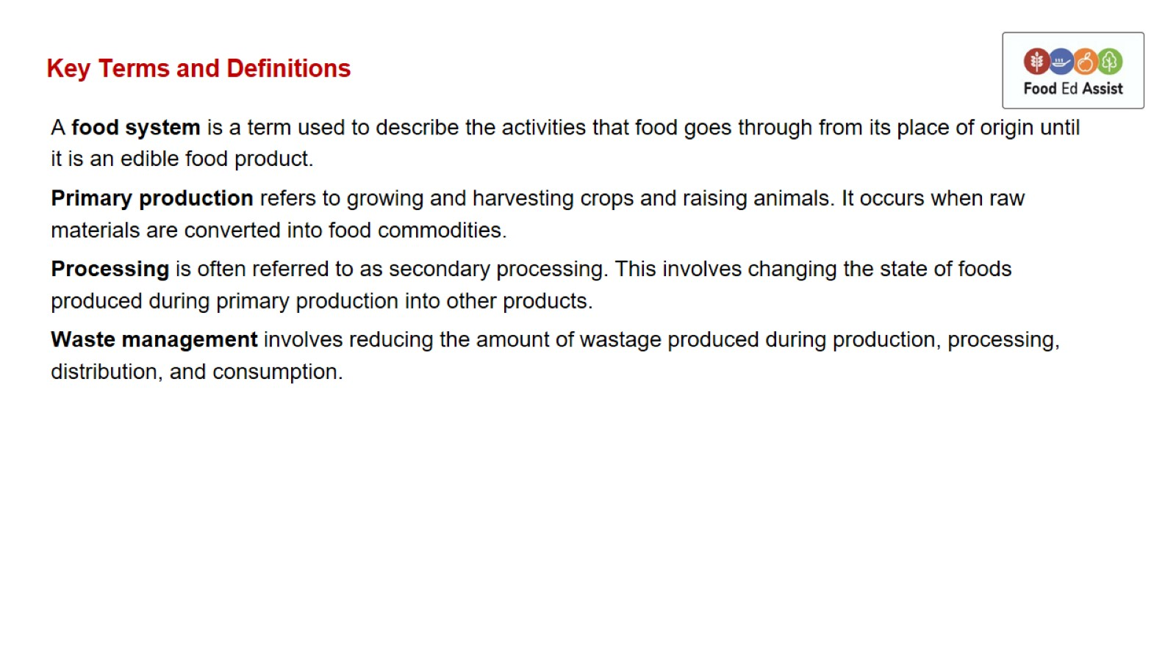
Key Terms and Definitions

Slide 4
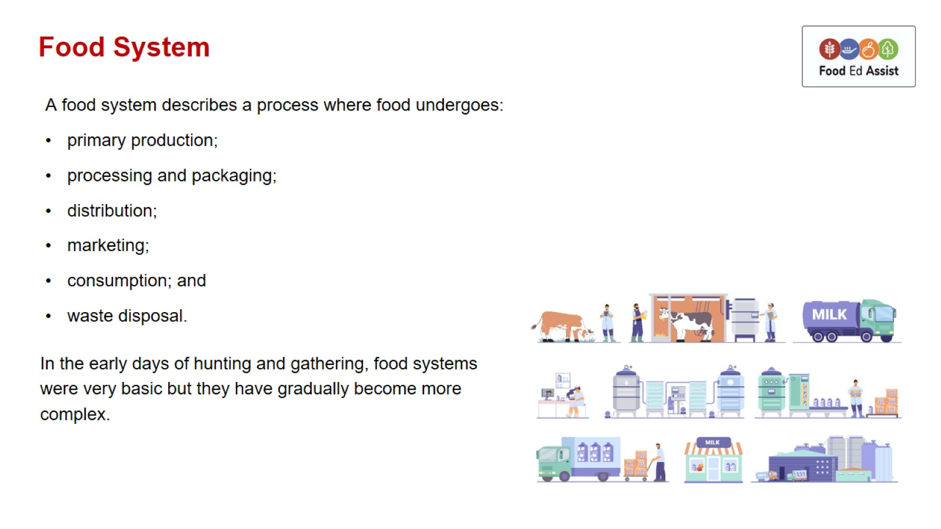
Food System

Slide 5
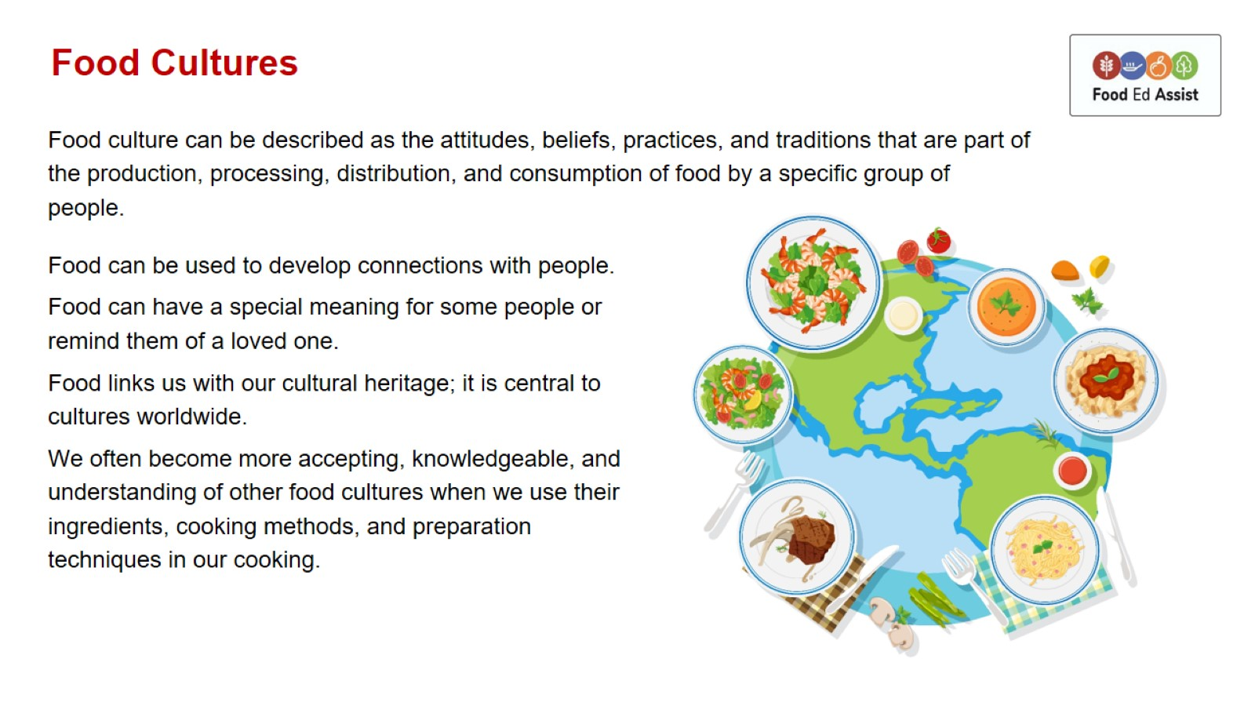
Food Cultures

Slide 6
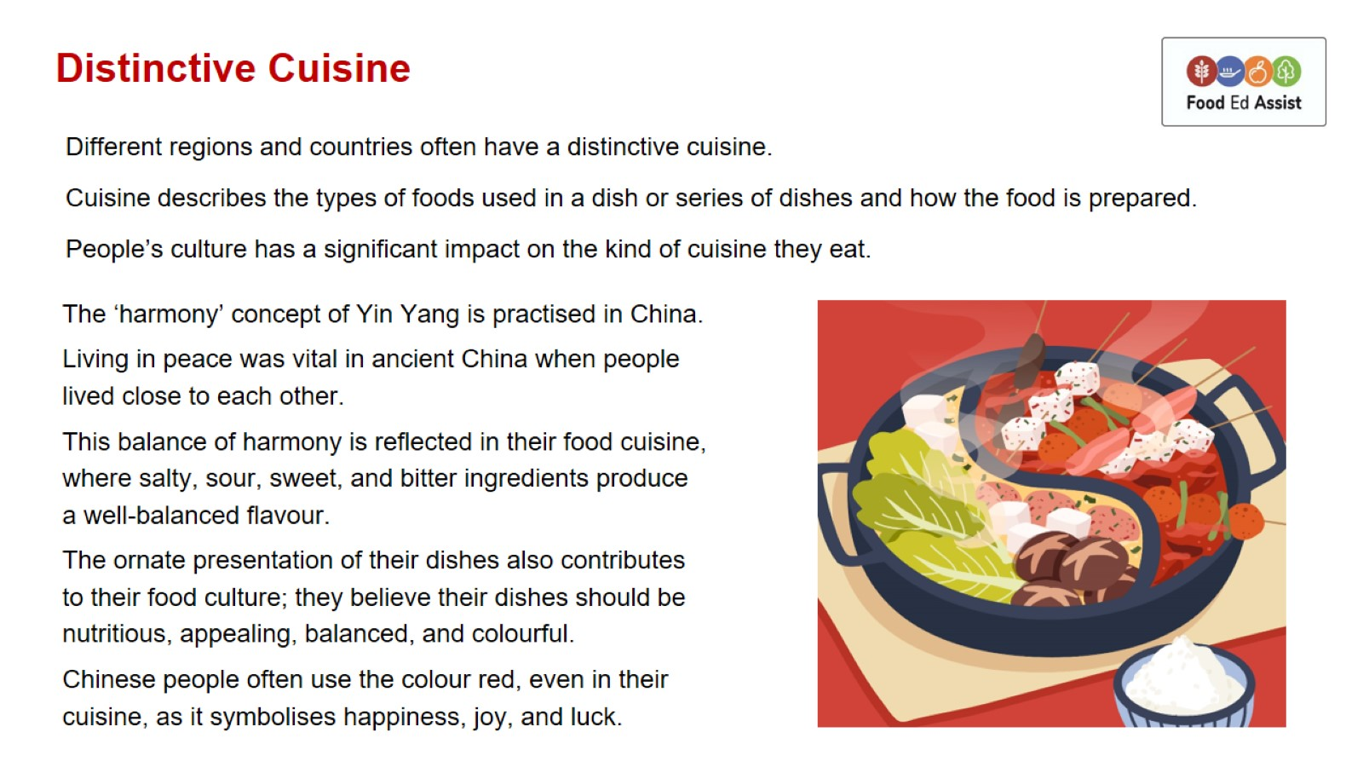
Distinctive Cuisine

Slide 7
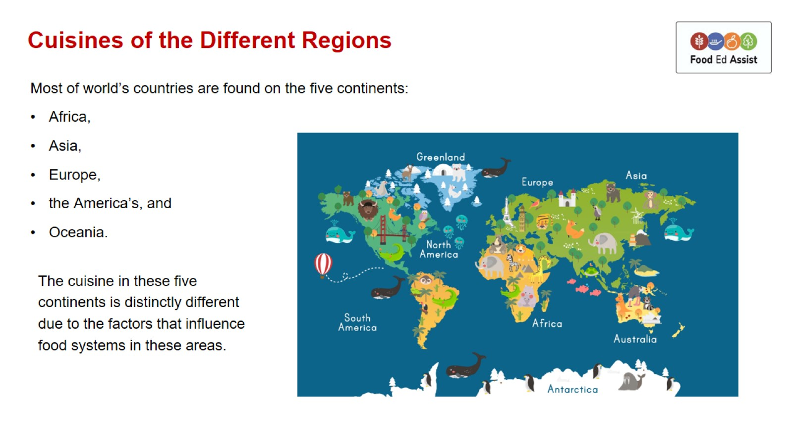
Cuisines of the Different Regions

Slide 8
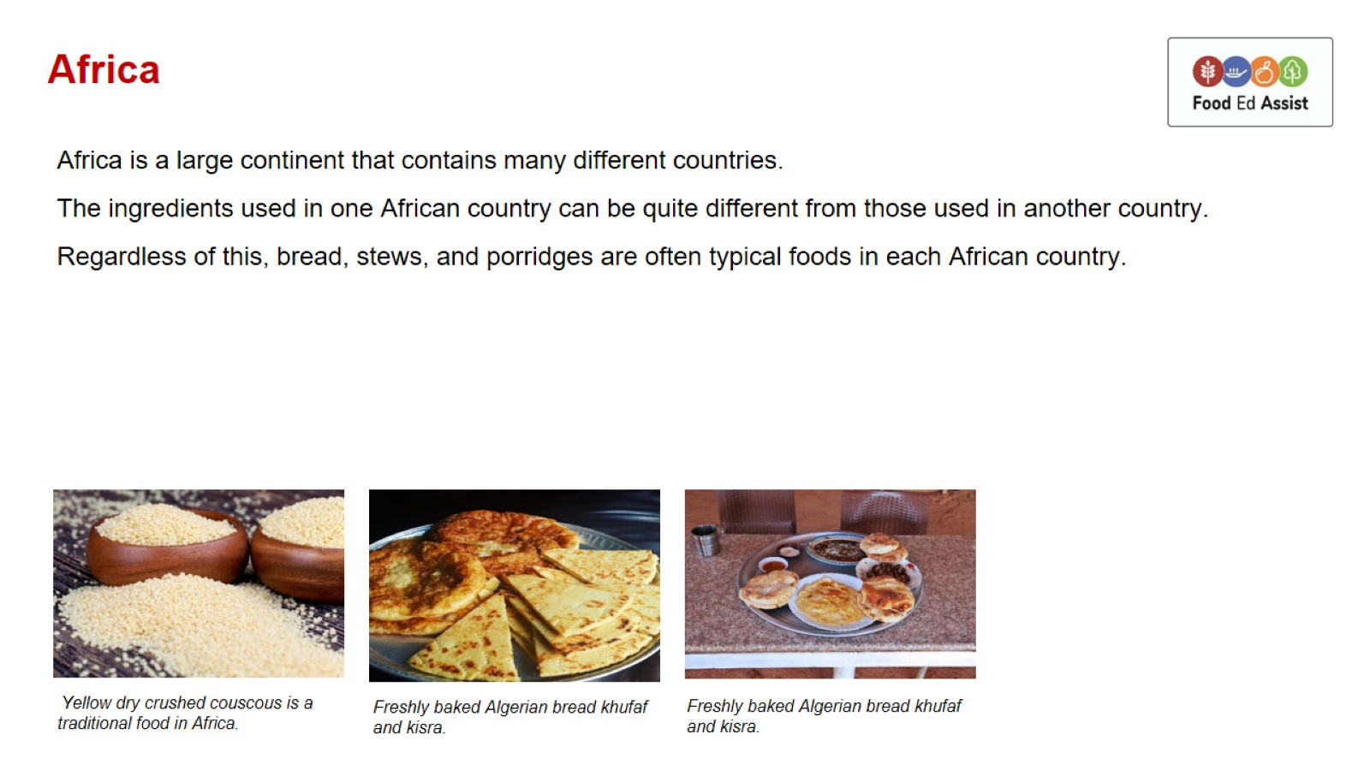
Africa

Slide 9
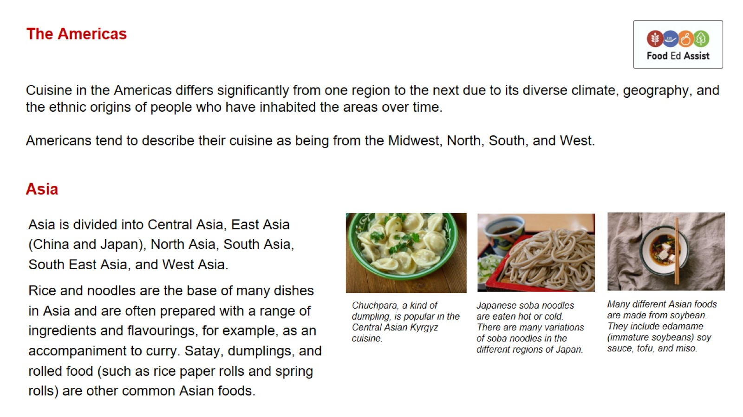
The Americas

Slide 10
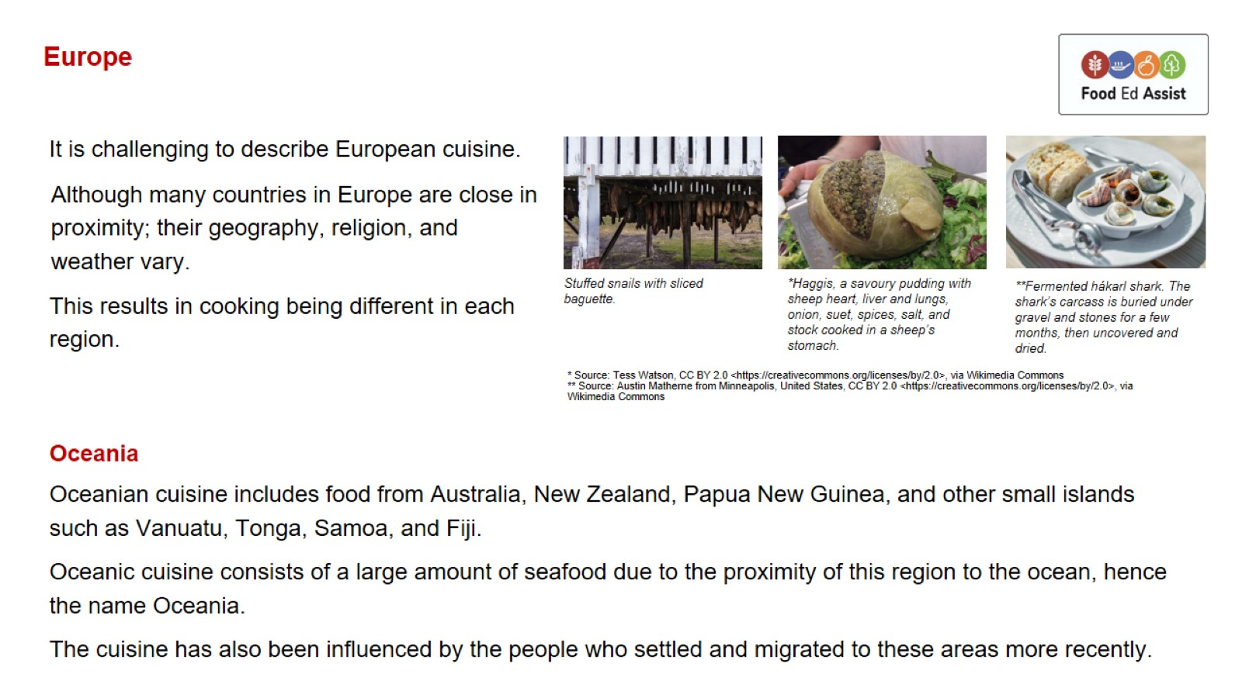
Europe

