Slide 1
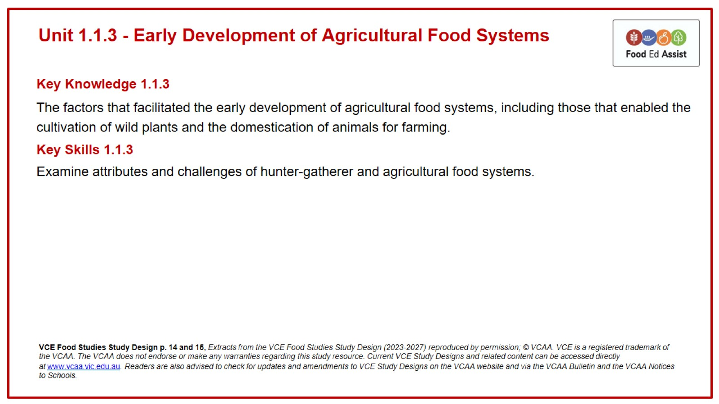
Unit 1.1.3 - Early Development of Agricultural Food Systems

Slide 2
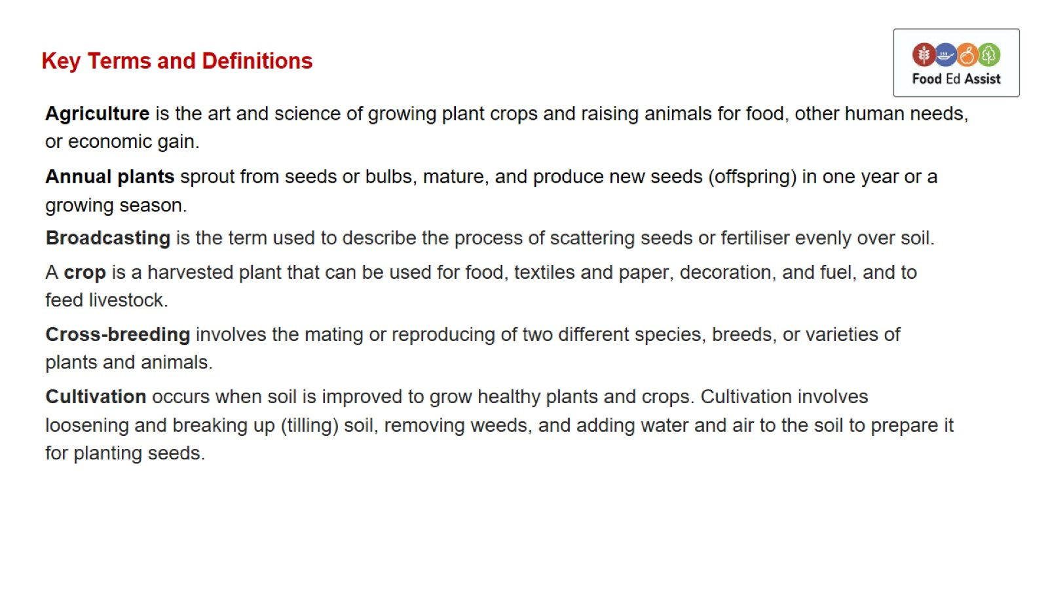
Key Terms and Definitions

Slide 3
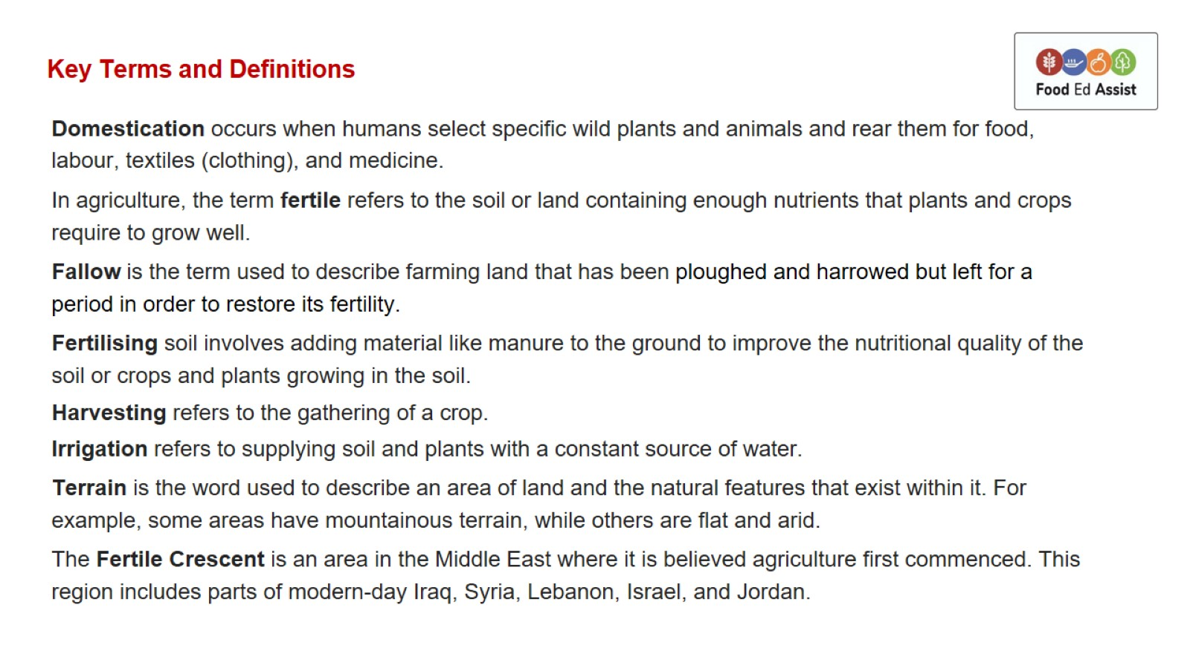
Key Terms and Definitions

Slide 4
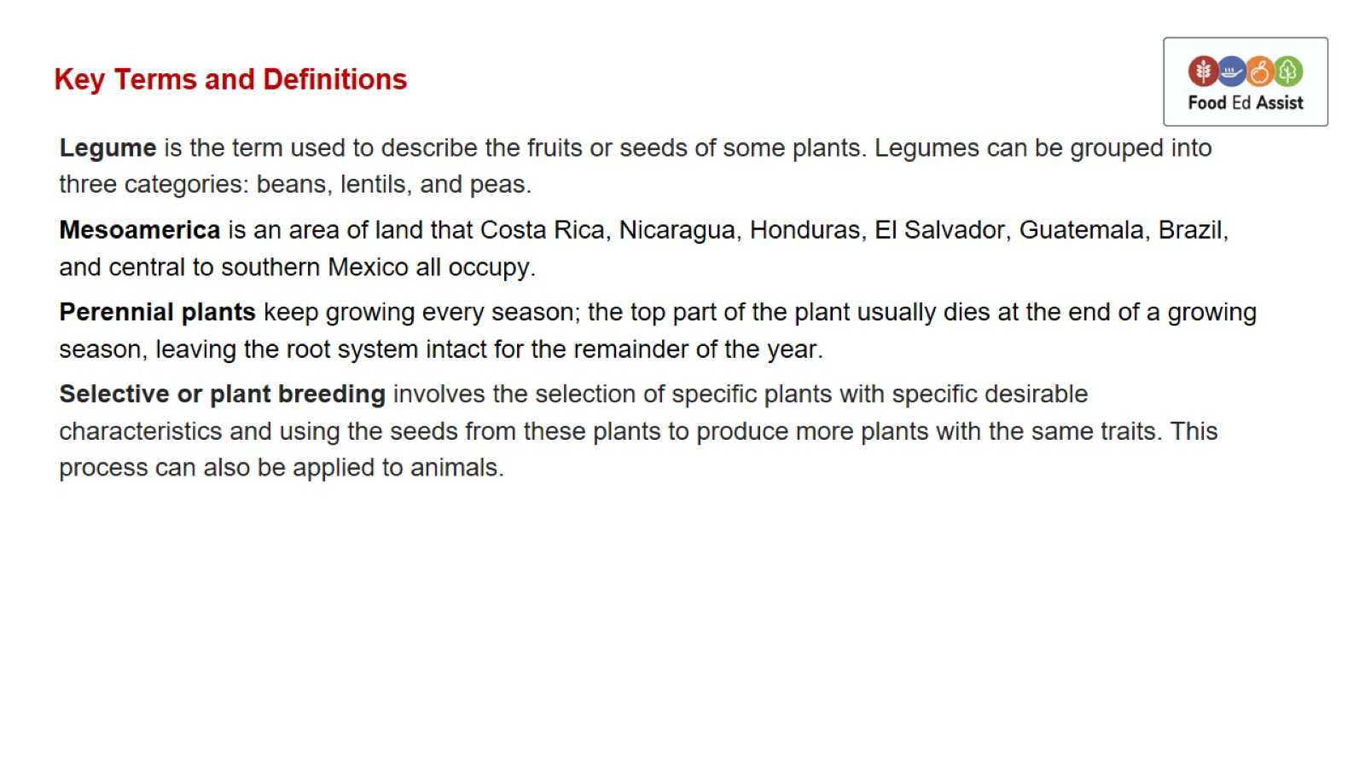
Key Terms and Definitions

Slide 5
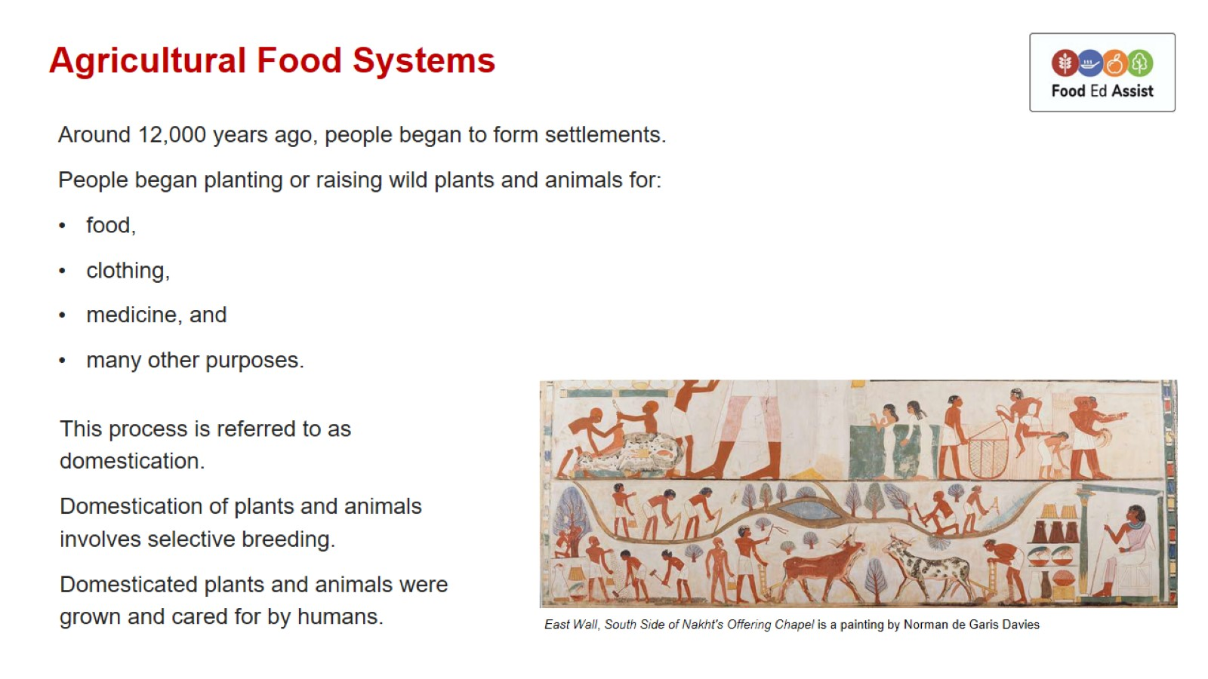
Agricultural Food Systems

Slide 6
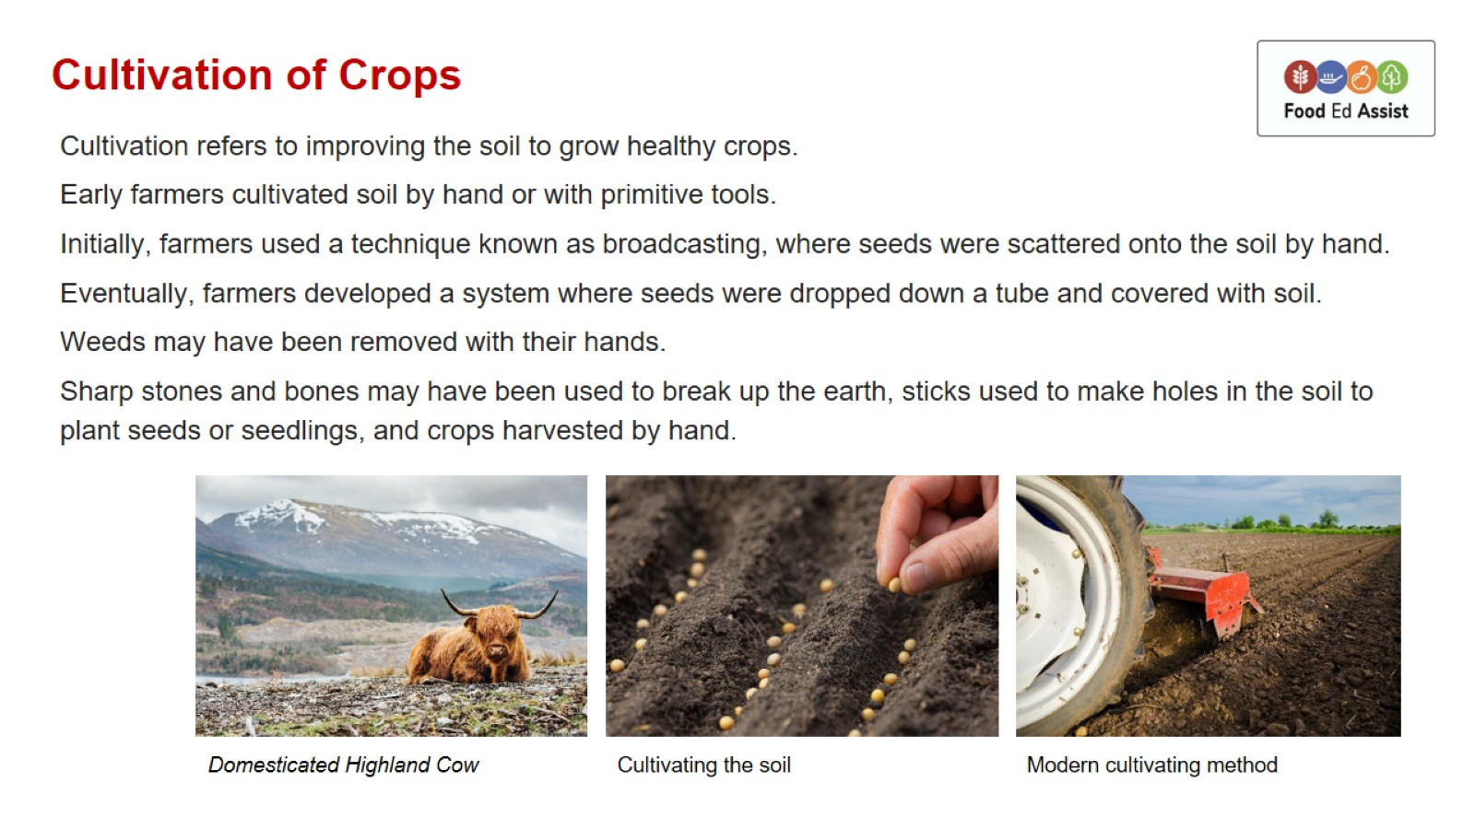
Cultivation of Crops

Slide 7
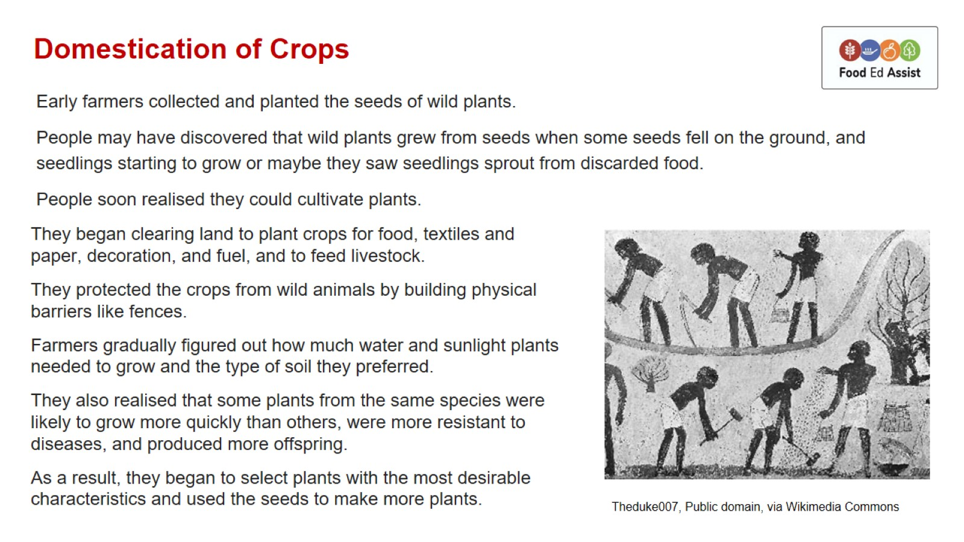
Domestication of Crops

Slide 8
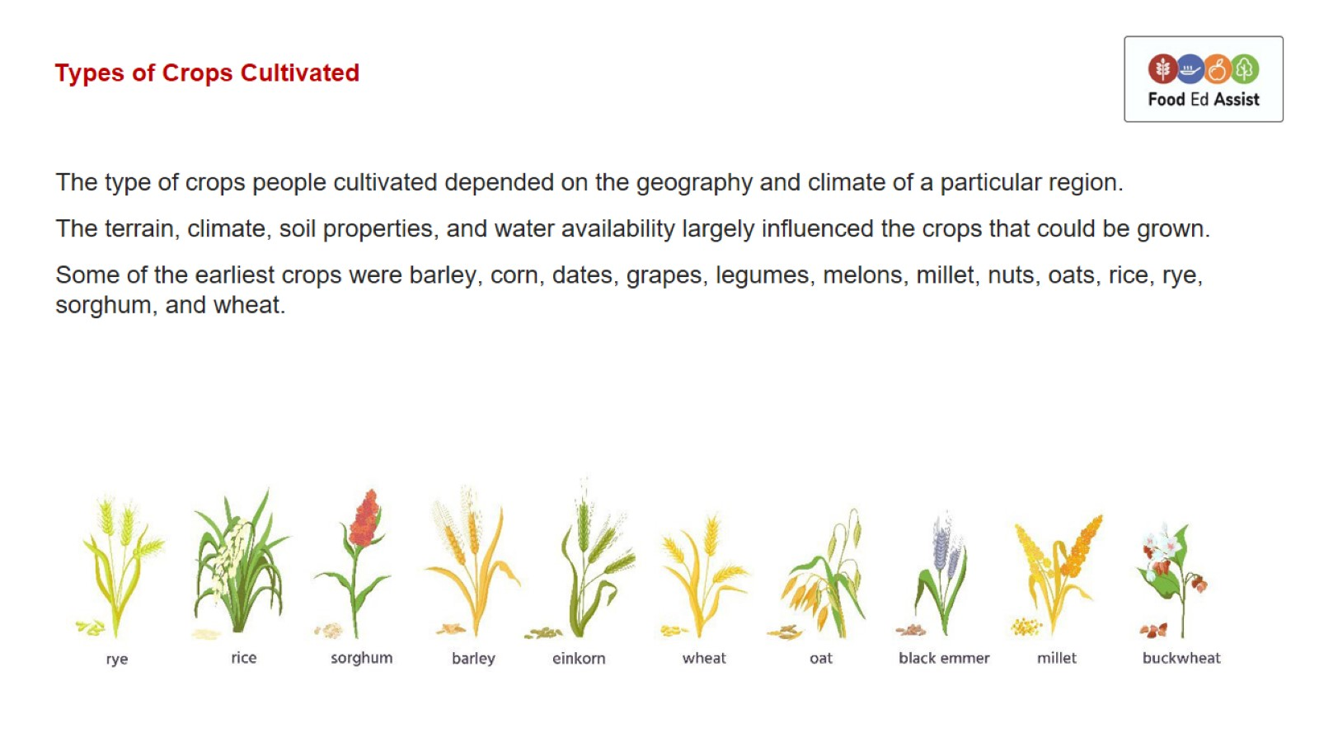
Types of Crops Cultivated

Slide 9
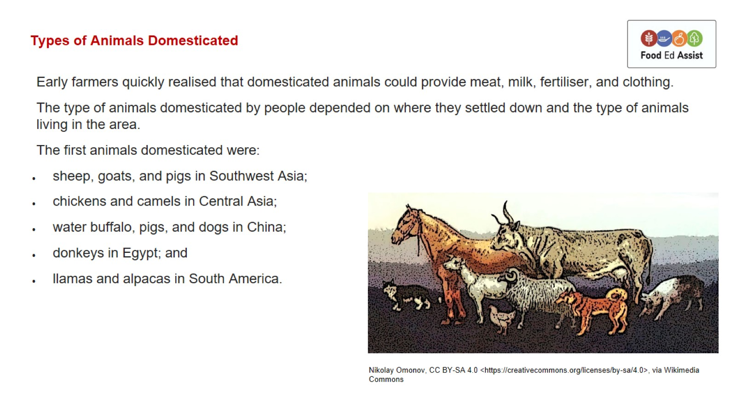
Types of Animals Domesticated

Slide 10
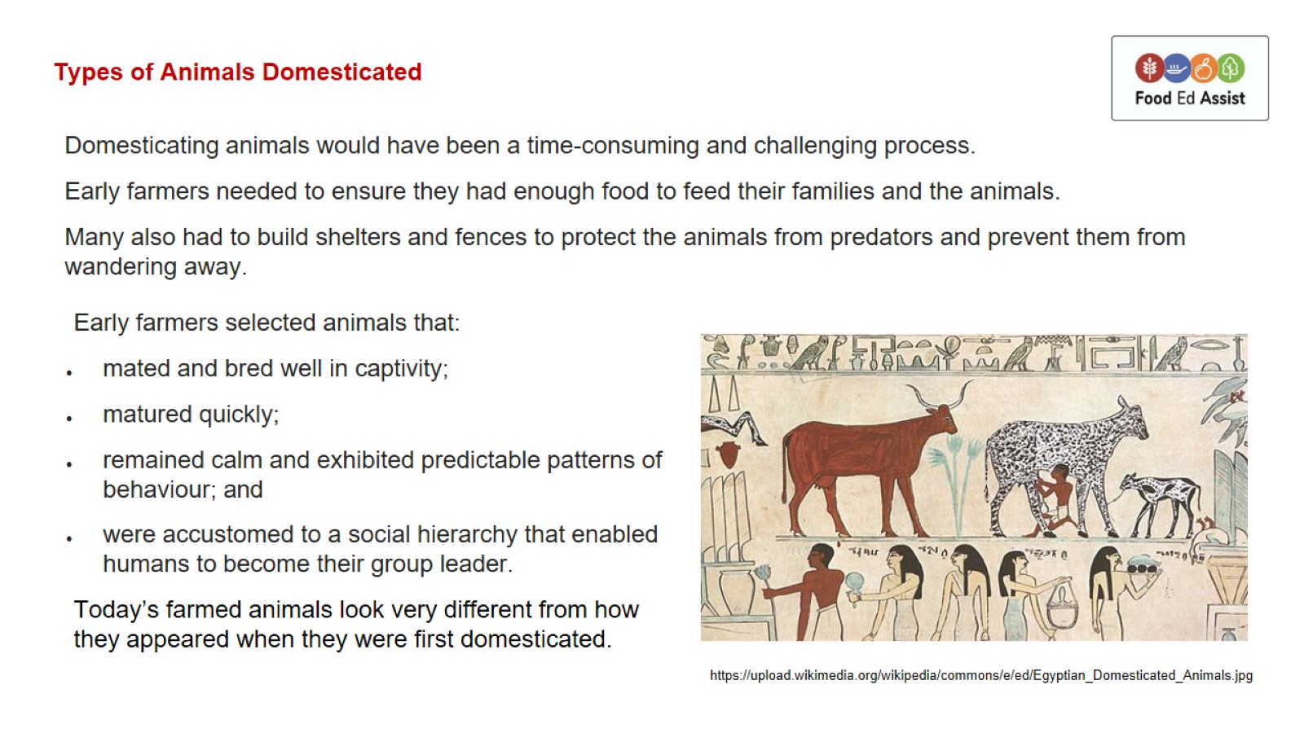
Types of Animals Domesticated

Slide 11
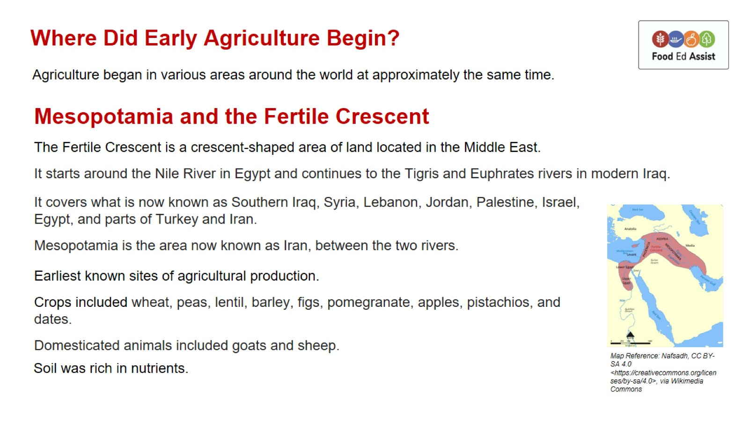
Where Did Early Agriculture Begin?

Slide 12
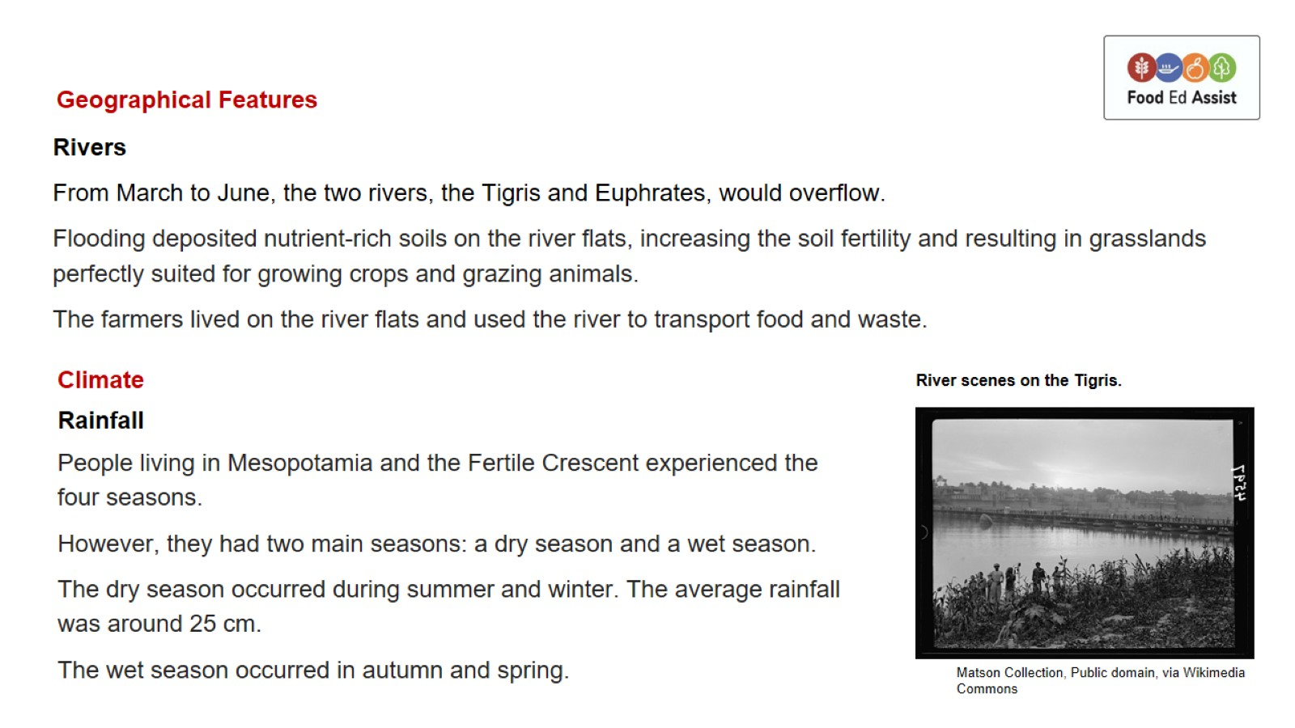
Geographical Features

Slide 13
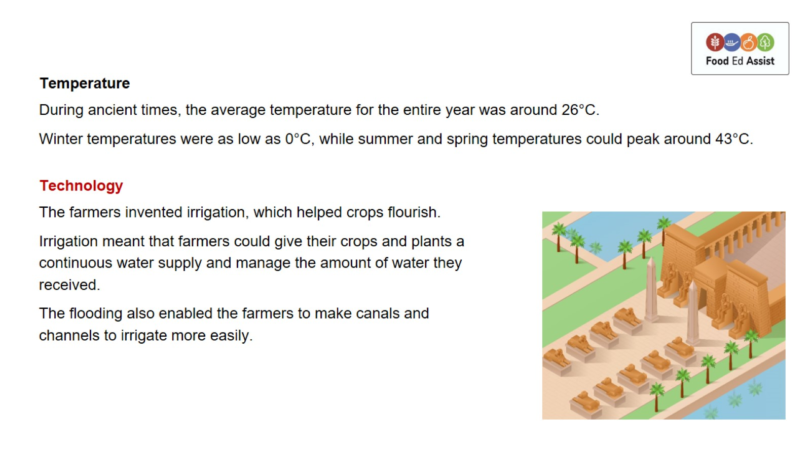

Slide 14
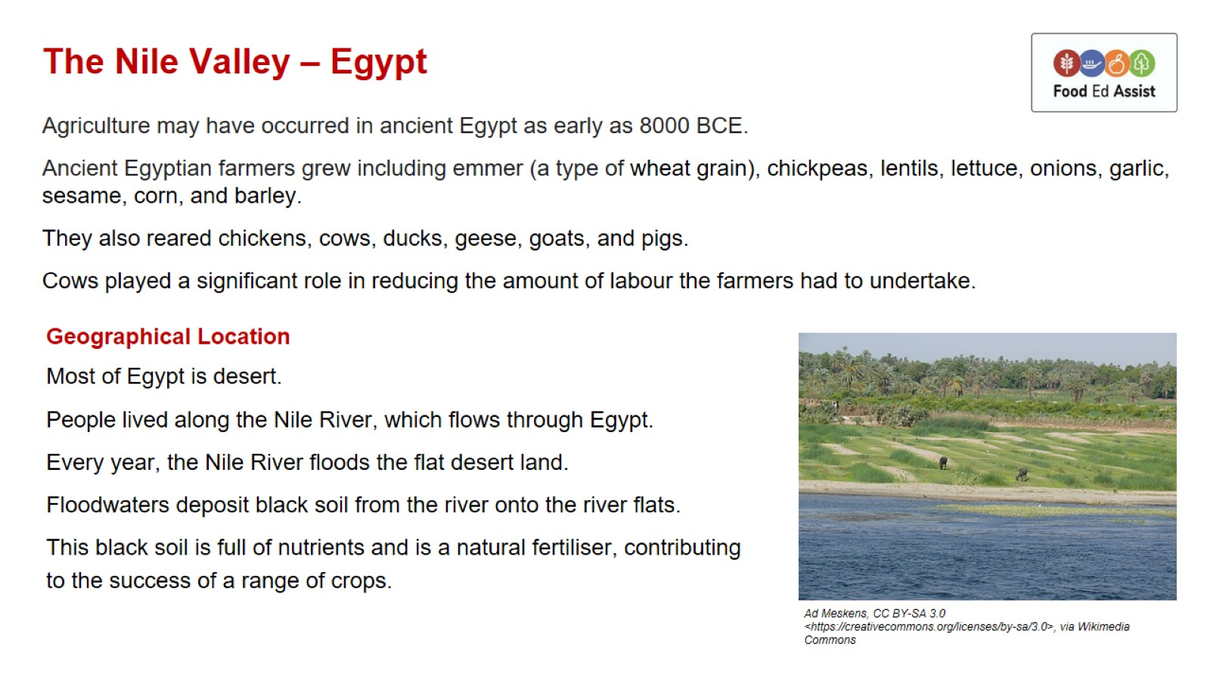
The Nile Valley – Egypt

Slide 15
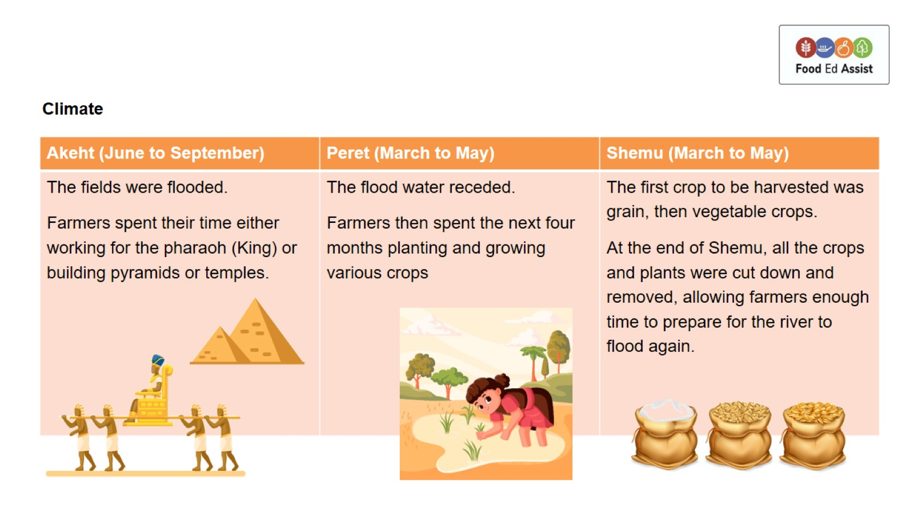

Slide 16
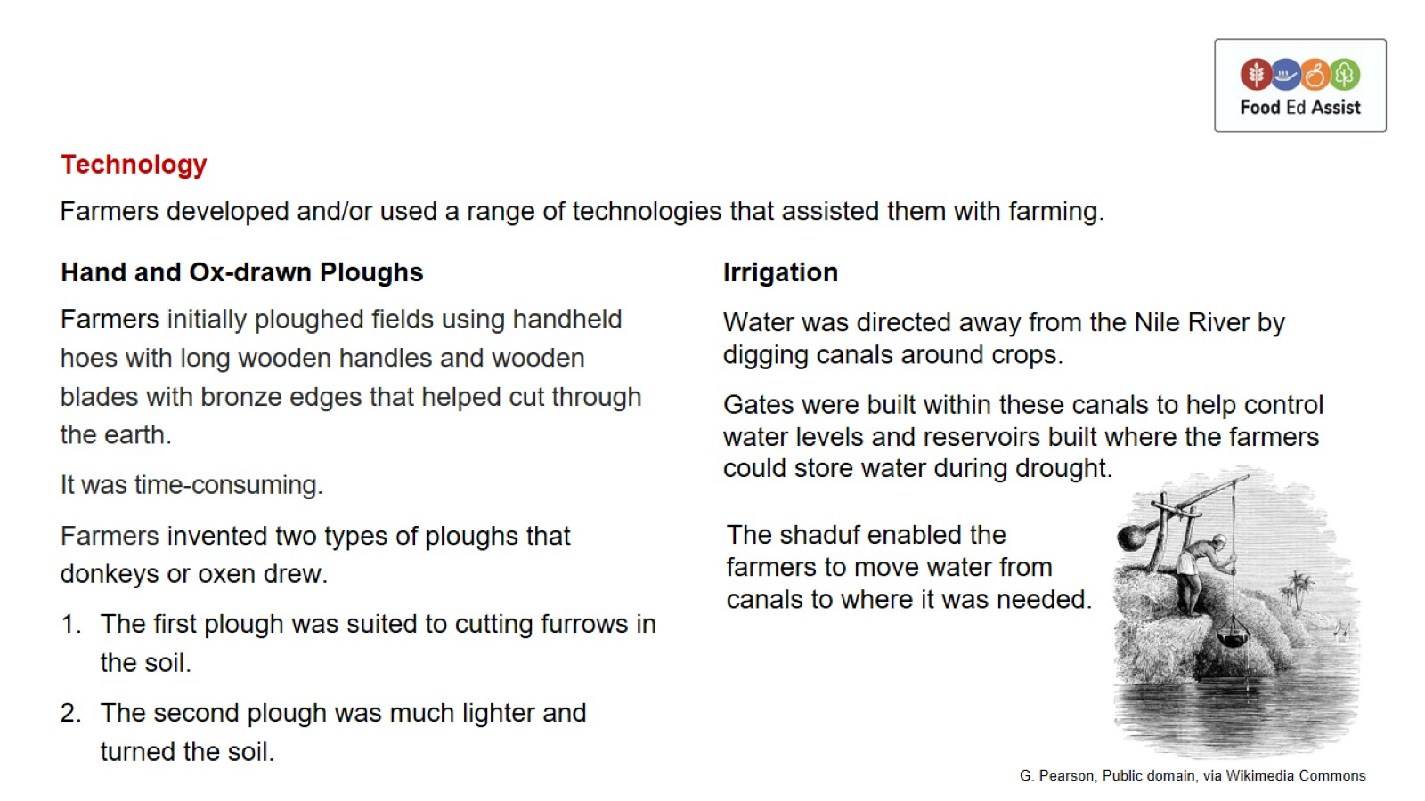

Slide 17
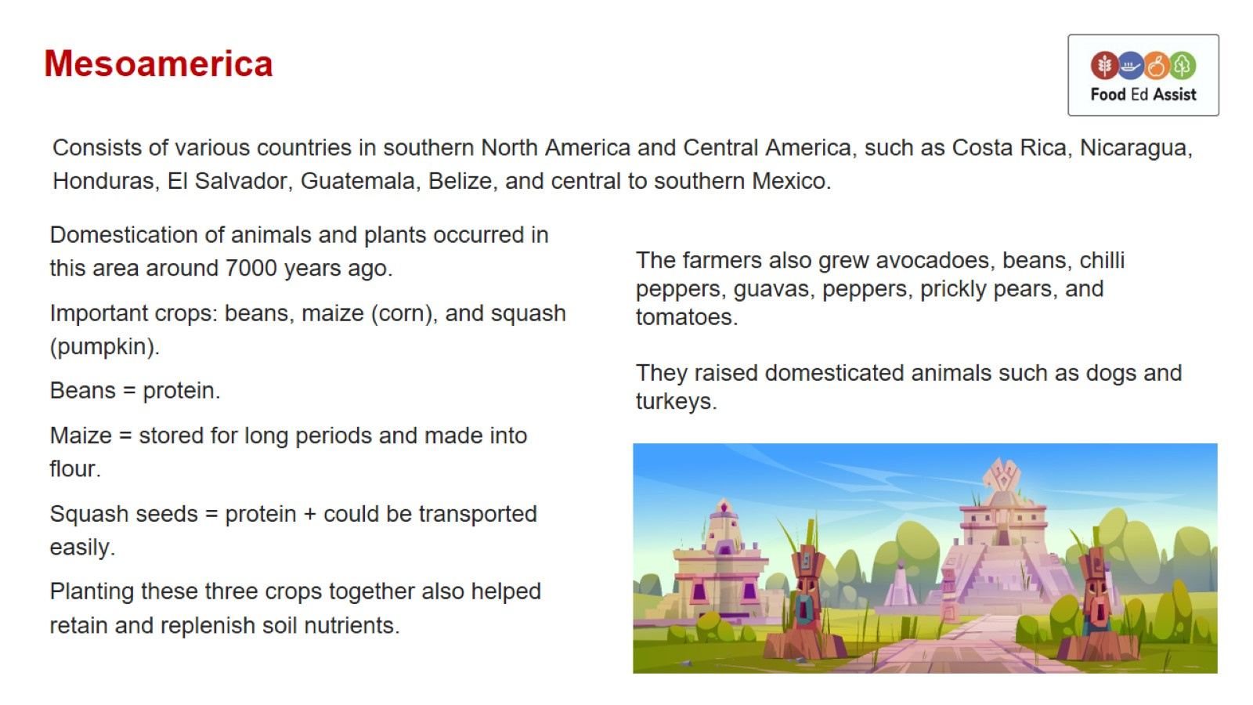
Mesoamerica

Slide 18
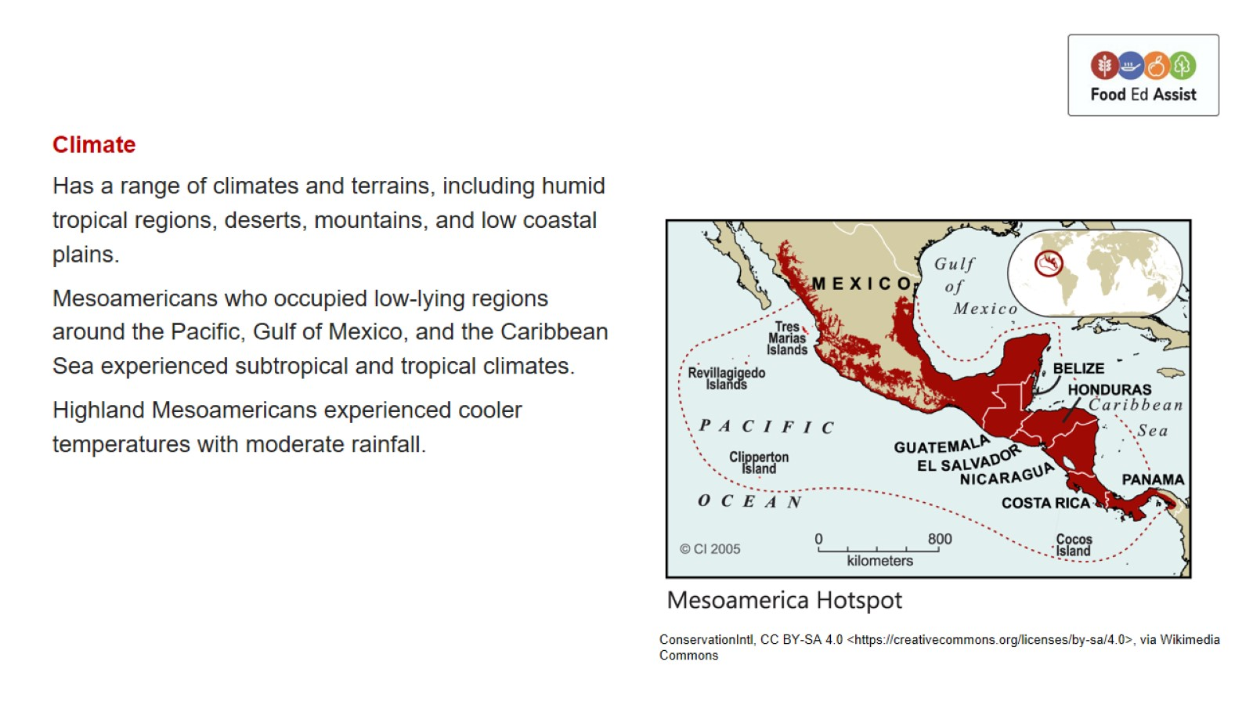

Slide 19
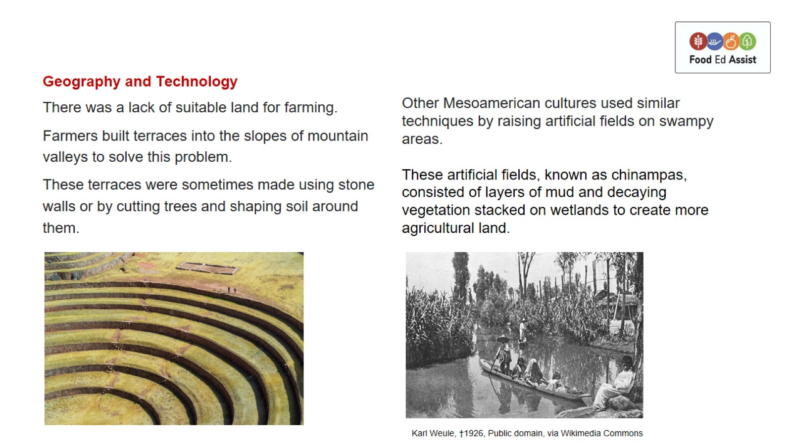

Slide 20
