Slide 1
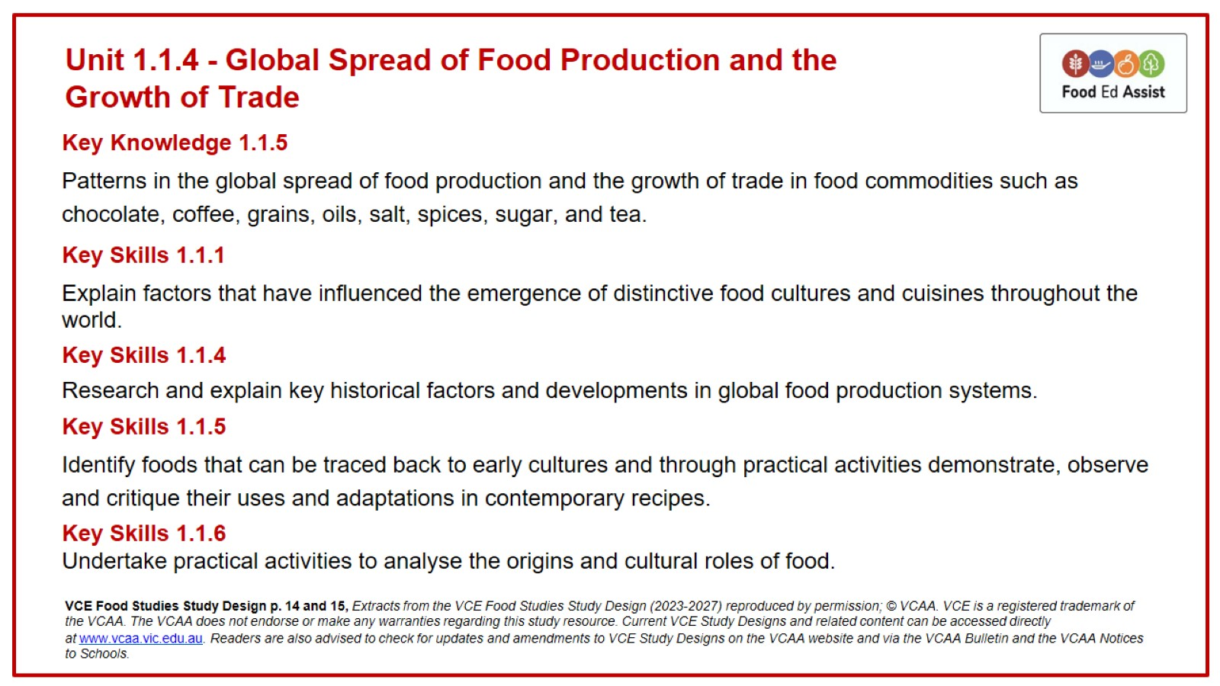
Unit 1.1.4 - Global Spread of Food Production and the
Growth of Trade

Slide 2
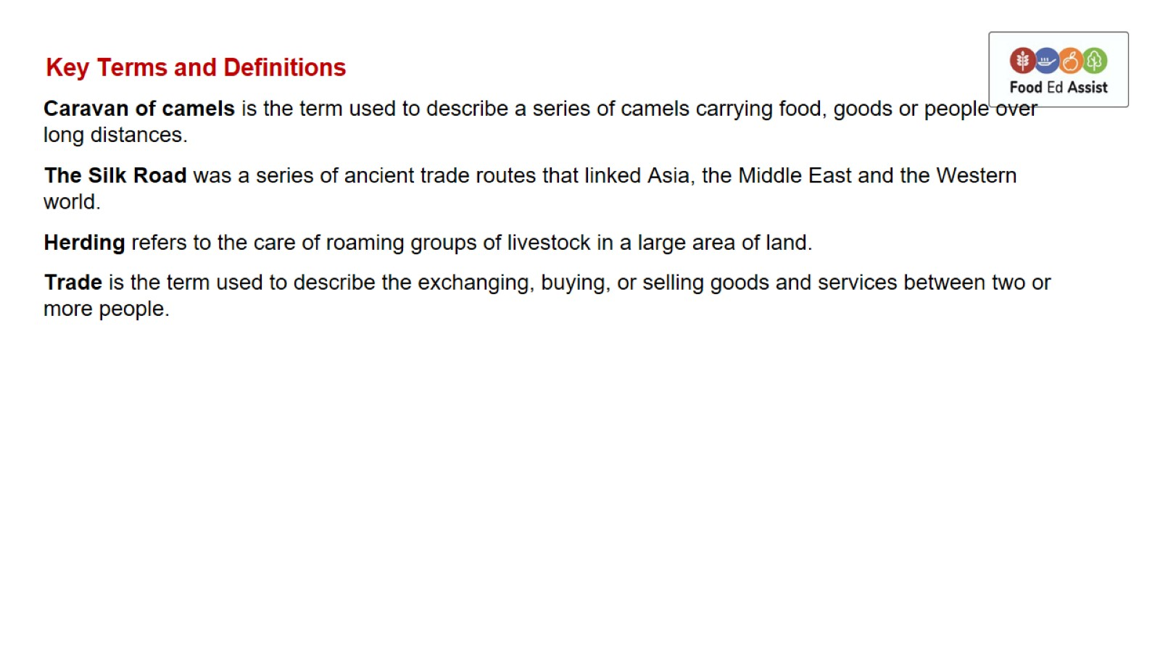
Key Terms and Definitions

Slide 3
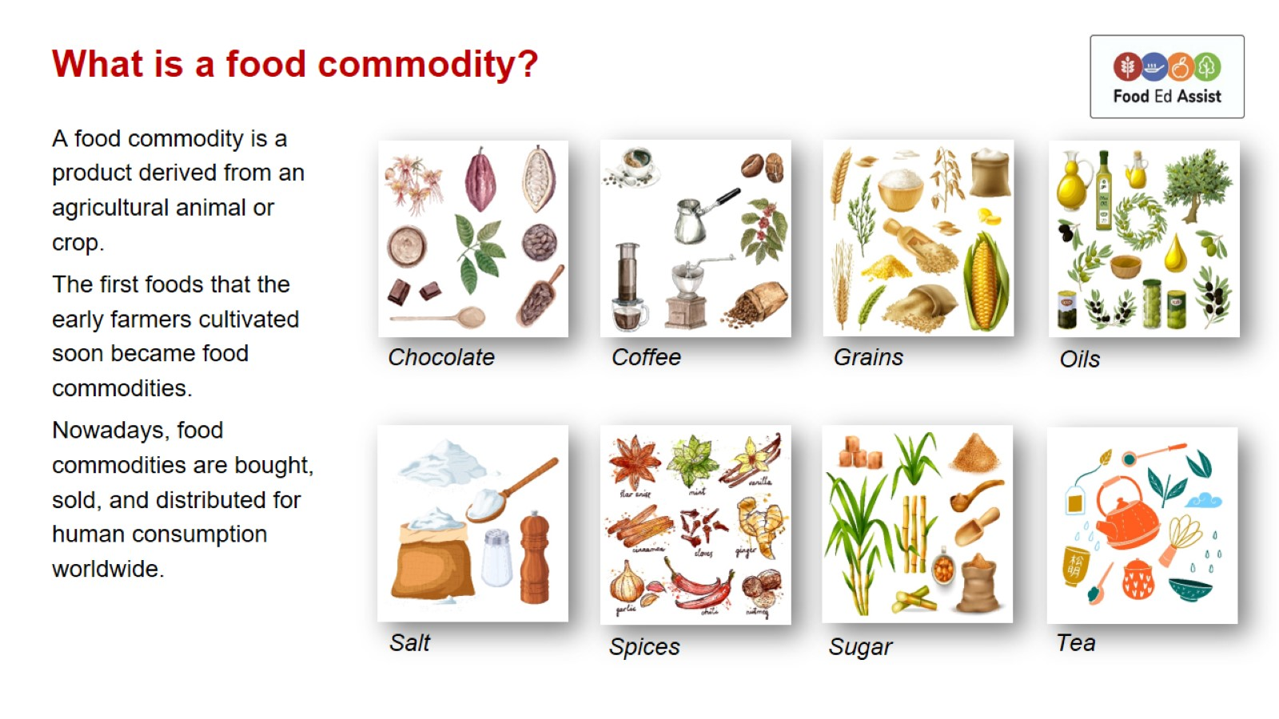
What is a food commodity?

Slide 4
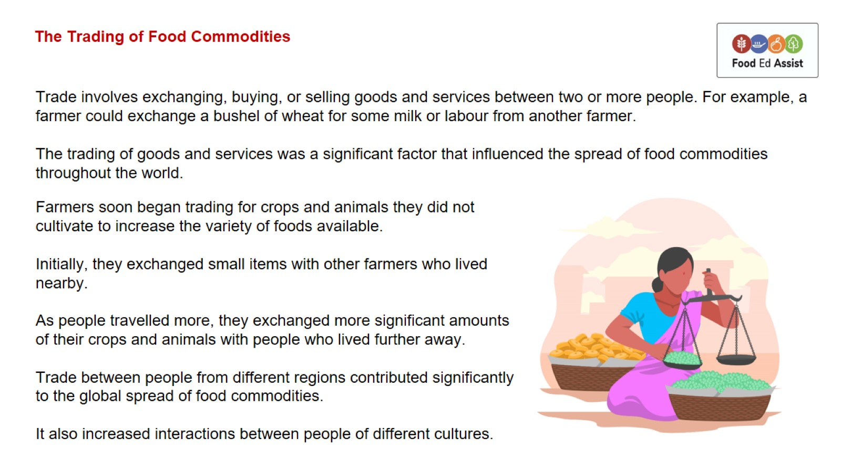
The Trading of Food Commodities

Slide 5
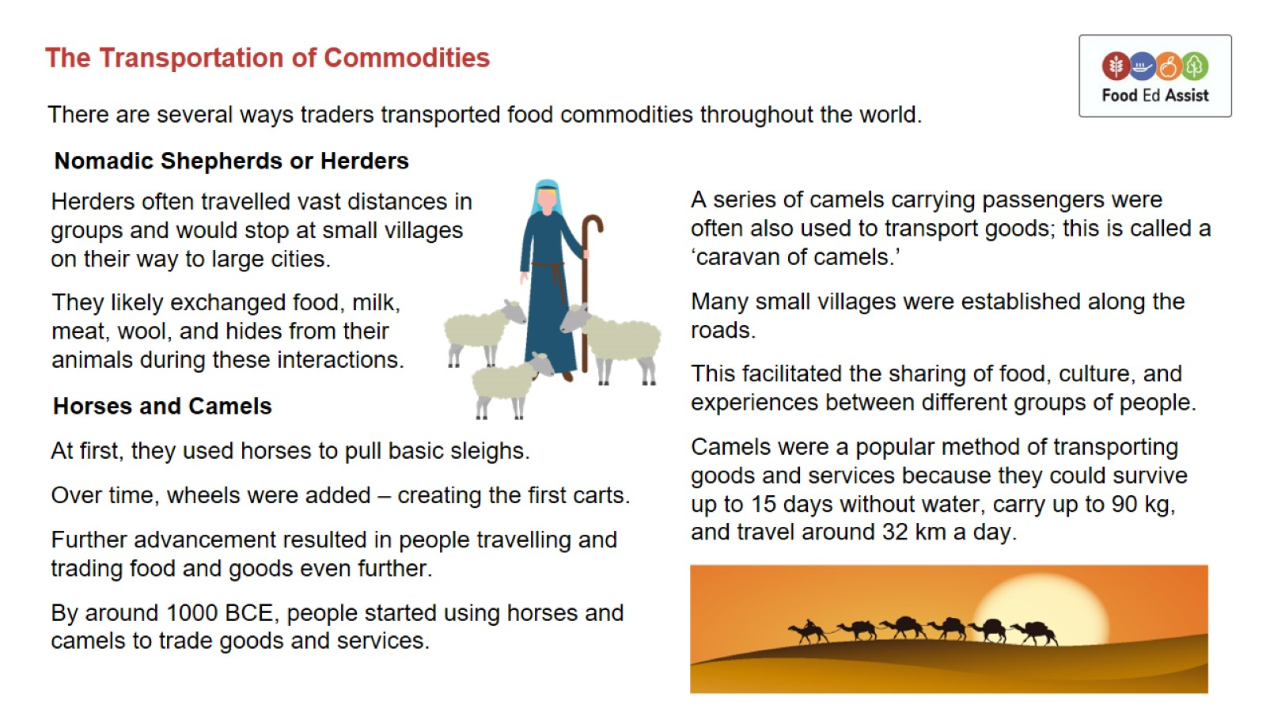
The Transportation of Commodities

Slide 6
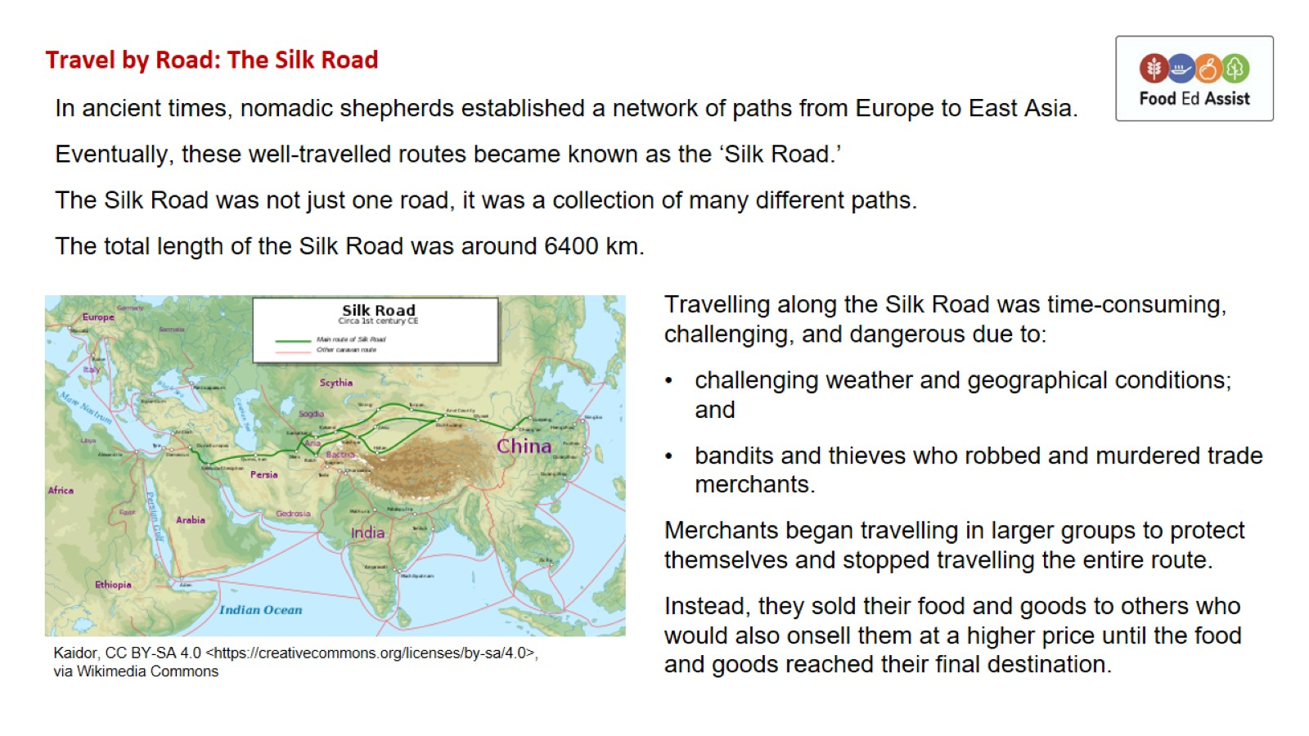
Travel by Road: The Silk Road

Slide 7
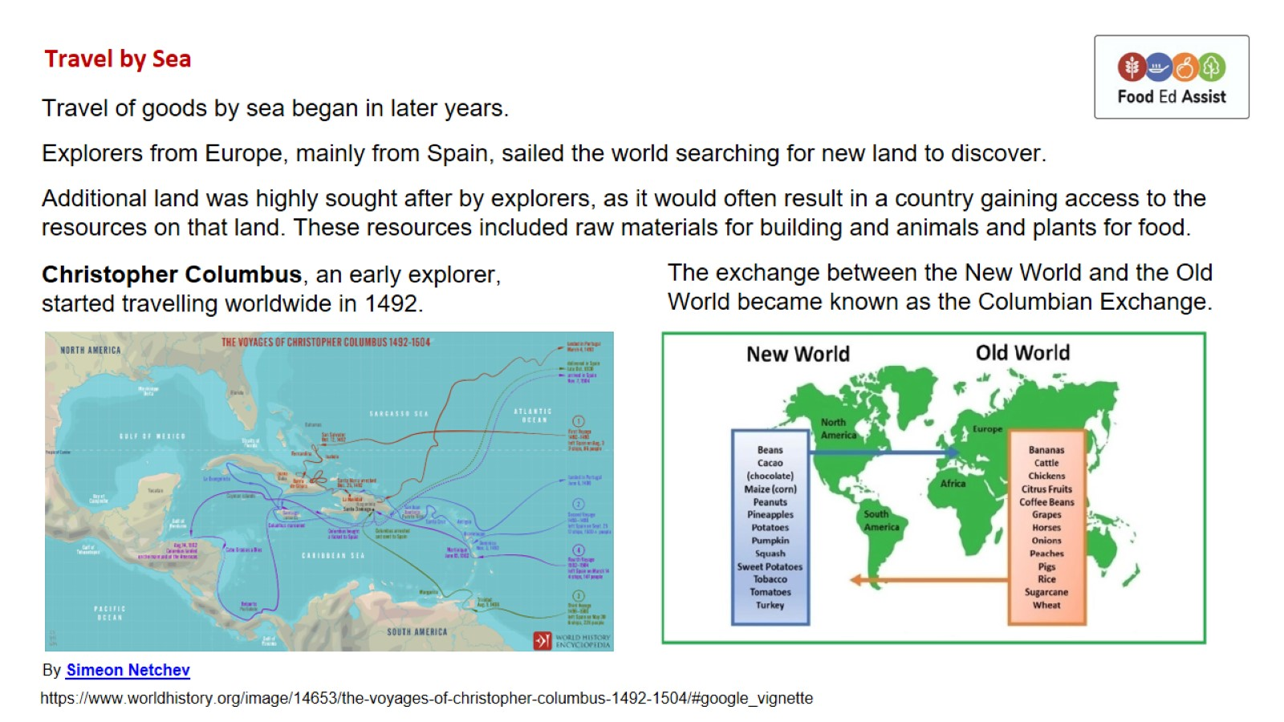
Travel by Sea

Slide 8
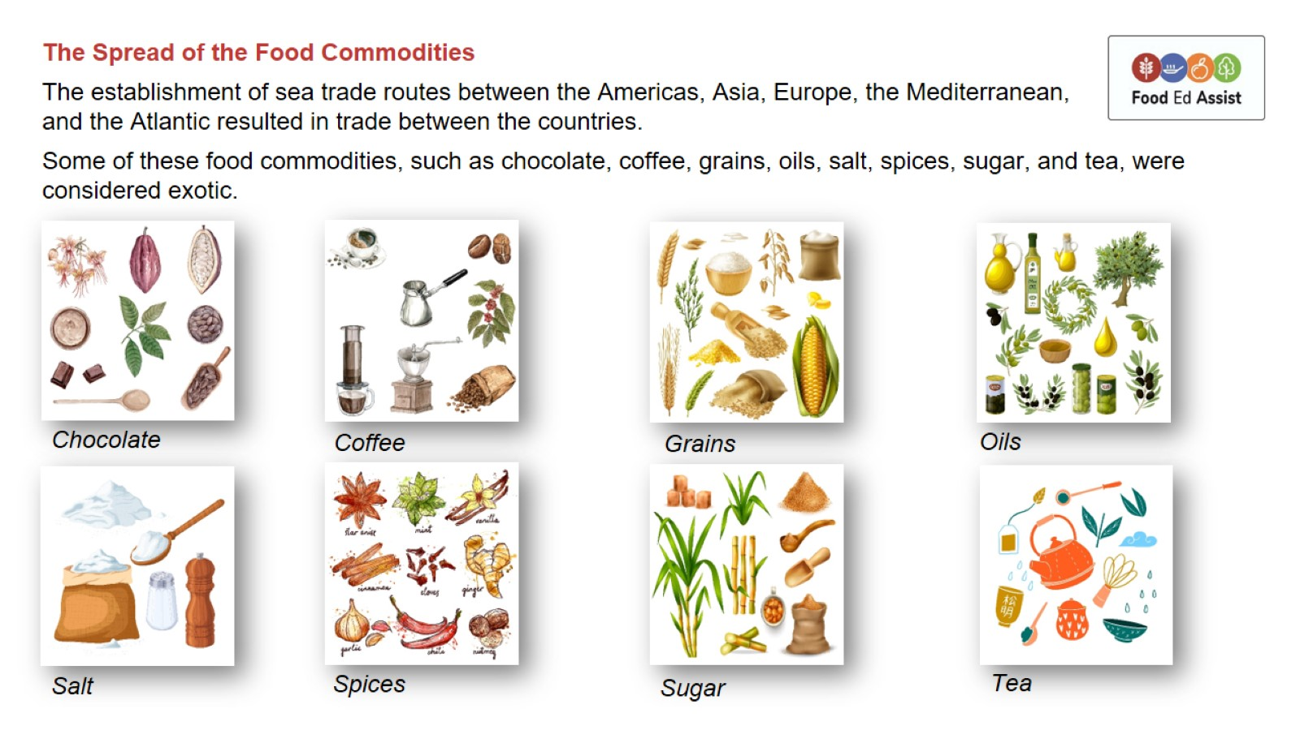

Slide 9
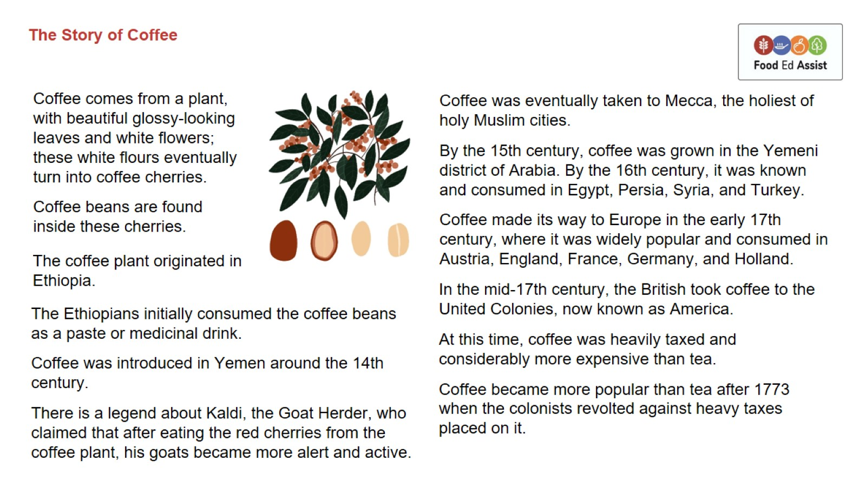

Slide 10
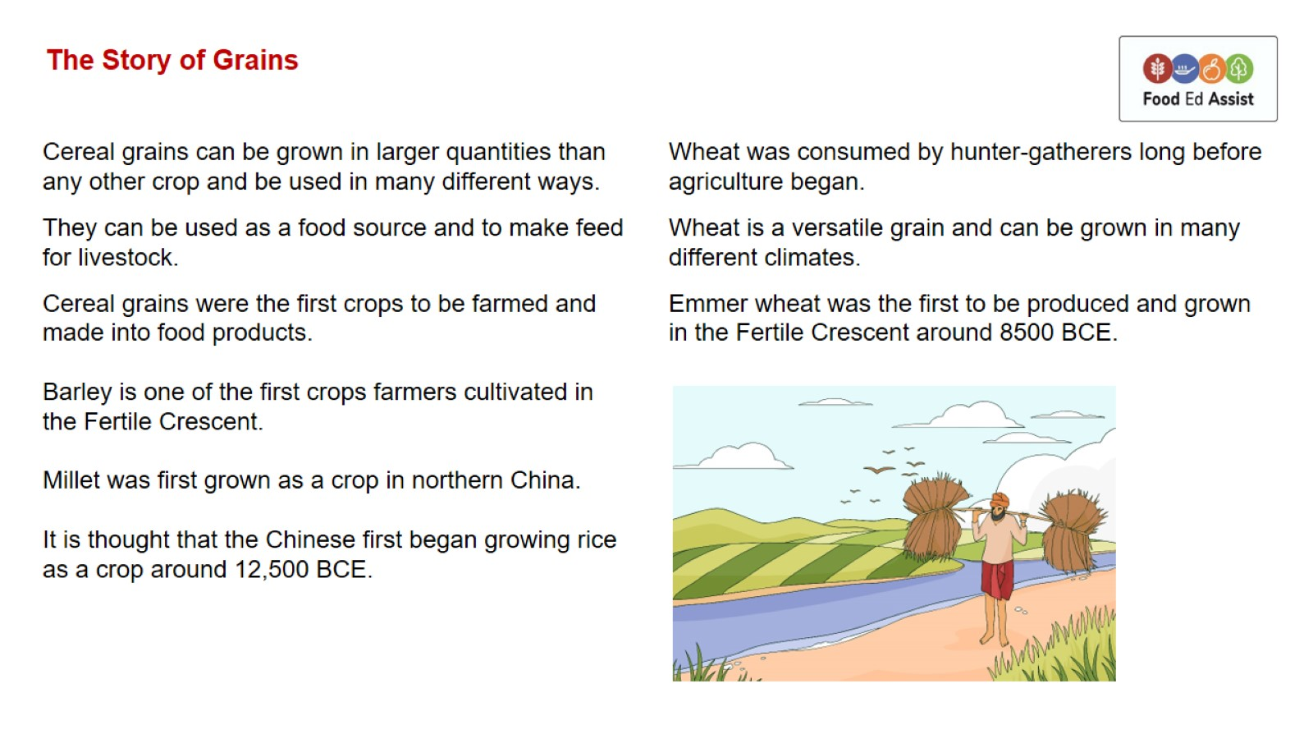
The Story of Grains

Slide 11
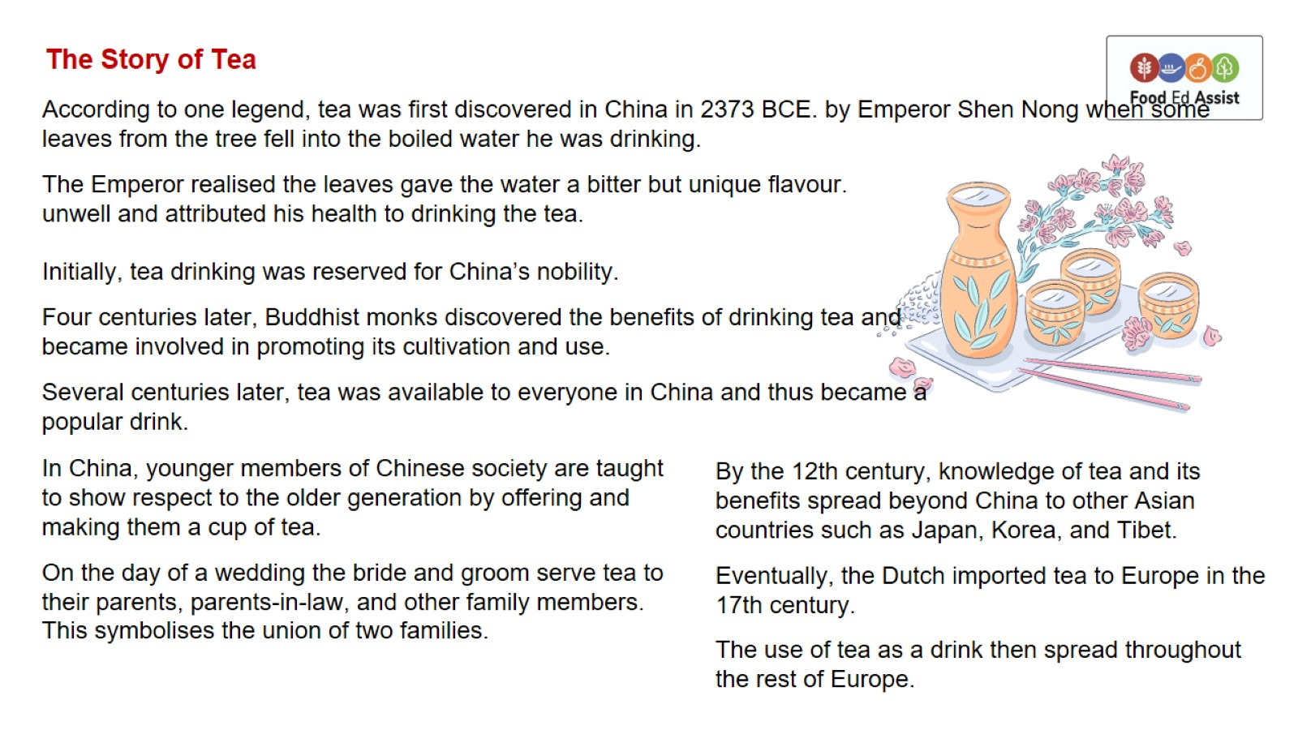
The Story of Tea

Slide 12
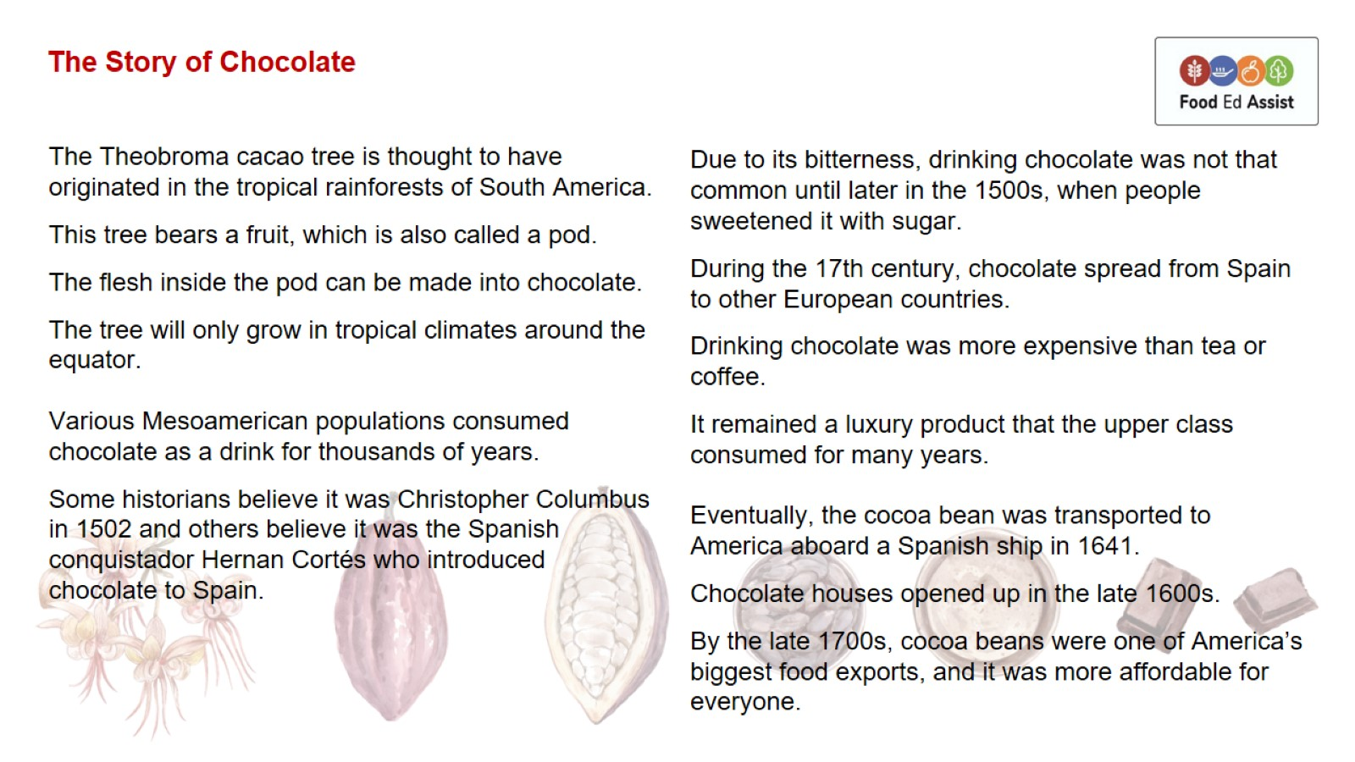
The Story of Chocolate

Slide 13
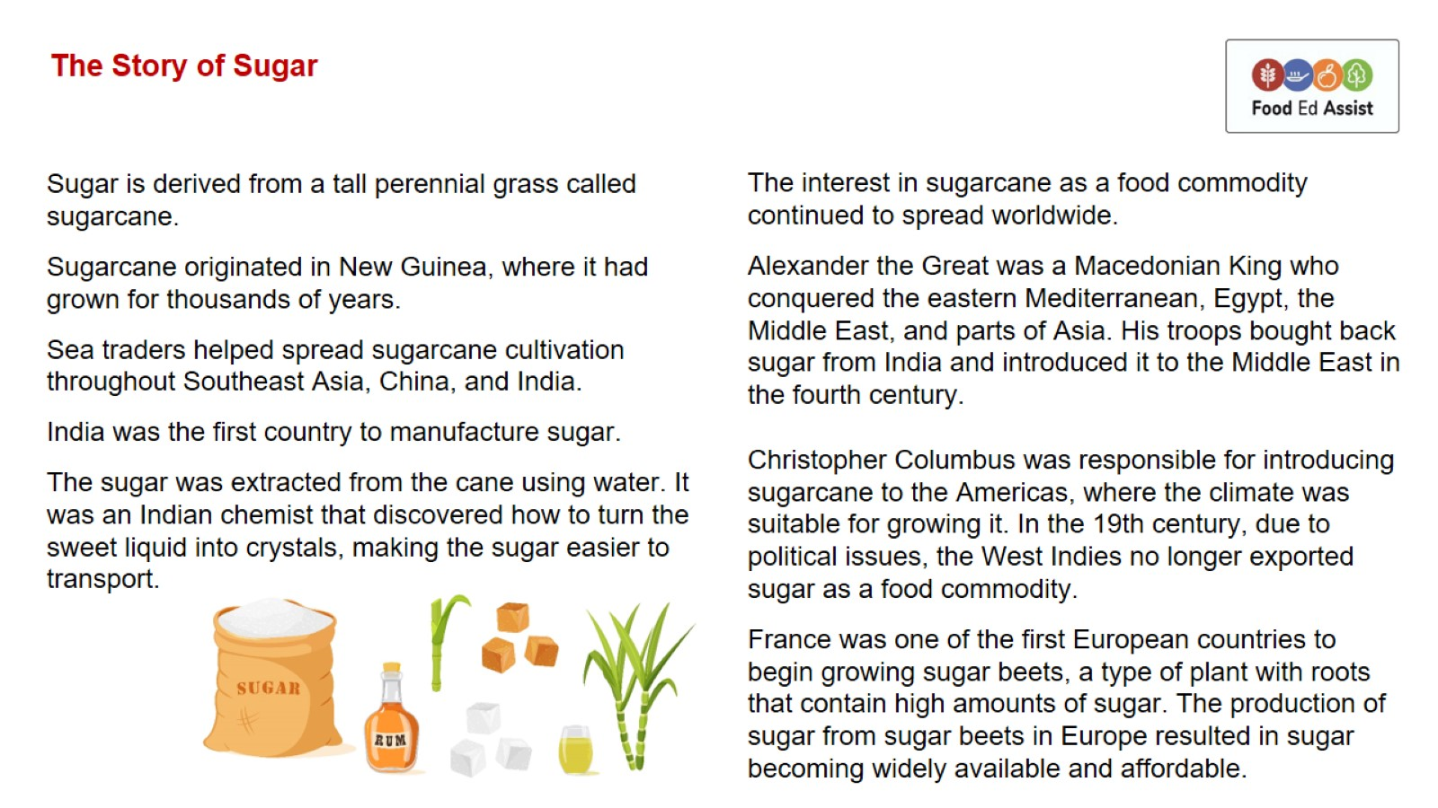
The Story of Sugar

Slide 14
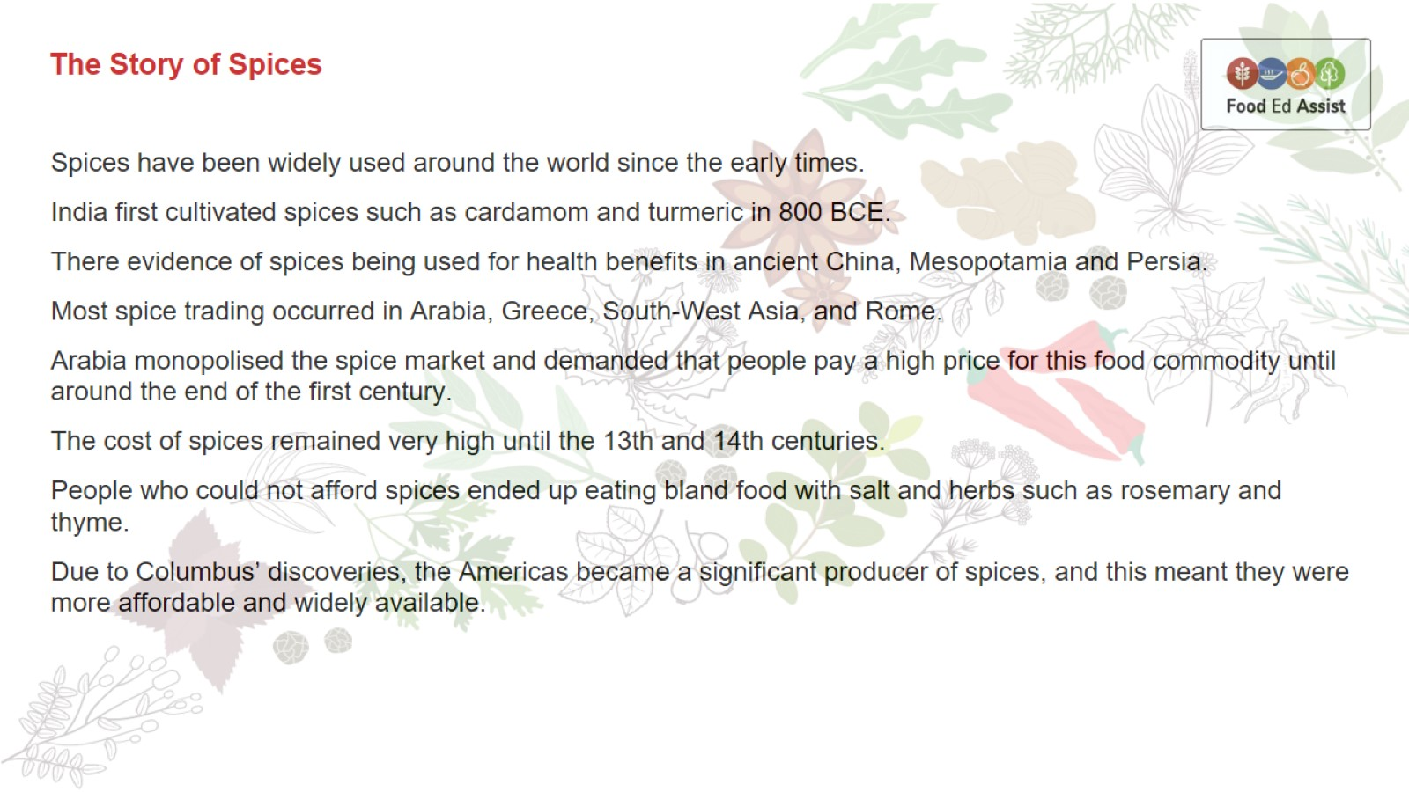
The Story of Spices

Slide 15
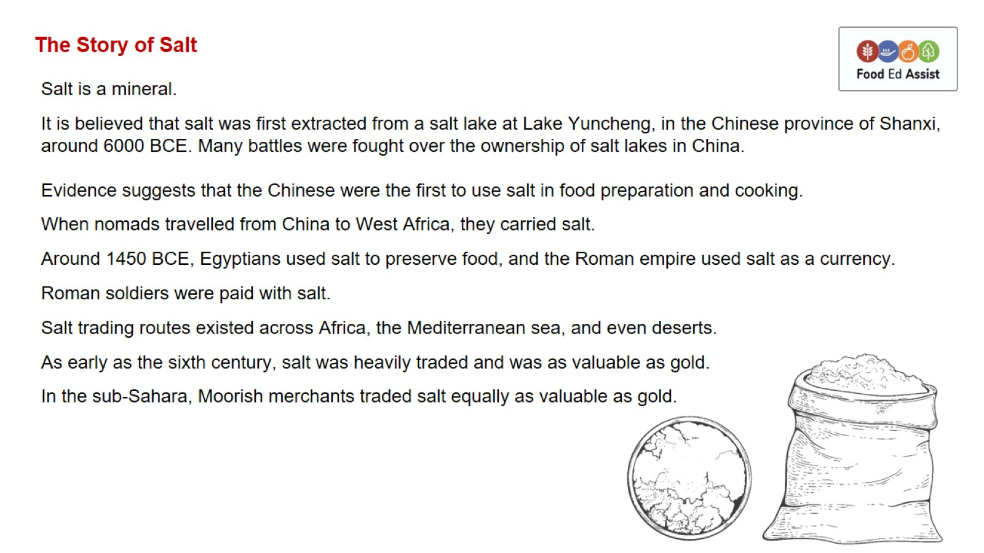
The Story of Salt

Slide 16
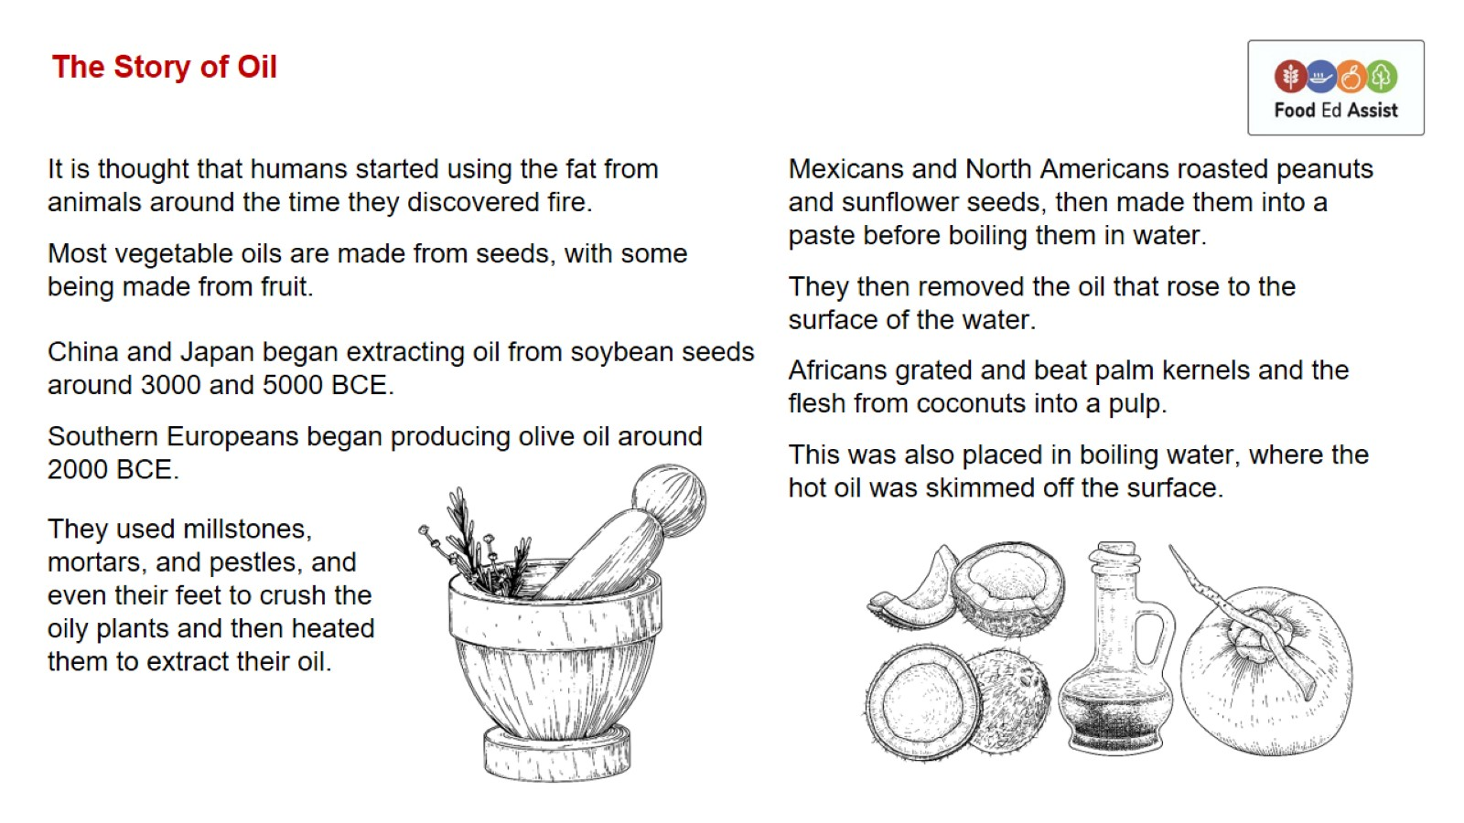
The Story of Oil

