Slide 1
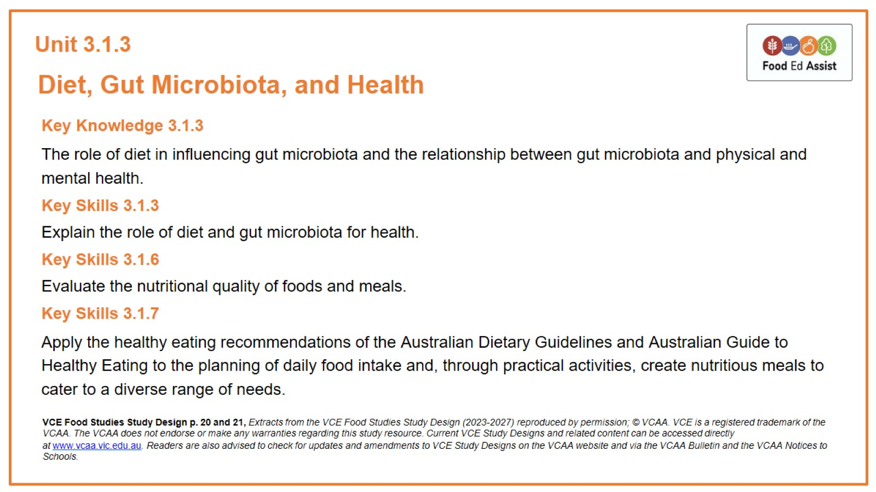
Unit 3.1.3

Slide 2
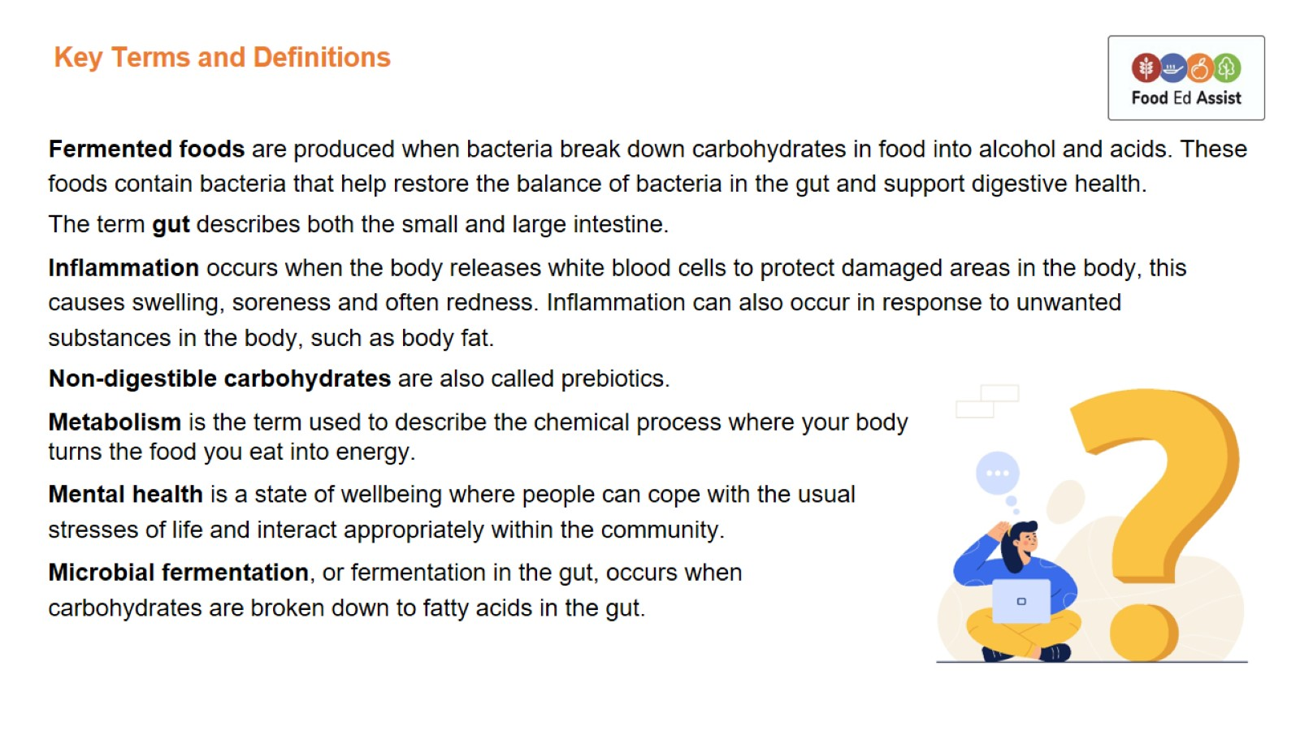
Key Terms and Definitions

Slide 3
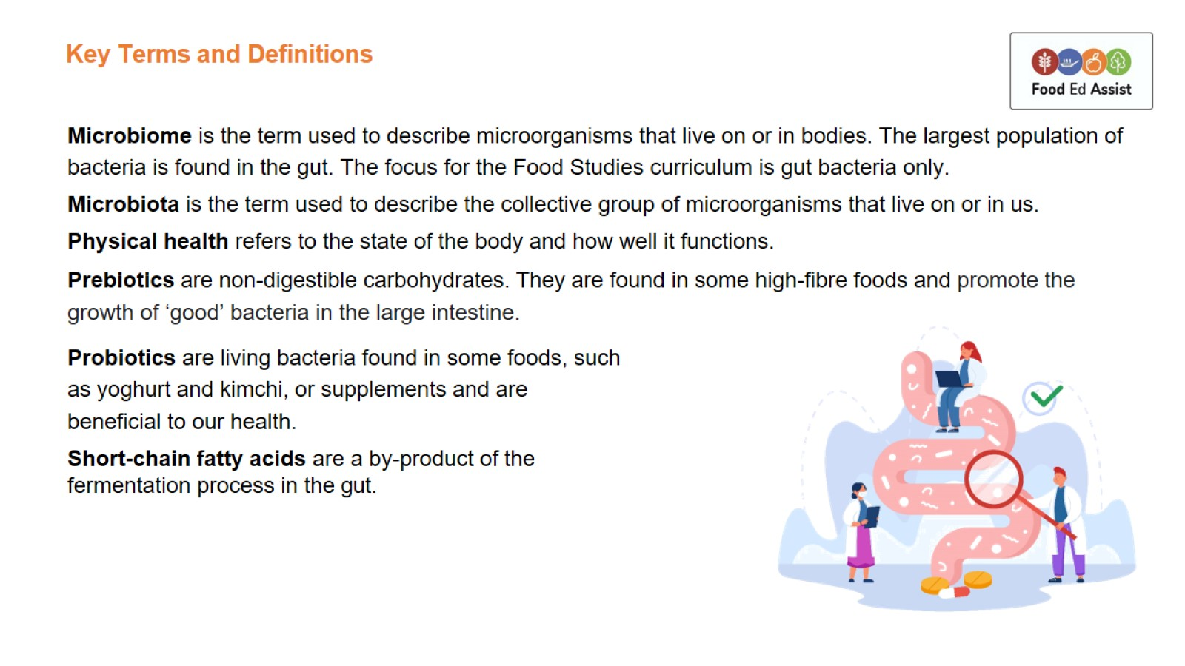
Key Terms and Definitions

Slide 4
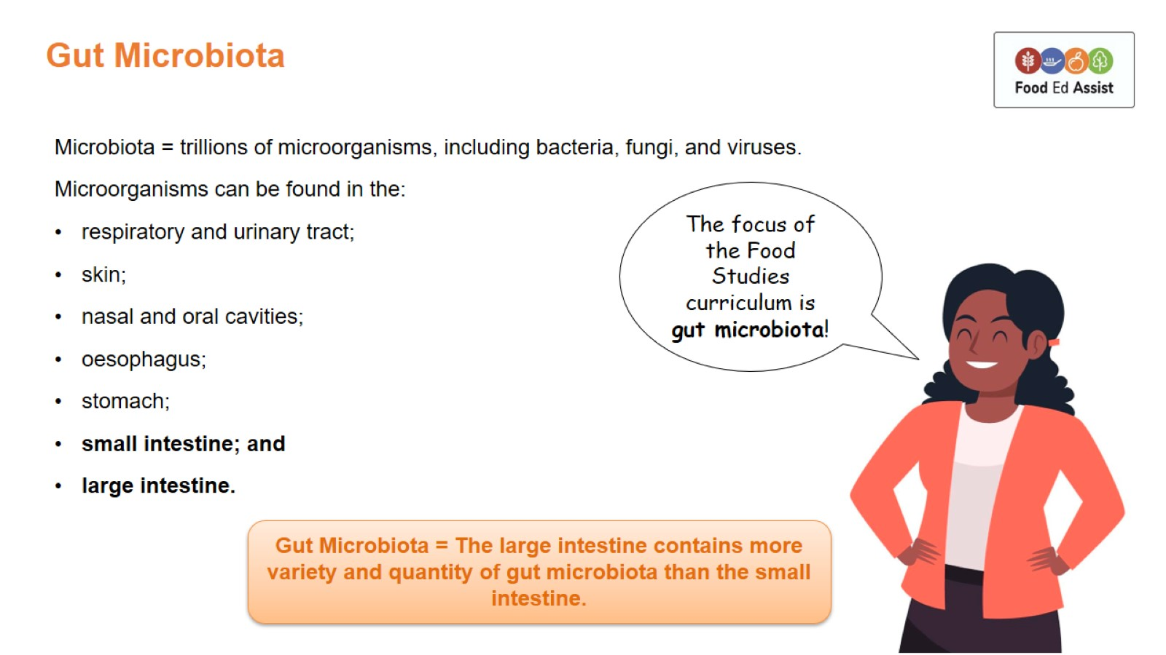
Gut Microbiota

Slide 5
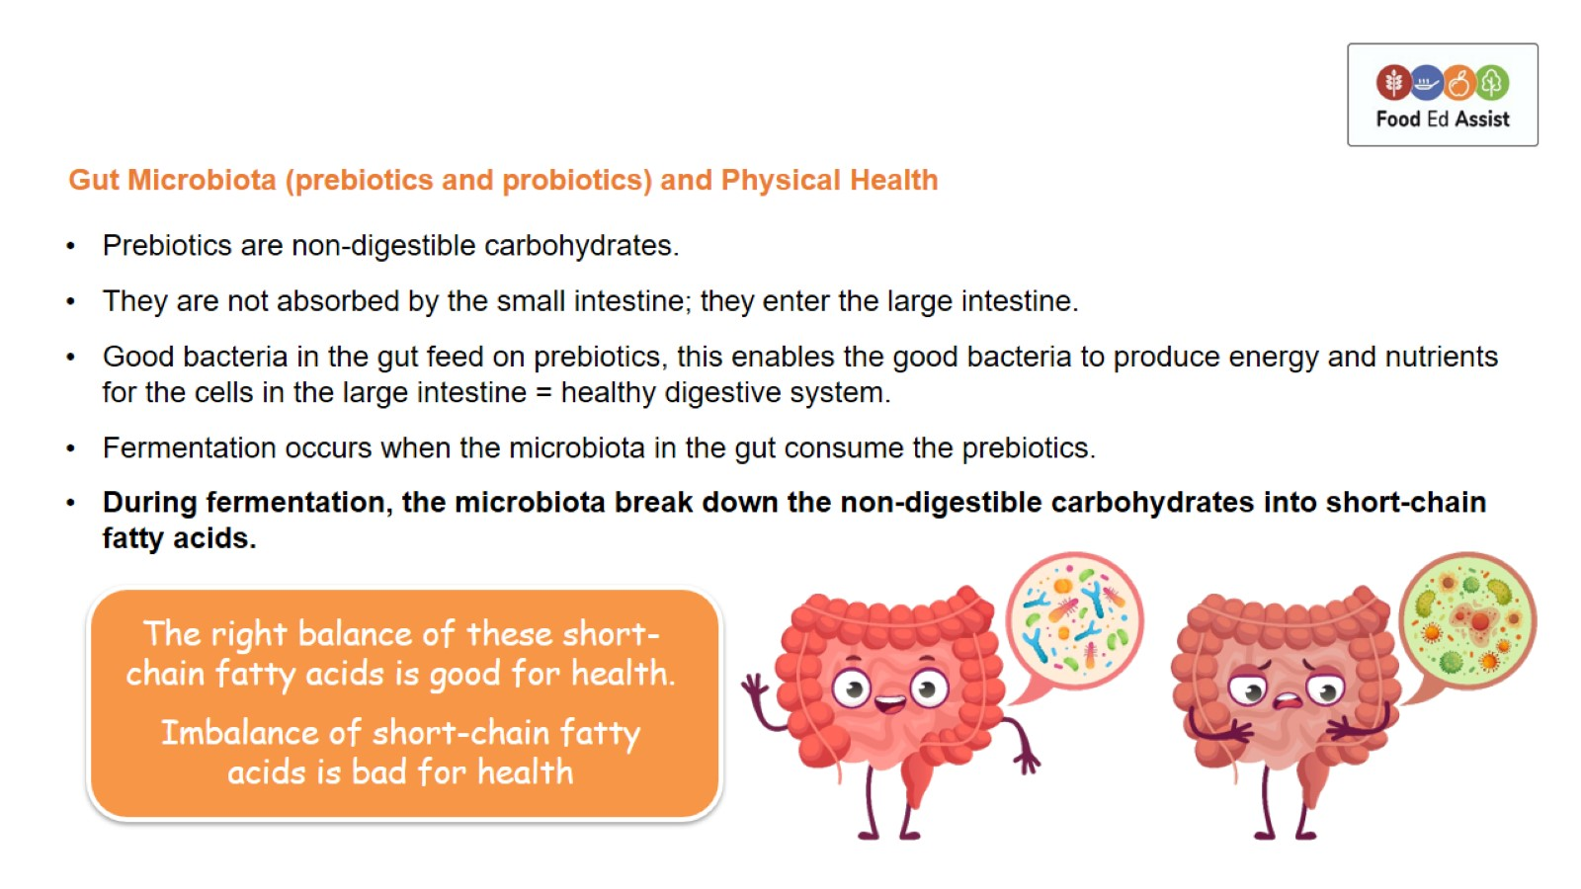
Gut Microbiota (prebiotics and probiotics) and Physical Health

Slide 6
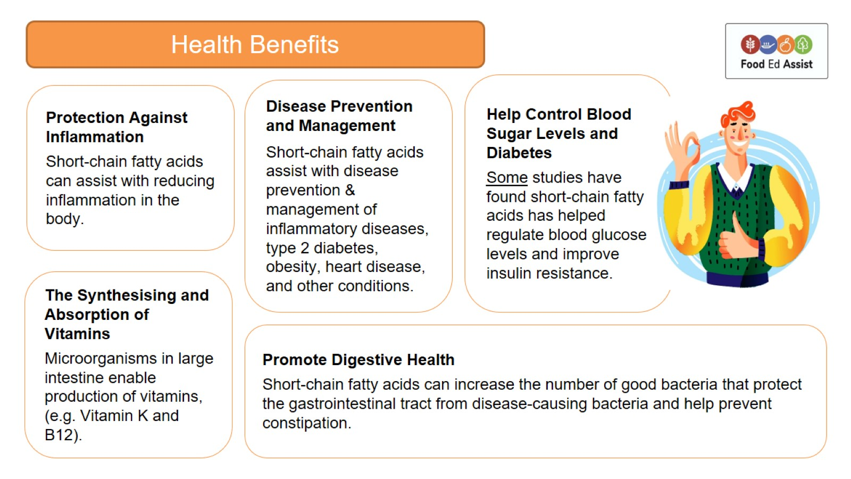

Slide 7
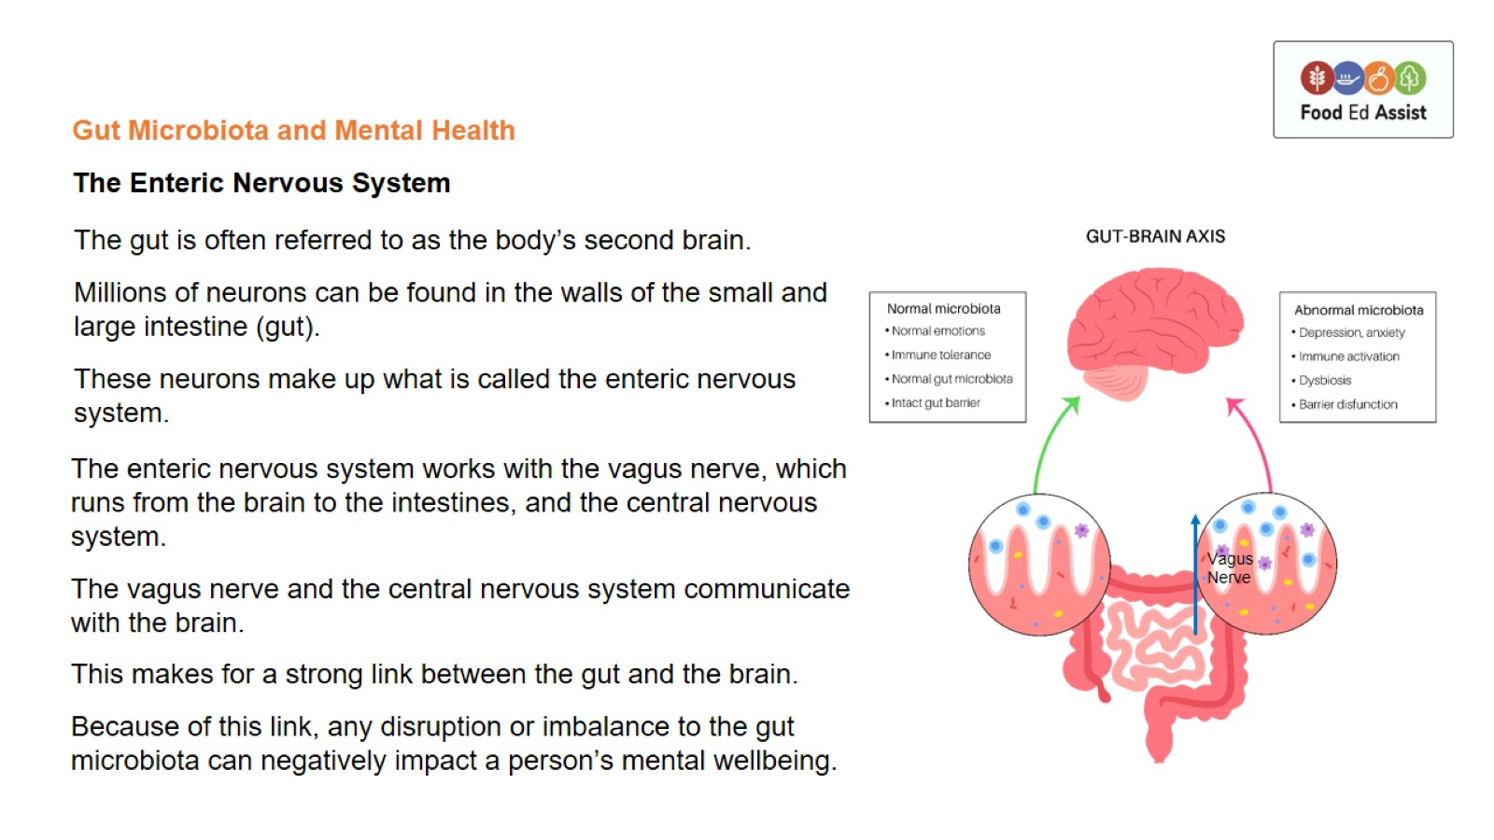
Gut Microbiota and Mental Health

Slide 8
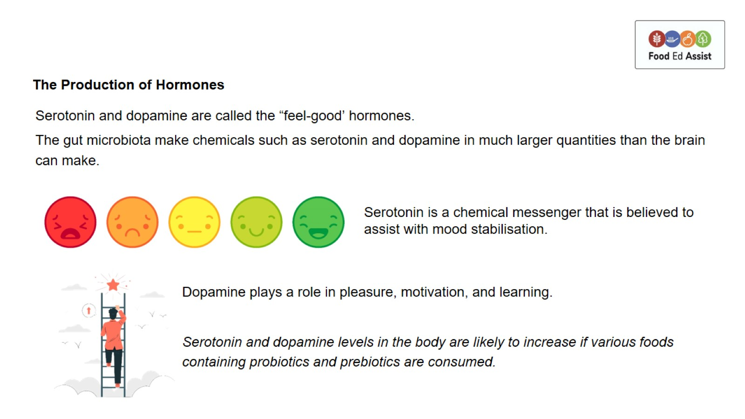
The Production of Hormones

Slide 9
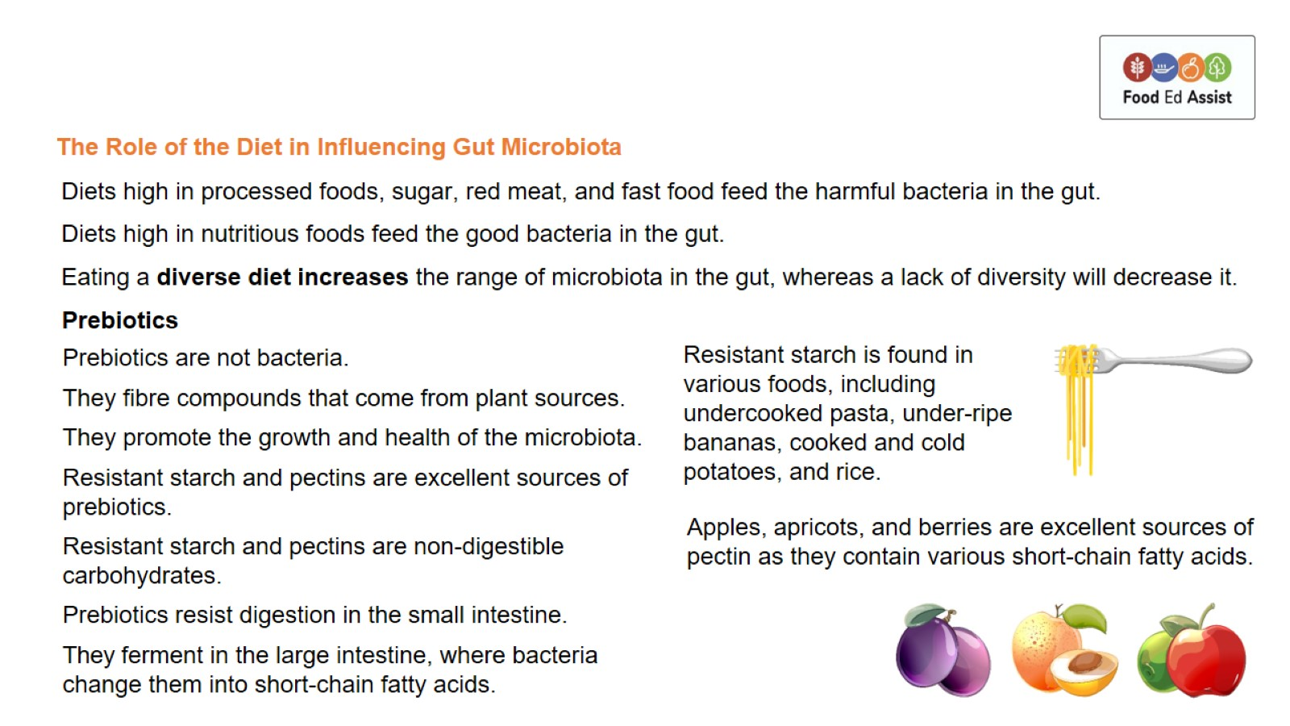
The Role of the Diet in Influencing Gut Microbiota

Slide 10
