Slide 1
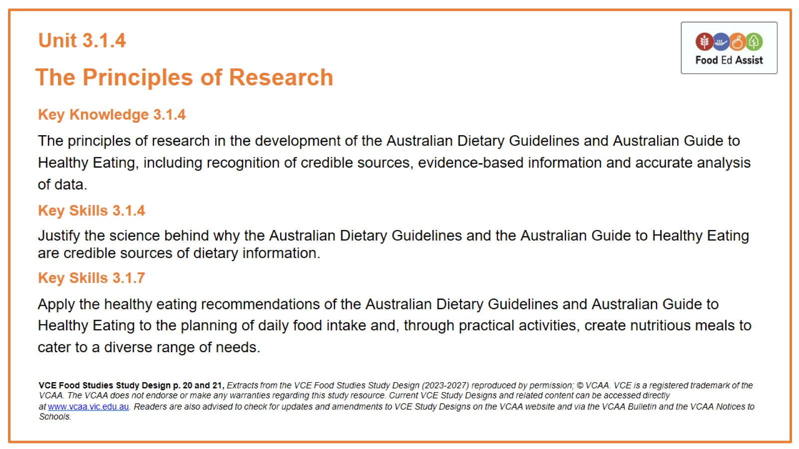
Unit 3.1.4

Slide 2
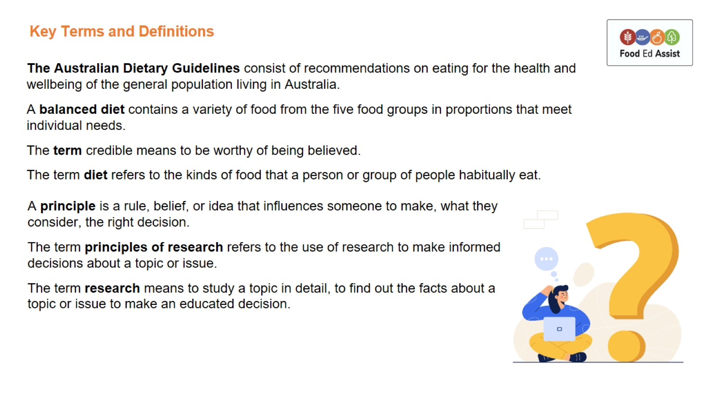
Key Terms and Definitions

Slide 3
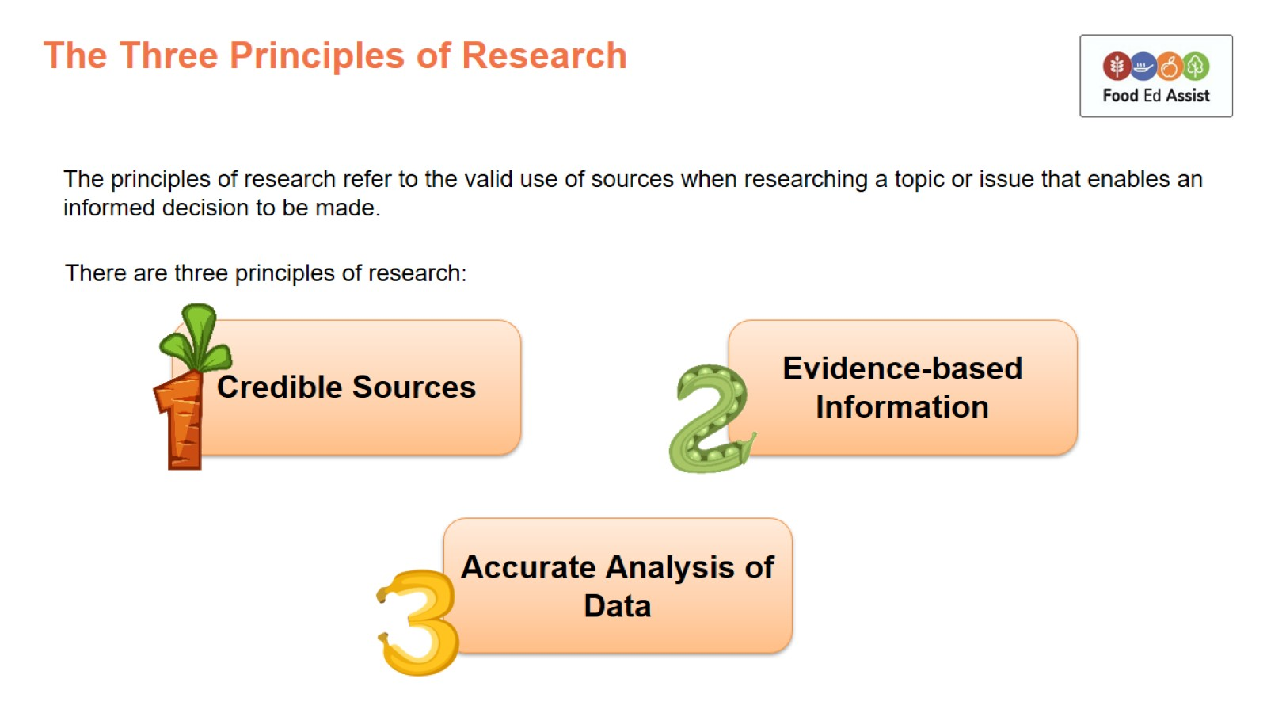
The Three Principles of Research

Slide 4
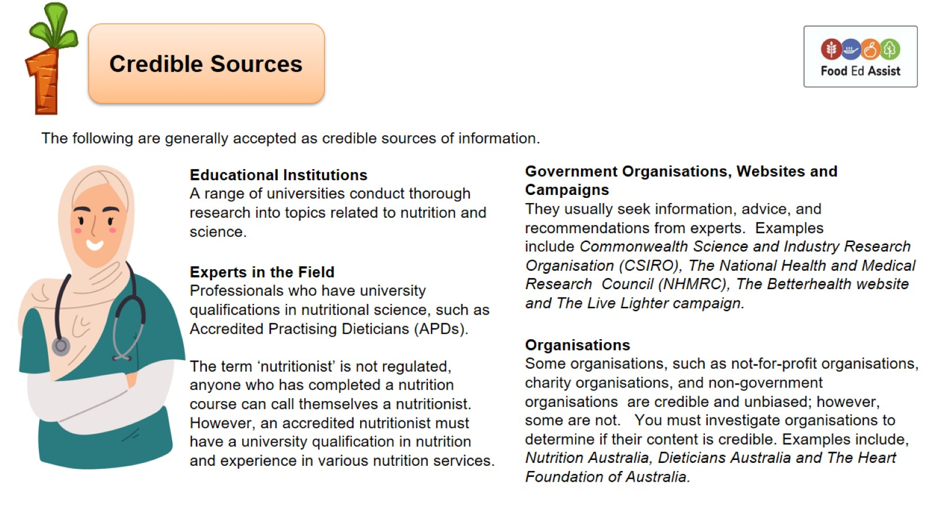

Slide 5
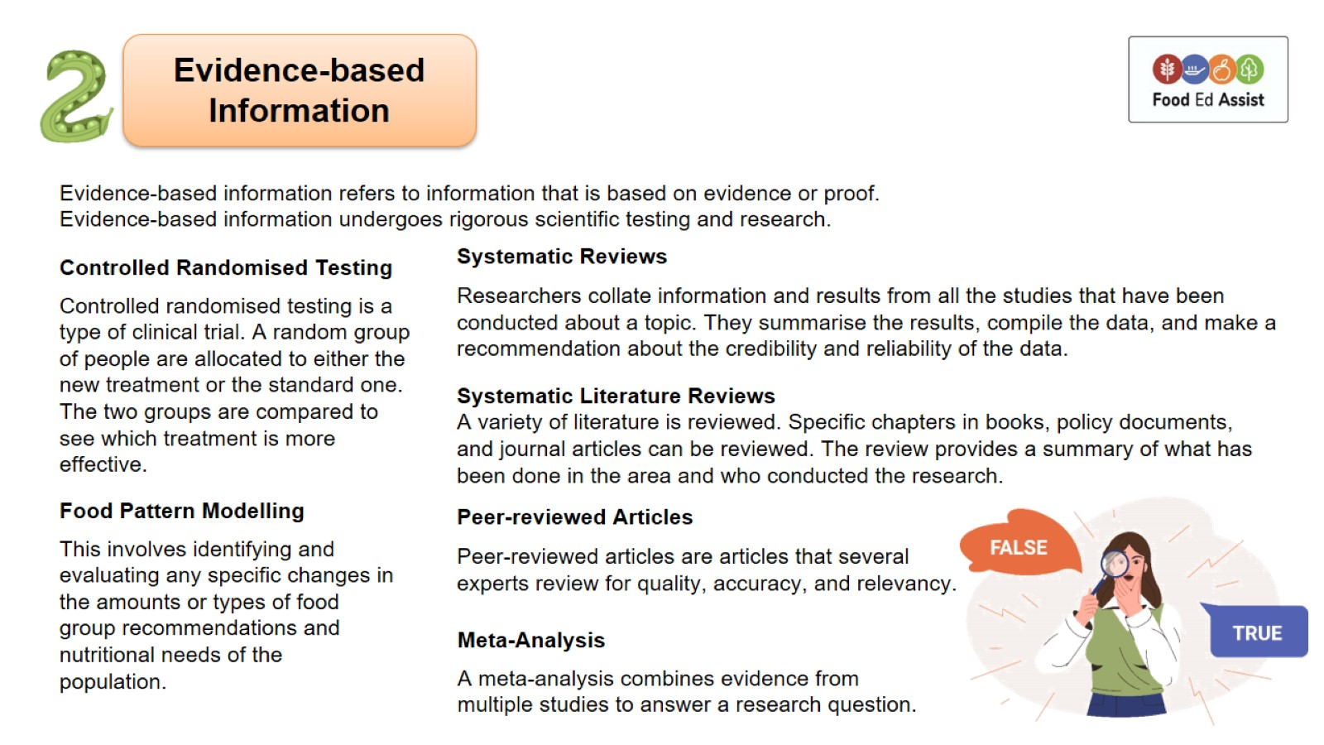

Slide 6
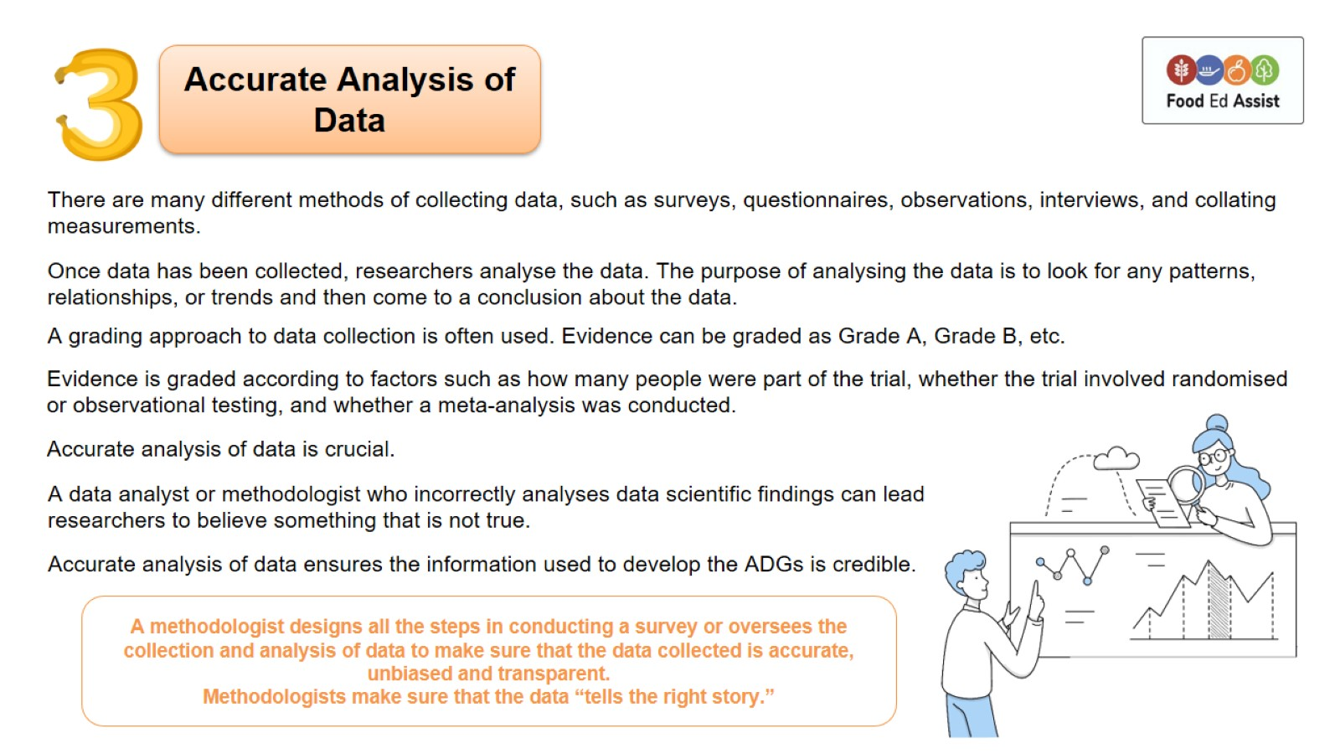

Slide 7
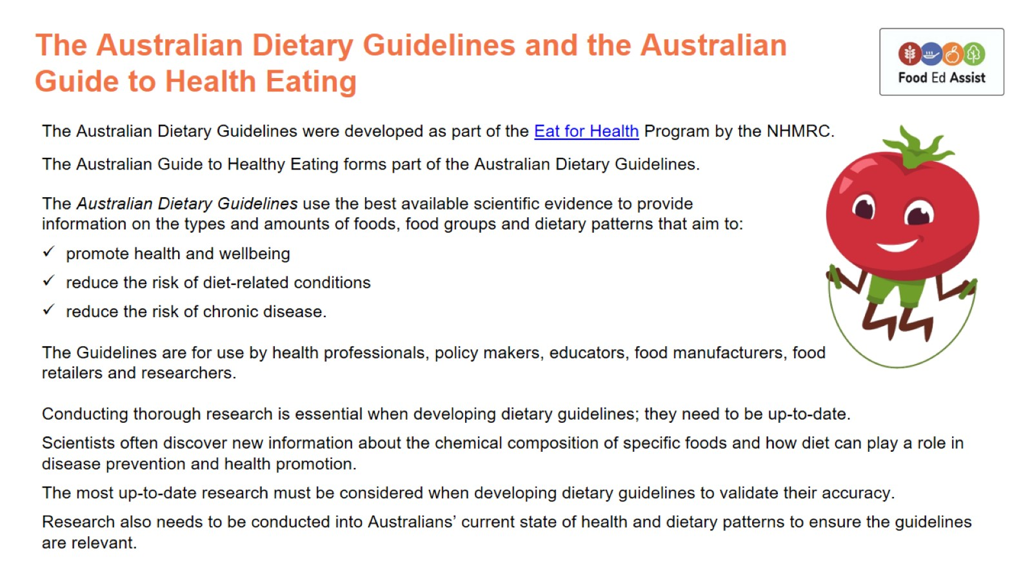
The Australian Dietary Guidelines and the Australian Guide to Health Eating

Slide 8
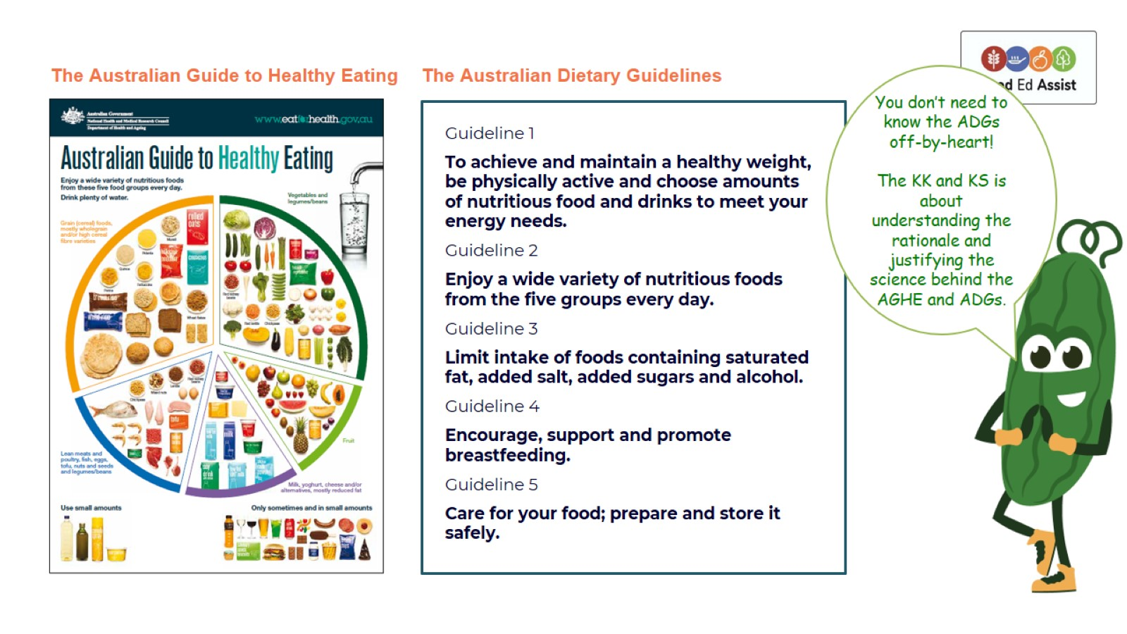

Slide 9
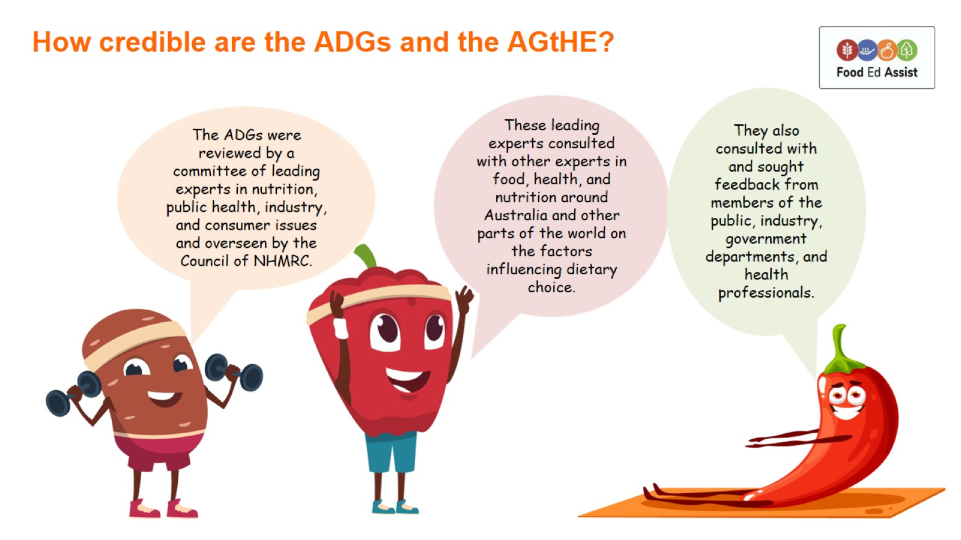
How credible are the ADGs and the AGtHE?

Slide 10
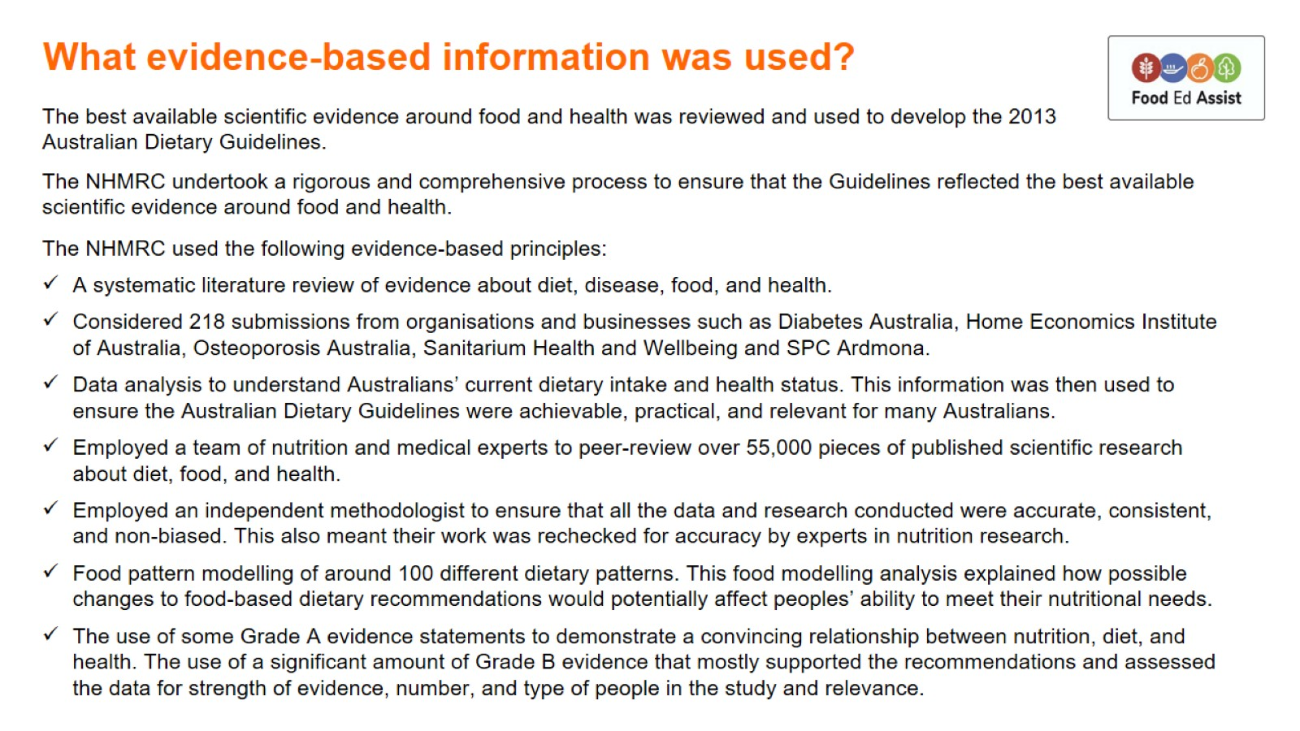
What evidence-based information was used?

Slide 11
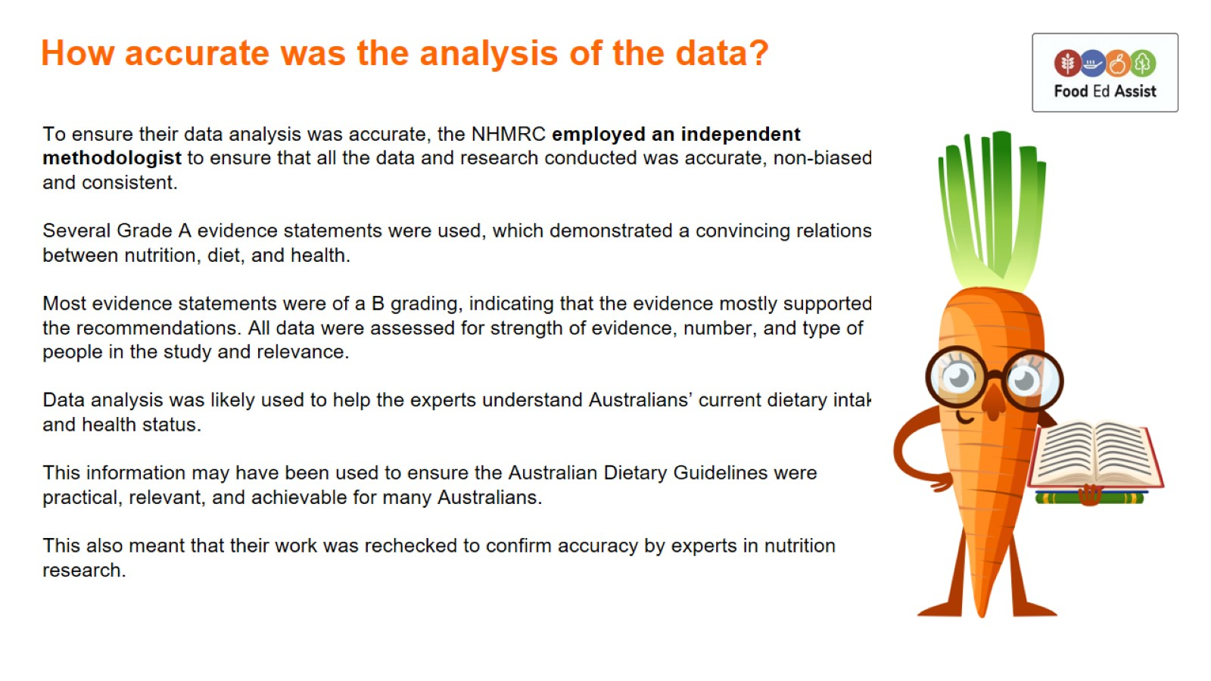
How accurate was the analysis of the data?

