Slide 1
Unit 3.1.5
The Australian Guide to Healthy Eating
Key Knowledge 3.1.5
The nutritional rationale of the Australian Guide to Healthy Eating, with particular focus on the ways in which food selection can assist in the prevention of obesity and related lifestyle diseases.
Key Skills 3.1.4
Discuss the nutritional rationale of the Australian Guide to Healthy Eating.
Key Skills 3.1.8
Apply the healthy eating recommendations of the Australian Dietary Guidelines and Australian Guide to Healthy Eating to the planning of daily food intake and, through practical activities, create nutritious meals to cater for a diverse range of needs.
VCE Food Studies Study Design p. 20 and 21, Extracts from the VCE Food Studies Study Design (2023-2027) reproduced by permission; © VCAA. VCE is a registered trademark of the VCAA. The VCAA does not endorse or make any warranties regarding this study resource. Current VCE Study Designs and related content can be accessed directly
at www.vcaa.vic.edu.au. Readers are also advised to check for updates and amendments to VCE Study Designs on the VCAA website and via the VCAA Bulletin and the VCAA Notices to Schools.

Slide 2

Key Terms and Definitions
Antioxidants are naturally occurring molecules that help to protect you from harmful free radicals that cause disease and illness.
Cancer is a term used for a group of diseases where someone's cells divide and grow uncontrollably and spread to other parts of the body.
Coronary Heart Disease is the term used to describe the process where plaque builds up around the artery walls in the heart. This results in the arteries, leading to the heart, becoming narrow and inhibiting oxygenated blood being delivered and flowing to the heart. It is a term used to describe a group of diseases, including stroke and heart attacks.
The term diet refers to a person’s eating patterns or the kinds of foods they regularly eat.
Free radicals are often dangerous molecules that can damage cells.
Insulin is a hormone released by the pancreas into the bloodstream to help glucose enter the body's cells and be used as an energy source.

Slide 3

Overweight or obesity is the term used to describe an individual who carries excess weight.
Phytochemicals are naturally occurring chemicals in plant foods such as fruits, vegetables, whole grains, beans, nuts and seeds. They act in a similar way as antioxidants by stopping free radicals causing damage in our bodies.
The word rationale is derived from the term 'reason.' The term rationale refers to the explanation that someone gives for something that happened or for something that exists.
Type 2 diabetes is a condition where the body cannot effectively produce and/ or use the insulin that the pancreas produces. People with this condition often have high glucose levels in the blood because the glucose cannot enter the cells effectively. This increases someone's risk of heart disease, stroke and problems with their eyes (cataracts, glaucoma and blindness) and nerve damage.
You will not need to define these terms for a Food Studies assessment; however, it is helpful to have some understanding of them in order to process the content in this area of study.

Slide 4
The Eat for Health Website
The Australian Government developed the Eat For Health website to help Australians understand the types of foods and lifestyle behaviours that contribute to their health and wellbeing.
The website uses two key tools to promote healthy eating,
the Australian Guide to Healthy Eating; and
the Australian Dietary Guidelines.
The Australian Guide to Healthy Eating and the Australian Dietary Guidelines aim to help Australians:
select food that prevents obesity and other related lifestyle diseases;
determine their daily energy and nutritional needs;
calculate the number of serves from the five food groups that they require each day;
have the necessary knowledge to plan nutritious meals; and
develop healthy eating patterns.
Click here to go to the:
Eat for Health website

Slide 5
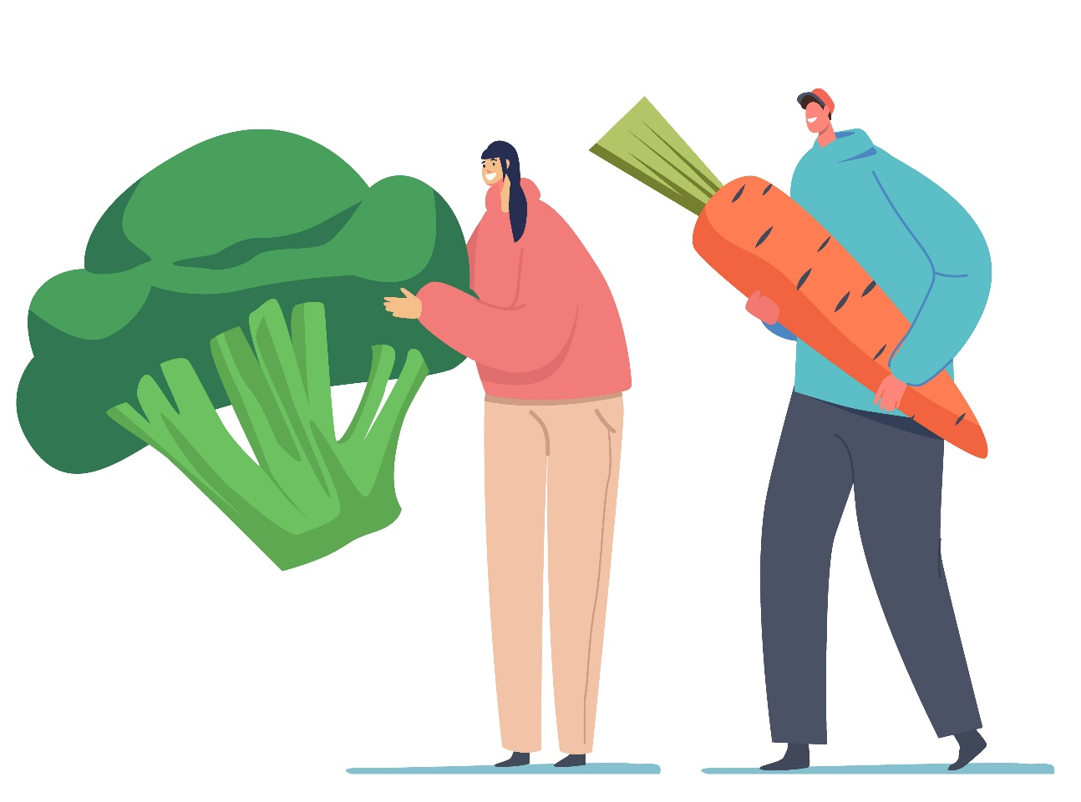
What are the Australian Dietary Guidelines?
The Australian Dietary Guidelines provide up-to-date advice about the amount and kinds of foods we need to eat for health and wellbeing.
The recommendations are based on scientific evidence that are developed after the consideration and analysis of quality research.
The current Australian Dietary Guidelines were developed by NHMRC, other leading nutrition experts and the Australian Government.
They were released in 2013.
In 2020, the NHMRC announced the review of the Guidelines.
Click here to access a poster of the Australian Dietary Guidelines. Click here to access the Healthy Eating for Adults brochure. Click here to access the Healthy Eating for Children brochure. Click here to access the Healthy Eating during Pregnancy brochure.

Slide 6





The Australian Dietary Guidelines
To achieve and maintain a healthy weight, be physically active and choose amounts of nutritious food and drinks to meet your energy needs.
Encourage, support and promote breastfeeding.
Enjoy a wide variety of nutritious foods from the five groups every day.
Care for your food; prepare and store it safely.
You do not need to memorise the Australian Dietary Guidelines!
You need to know how to apply them to planning and cooking nutritious meals.
You need to understand that they are evidence-based.
Limit intake of foods containing saturated fat, added salt, added sugars and alcohol.

Slide 7
What is the Australian Guide to Healthy Eating?
The Australian Guide to Healthy Eating has several components, including:
a visual guide of how much of the five food groups people should eat each day;
a table that recommends how much of each food group adolescents, adults, and children should eat every day; and
a guide that explains what a serving size equals.
The Australian Guide to Healthy Eating has a circle divided into five separate sections representing each of the five food groups.
The area of each section indicates the proportion of food from each food group that should be eaten every day.
Click here to access a diagram of the Australian Guide to Healthy Eating.
Click here to access the Recommended Serving Sizes.
Having a rough idea of a serving size is recommended. However, you will not be required to memorise this information!

Slide 8
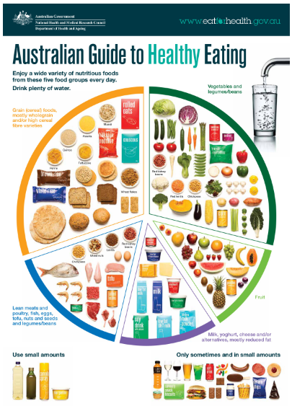

Slide 9
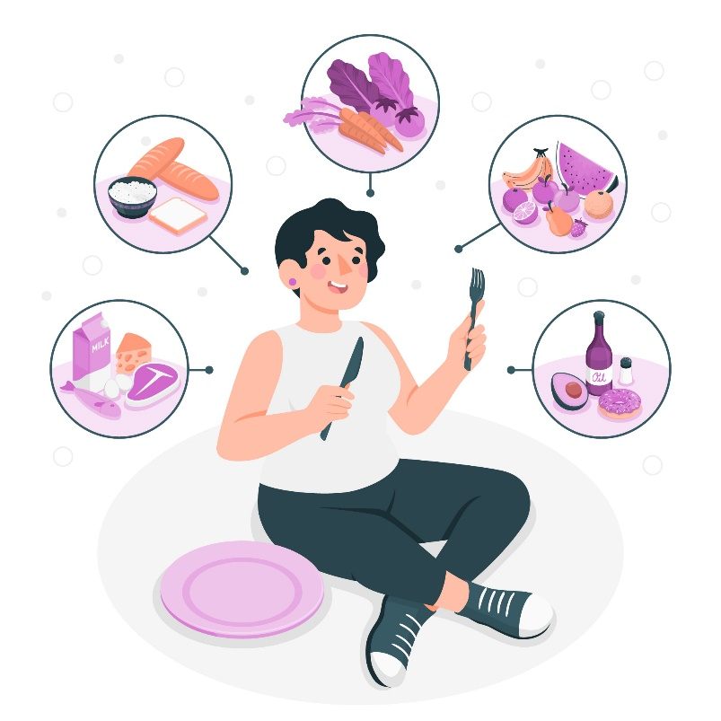
The Rationale of the Australian Guide to Healthy Eating
The rationale (reasons) for the development of the Australian Guide to Healthy Eating and the Australian Dietary Guidelines include:
the provision of resources to support educators, food manufacturers, food retailers, health professionals, policy-makers, and the general public about nutrition and wellbeing;
the provision of reliable and trustworthy dietary information.
These resources aim to:
reduce the incidence of type 2 diabetes, cardiovascular disease, and some cancers; and
encourage and inform Australians about how to make healthy food choices.
It is important to note that the Australian Dietary Guidelines apply to all healthy Australians as well as those with health conditions such as being overweight.
However, they do not apply to people who need special dietary advice for a specific medical condition and the frail elderly.

Slide 10
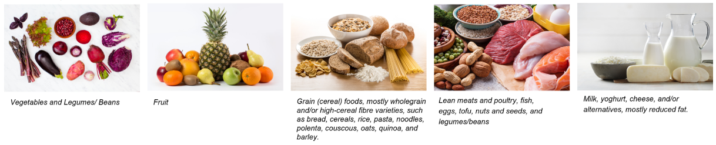
Rationale of The Australian Guide to Healthy Eating
‘Enjoy a Wide Variety of Nutritious Foods from the Five Food Groups’
When people eat a variety of foods, they are more likely to absorb a range of nutrients and other food components, such as antioxidants and phytochemicals.
The Five Food Groups
It’s unlikely that you will be required to discuss antioxidants and phytochemicals. However, it is helpful to know that nutrients are not the only chemicals in food that contribute to our health.
A range of food will provide a range of nutrients, antioxidants, phytochemicals, prebiotics and probiotics.

Slide 11
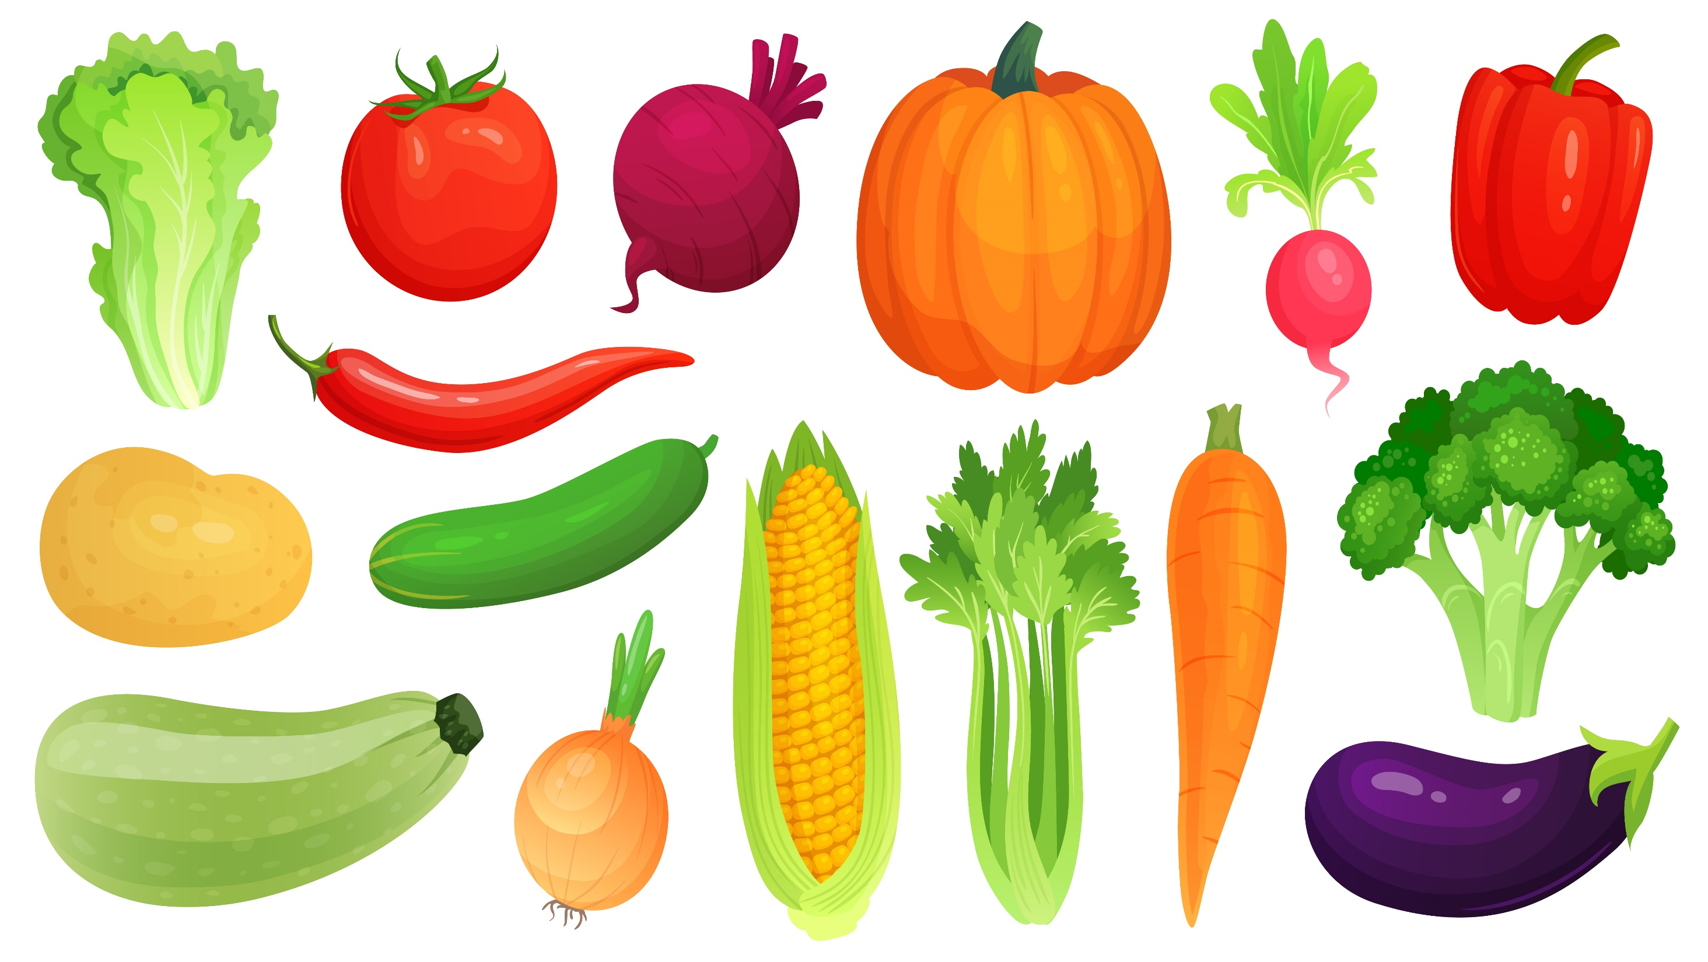
Vegetables and Legumes/ Beans
In 2017–2018, less than 1 in 10 adults met the recommendations for daily vegetable consumption.
The rationale for recommending a variety of coloured and types of vegetables and legumes is because different vegetables contain different antioxidants, nutrients, and phytochemicals which protect people from diseases and illness such as heart disease, type 2 diabetes, obesity, and some cancers.
The rationale for the serving sizes of vegetables are higher than for fruit is because vegetables are lower in kilojoules than fruit. High consumption of vegetables helps people control or lose weight because they are low in kilojoules and nutrient-dense.
Different coloured and types of vegetables
Dark green or cruciferous/brassica Broccoli, brussels sprouts, bok choy, cabbages, cauliflower, kale, lettuce, silverbeet, spinach, snow peas | Root/tubular/bulb vegetables Bamboo shoots, turnip, carrots, cassava, garlic, potato, taro, turnip, shallots, sweet potato, swede, taro and turnip. | Legumes/beans Cannellini beans, chickpeas, lentils, lima beans, red kidney beans, soybeans, split peas, and tofu. | Other Vegetables Avocado, capsicum, celery, cucumber, green beans, eggplant, mushrooms, okra, pumpkin, sprouts, squash, tomato, zucchini.

Slide 12

Fruit
In 2017–2018, only 51.3% of Australian adults ate the required two serves of fruit per day.
The rationale for eating a wide variety of fruit is because:
Fruit provides a range of essential nutrients, including vitamin C, folate, potassium, fibre, and carbohydrates.
Fruit contains antioxidants, fibre, and phytochemicals found in fruit help prevent some cancers.
Fruit contains fibre which can help to fill us up and prevent weight gain.
The rationale for fruit juice in the discretionary section of the Australian Guide to Healthy Eating because:
around 3–4 pieces of fruit are needed to make one glass of fruit juice, making this drink high in sugar and lacking in fibre; and
eating fruit takes longer to consume than drinking juice. This allows the stomach more time to signal to the brain that hunger has been satisfied.
Note: Eating dried fruit regularly, is not recommended as it is high in kilojoules. For example, one sultana contains the same kilojoules as one grape. However, the sultana is less filling that the grape.

Slide 13
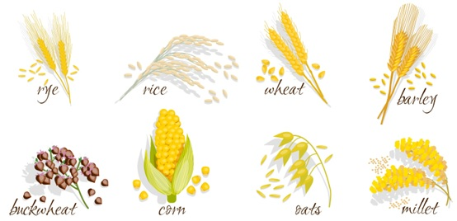
Grain (cereal) foods, mostly wholegrain and/or high-cereal fibre varieties, such as bread, cereals, rice, pasta, noodles, polenta, couscous, oats, quinoa, and barley
The rationale for promoting wholegrain or high-fibre grain is that the:
contain a range of nutrients, including carbohydrates (starch), fibre, B group vitamins, vitamin E, iron, zinc, magnesium, and phosphorous;
prevent constipation and therefore help reduce the incidence of colon (bowel) cancer;
help lower cholesterol levels in the blood and therefore reduce the risk of heart disease;
manage type 2 diabetes because they do not break down as rapidly as refined grains in the digestive tract, and so they do not raise the blood sugar as dramatically; and
assist with weight management by contributing to satiety.

Slide 14

Lean meats and poultry, fish, eggs, tofu, nuts and seeds, and legumes/beans
The rationale for including this food group is that:
The food in this food group are great sources of protein which is needed for growth, repair and maintenance of body cells.
This group also provides nutrients like iodine, iron, zinc, vitamins (especially B12) and essential fatty acids.
The rationale for removing the skin on chicken and trimming the fat from meat is to reduce the amount of saturated fat. This prevents the build up of cholesterol in the arteries, decreasing the risk of heart disease and stroke.
The rationale for including fish, nuts, and seeds contain essential Omega-3 fatty acids (polyunsaturated fats) is because they are good for brain development and to reduce cholesterol levels in the blood.
The rationale for including processed and cured meats like bacon, ham, sausages, and salami in the discretionary section is because they are high in saturated fat and salt.

Slide 15

Milk, yoghurt, cheese, and/or alternatives, mostly reduced fat
The rationale for including this food group is that:
dairy foods in this group are excellent sources of calcium, protein, and vitamins, including vitamin B12.
The rationale for recommending low-fat dairy foods is that full-fat varieties increase the risk of heart disease.
The rationale for including dairy alternatives in this section is to allow people with allergies, intolerances and ethical choices to have access to foods that contain similar nutrients and sensory properties as dairy food.
Water
The rationale for including water as part of the guide is because assist with digestion, absorption of nutrients, and getting rid of waste products.
It helps regulate our body temperature and prevents dehydration.
The guide encourages people to drink water instead of drinks like cordials, juices, and soft drinks because these drinks are usually high in sugar and could easily contribute to weight gain

Slide 16
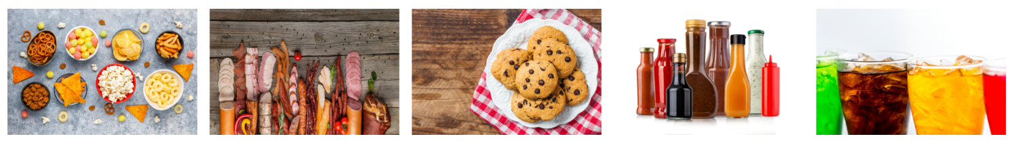
Use Small Amounts
The rationale for recommending the use of unsaturated fats in small amounts is that even though they reduce the risk of heart disease and lower assist in lowering cholesterol levels; they still have the same kilojoule value as saturated fats and therefore must only be used in small amounts otherwise they will contribute to weight gain.
Only Sometimes and in Small Amounts (Discretionary Foods)
The rationale for recommending these foods in the discretionary section is that they are high in fat, salt, and/or sugar, and are mostly energy-dense and contain little, if any, nutritional value.
Eating high amounts of these foods can make someone overweight or obese. It is also linked to heart disease, type 2 diabetes, and some forms of cancer.

Slide 17
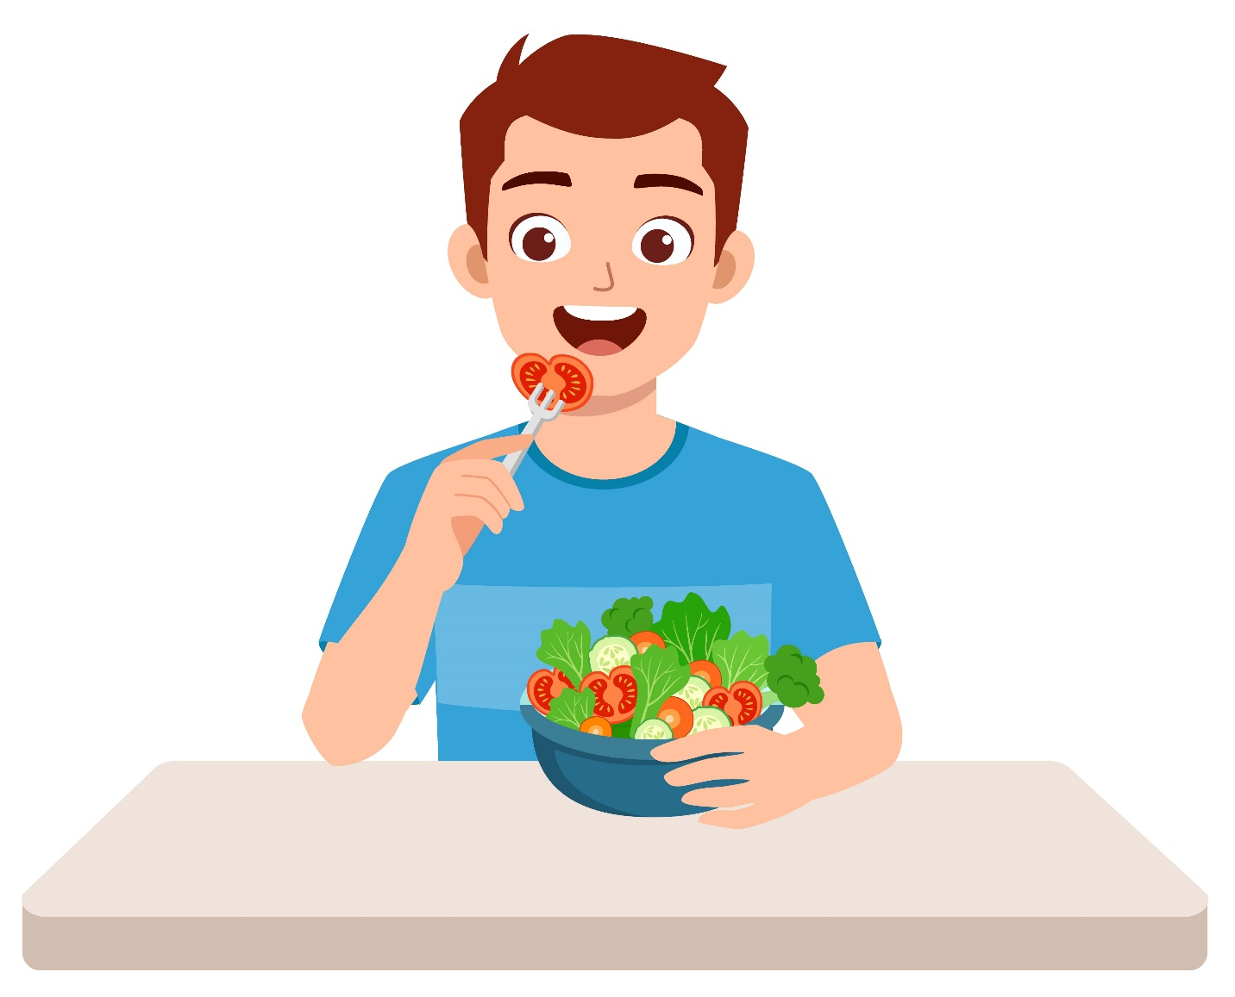
Food Selection and the Prevention of Obesity and Related Lifestyle Diseases
Food Selection and the Prevention of Obesity
The following measures can be taken to prevent obesity:
Eat less processed and sugary foods - they can contain high amounts of hidden fat, salt, and sugar.
Eat more servings of vegetables and fruit – they keep you feeling full for longer, help regulate your blood sugar levels and are low in kilojoules.
Eat more fibre – they contribute to satiety, which is a feeling of fullness reducing the likelihood of people eating high-energy-dense foods.
Eat low-glycaemic index (GI) foods – if low in kilojoules, low GI foods may help people lose weight.

Slide 18

Food Selection and the Prevention of Type Two Diabetes
The following measures can be taken to prevent type two diabetes:
Eat a diet low in fat, particularly saturated fats
Eat a diet low in sugar
Eat low-GI foods
Eat regular meals and eat carbohydrate foods throughout the day.

Slide 19

Food Selection and the Prevention of Cardiovascular Disease
The following measures can be taken to prevent cardiovascular disease:
Decrease the consumption of LDL cholesterol and increase the consumption high-density lipoprotein (HDL) cholesterol.
Replace saturated and trans fats with unsaturated fats
Eat foods that contain more fibre, particularly soluble fibre
Reduce your salt intake

Slide 20
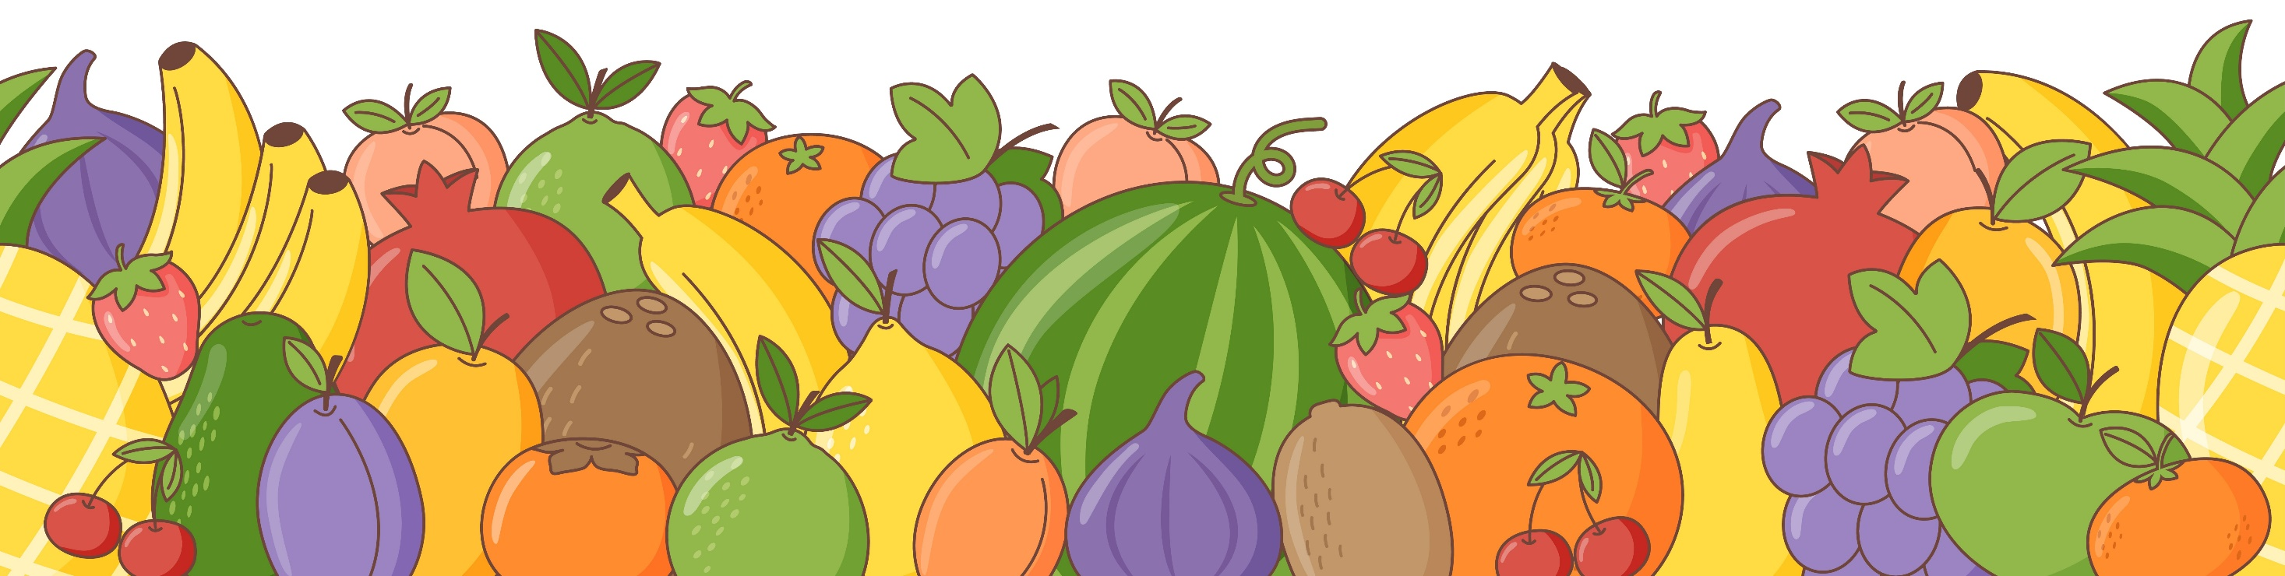
Food Selection and the Prevention of Some Types of Cancers
The following measures can be taken to prevent diet-related cancers:
Eat more wholegrains
Eat less processed and red meat
Eat a variety of different types and coloured fruits and vegetables
Consuming a high-fibre diet

Slide 21
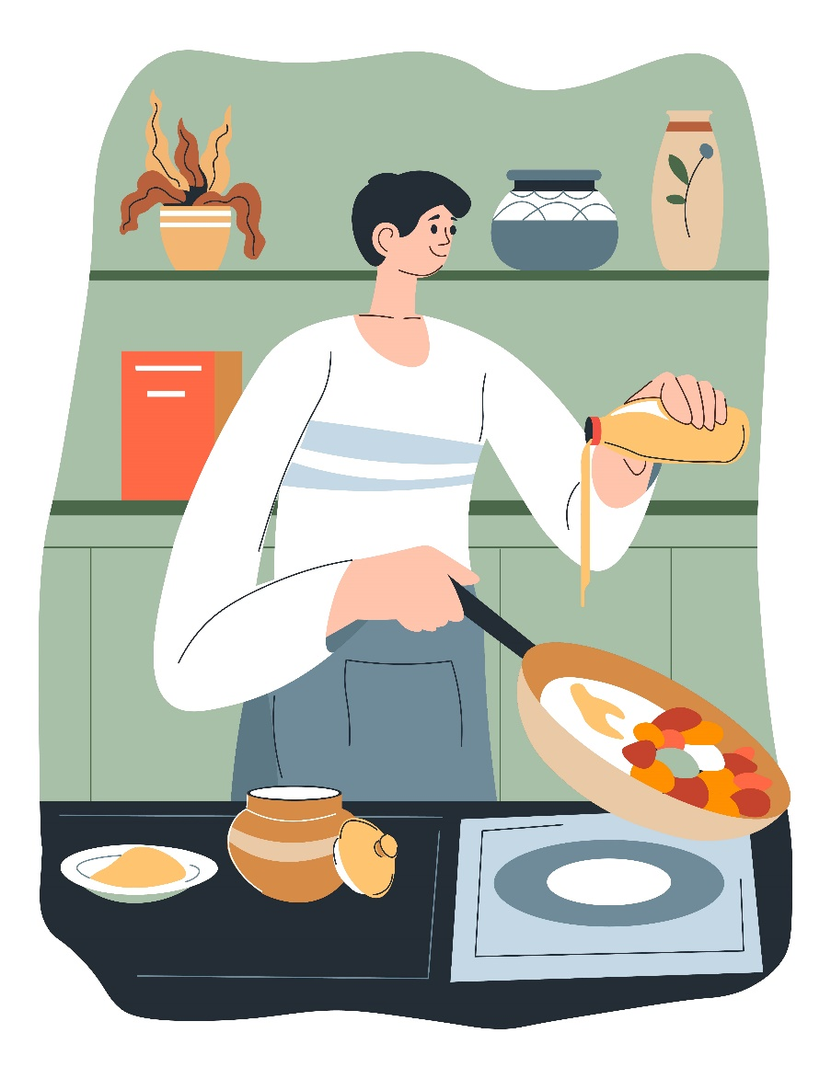
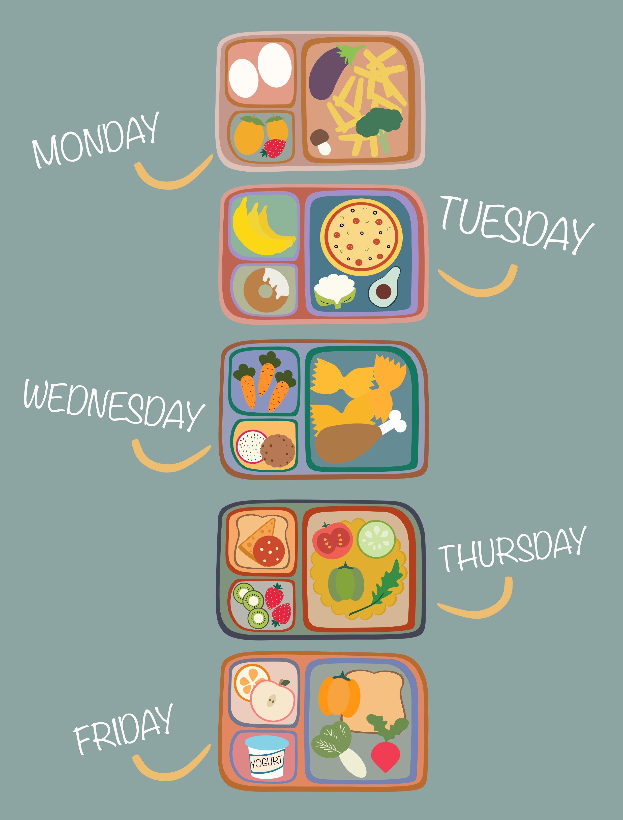
Applying the Recommendations to plan daily intake and create healthy meals
Click here to find out about low-fat cooking techniques
Click here to find out about adding a variety of fruits and vegetables to meals.
Click here to find out how to plan nutritious meals.
Click here to find out how to make healthy meals and snacks.

