Slide 1
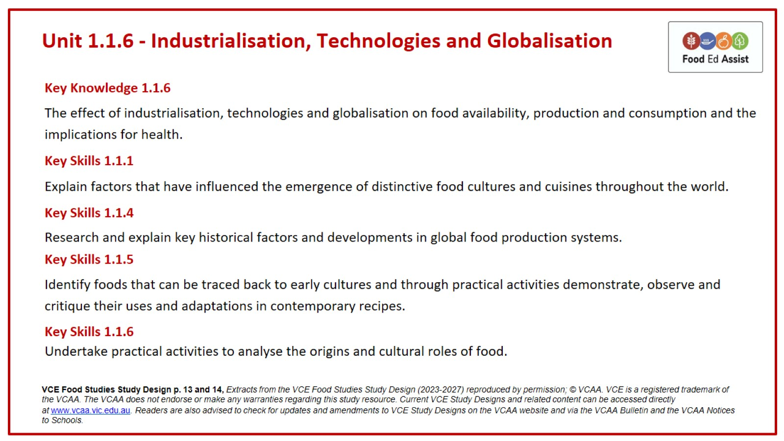
Unit 1.1.6 - Industrialisation, Technologies and Globalisation

Slide 2
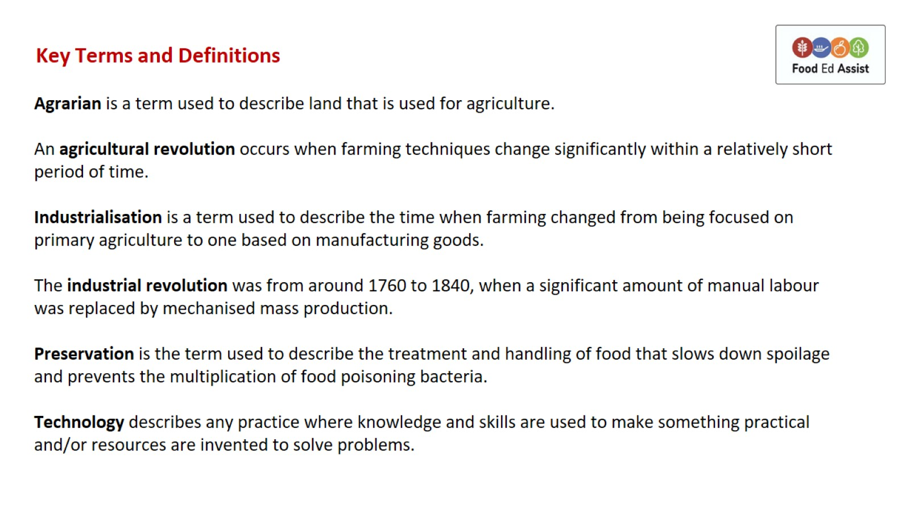
Key Terms and Definitions

Slide 3
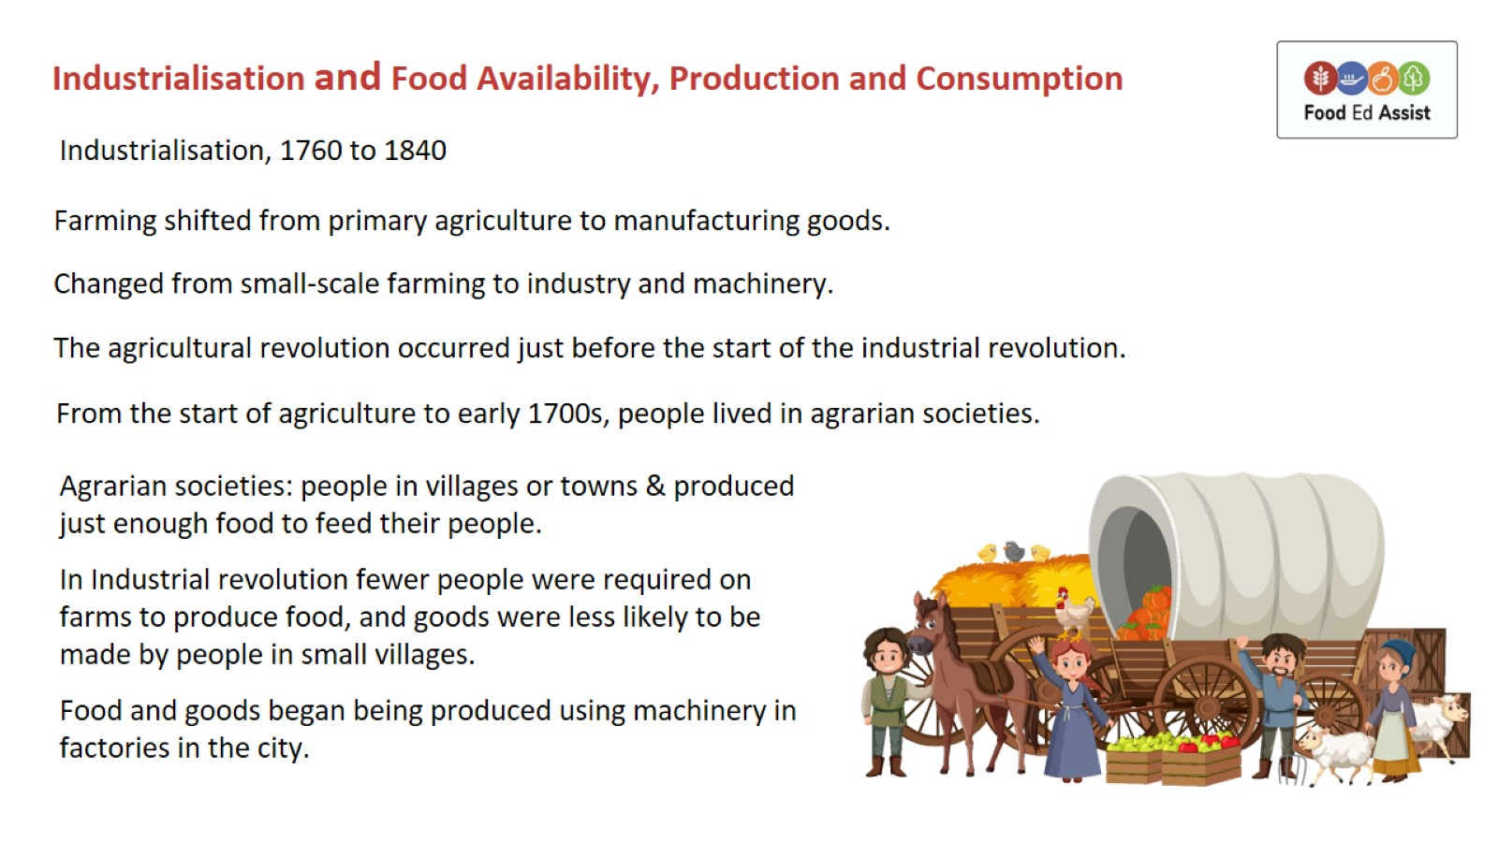
Industrialisation and Food Availability, Production and Consumption

Slide 4
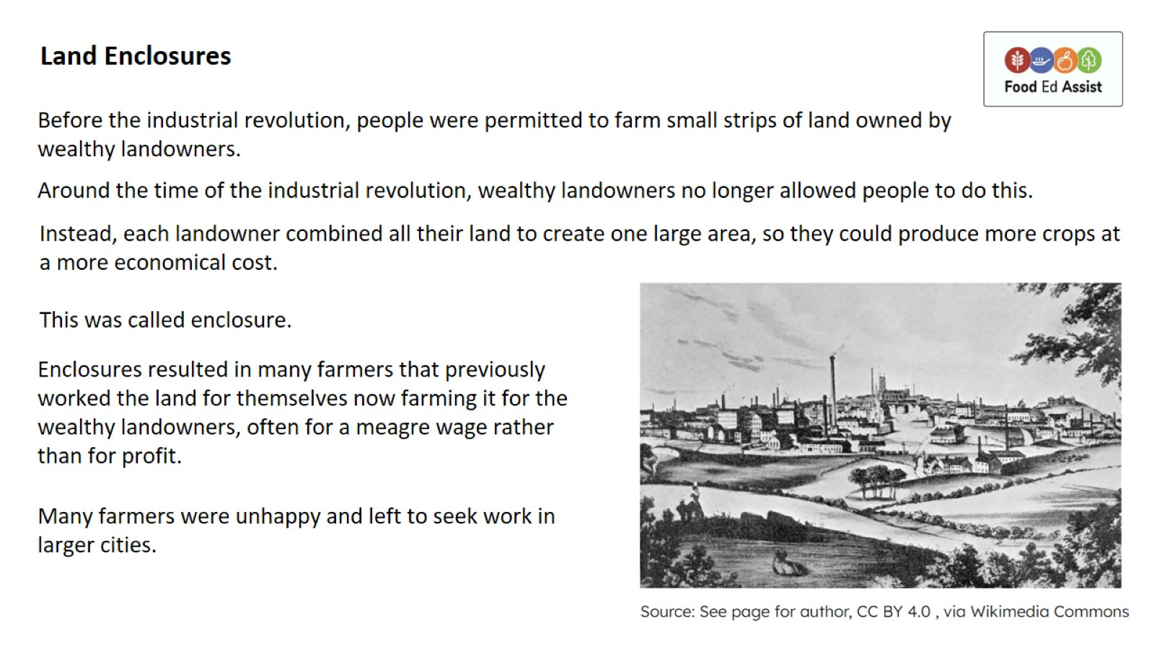
Land Enclosures

Slide 5
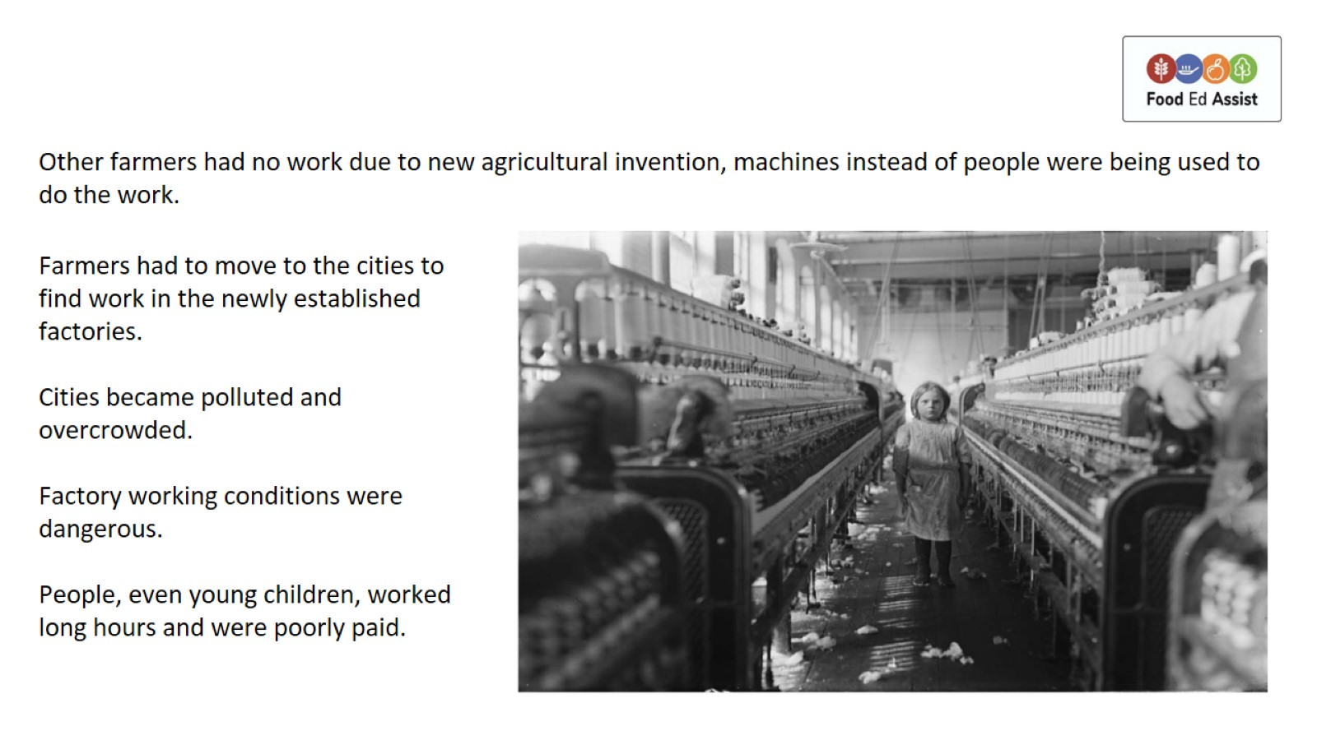

Slide 6
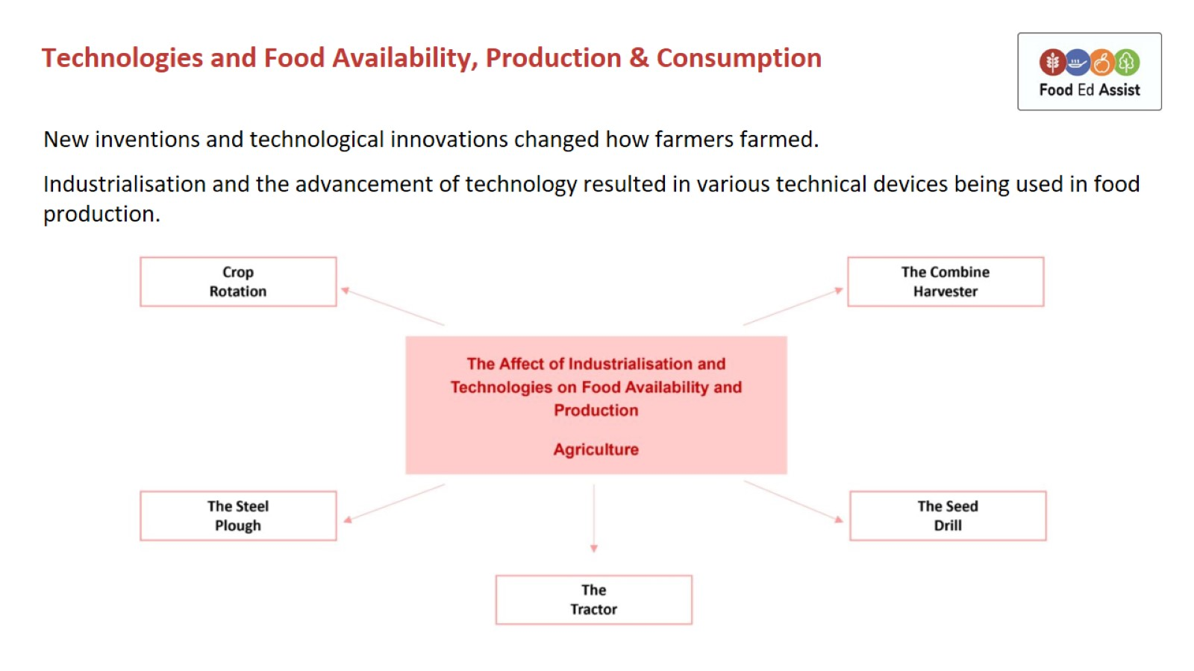
Technologies and Food Availability, Production & Consumption

Slide 7
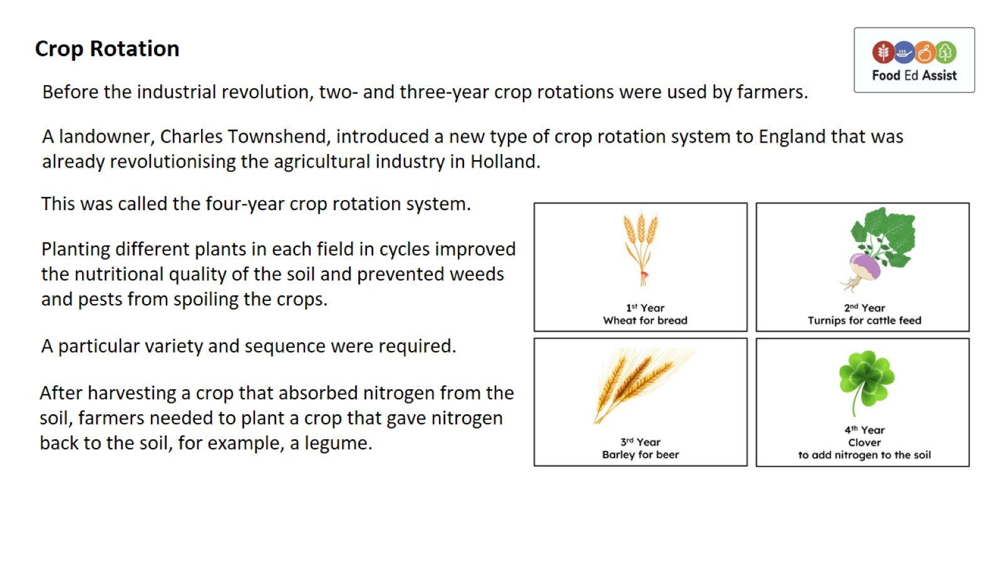
Crop Rotation

Slide 8
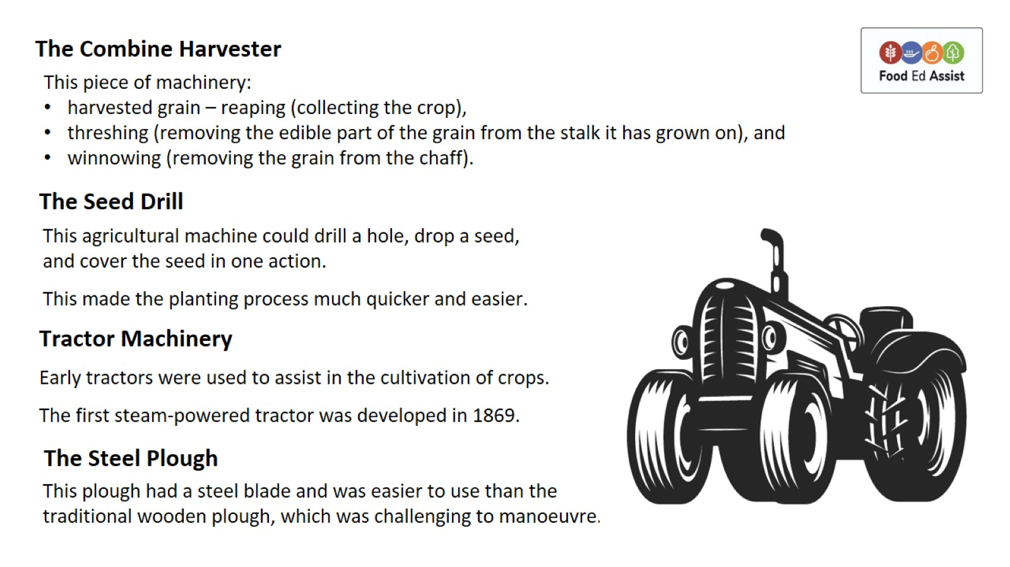
The Combine Harvester

Slide 9
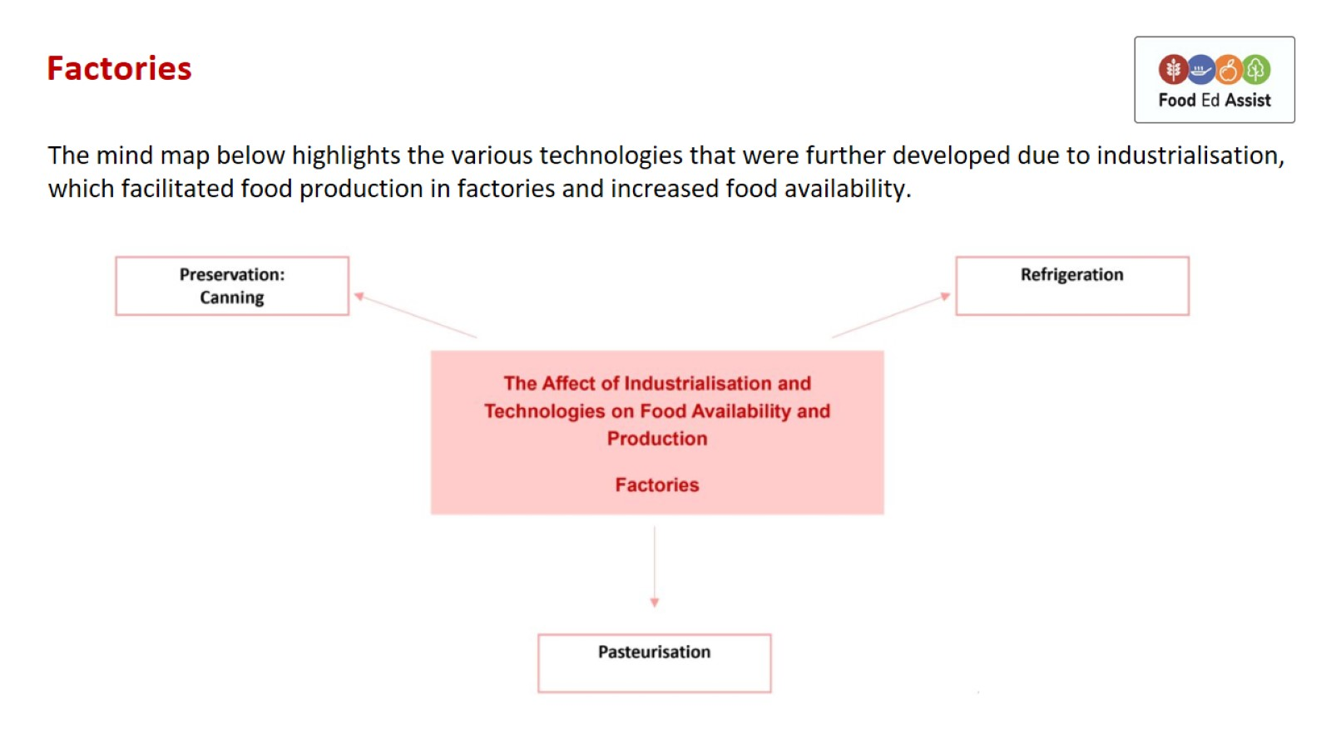
Factories

Slide 10
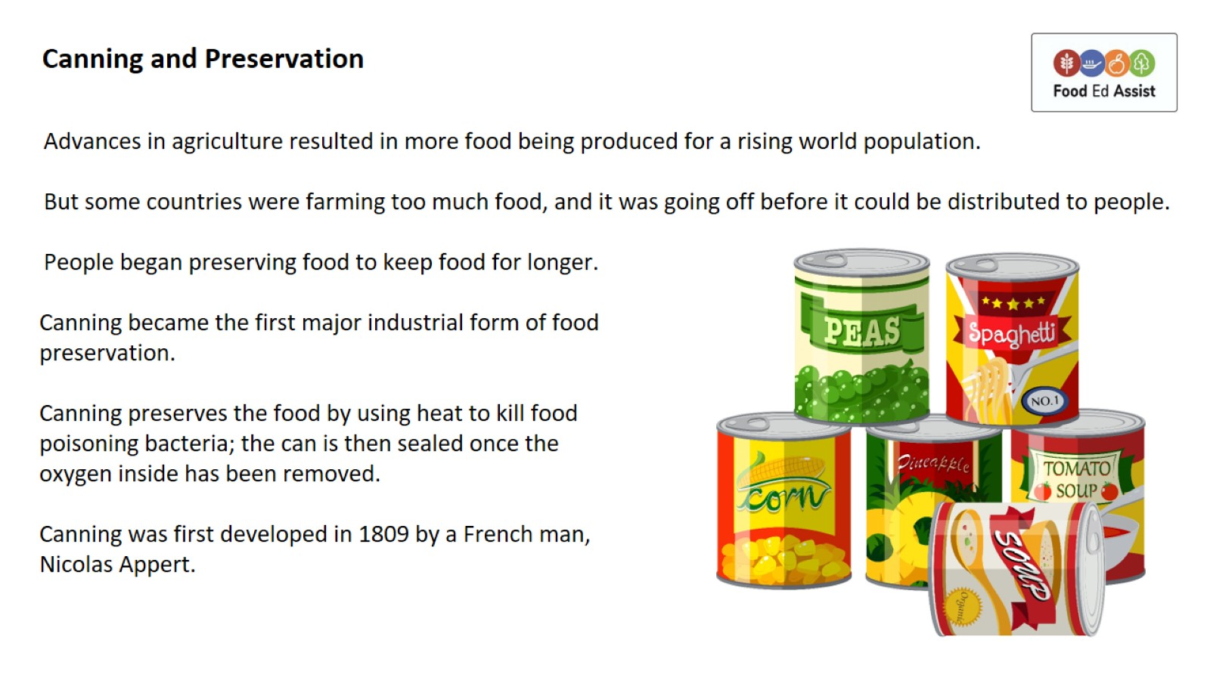
Canning and Preservation

Slide 11
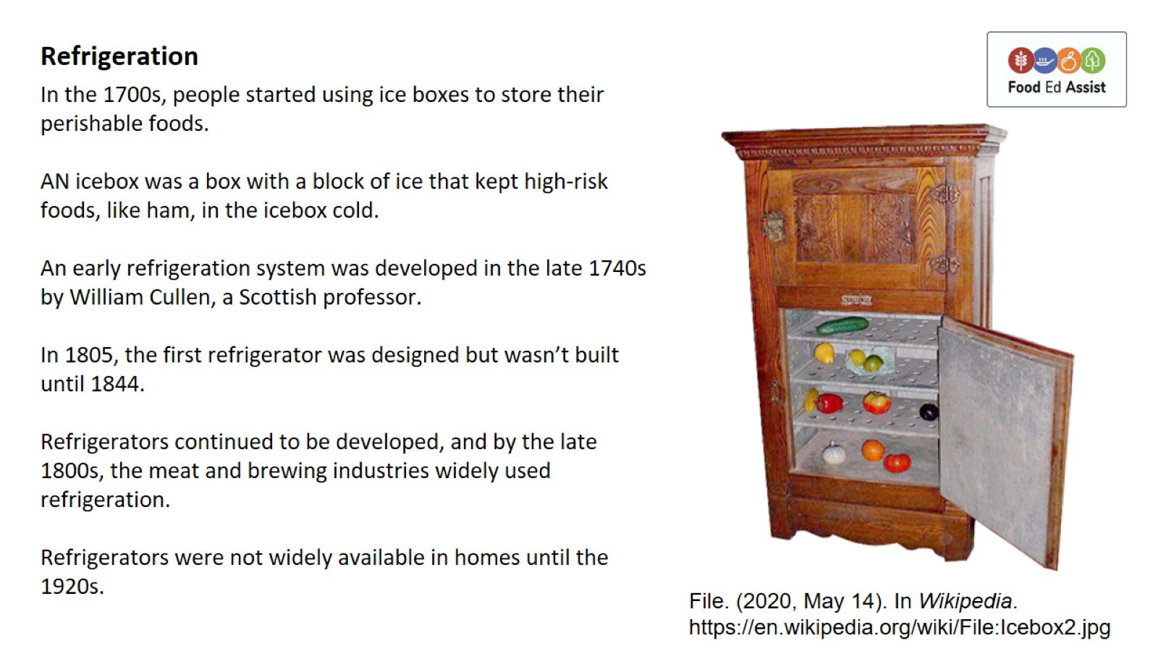
Refrigeration

Slide 12
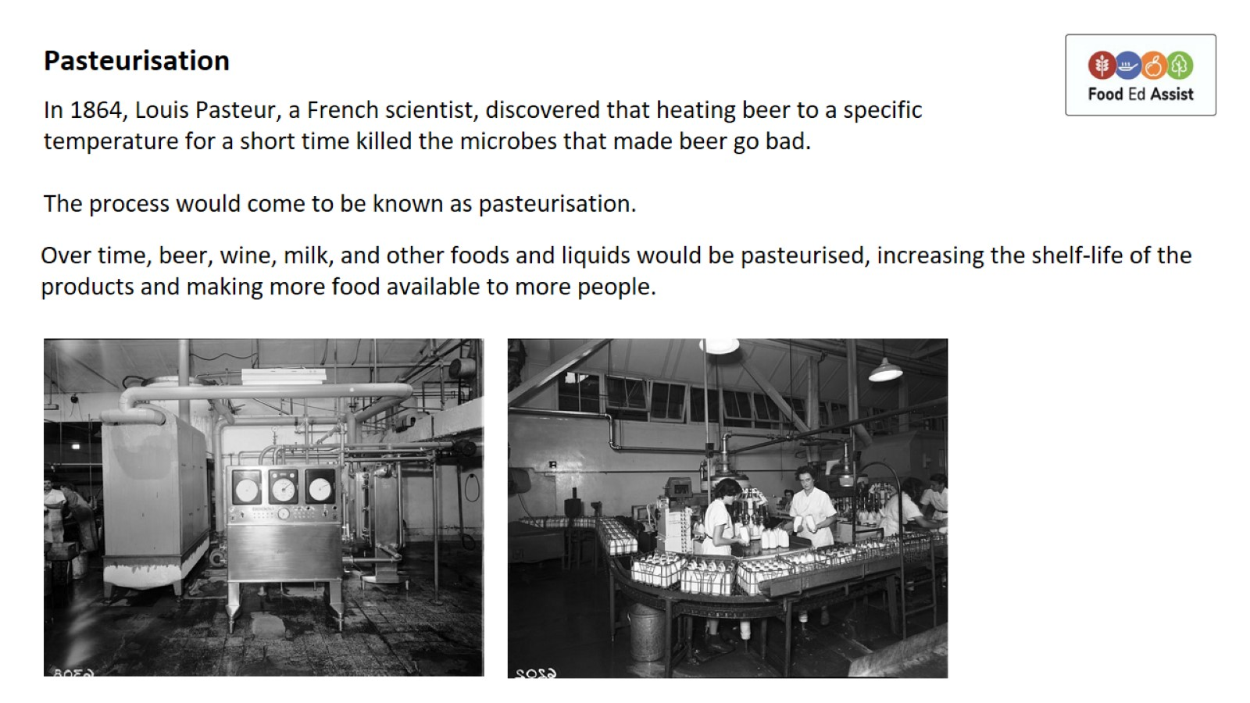
Pasteurisation

Slide 13
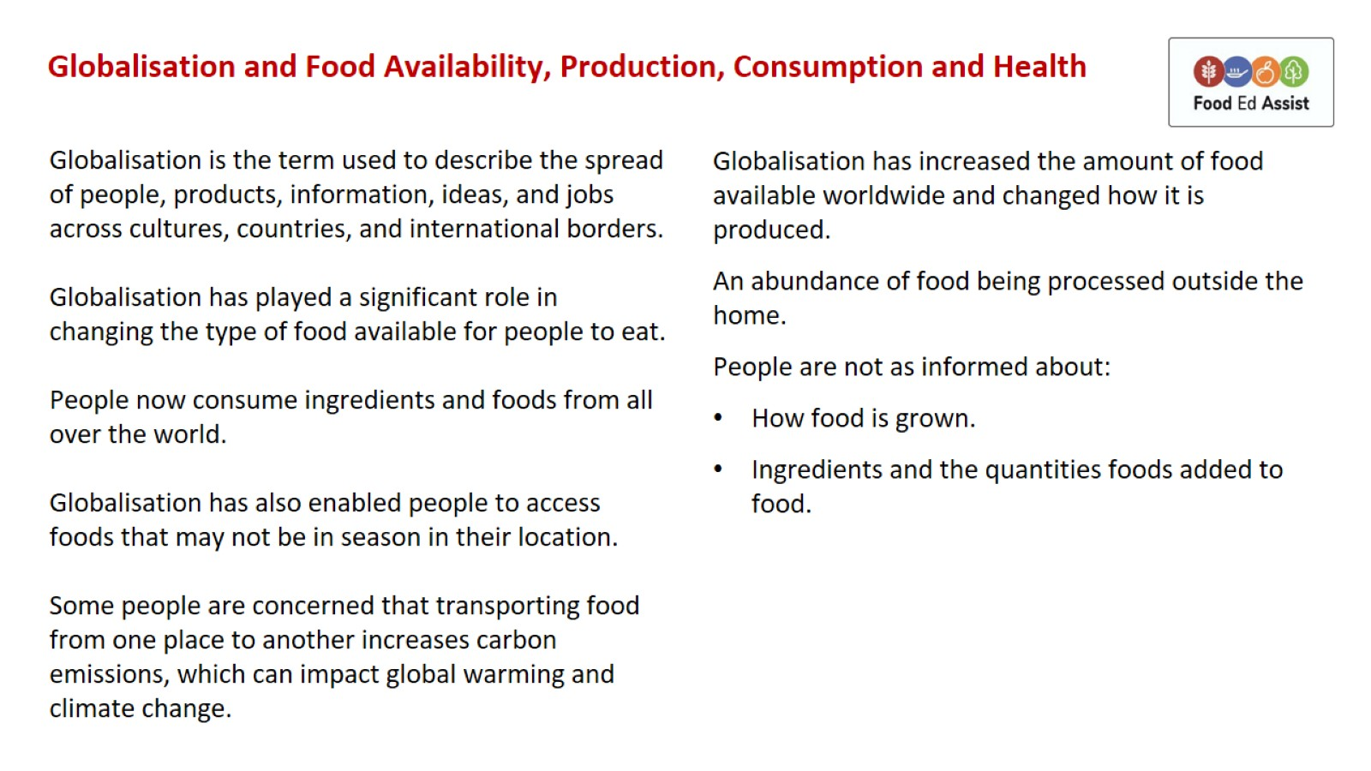
Globalisation and Food Availability, Production, Consumption and Health

Slide 14
