Slide 1
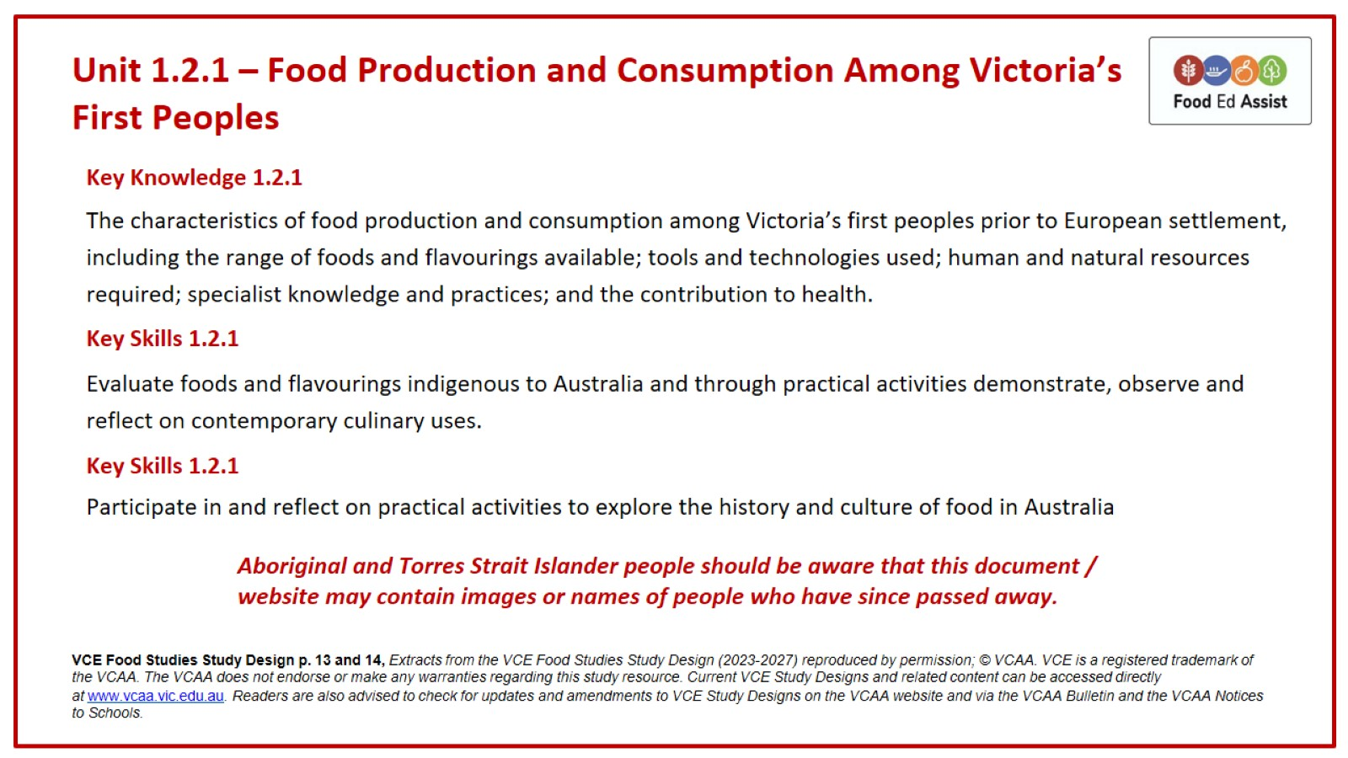
Unit 1.2.1 – Food Production and Consumption Among Victoria’s First Peoples

Slide 2
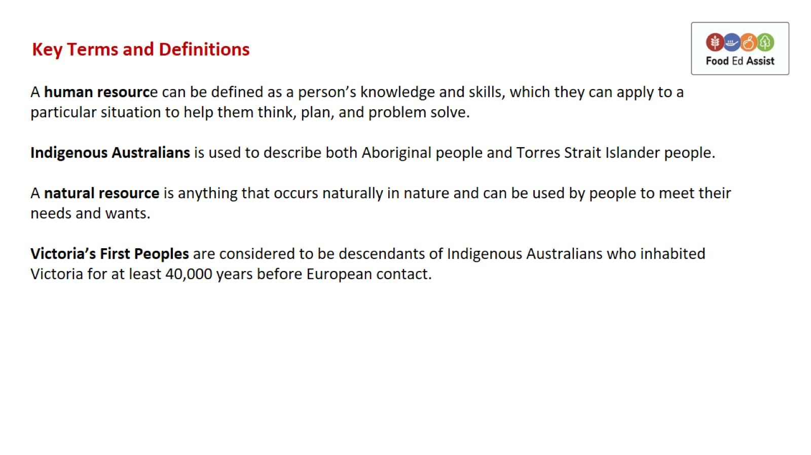
Key Terms and Definitions

Slide 3
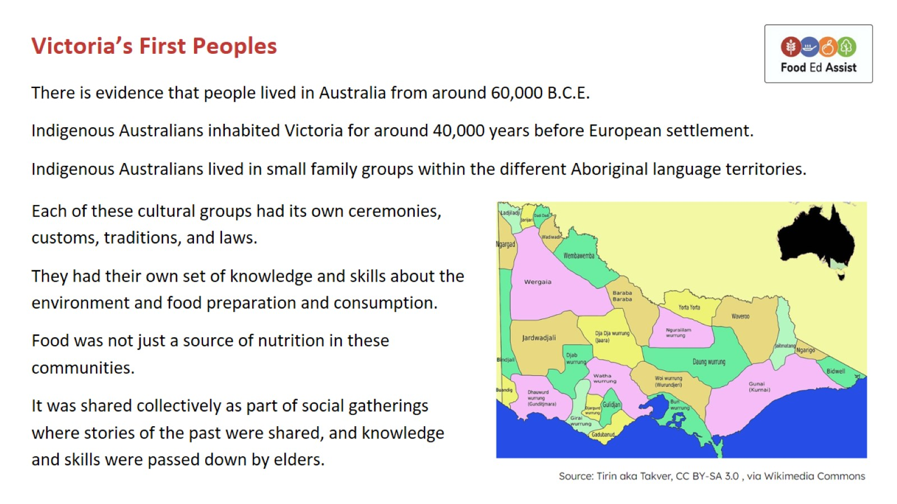
Victoria’s First Peoples

Slide 4
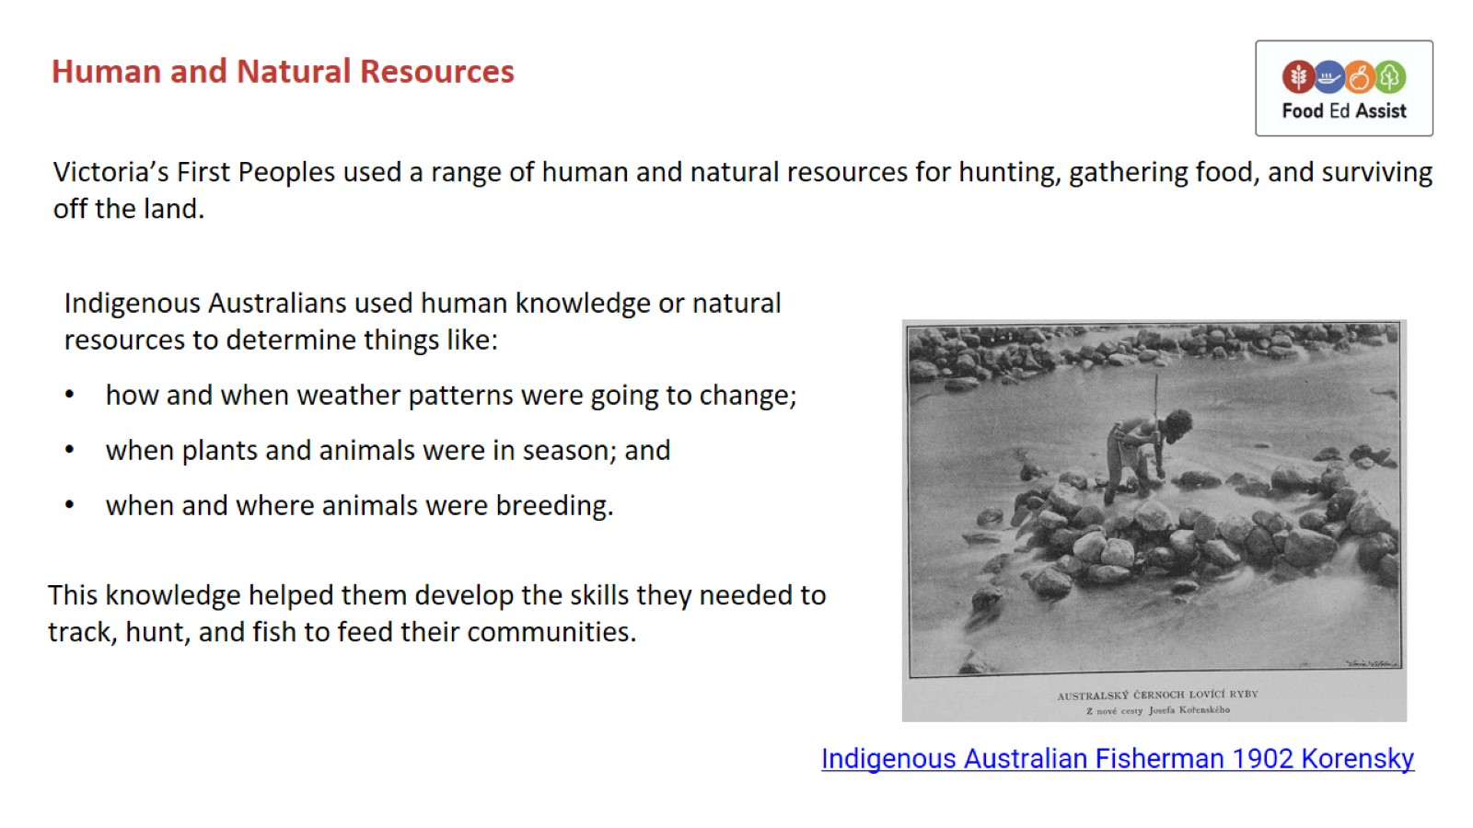
Human and Natural Resources

Slide 5
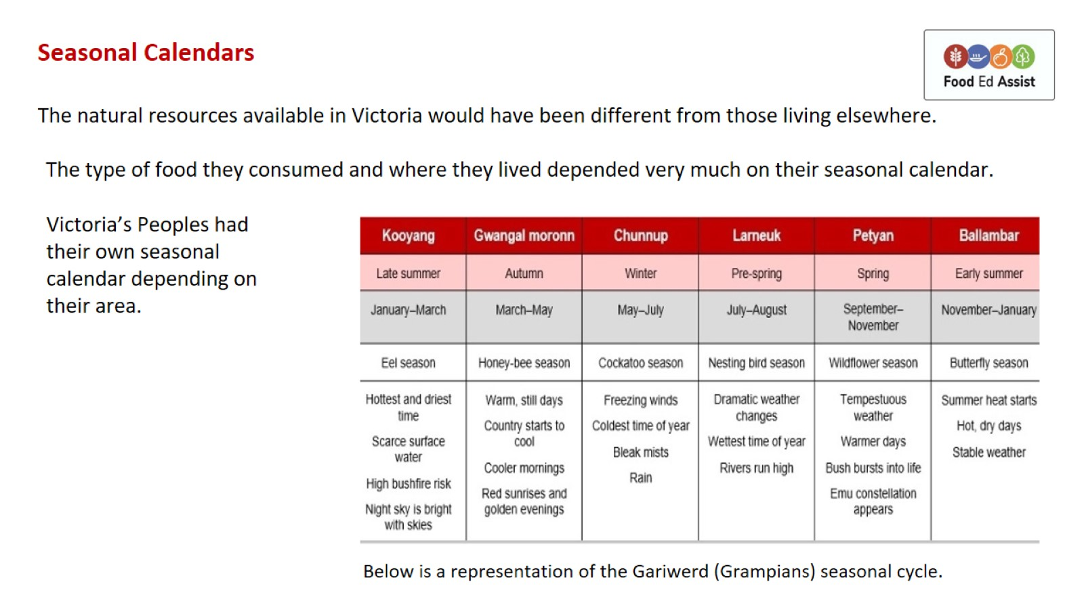
Seasonal Calendars

Slide 6
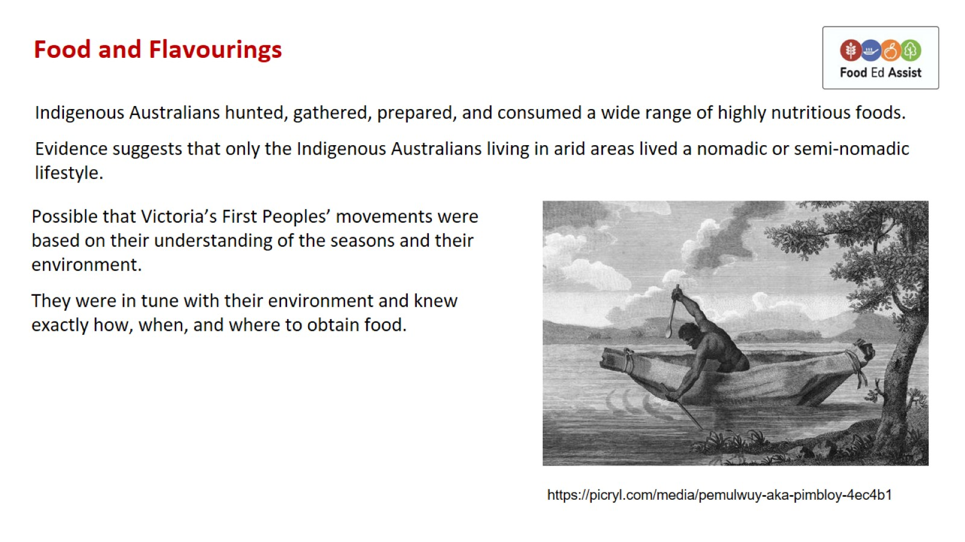
Food and Flavourings

Slide 7
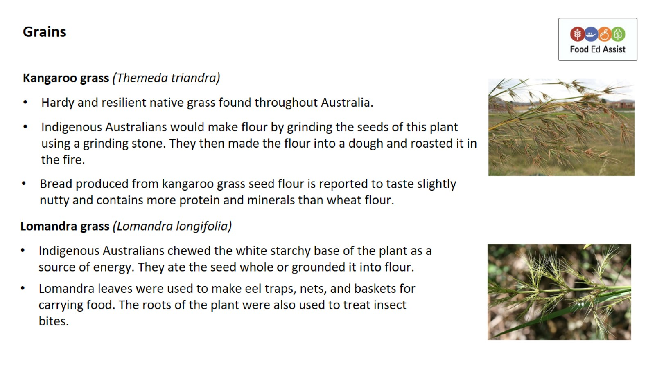
Grains

Slide 8
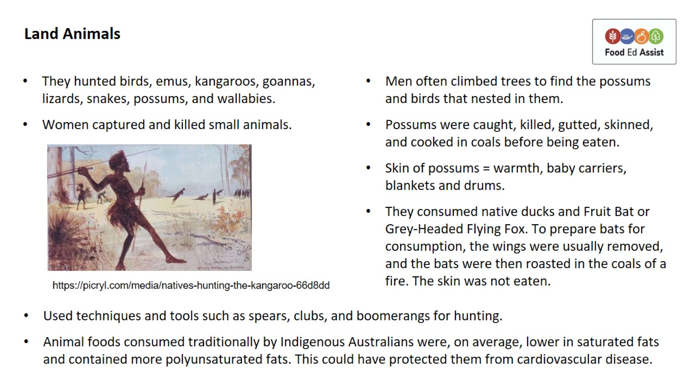
Land Animals

Slide 9
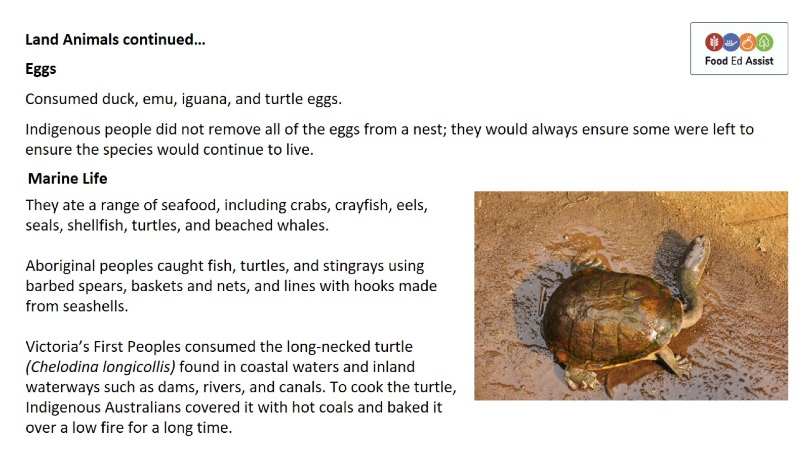
Land Animals continued…

Slide 10
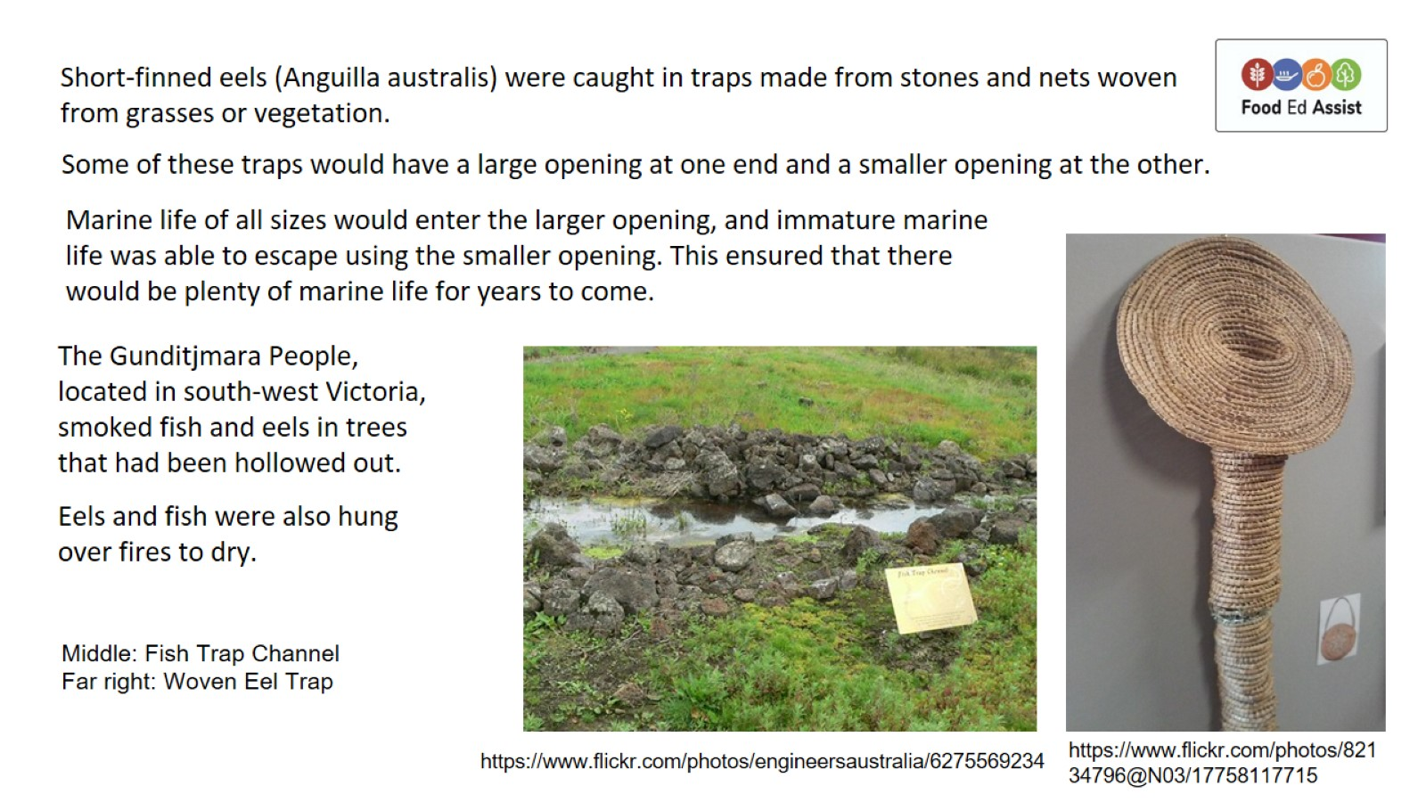

Slide 11
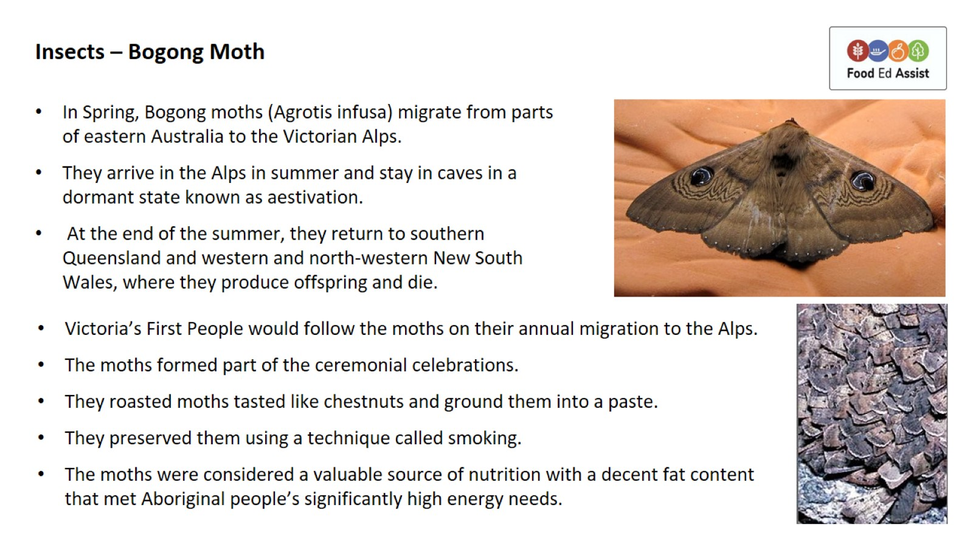
Insects – Bogong Moth

Slide 12
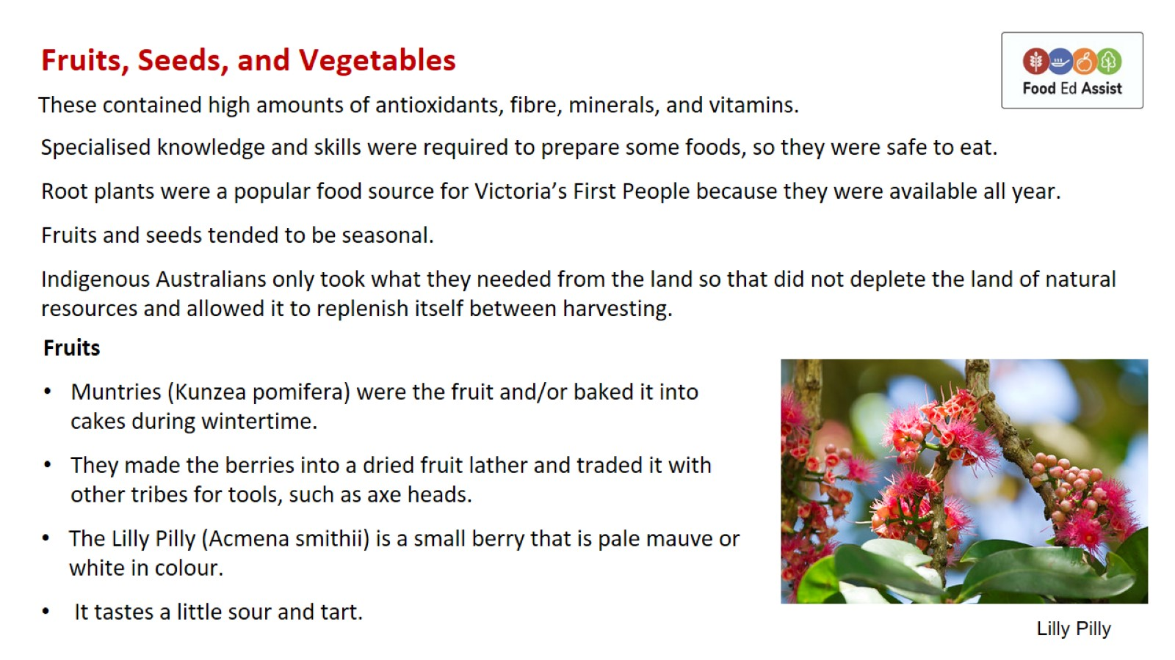
Fruits, Seeds, and Vegetables

Slide 13
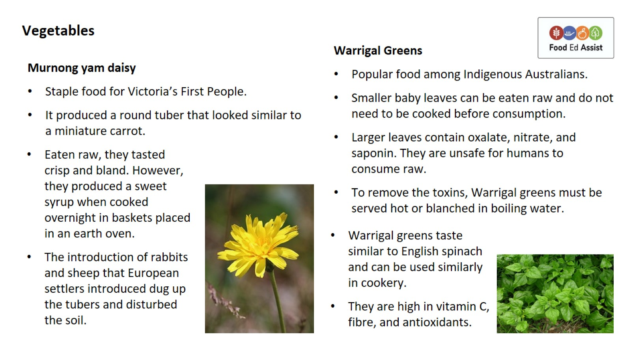
Vegetables

Slide 14
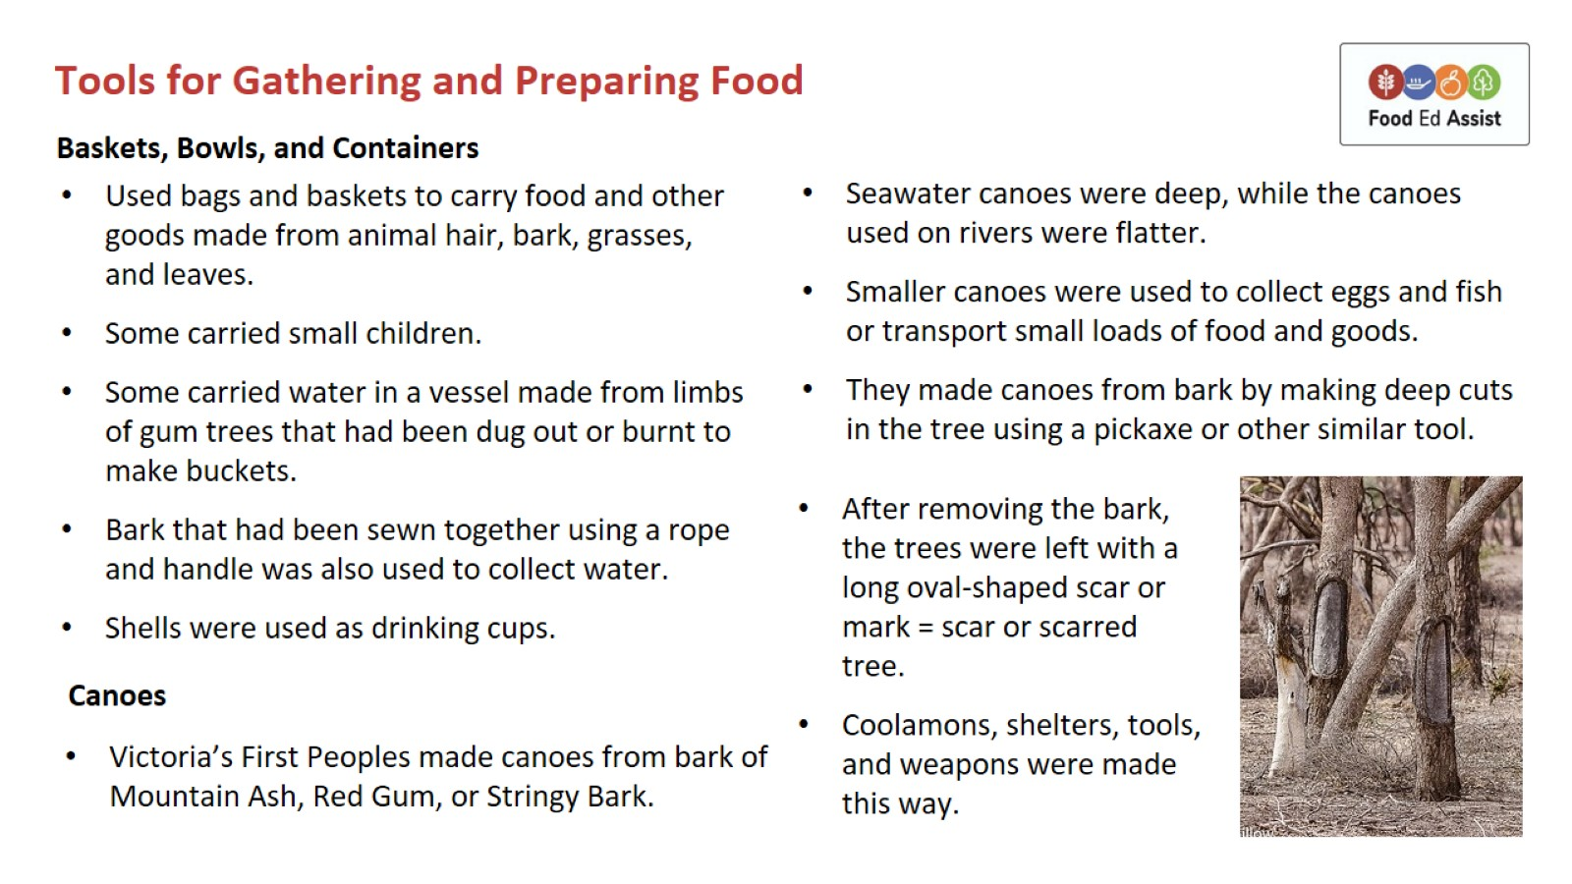
Tools for Gathering and Preparing Food

Slide 15
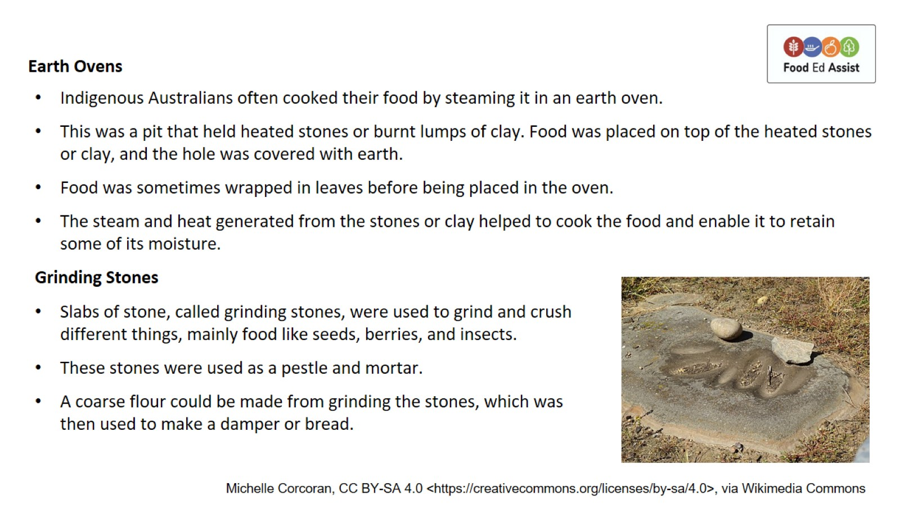

Slide 16
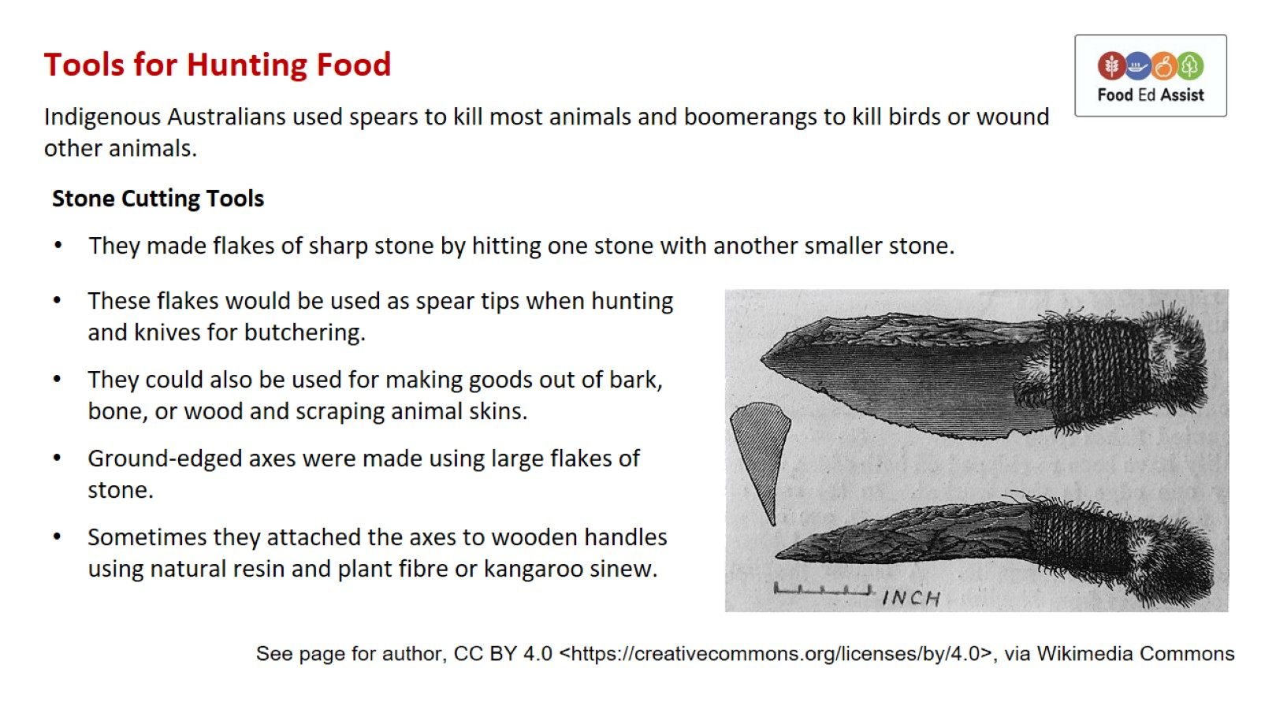
Tools for Hunting Food

Slide 17
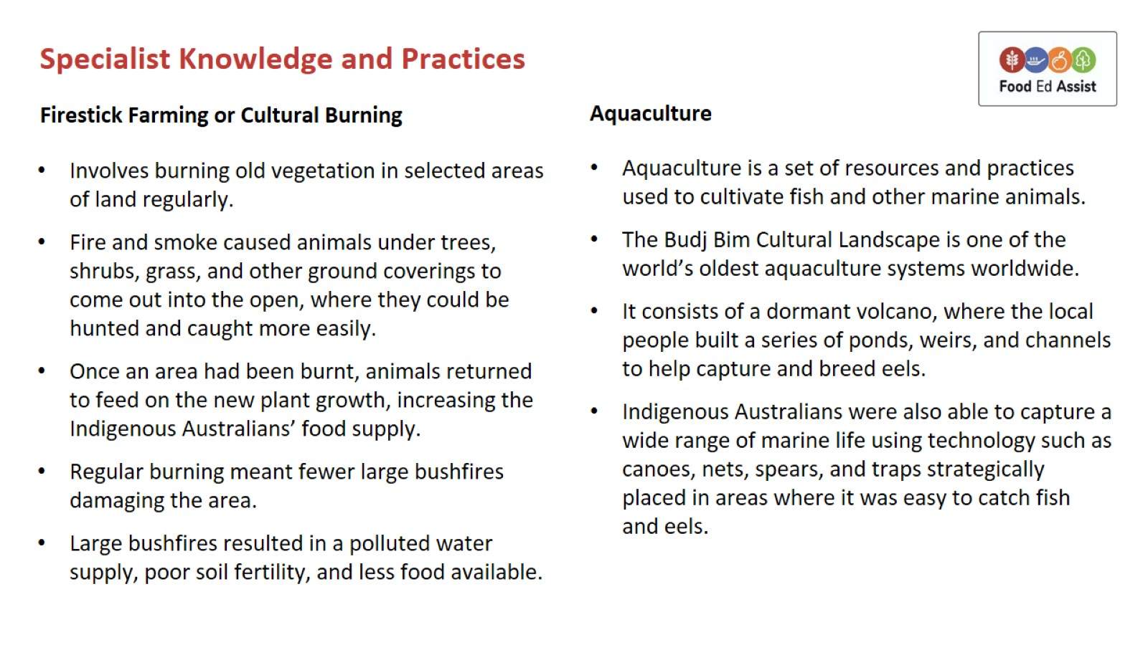
Specialist Knowledge and Practices

Slide 18
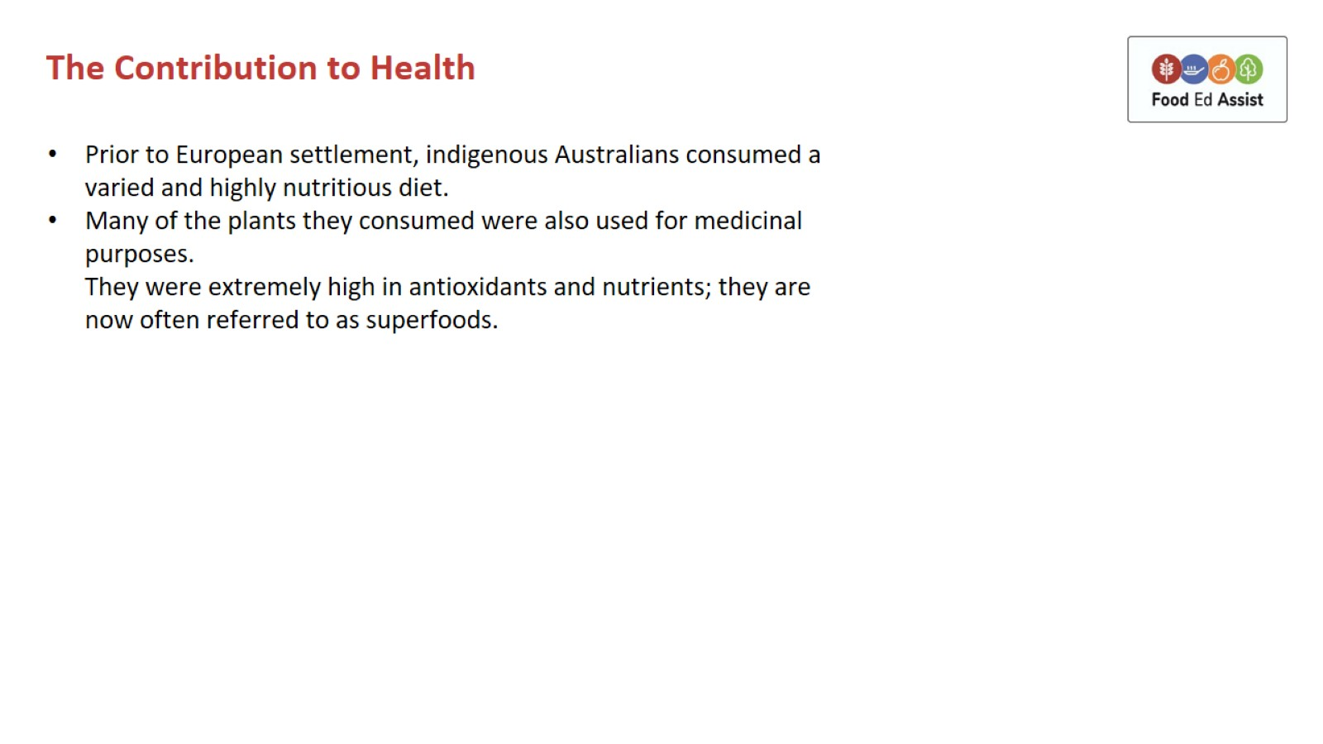
The Contribution to Health

