Slide 1
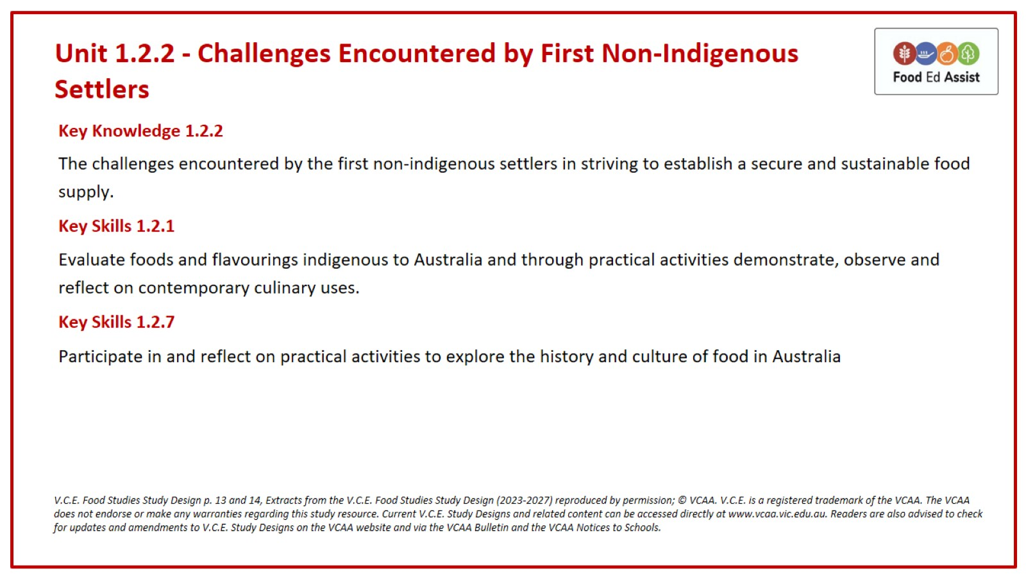
Unit 1.2.2 - Challenges Encountered by First Non-Indigenous Settlers

Slide 2
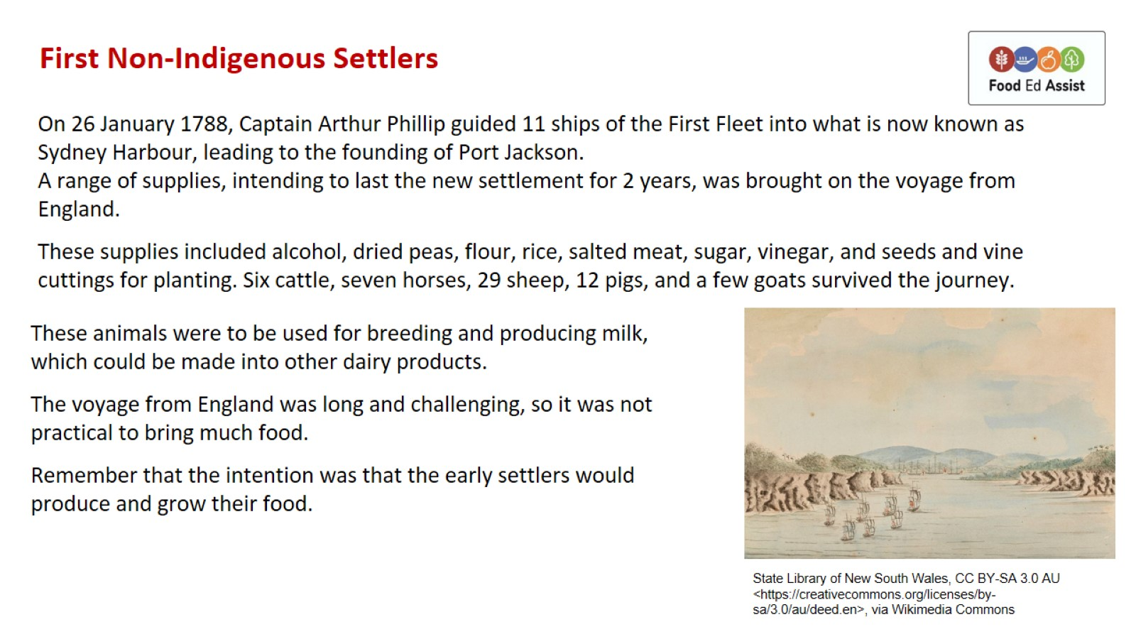
First Non-Indigenous Settlers

Slide 3
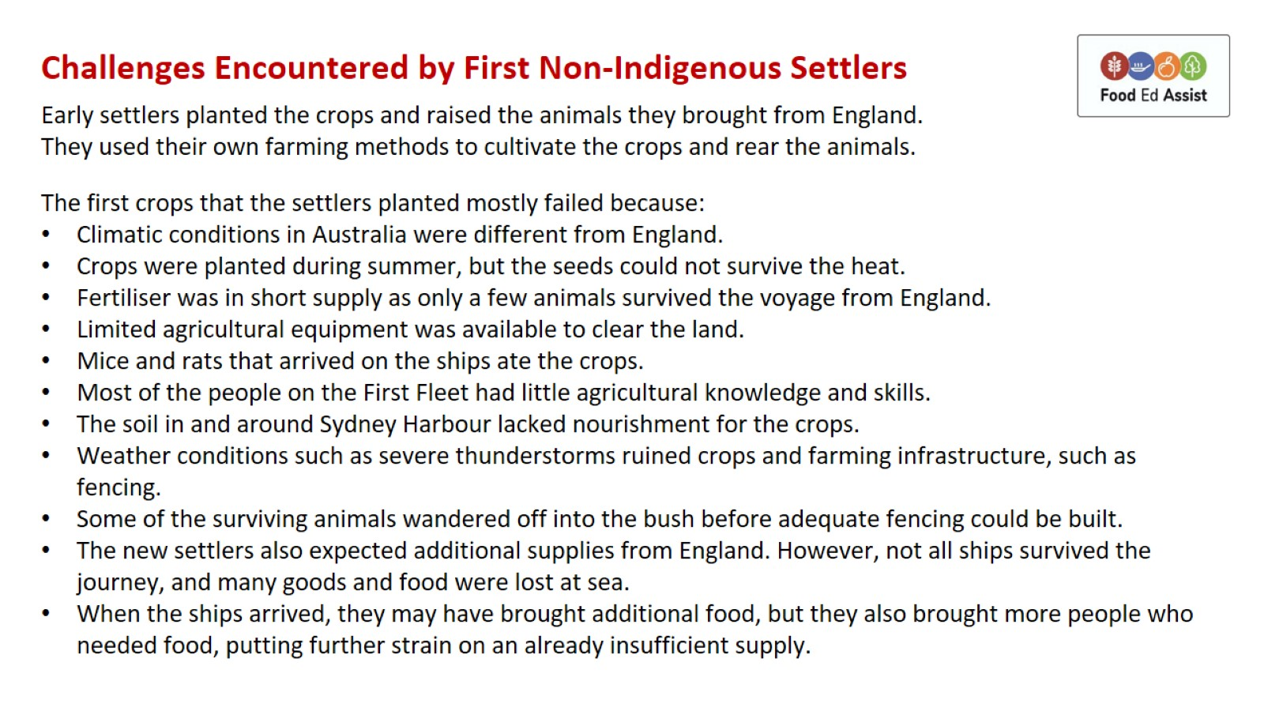

Slide 4
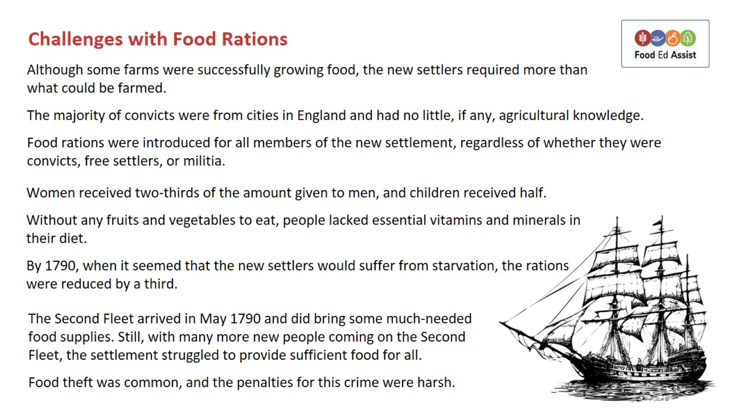

Slide 5
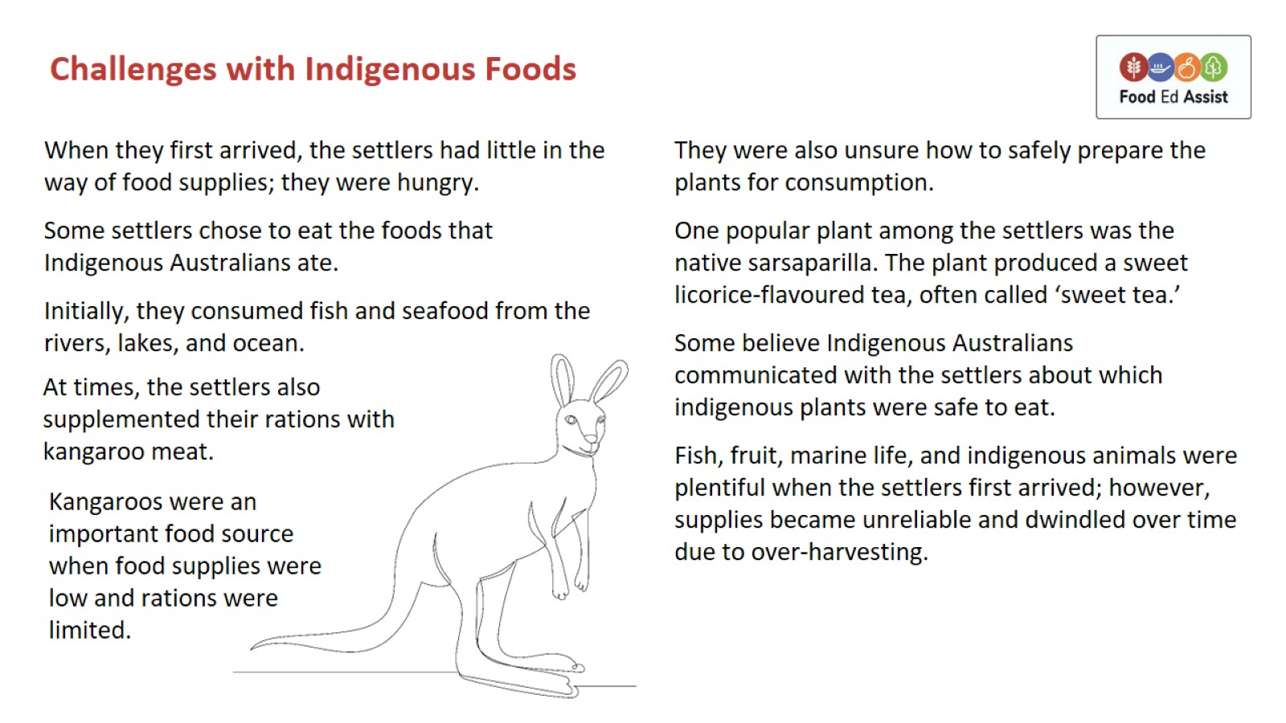

Slide 6
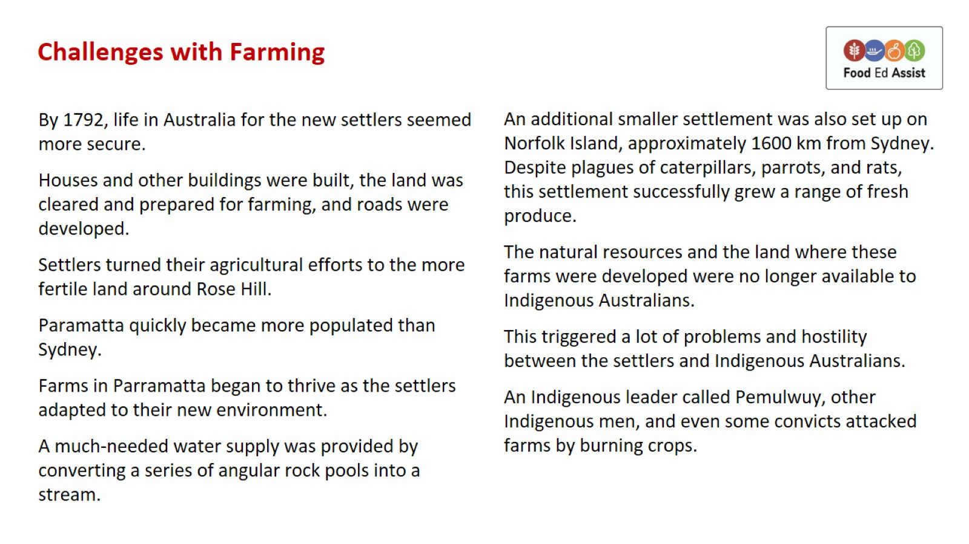

Slide 7
