Slide 1
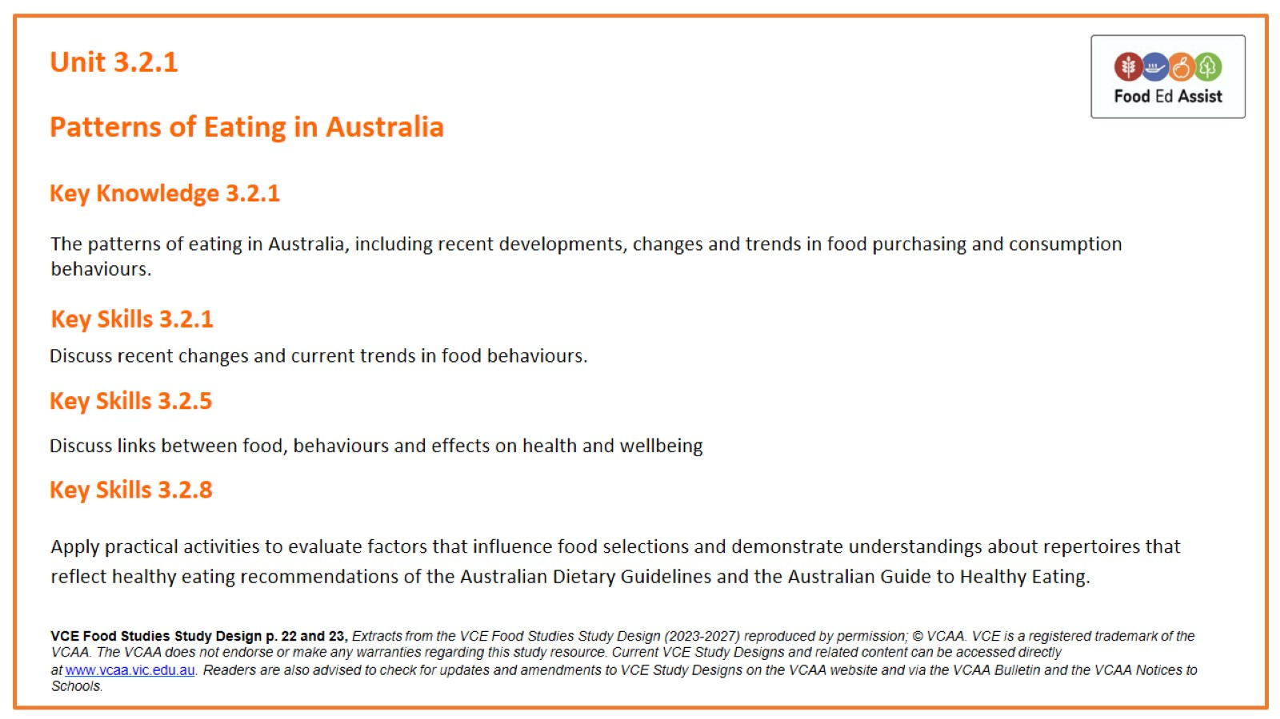
Unit 3.2.1

Slide 2
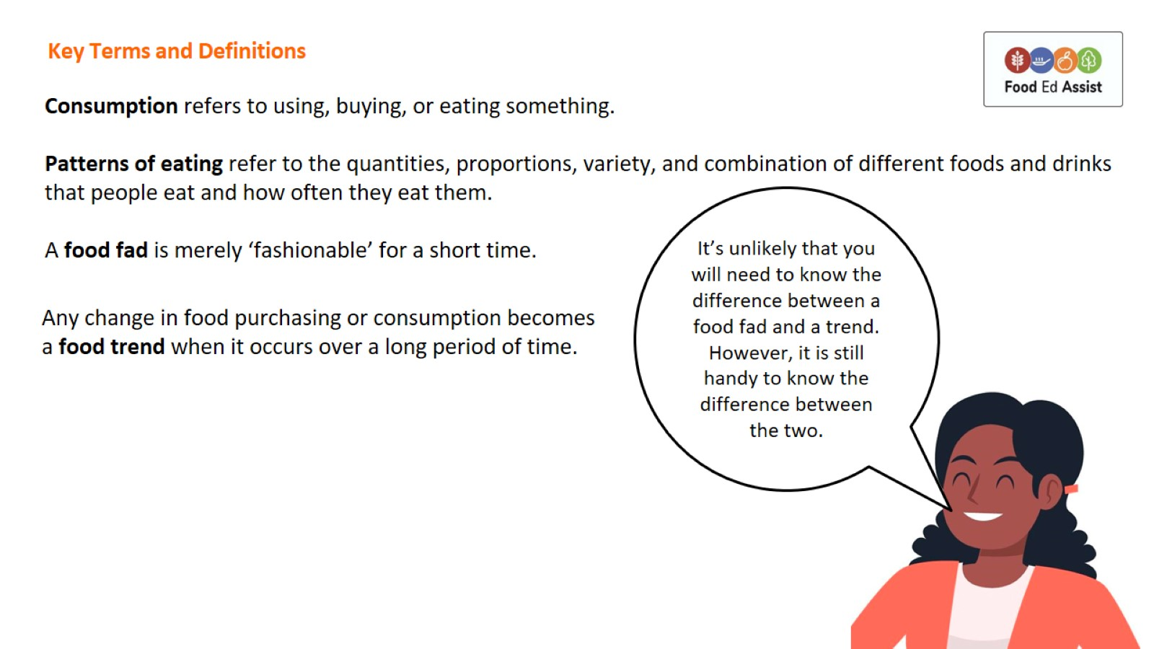
Key Terms and Definitions

Slide 3
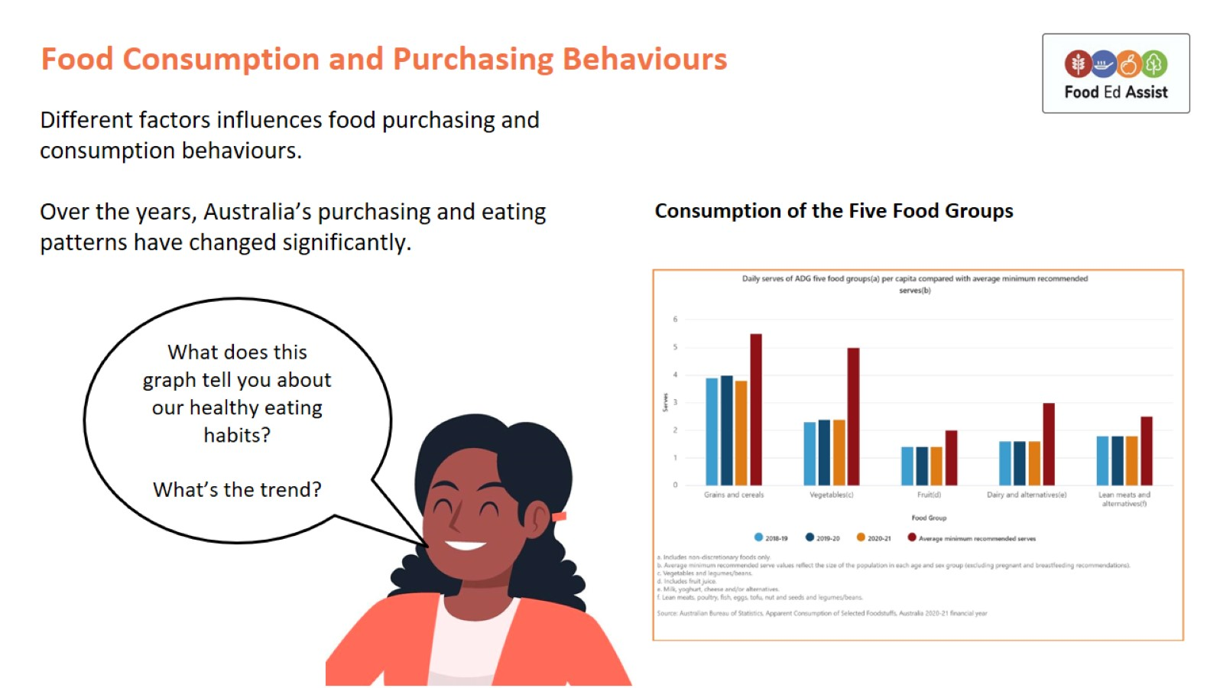
Food Consumption and Purchasing Behaviours

Slide 4
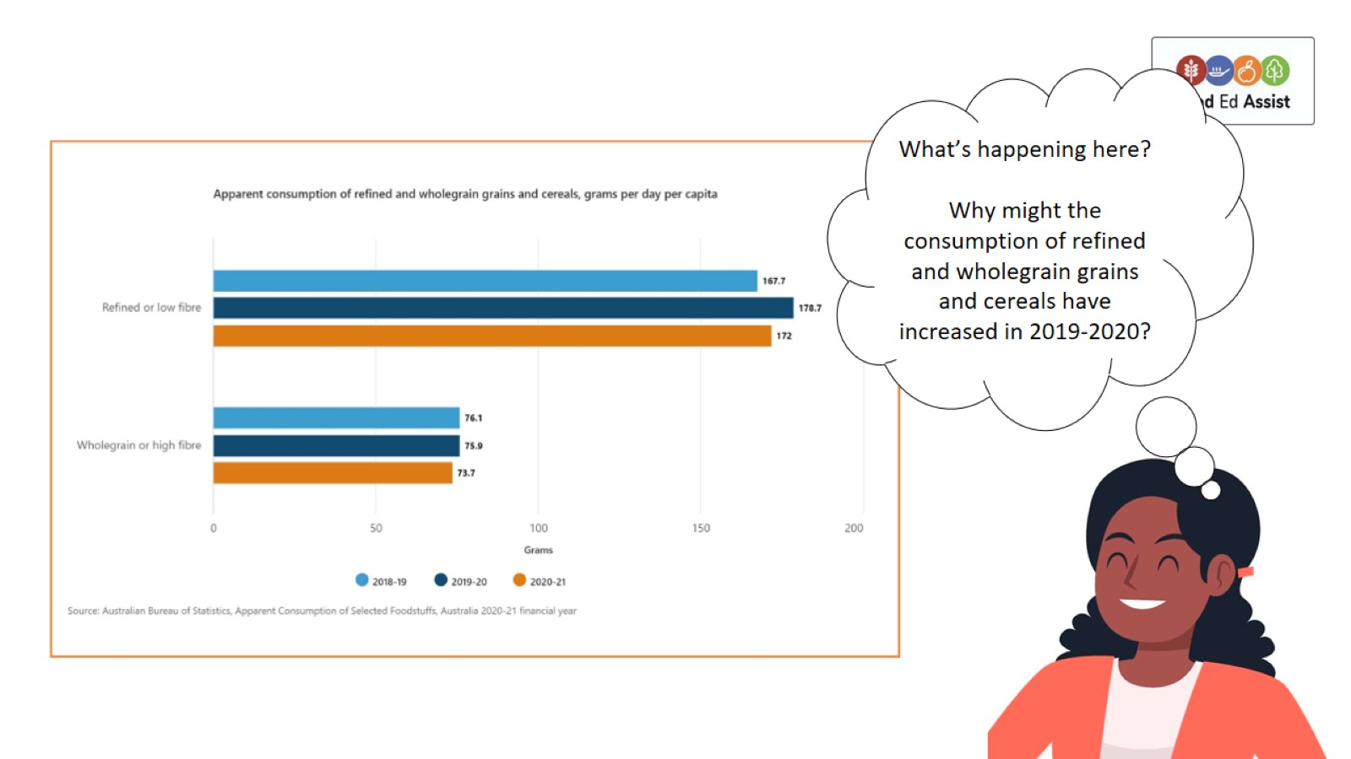

Slide 5
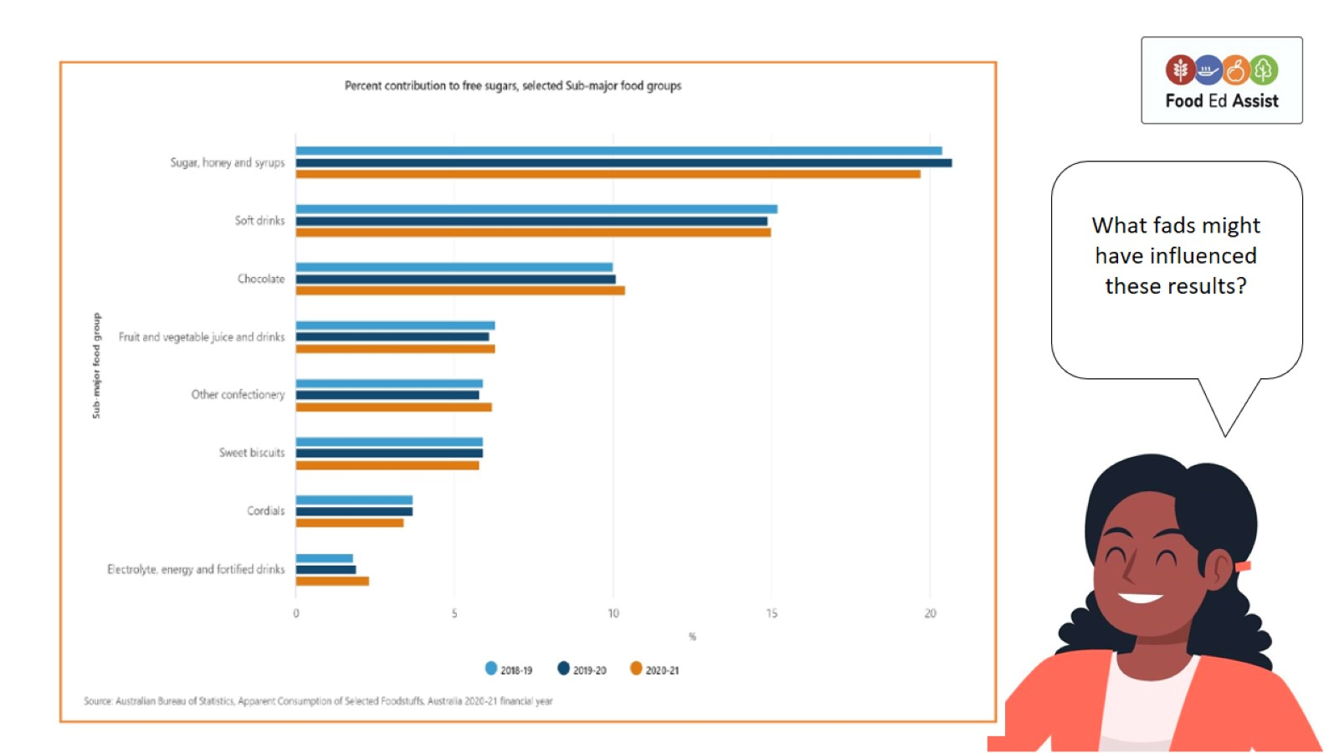

Slide 6
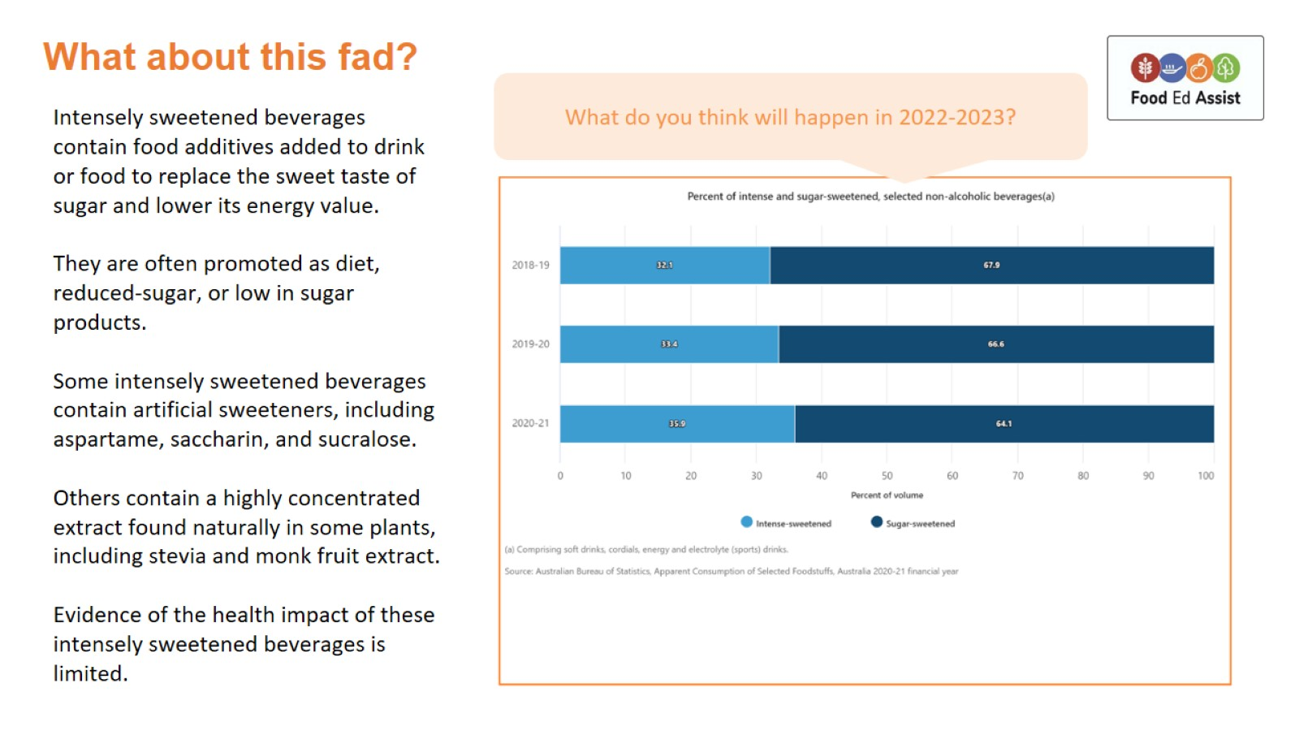
What about this fad?

Slide 7
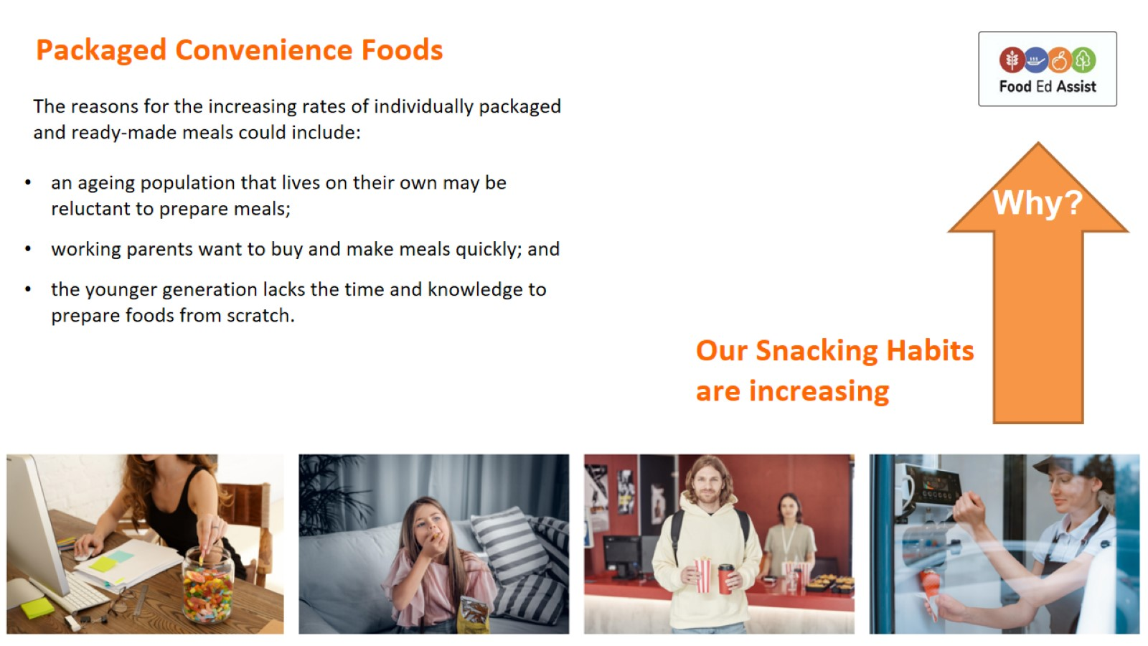
Packaged Convenience Foods

Slide 8
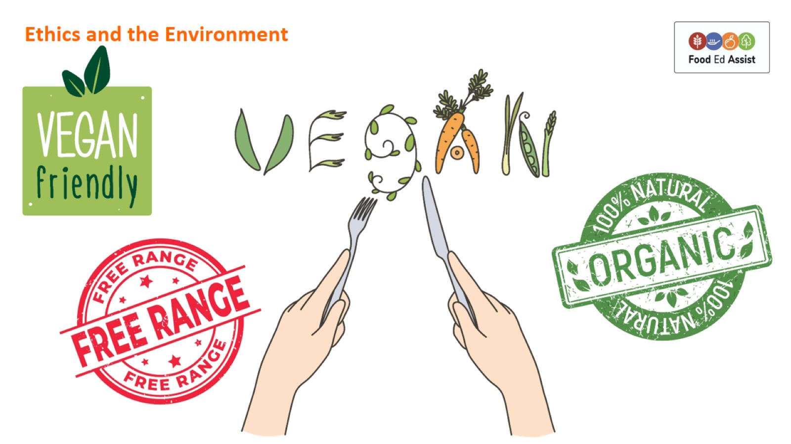
Ethics and the Environment

Slide 9
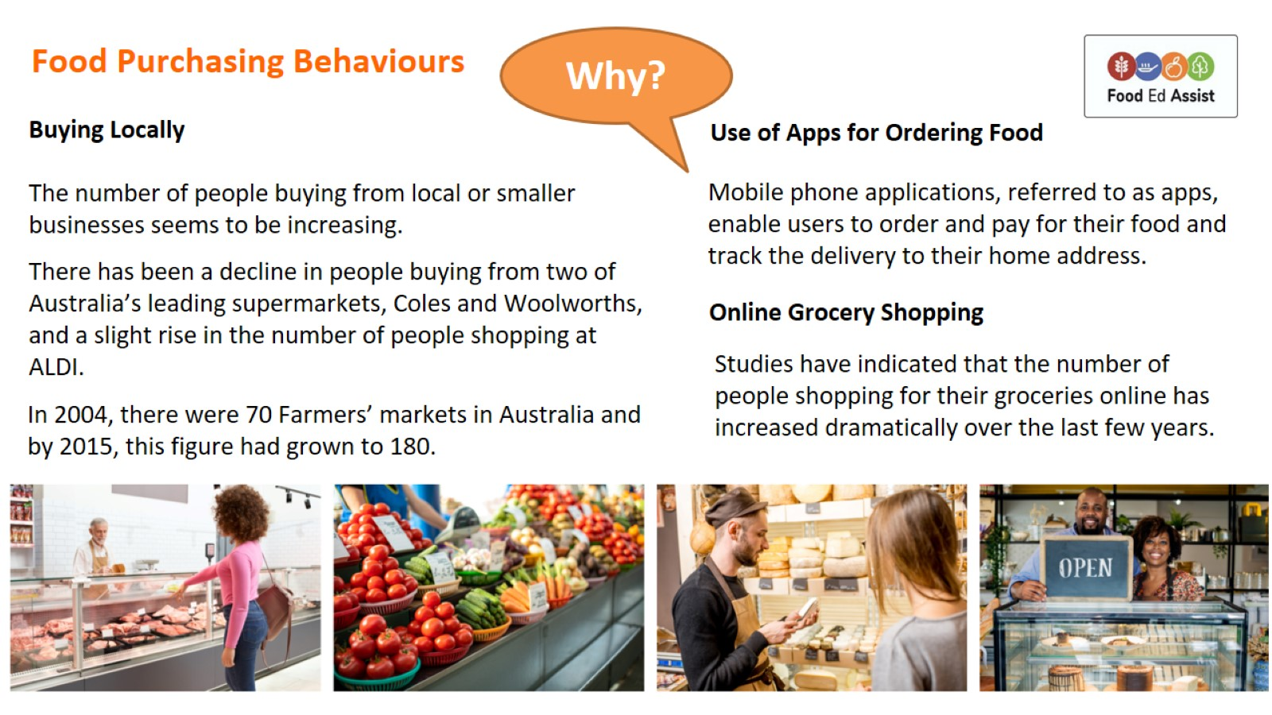
Food Purchasing Behaviours

Slide 10
