Slide 1
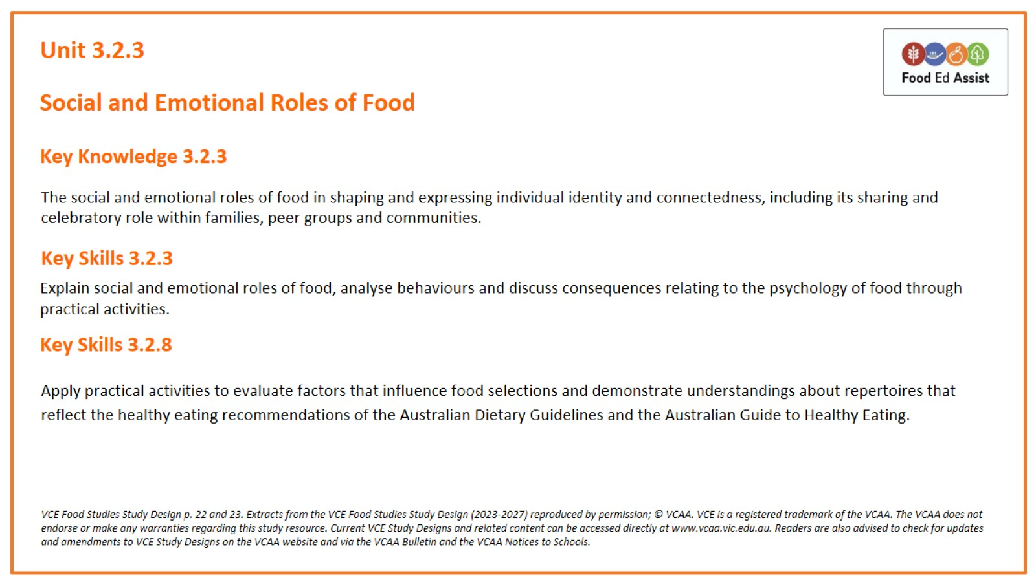
Unit 3.2.3

Slide 2
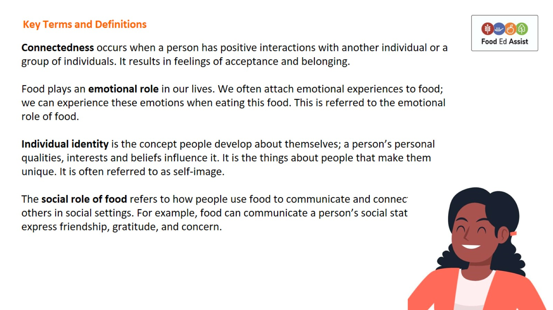
Key Terms and Definitions

Slide 3
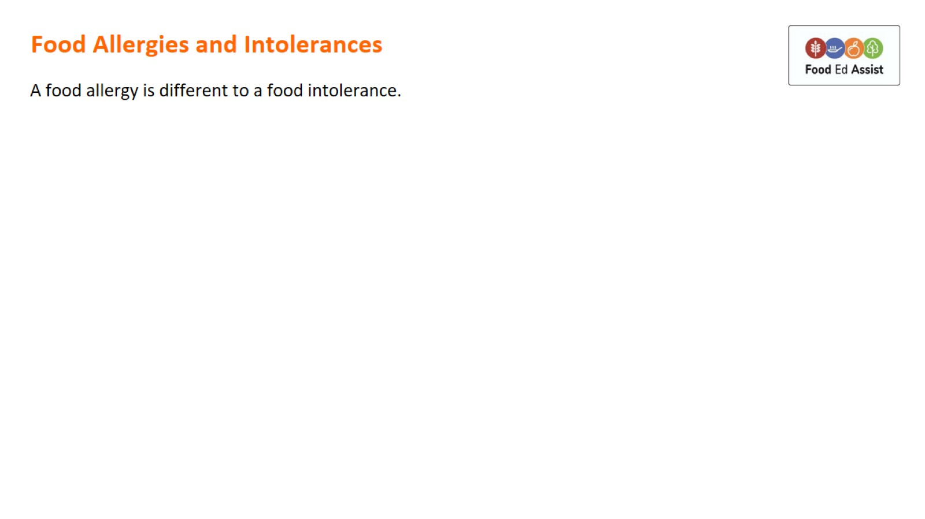
Food Allergies and Intolerances

Slide 4
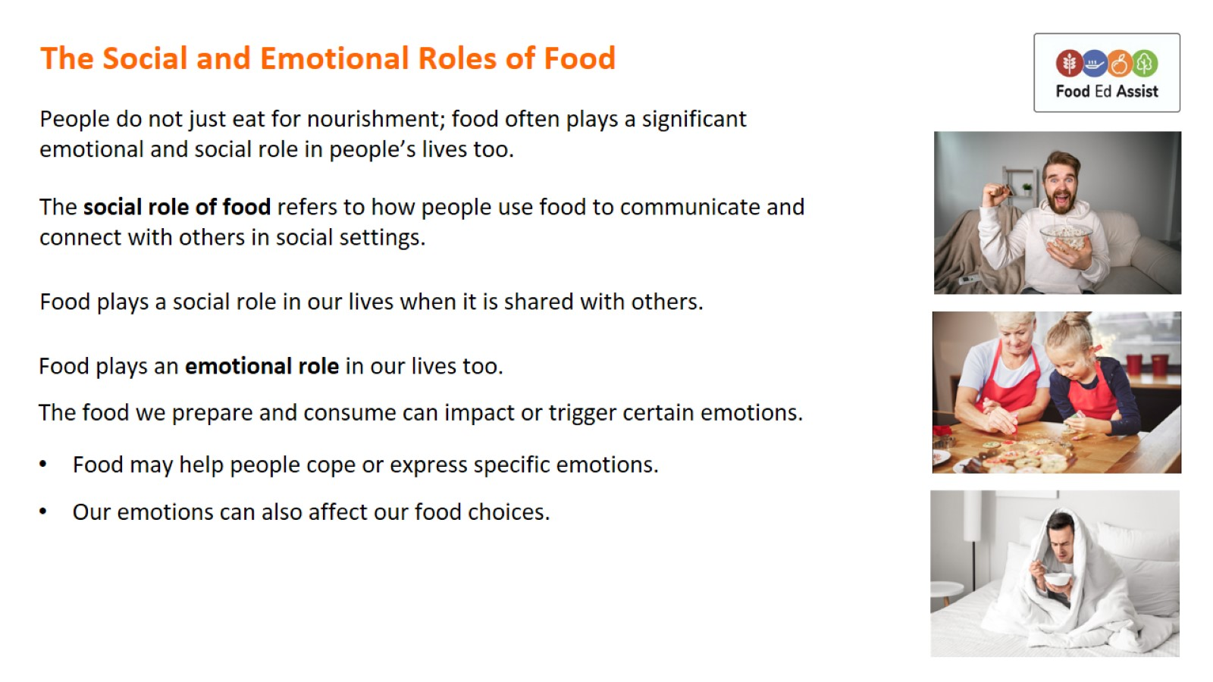
The Social and Emotional Roles of Food

Slide 5
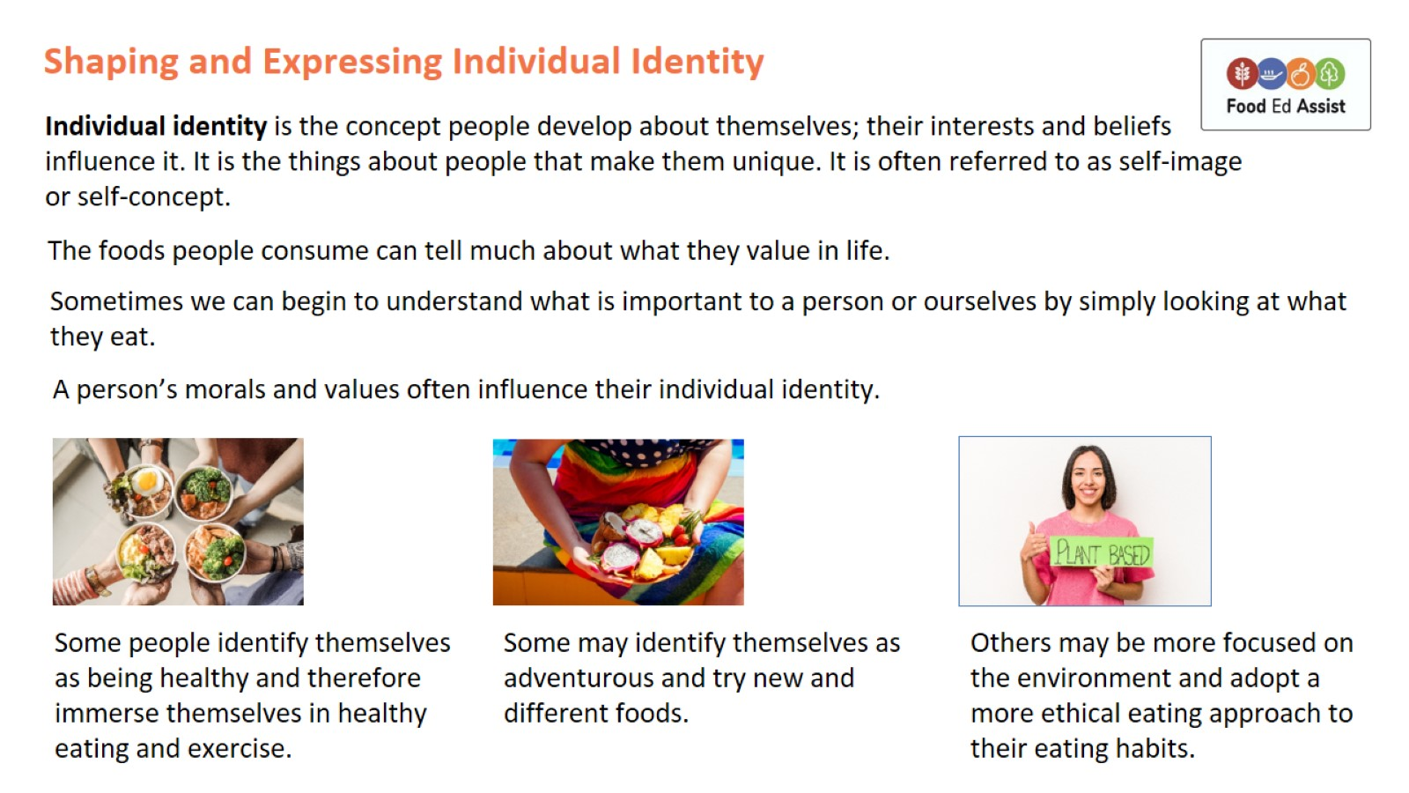
Shaping and Expressing Individual Identity

Slide 6
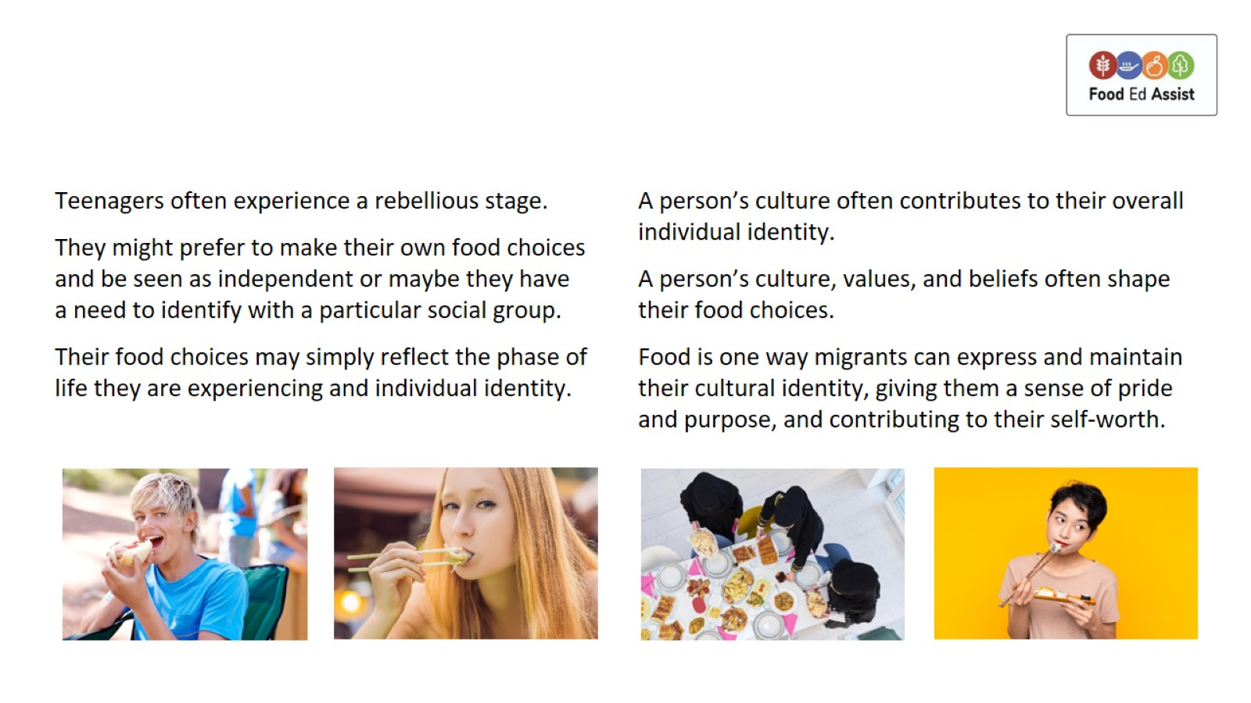

Slide 7
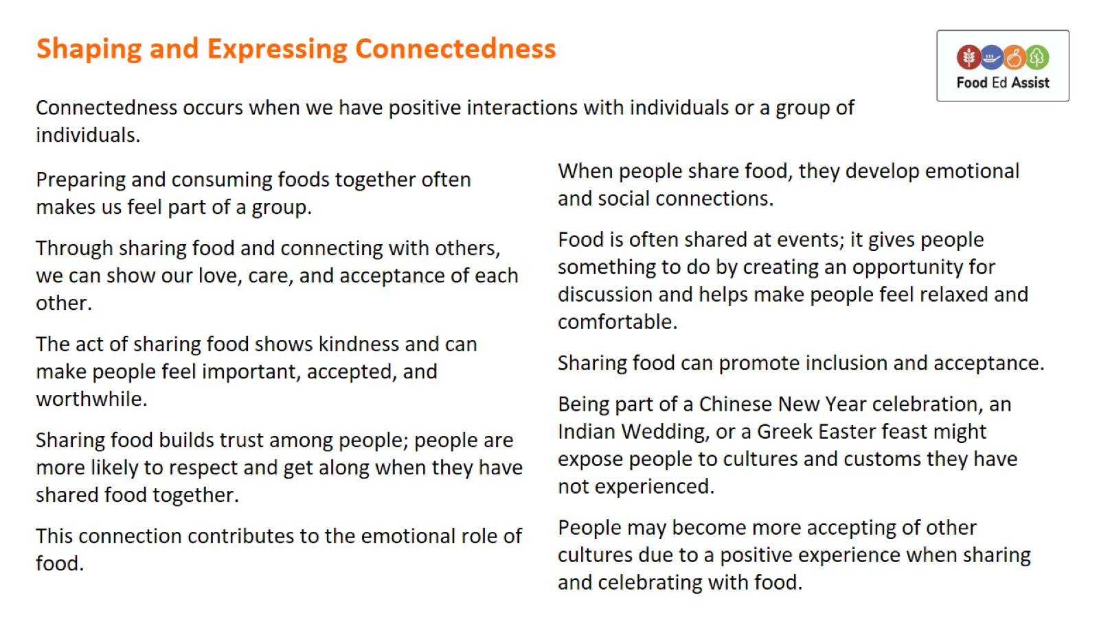
Shaping and Expressing Connectedness

