Slide 1
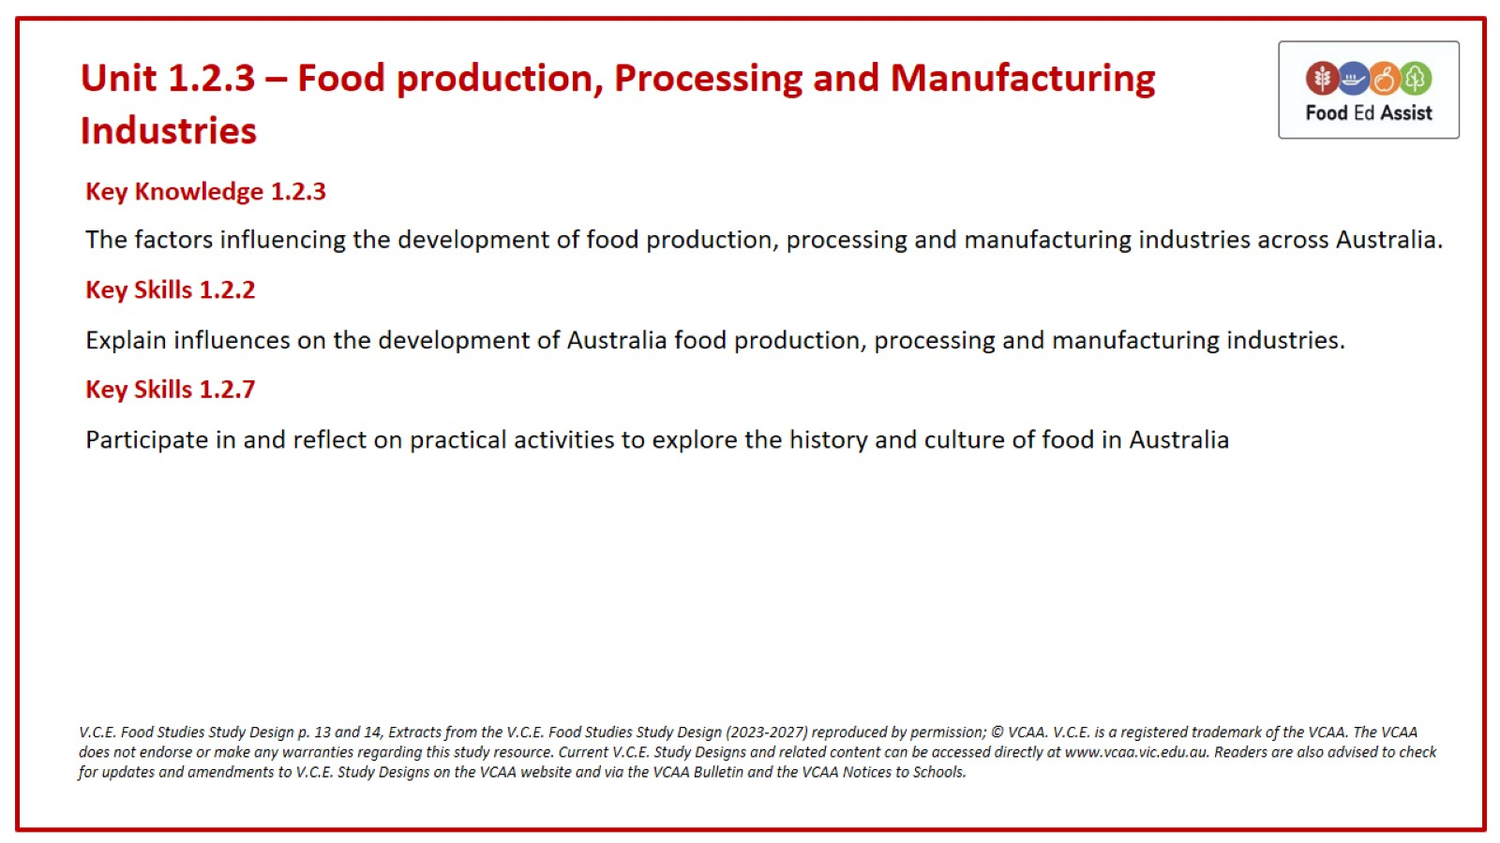
Unit 1.2.3 – Food production, Processing and Manufacturing Industries

Slide 2
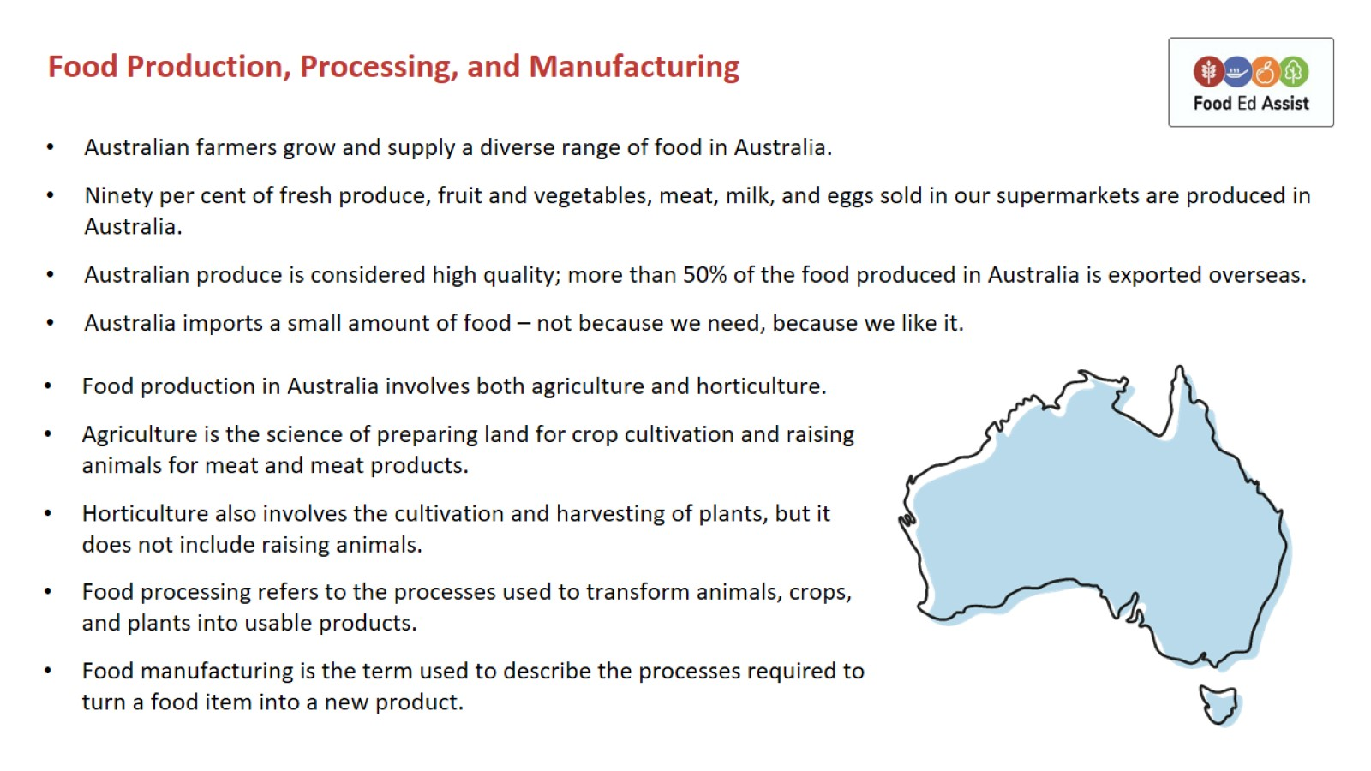
Food Production, Processing, and Manufacturing

Slide 3
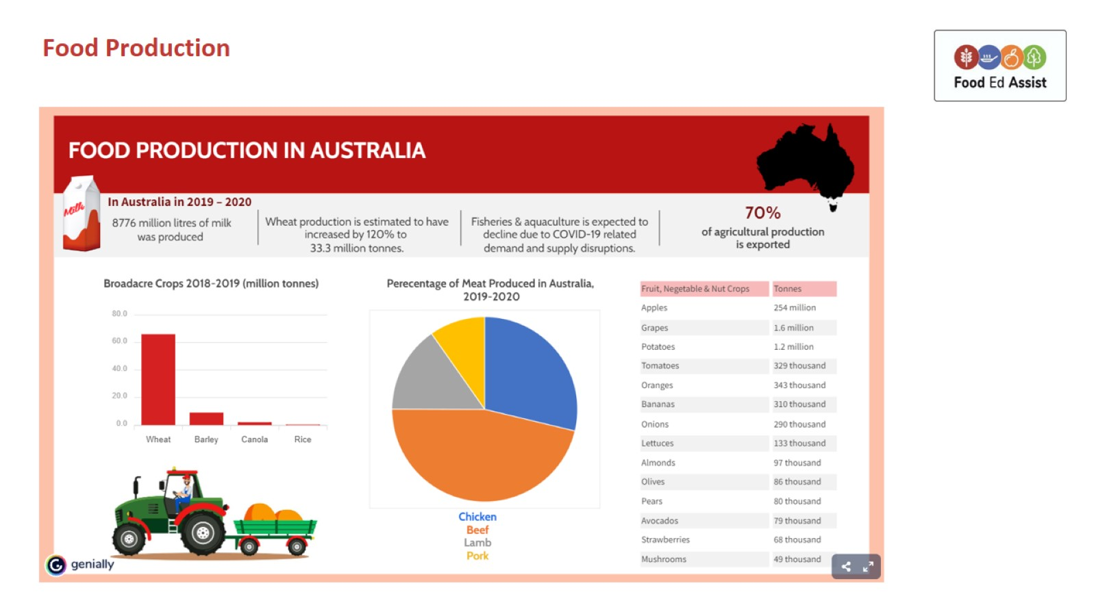

Slide 4
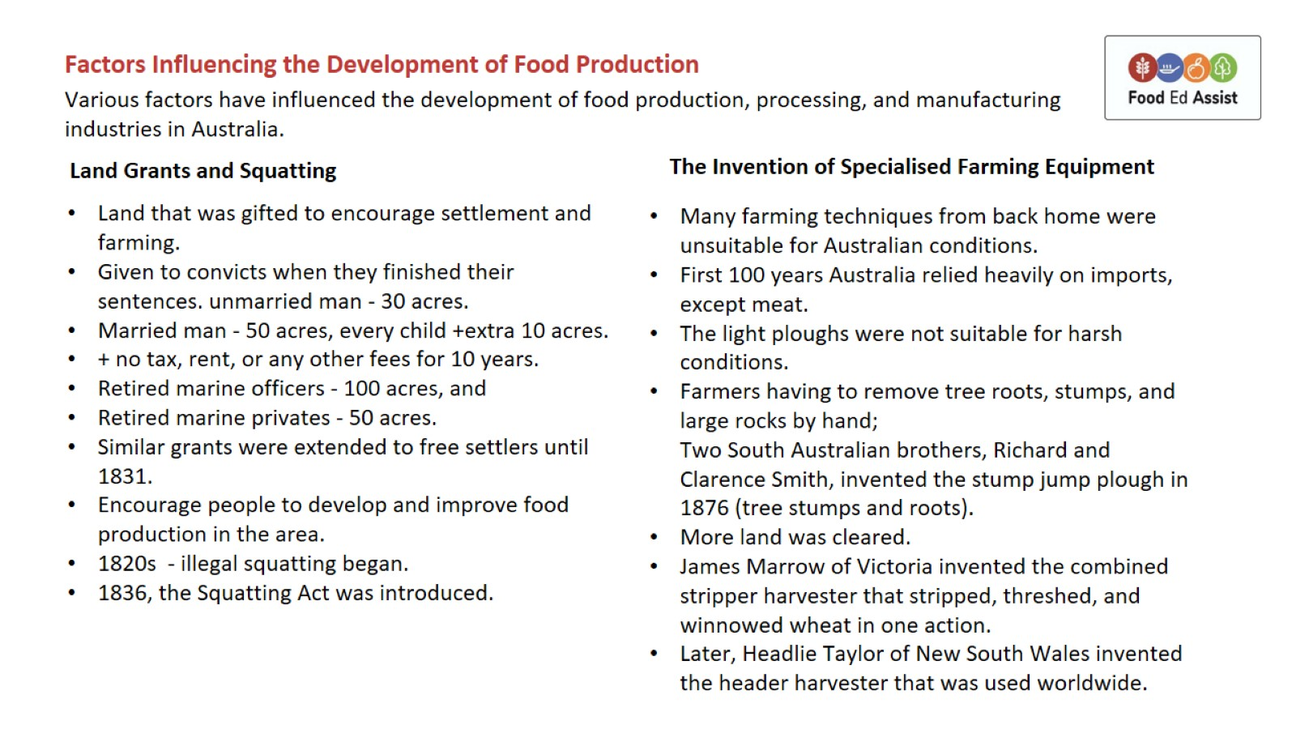
Factors Influencing the Development of Food Production

Slide 5
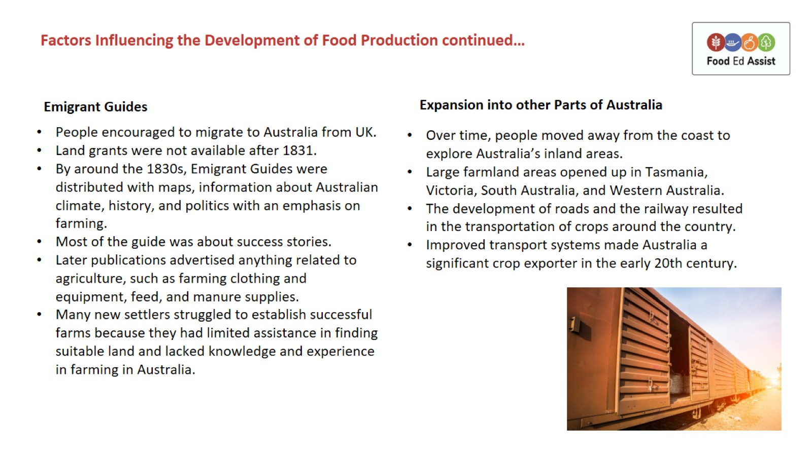
Factors Influencing the Development of Food Production continued…

Slide 6
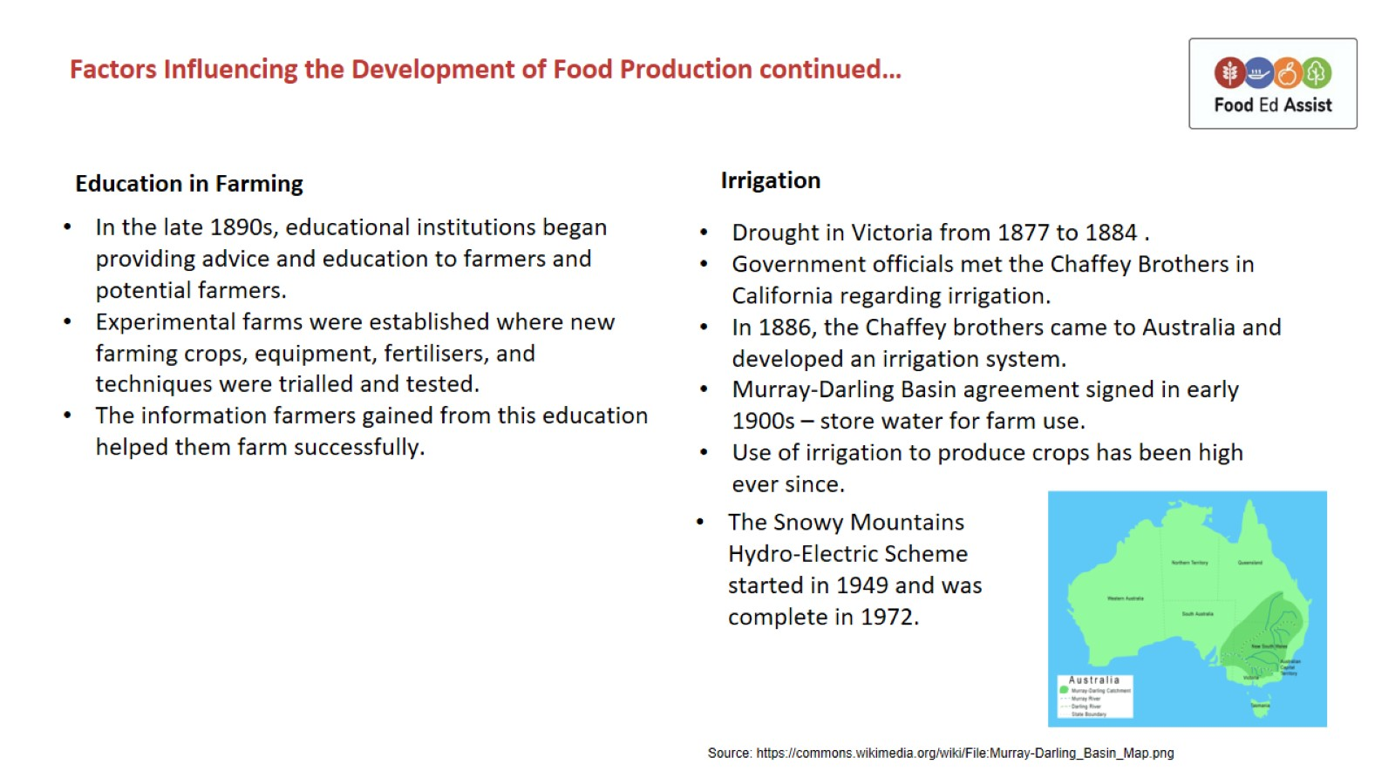
Factors Influencing the Development of Food Production continued…

Slide 7
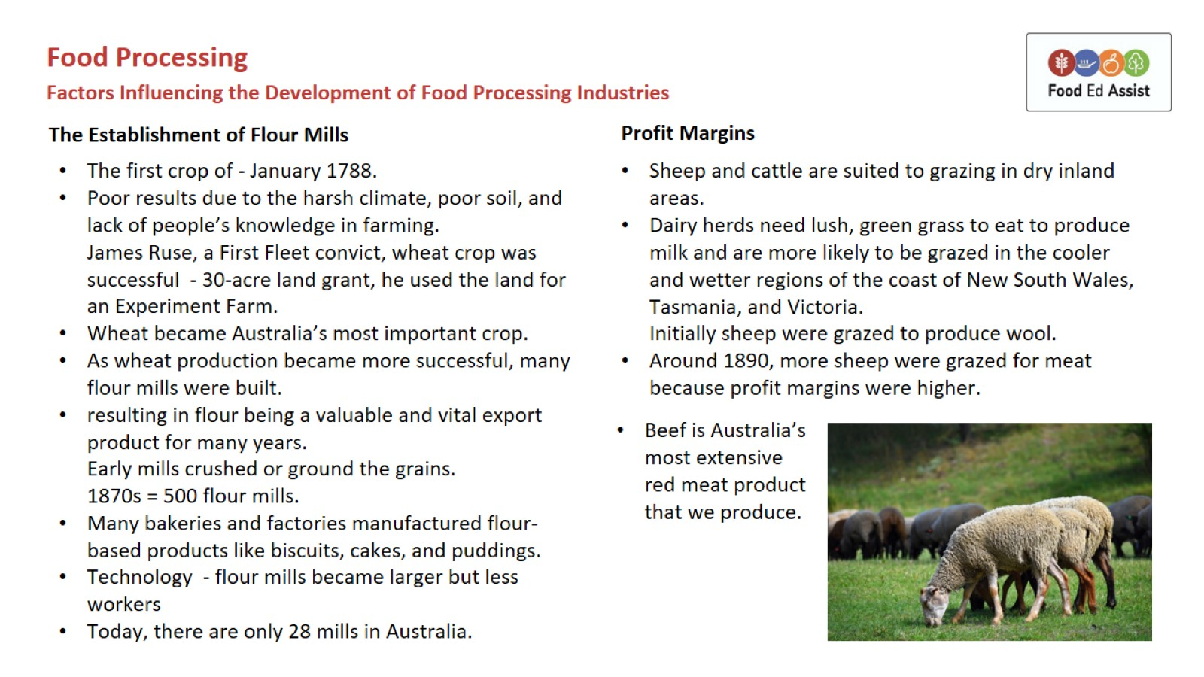

Slide 8
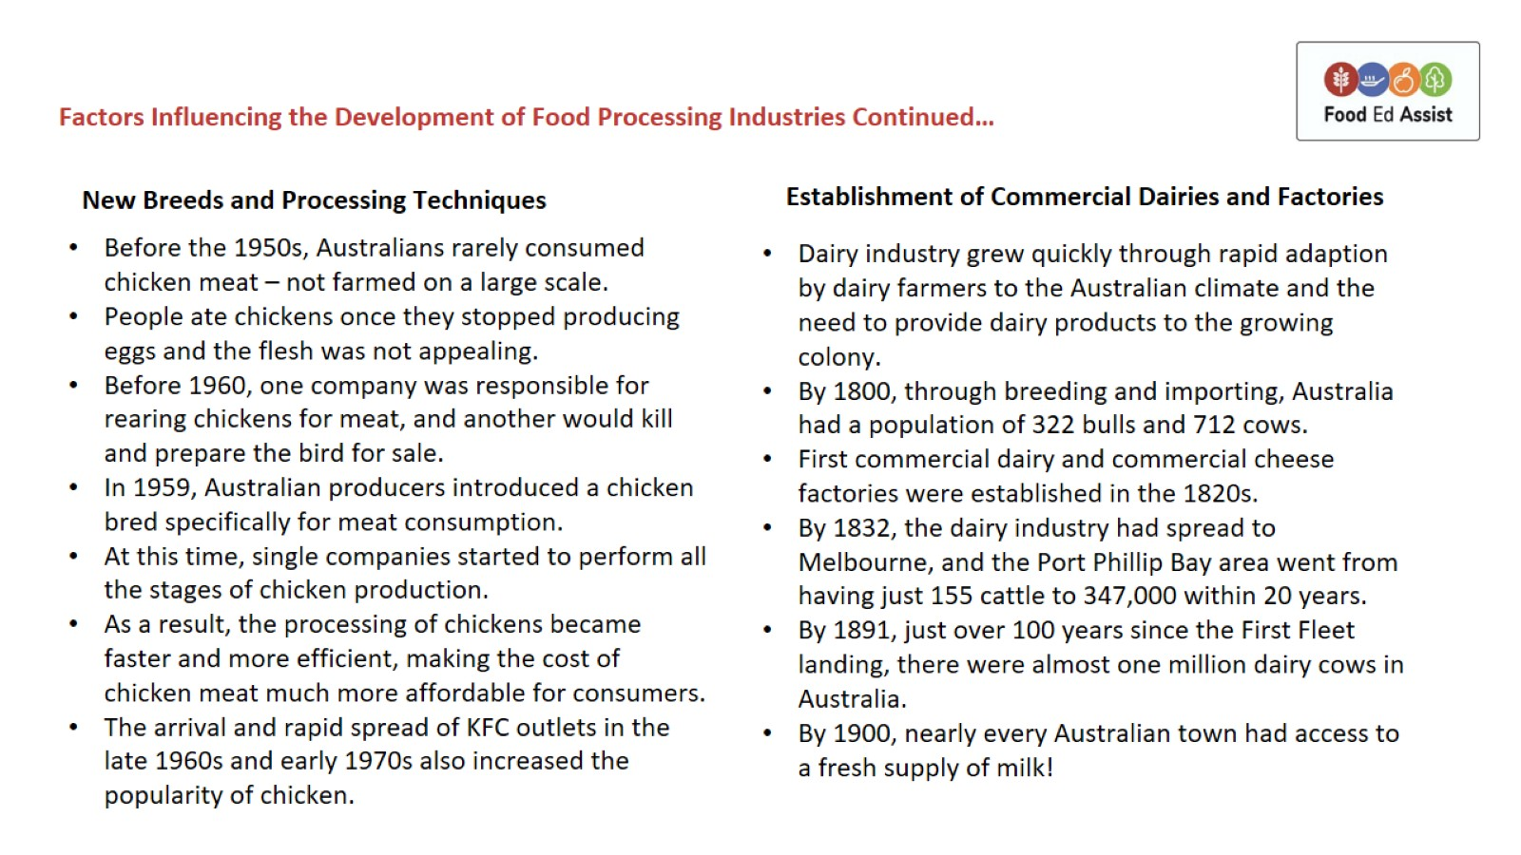

Slide 9
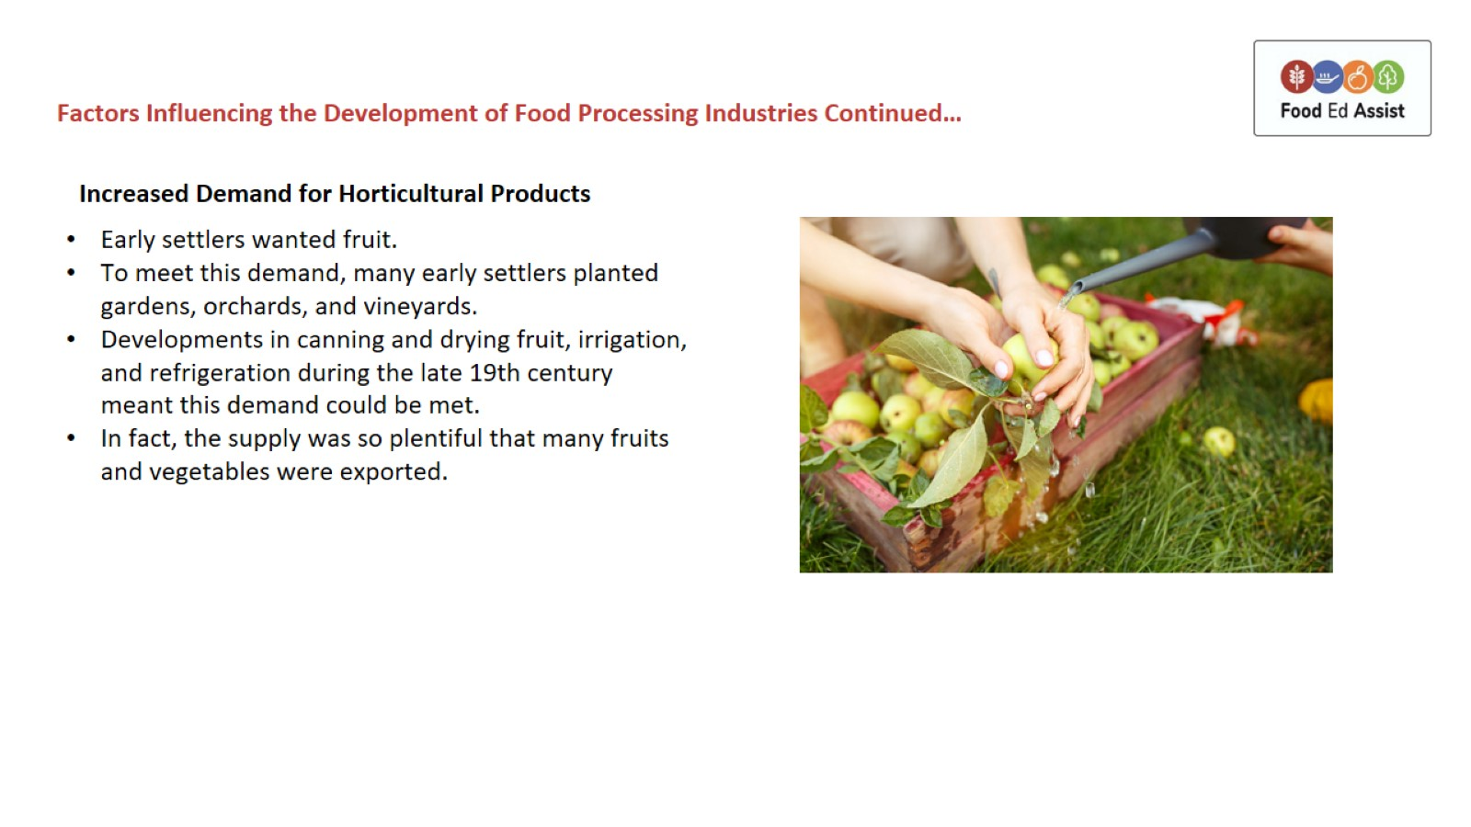

Slide 10
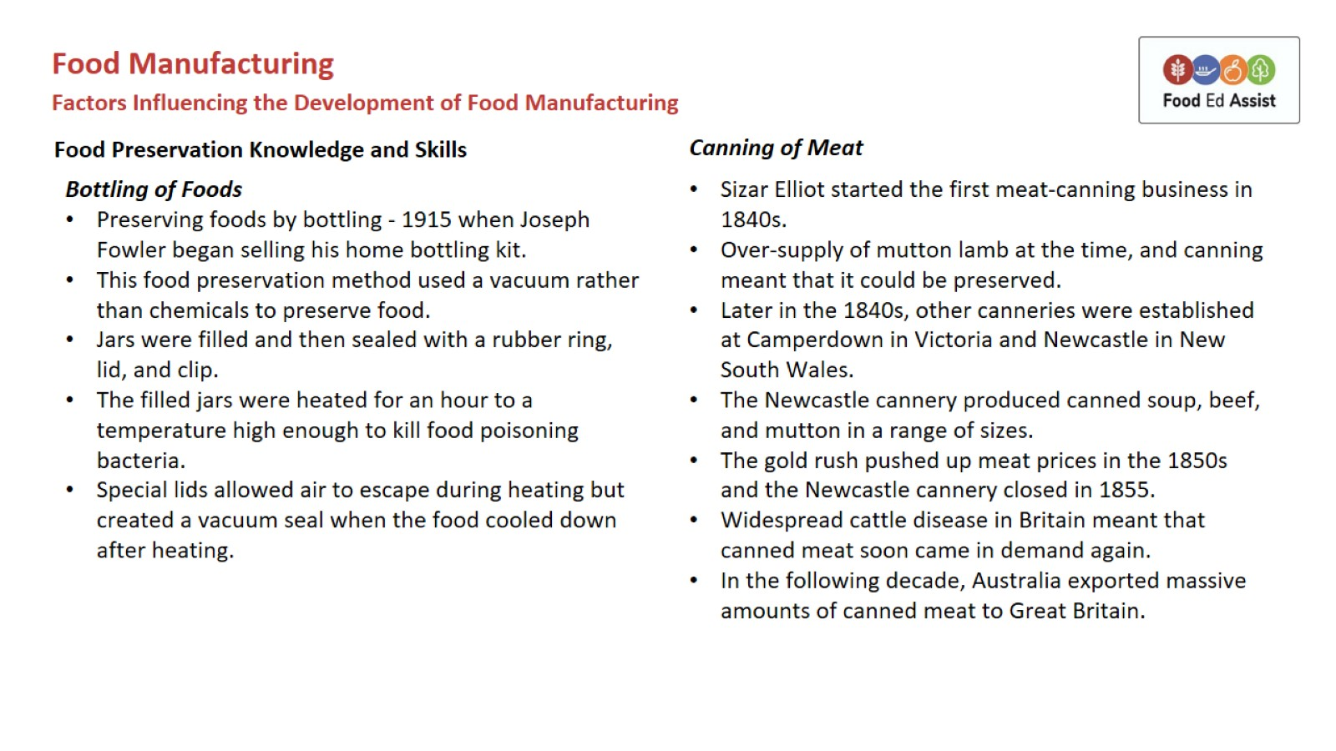

Slide 11
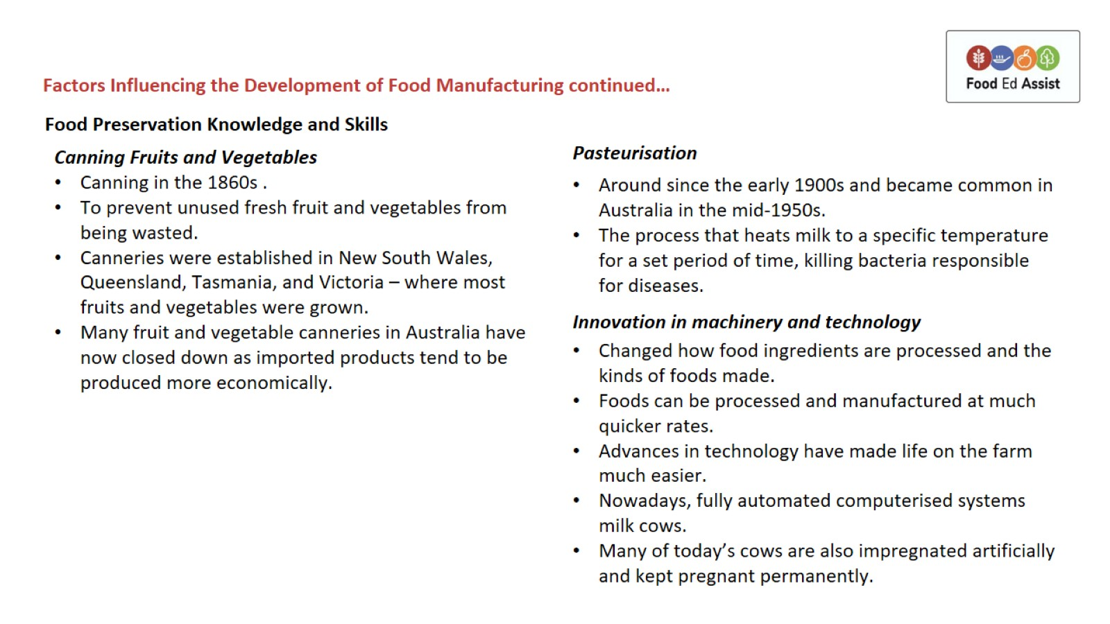

Slide 12
