Slide 1
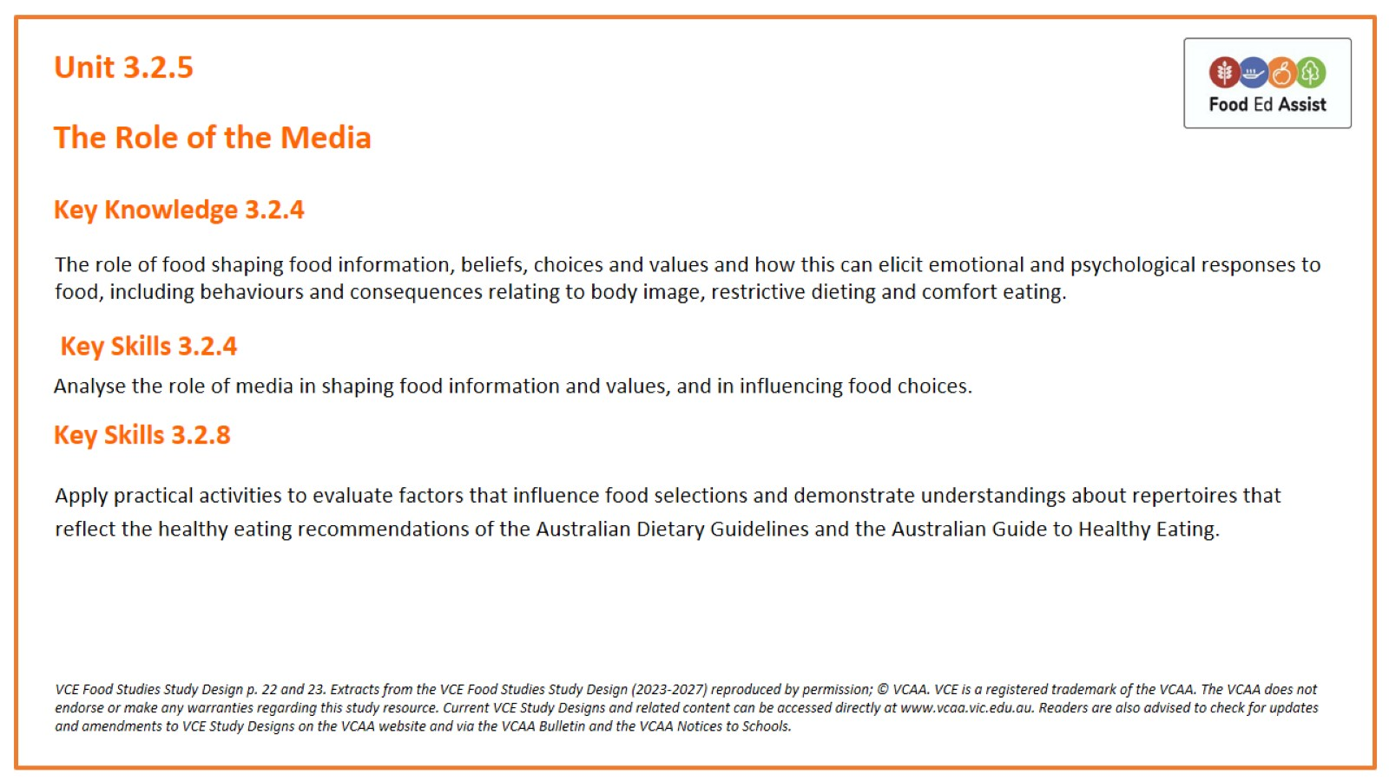
Unit 3.2.5

Slide 2
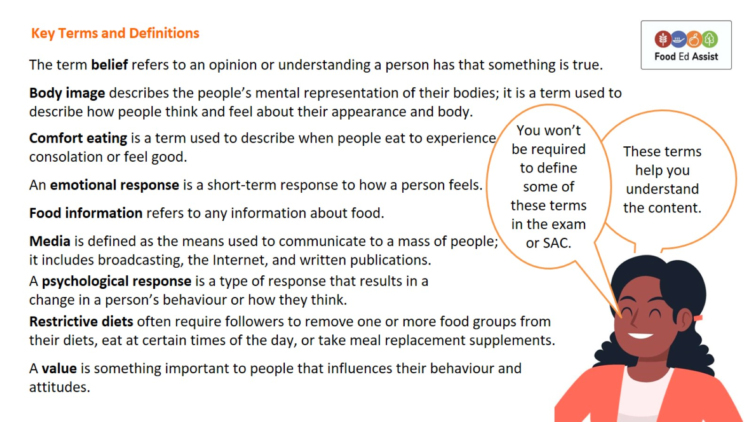
Key Terms and Definitions

Slide 3
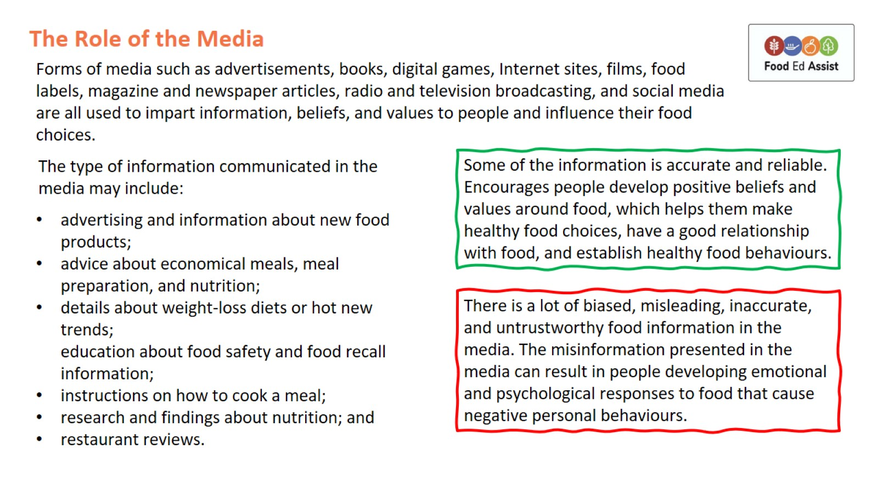
The Role of the Media

Slide 4
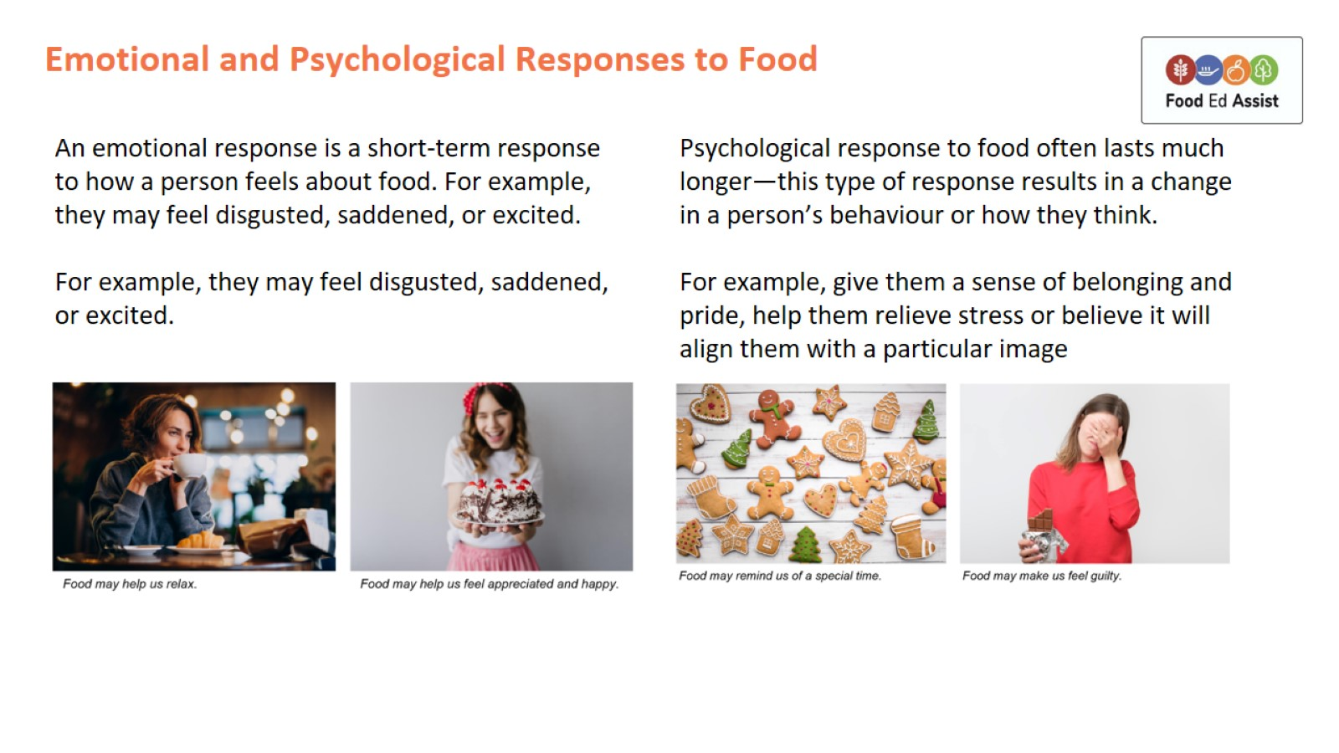
Emotional and Psychological Responses to Food

Slide 5
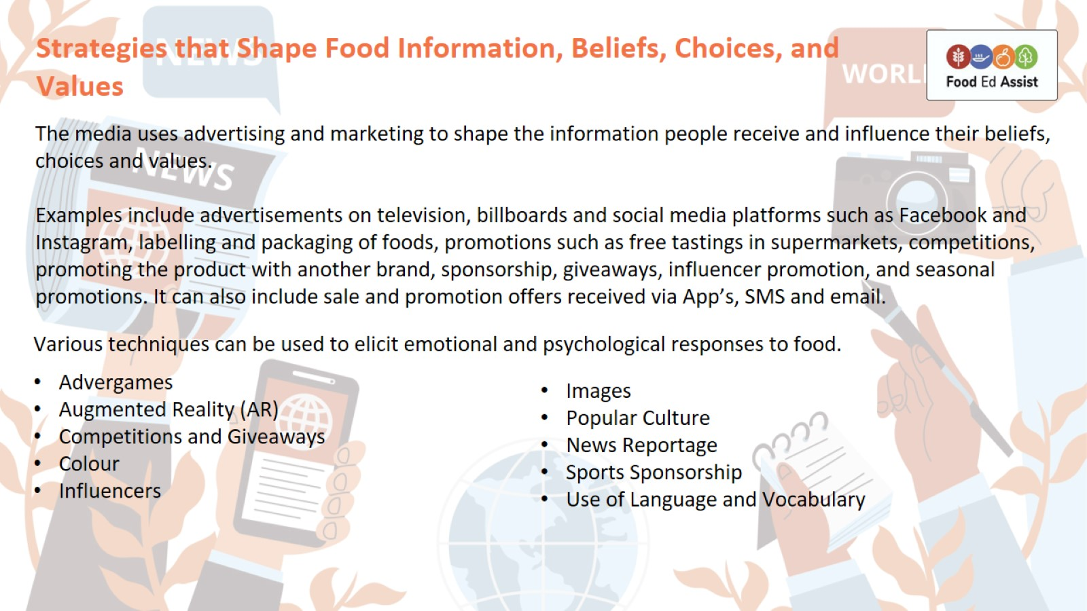
Strategies that Shape Food Information, Beliefs, Choices, and Values

Slide 6
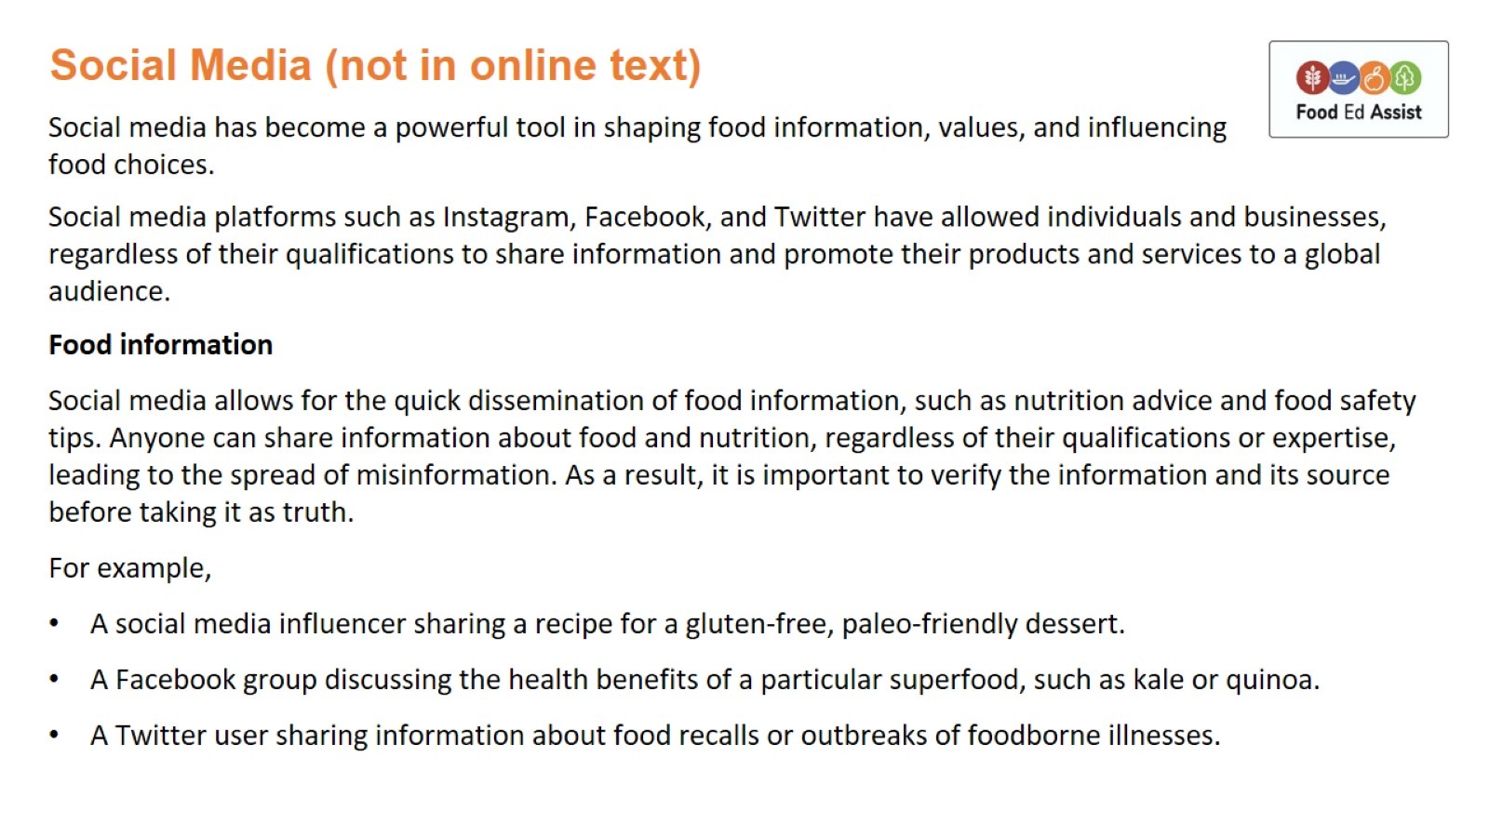
Social Media (not in online text)

Slide 7
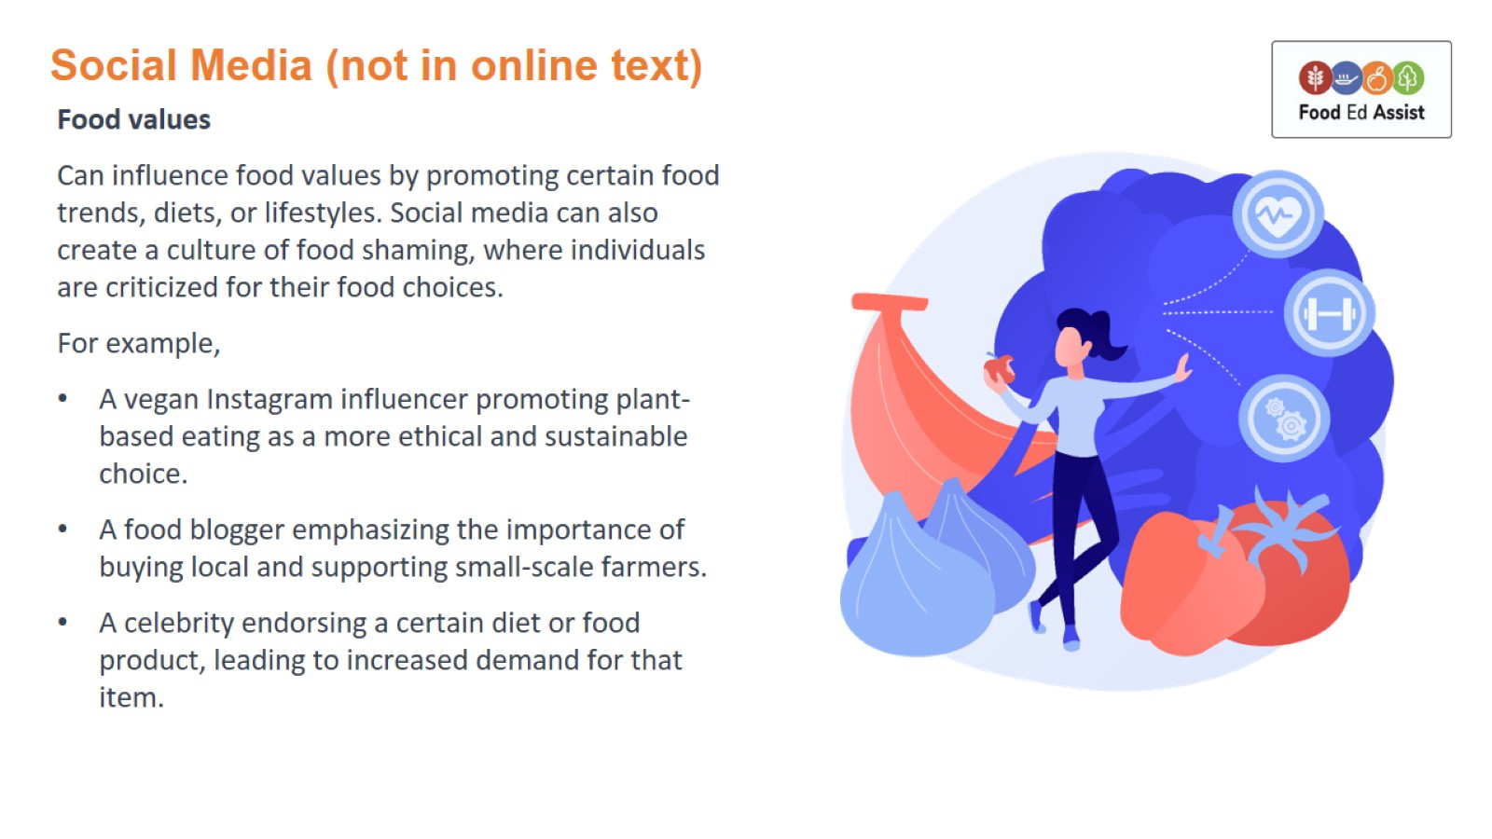
Social Media (not in online text)

Slide 8
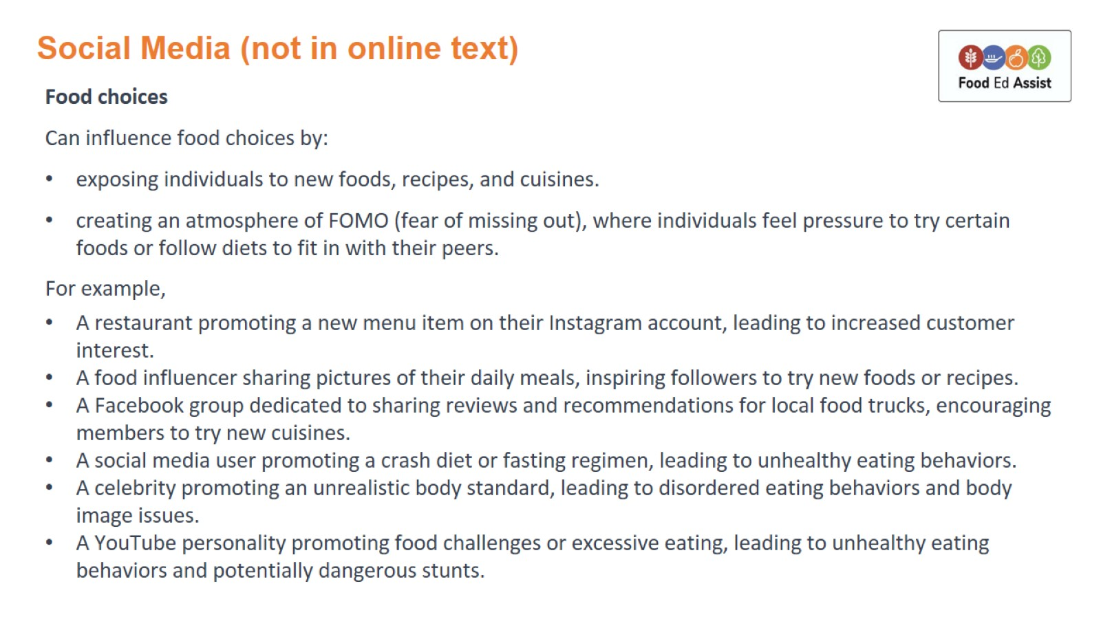
Social Media (not in online text)

Slide 9
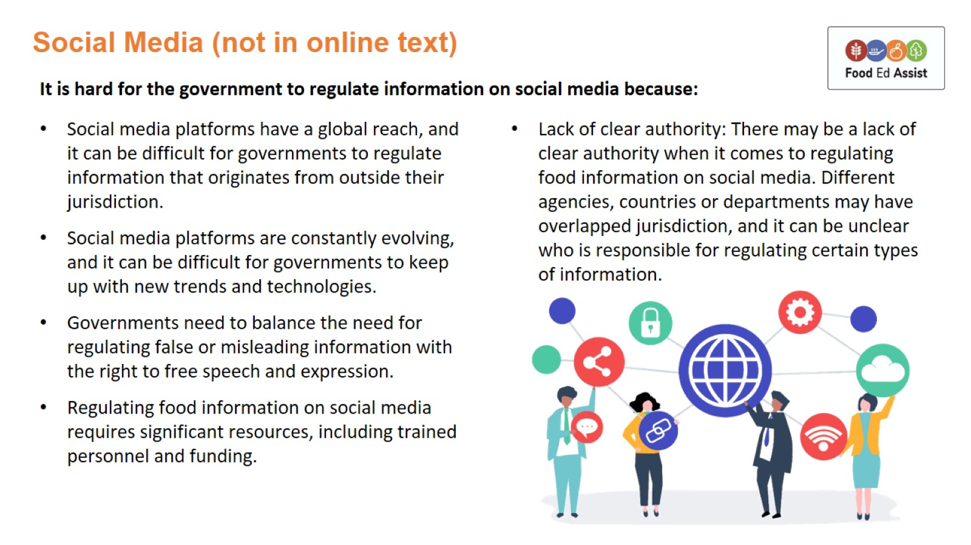
Social Media (not in online text)

Slide 10
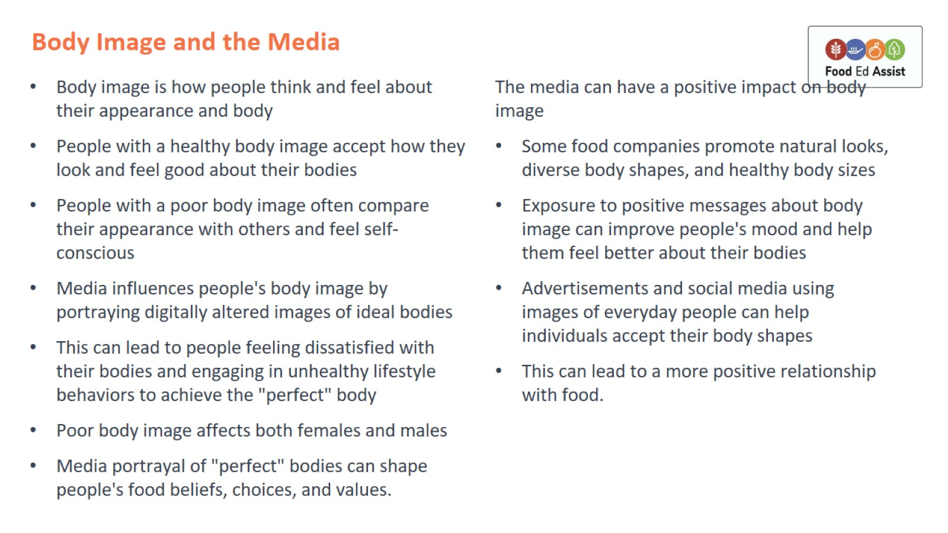
Body Image and the Media

Slide 11
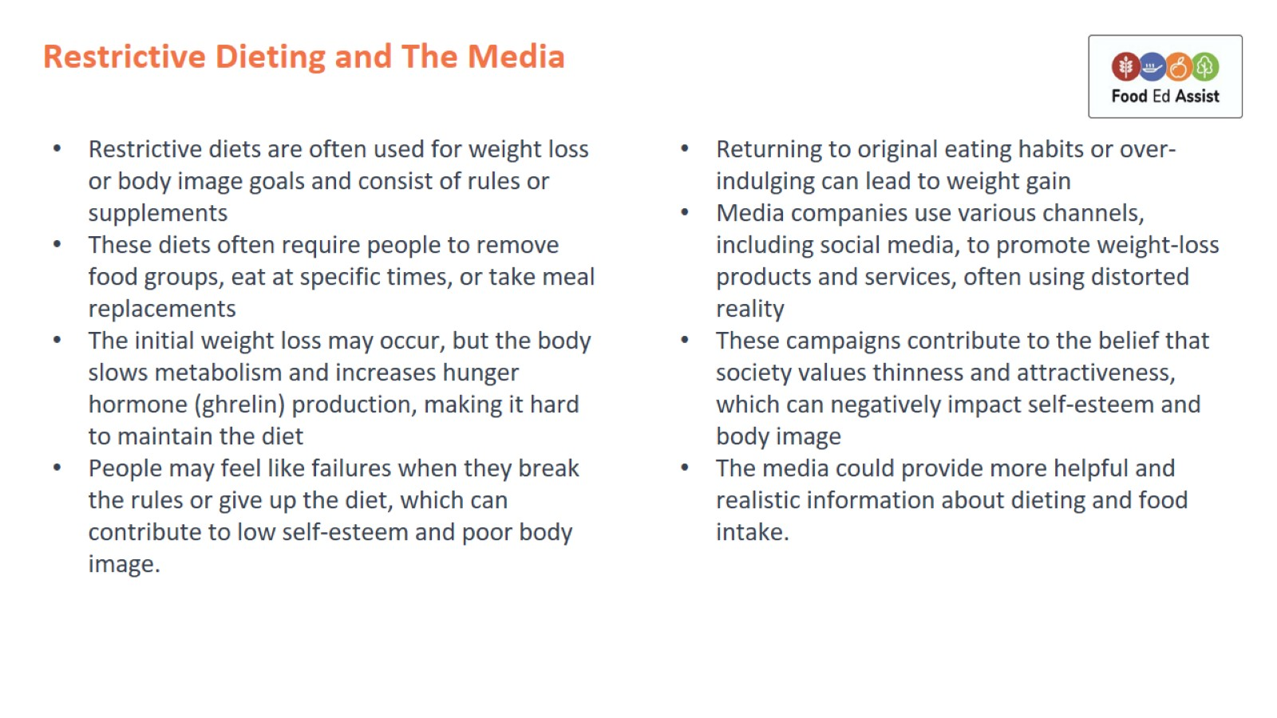
Restrictive Dieting and The Media

Slide 12
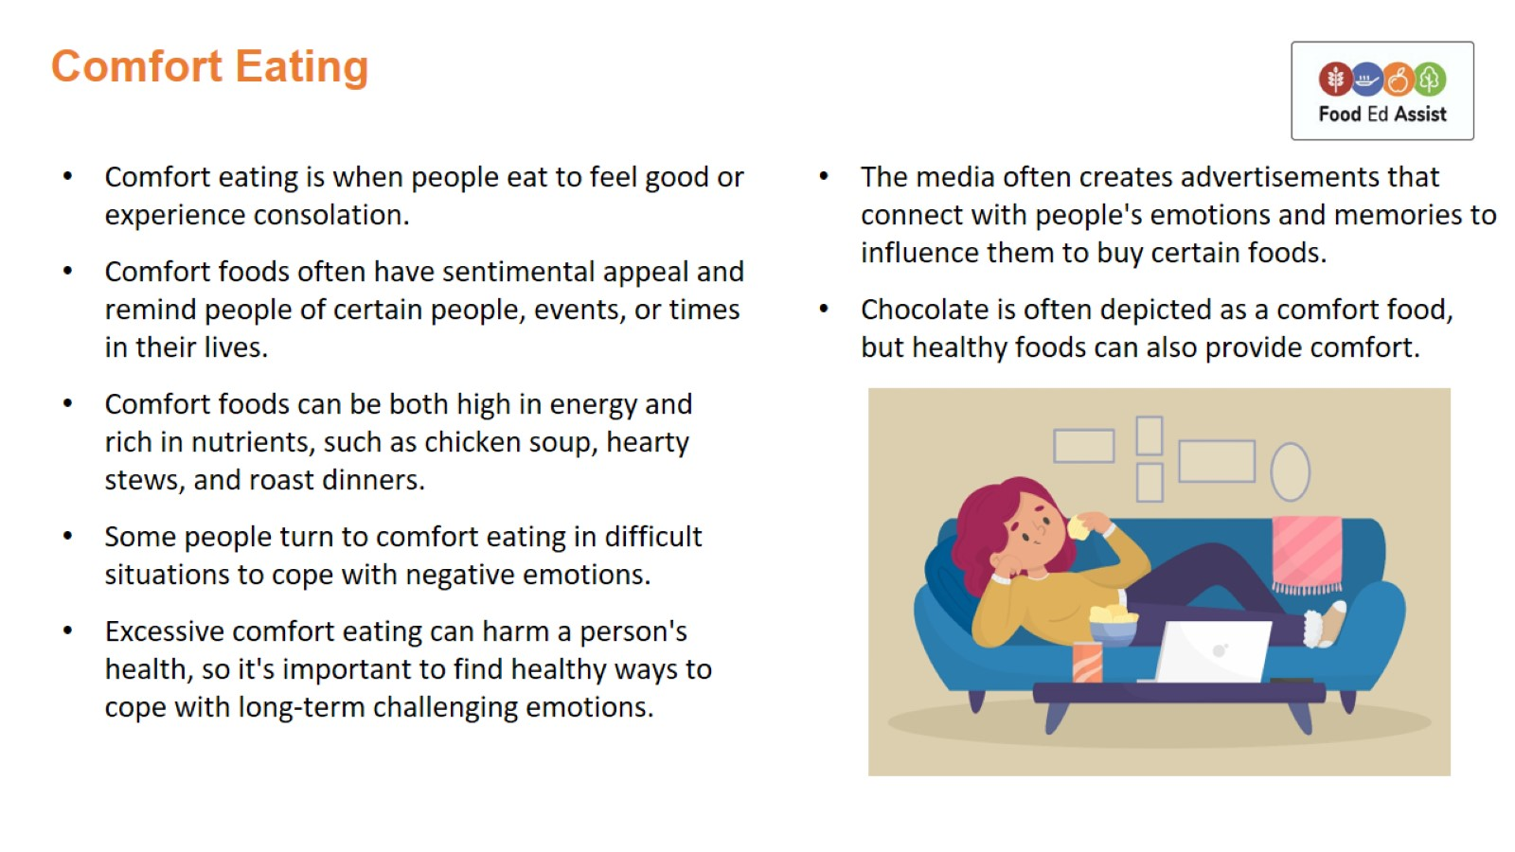
Comfort Eating

Slide 13
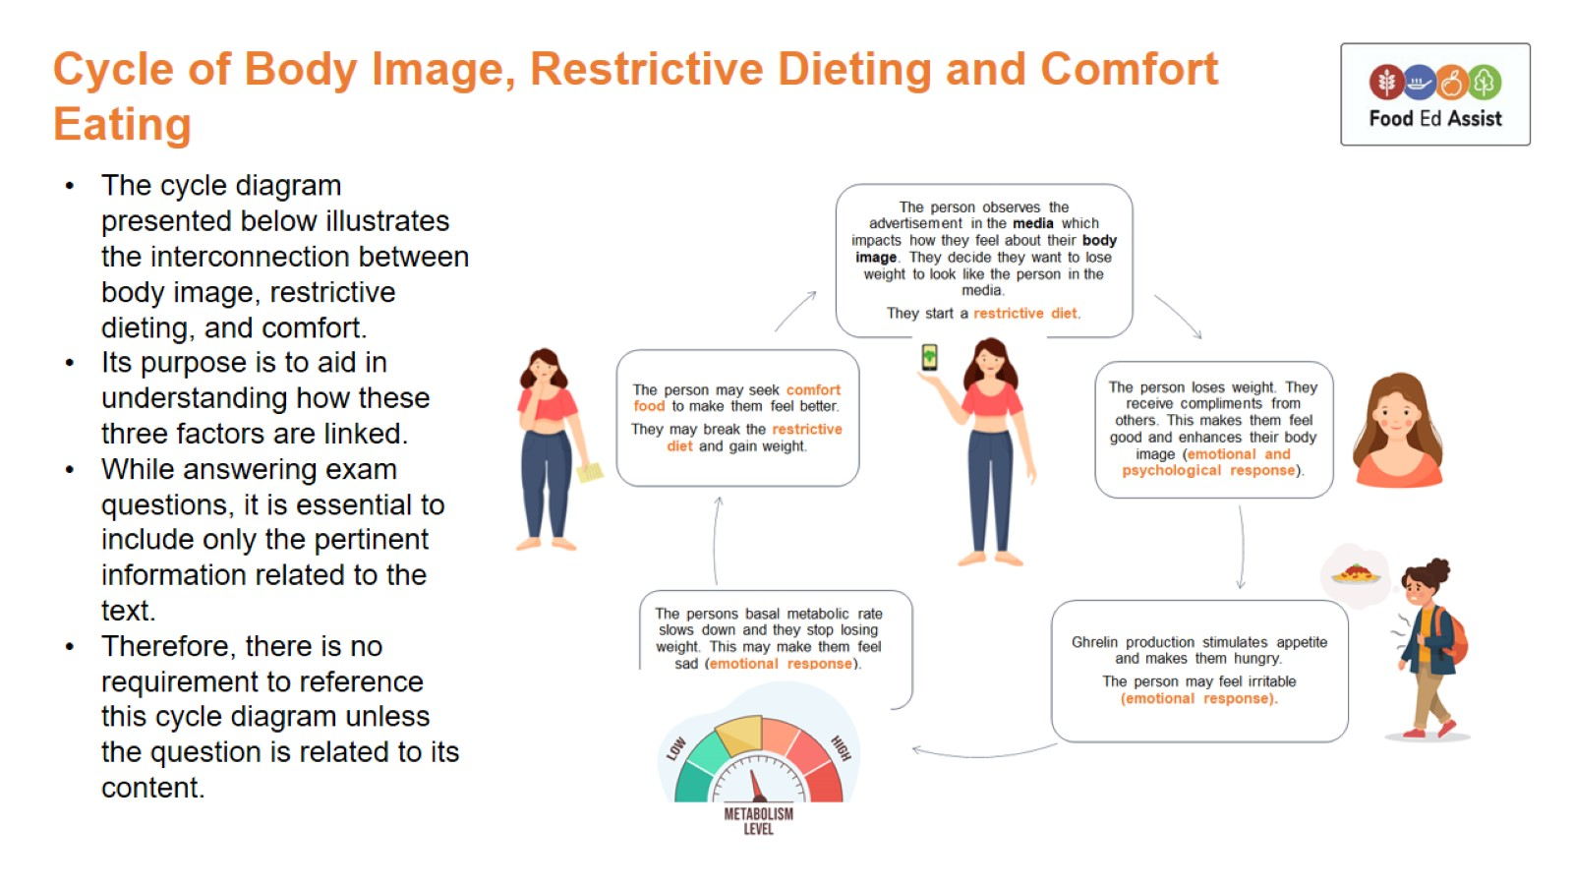
Cycle of Body Image, Restrictive Dieting and Comfort Eating

