Slide 1
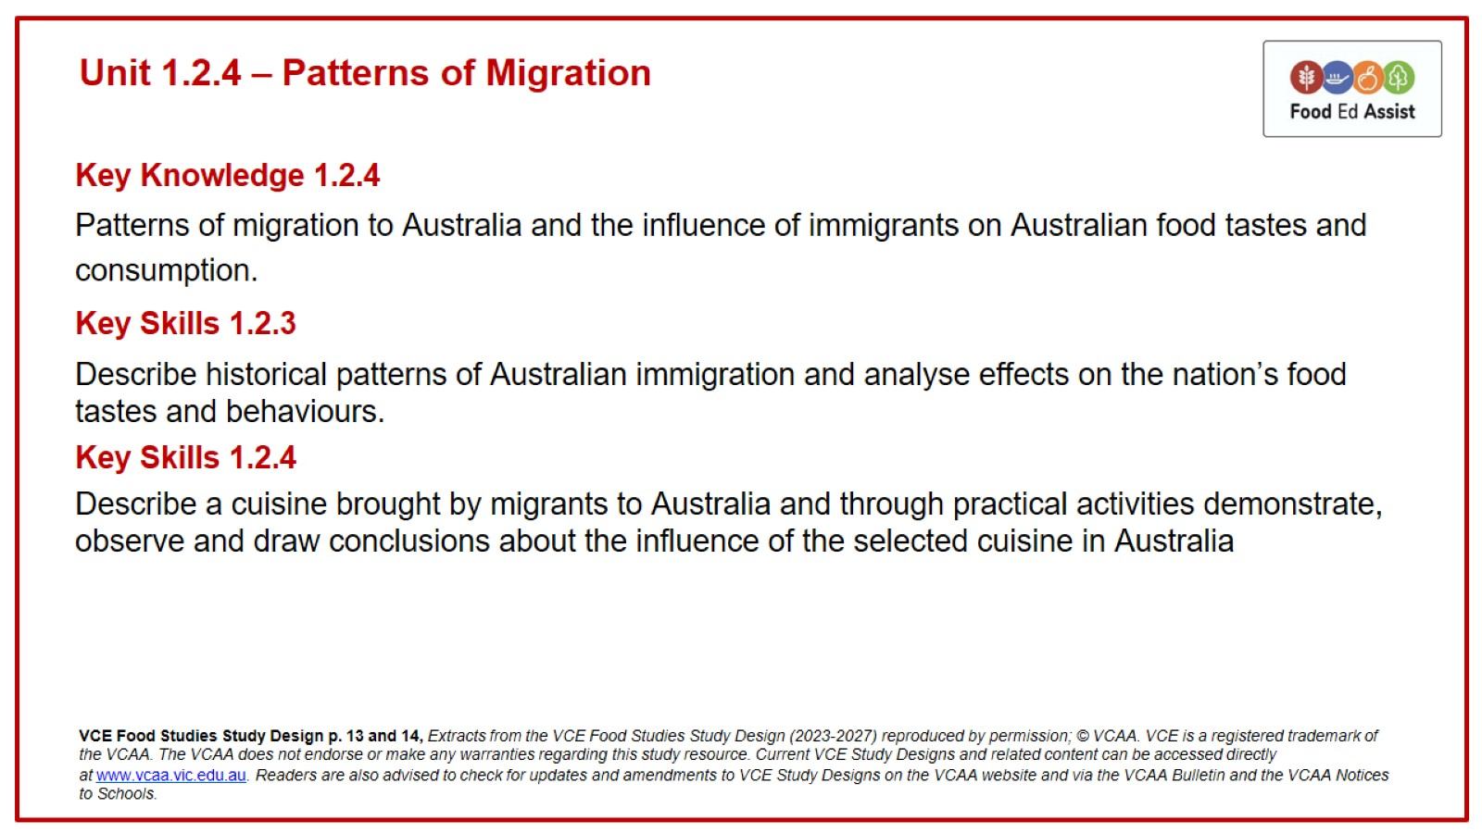
Unit 1.2.4 – Patterns of Migration

Slide 2
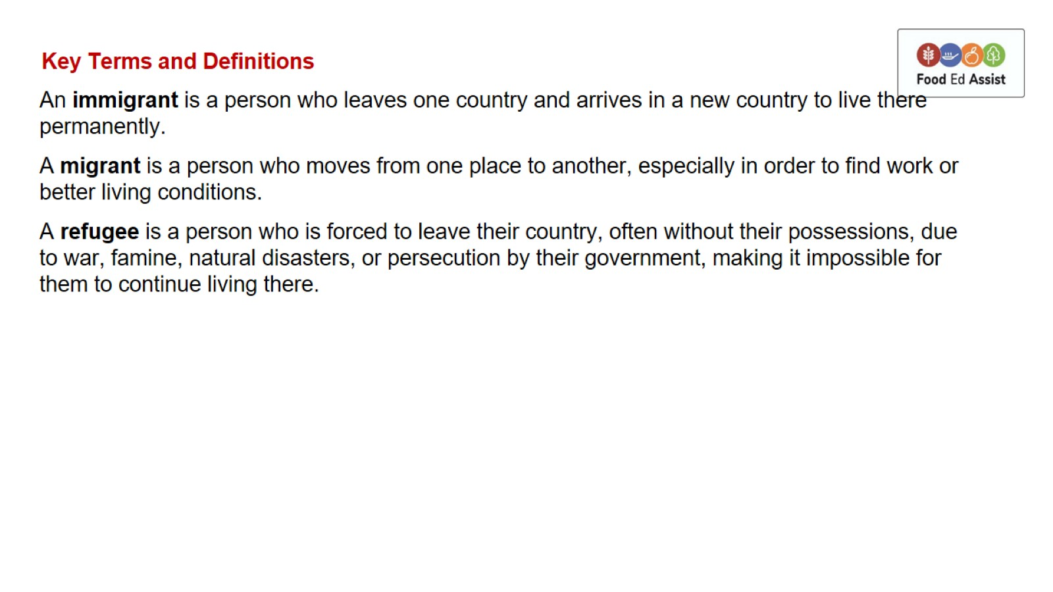
Key Terms and Definitions

Slide 3
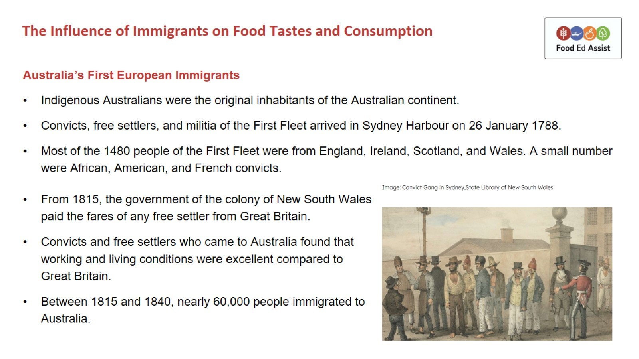
The Influence of Immigrants on Food Tastes and Consumption

Slide 4
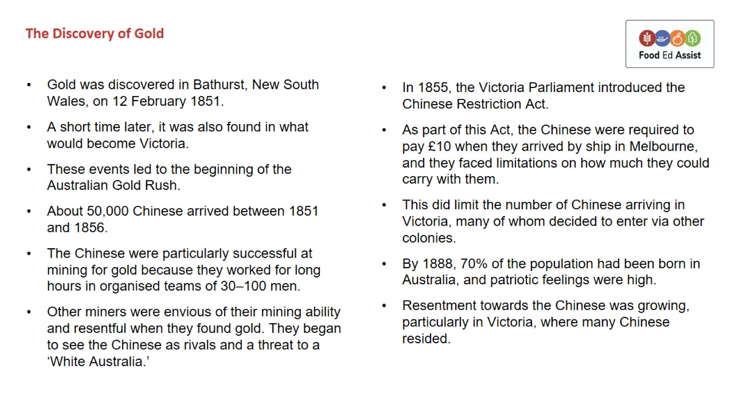
The Discovery of Gold

Slide 5
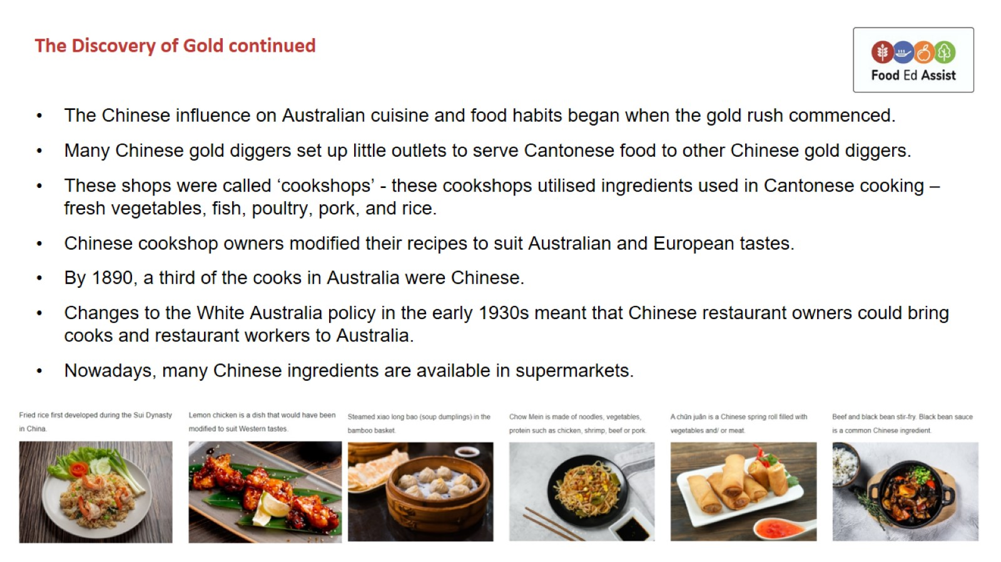
The Discovery of Gold continued

Slide 6
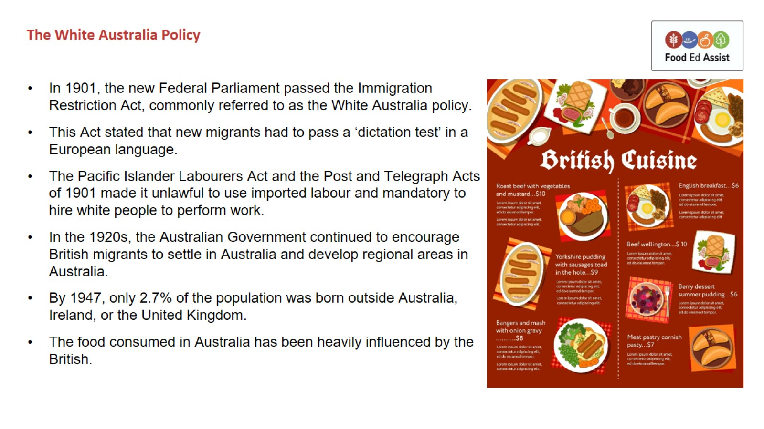
The White Australia Policy

Slide 7
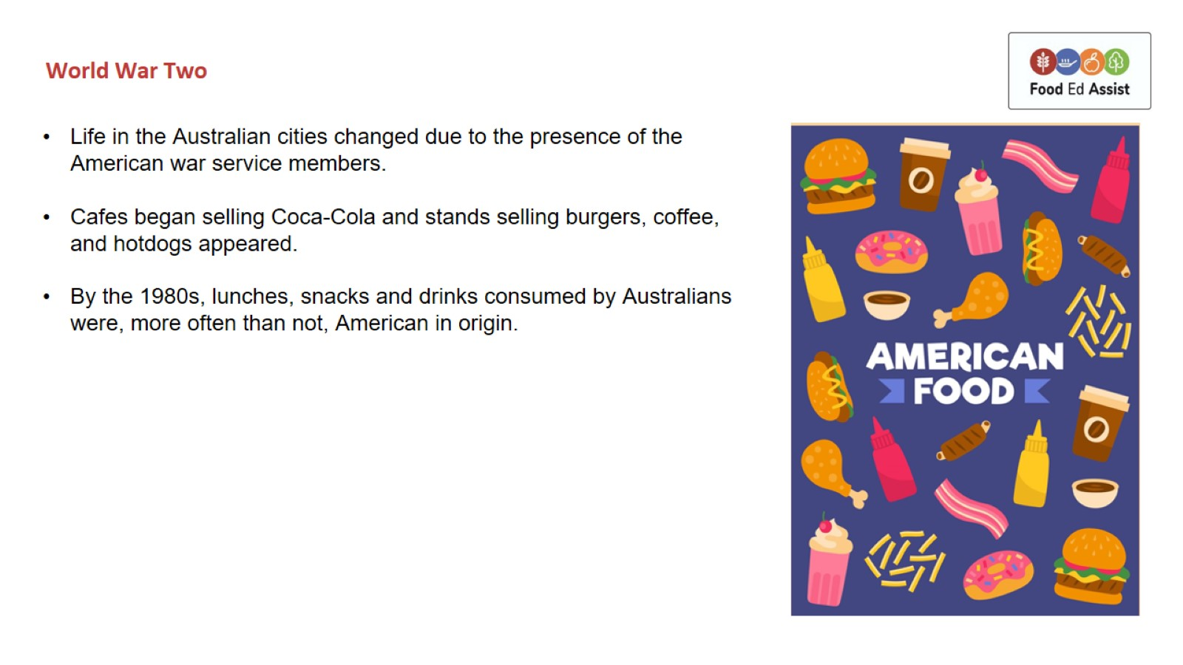
World War Two

Slide 8
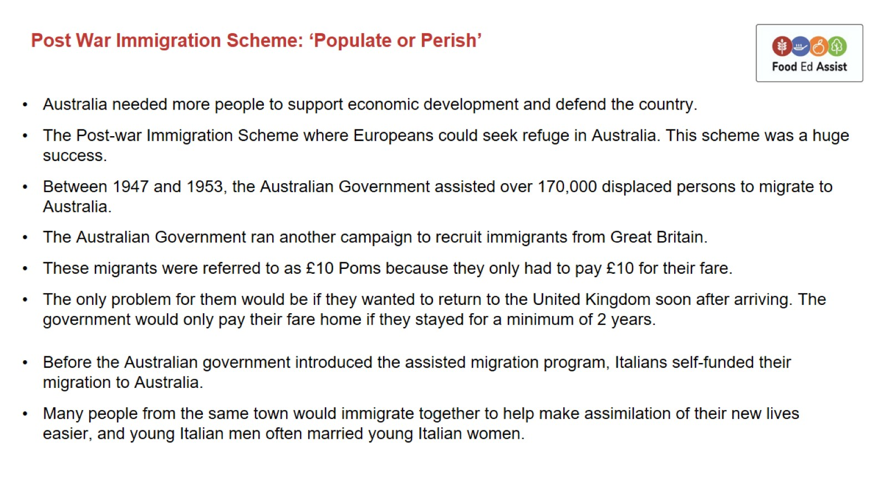
Post War Immigration Scheme: ‘Populate or Perish’

Slide 9
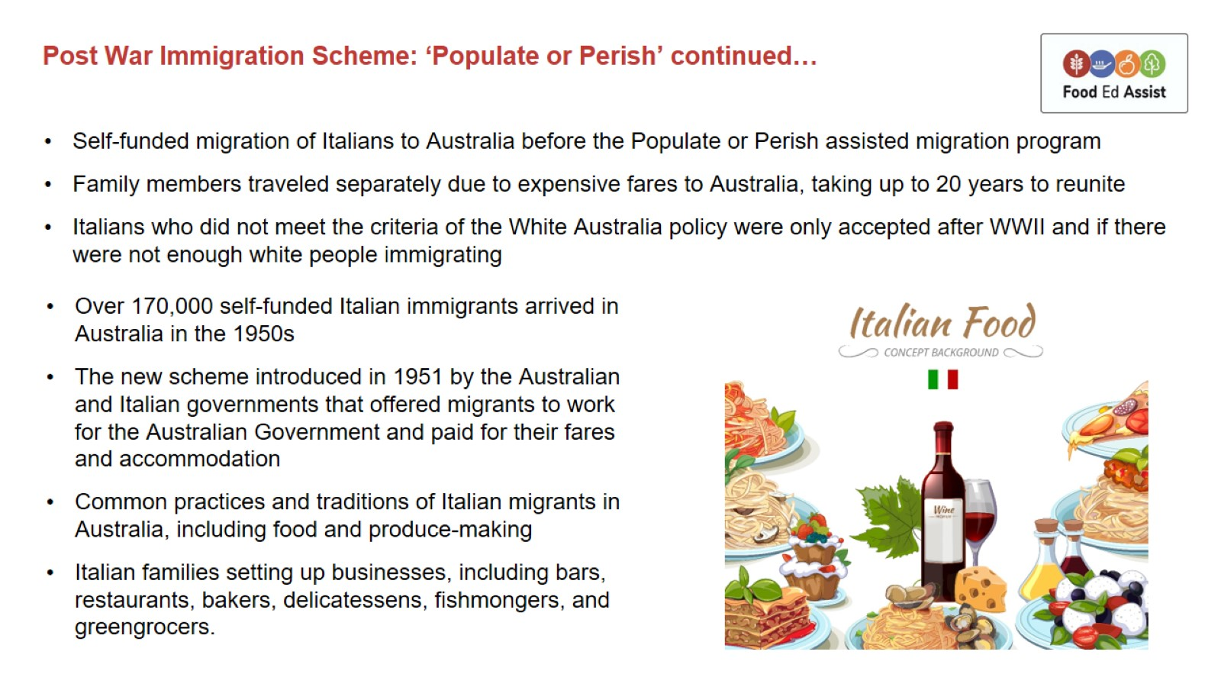
Post War Immigration Scheme: ‘Populate or Perish’ continued…

Slide 10
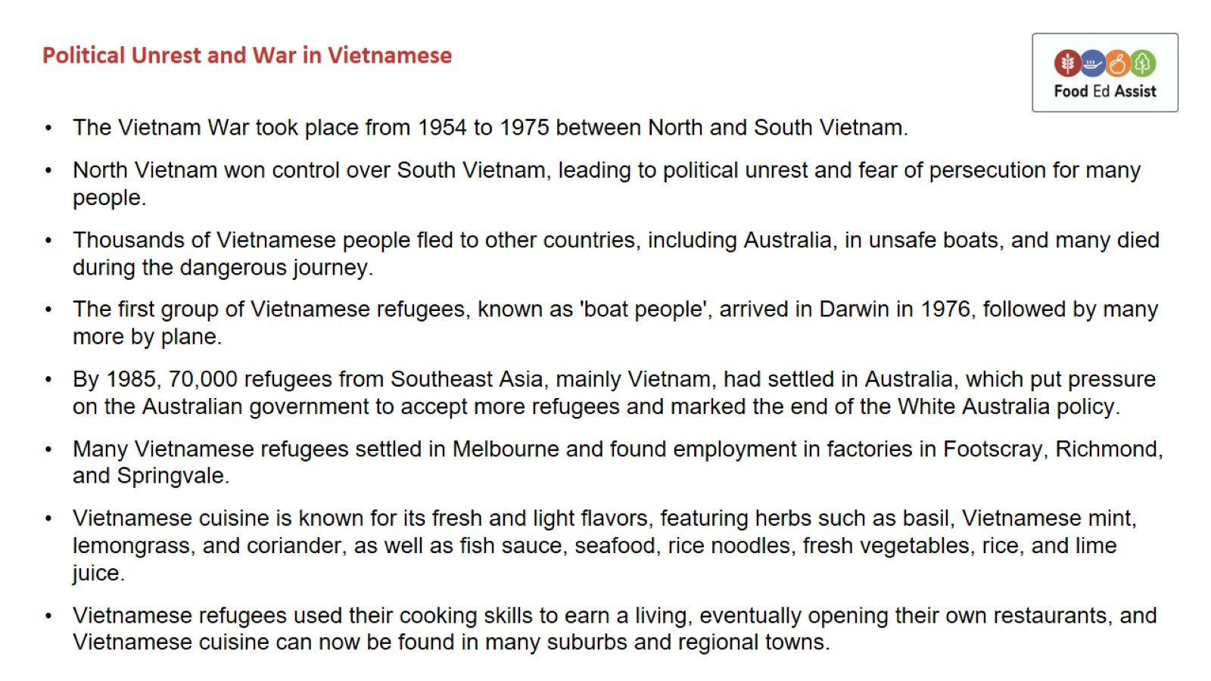
Political Unrest and War in Vietnamese

