Slide 1
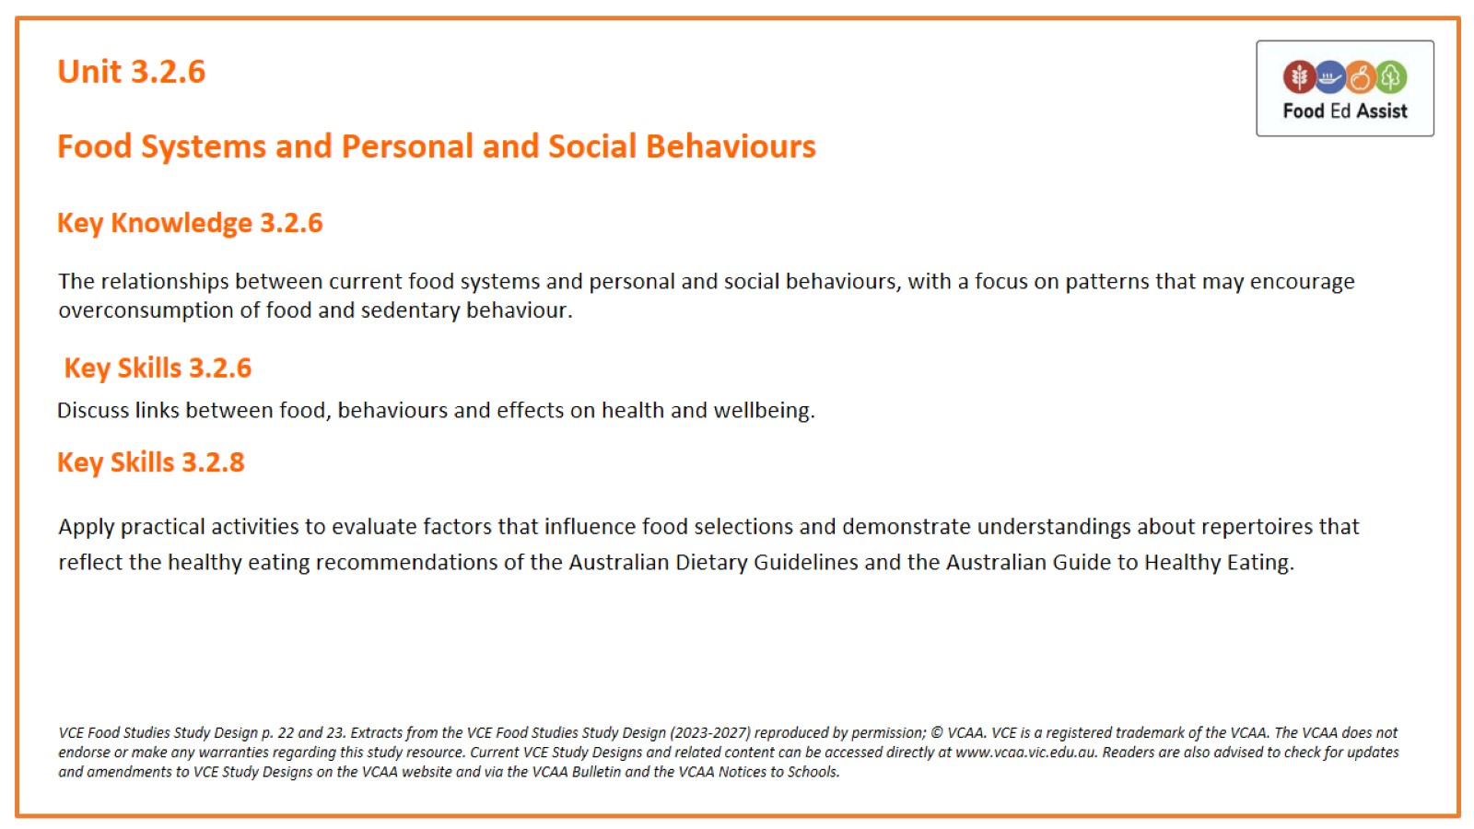
Unit 3.2.6

Slide 2
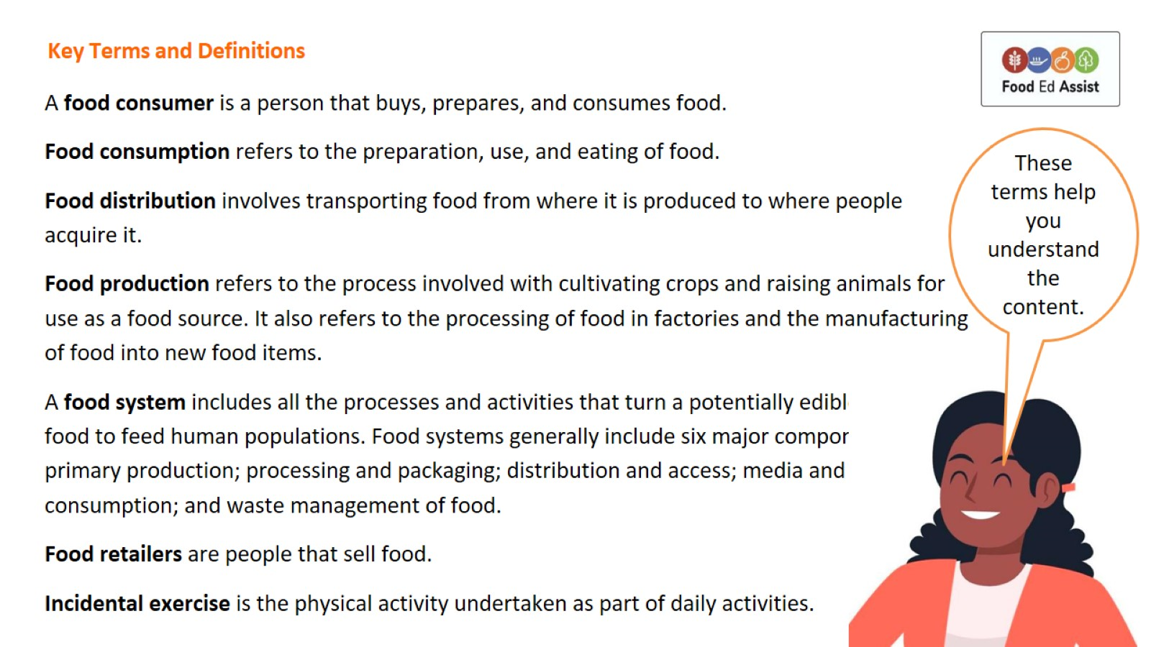
Key Terms and Definitions

Slide 3
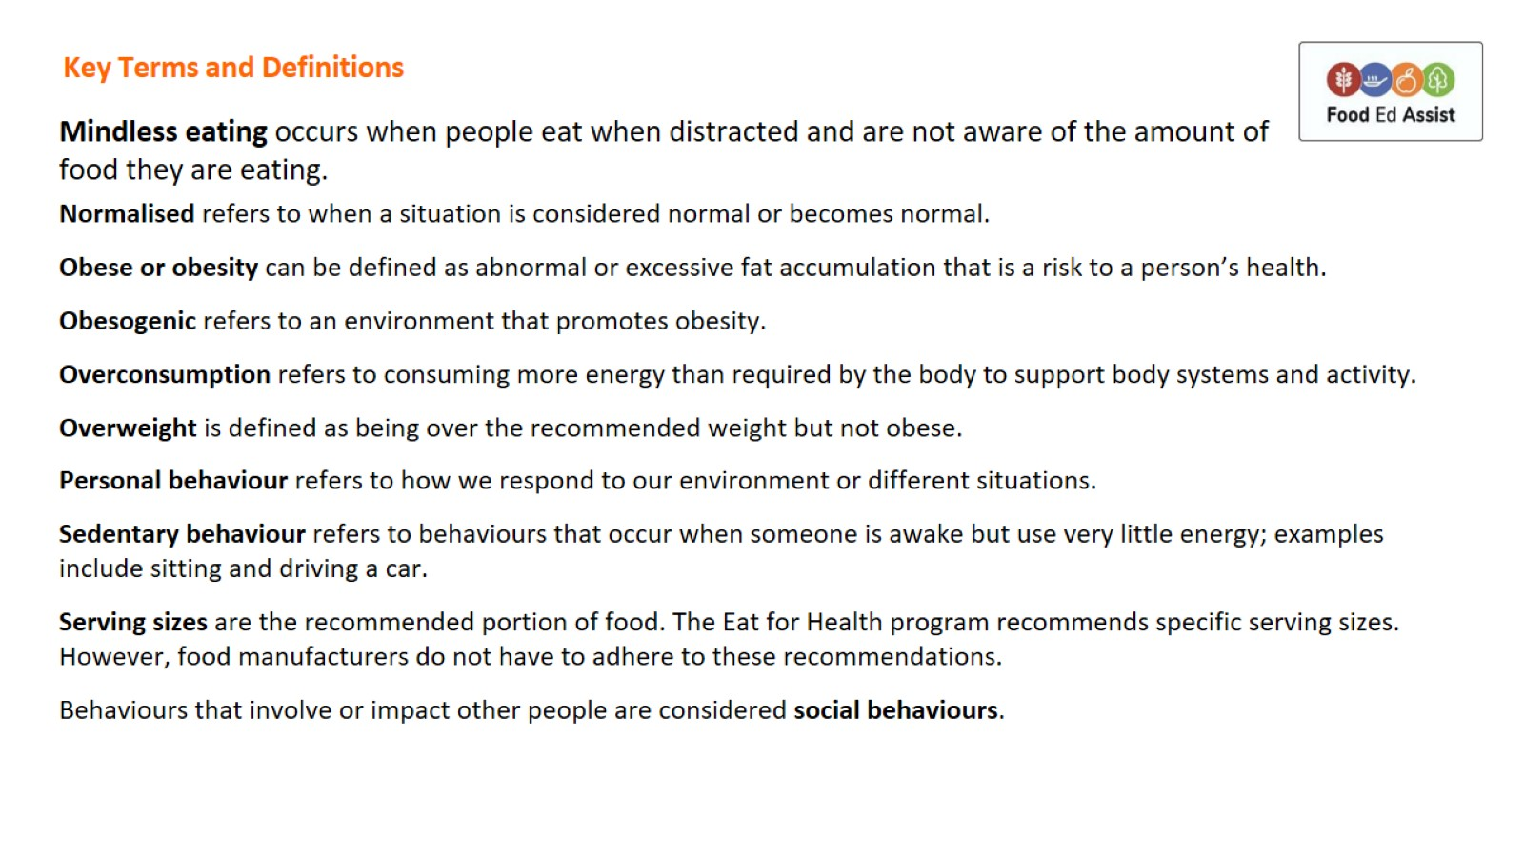
Key Terms and Definitions

Slide 4
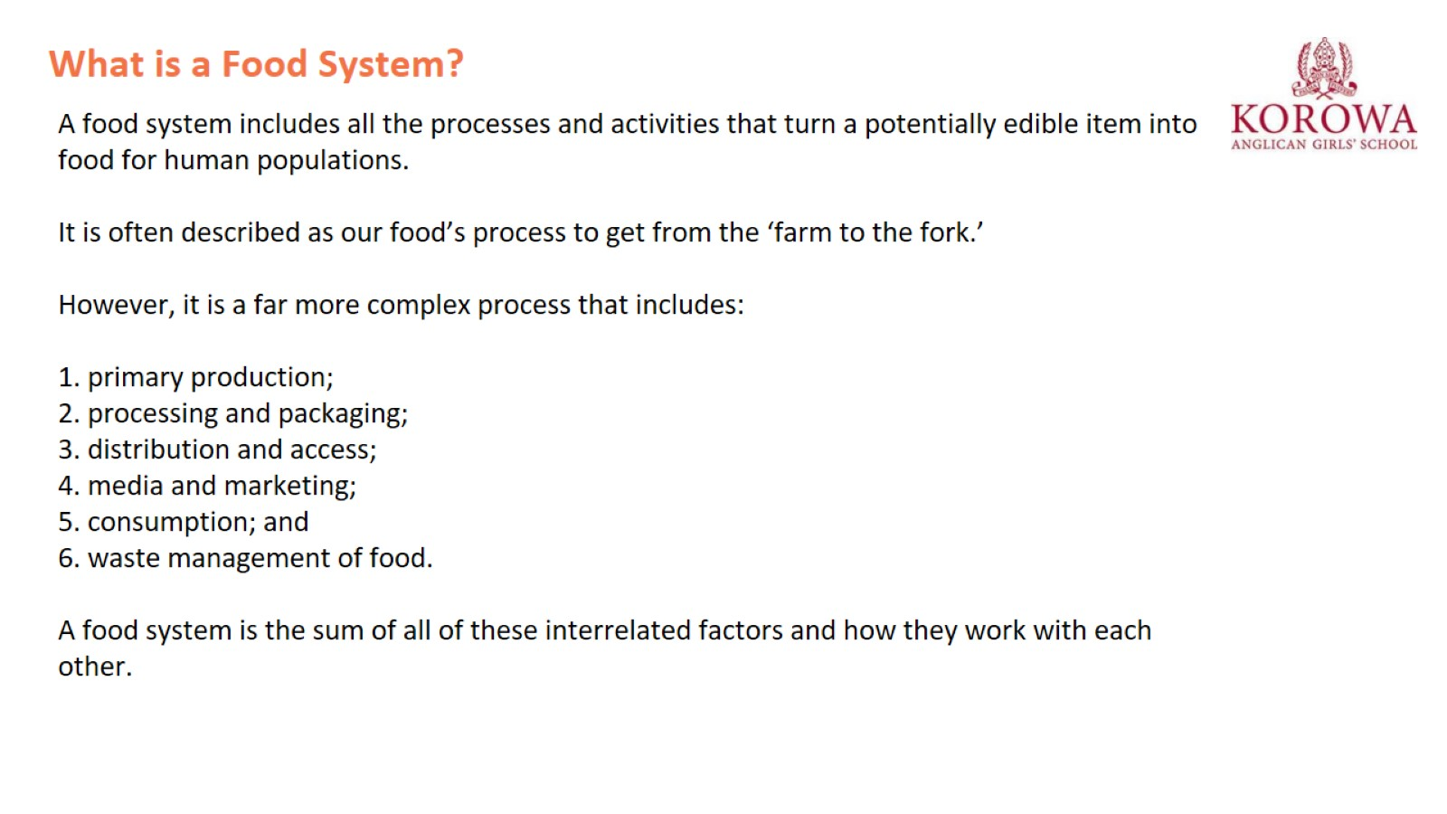
What is a Food System?

Slide 5
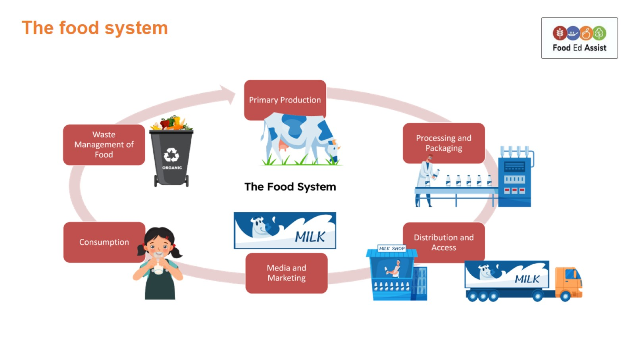
The food system

Slide 6
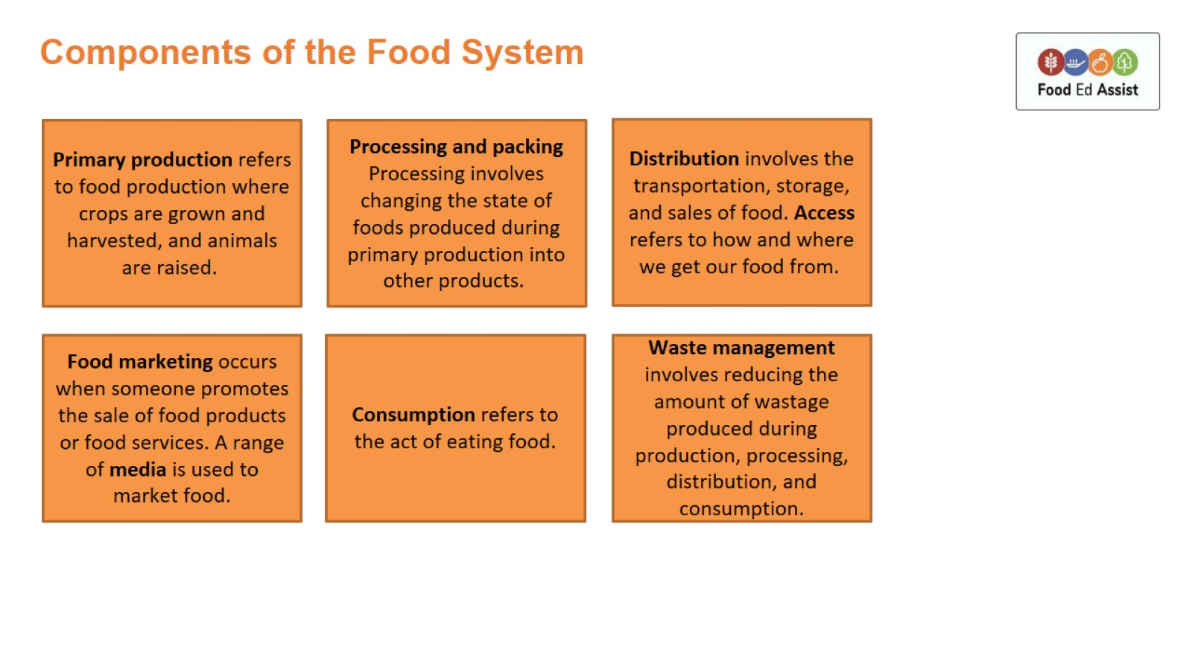
Components of the Food System

Slide 7
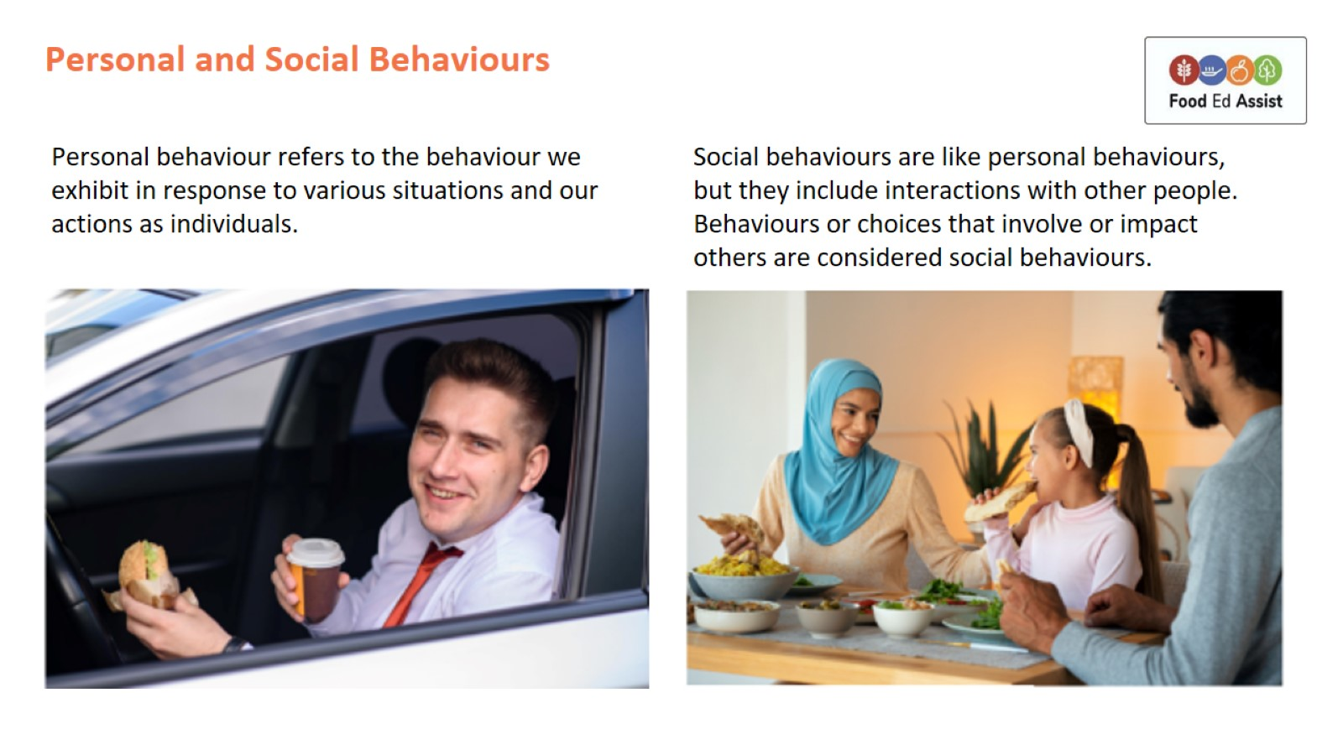
Personal and Social Behaviours

Slide 8
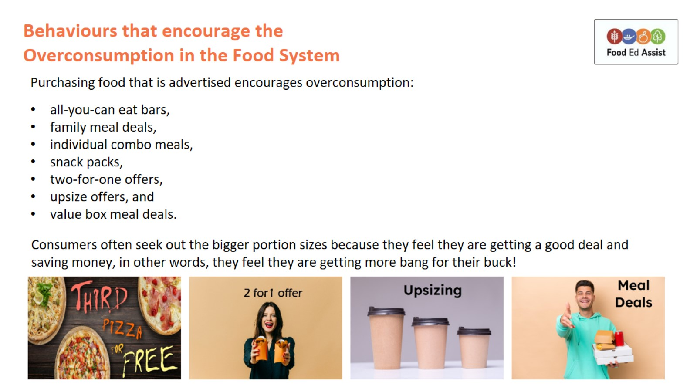
Behaviours that encourage the Overconsumption in the Food System

Slide 9
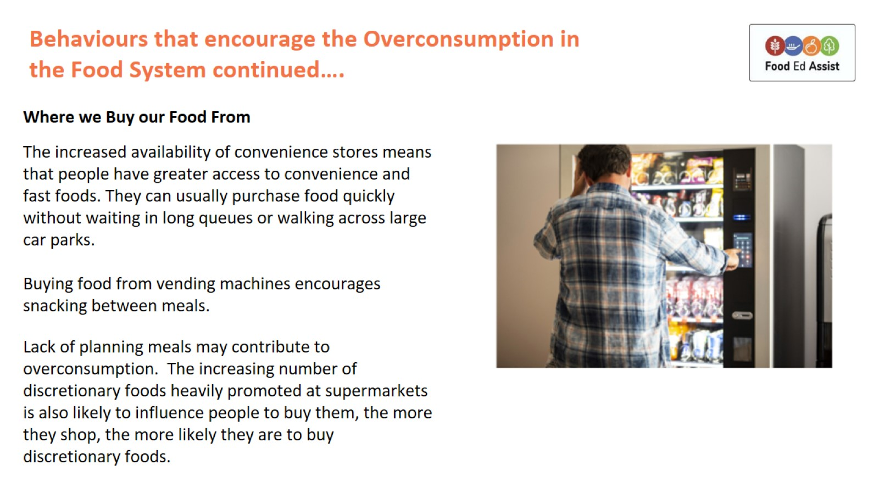
Behaviours that encourage the Overconsumption in the Food System continued….

Slide 10
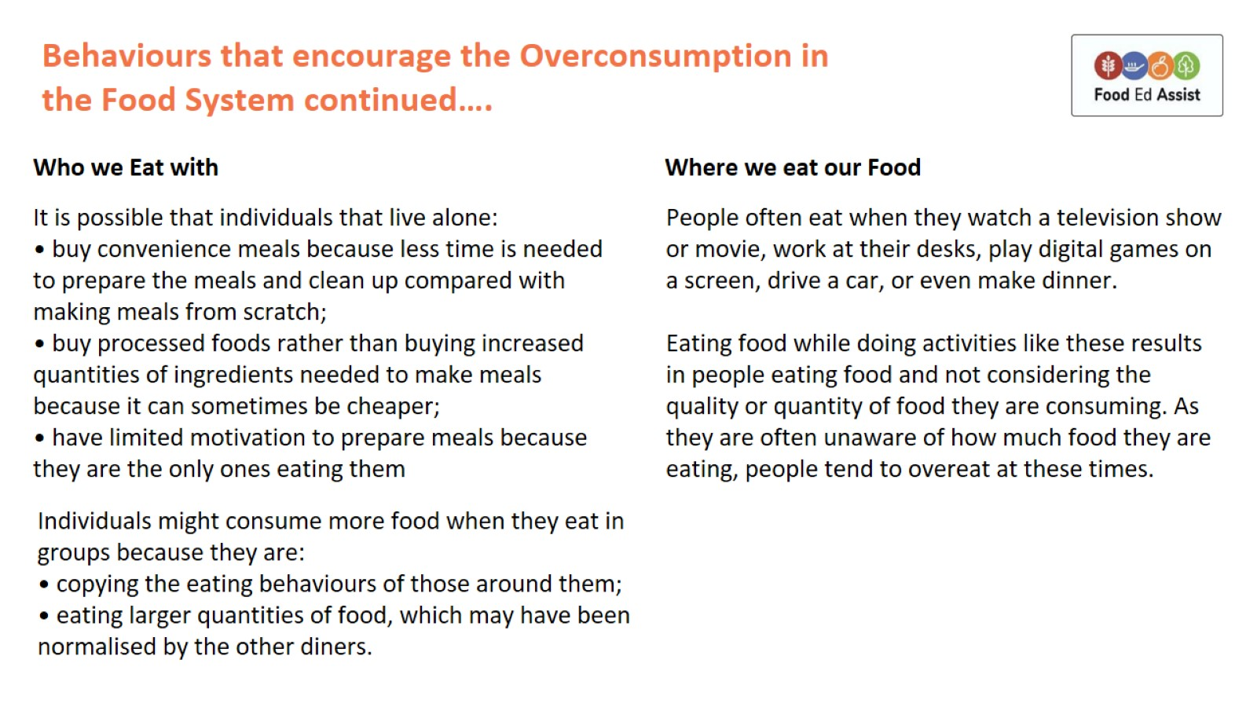
Behaviours that encourage the Overconsumption in the Food System continued….

Slide 11
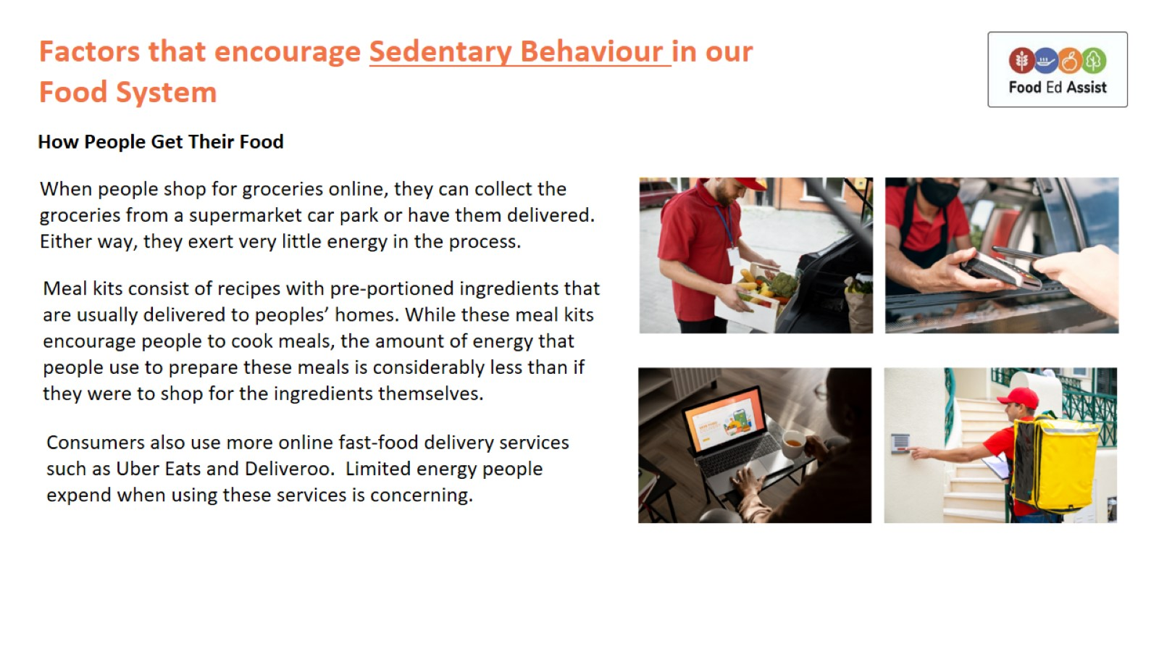
Factors that encourage Sedentary Behaviour in our Food System

