Slide 1
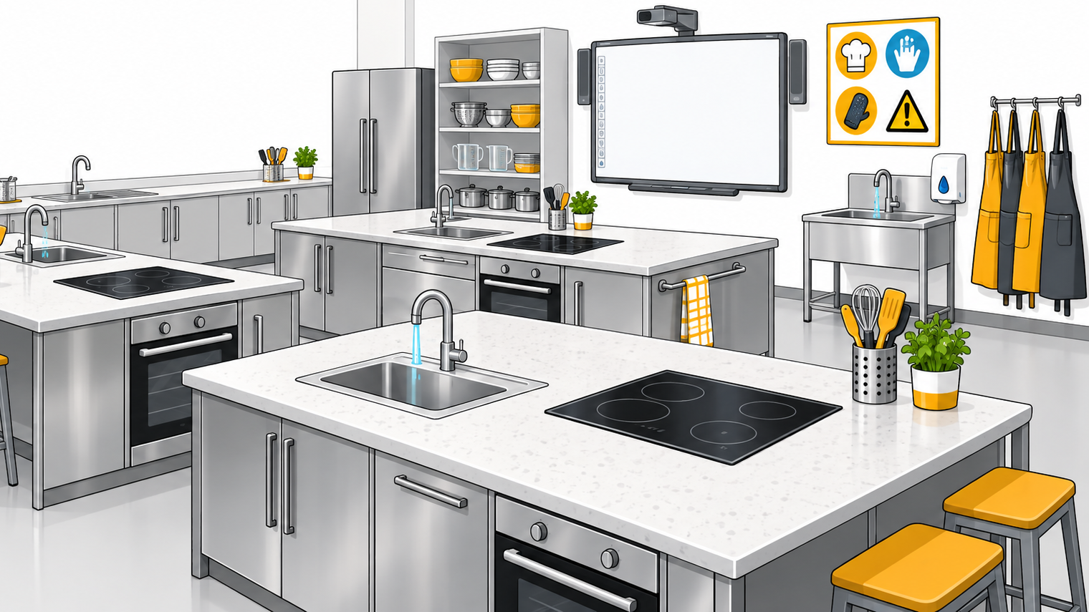

Kitchen Ready
Master personal hygiene, safe food routines and kitchen workflows.

Slide 2
Key Knowledge
Key Skills
personal hygiene practices used to prevent food
contamination and foodborne illness during food preparation.
harmful microorganisms that may be transferred to food
through poor personal hygiene and their potential impact on health.
apply personal hygiene practices to safely prepare
food.
explain how personal hygiene practices reduce the risk of food contamination and foodborne illness.

Slide 3
Learning Intentions
Success Criteria
We are learning to:
Understand how harmful microorganisms can contaminate food and cause illness.
Explain how personal hygiene and cleaning routines help keep food safe.
Apply safe hygiene practices before, during and after preparing food.
I have achieved this when I can:
Identify hygiene risks and explain how microorganisms could be transferred to food.
Choose a suitable hygiene or cleaning action and explain why it helps keep food safe.
Demonstrate safe routines when getting ready, preparing food and cleaning up.

Slide 4
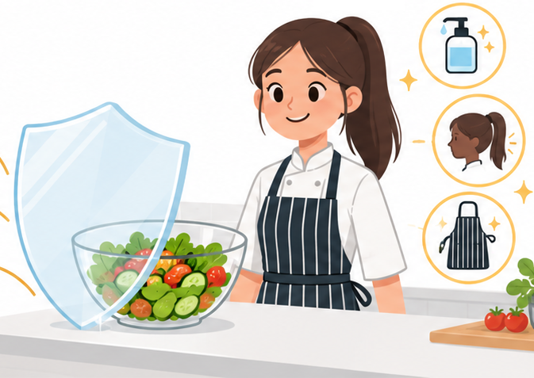
Essential Question
How can personal hygiene practices prevent food contamination and keep people safe when cooking?

Slide 5
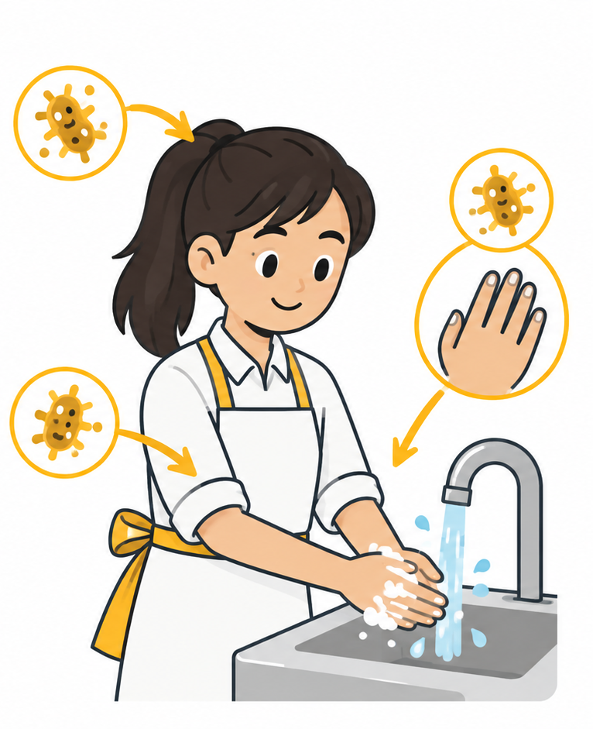
Personal Hygiene
Personal hygiene refers to keeping your body, hands, fingernails, hair and clothing clean.
Why does Personal Hygiene Matter?
Microorganisms on us can get into food and make it unsafe to eat.

Slide 6
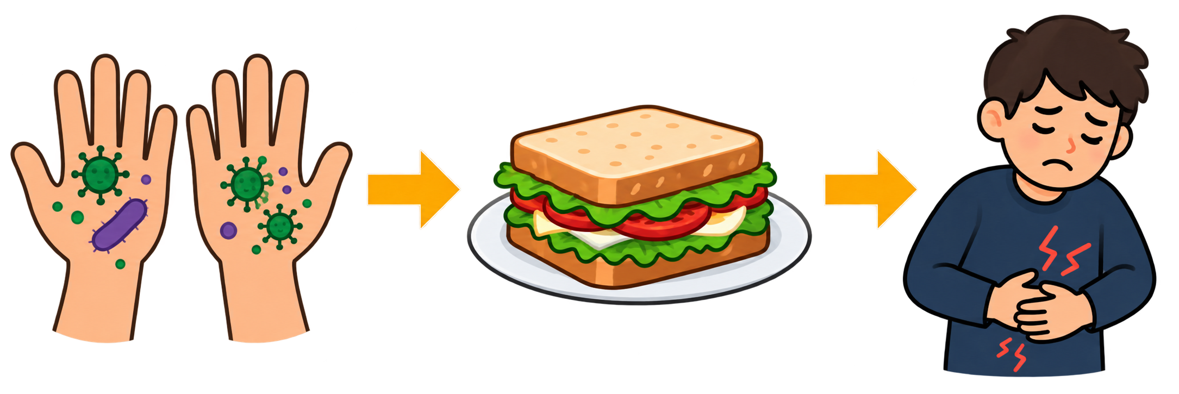
Some Microorganisms can Make us Sick
Harmful Bacteria
Salmonella
Campylobacter
E. Coli
Norovirus
Virus
Food Poisoning Symptoms
Nausea, vomiting, stomach cramps, diarrhoea and fever.
Norovirus

Slide 7
Check Your Thinking
You only need to wash your hands if they look or feel visibly dirty.
👍 TRUE
👎 FALSE
🤔 Be ready to explain your thinking.

Slide 8
Check Your Thinking
✅
You only need to wash your hands if they look or feel visibly dirty.
✓
👍 TRUE
👎 FALSE
🔑
Why is that?
Harmful microorganisms are invisible, so even if your hands look clean, there may still be backing on them.

Slide 9
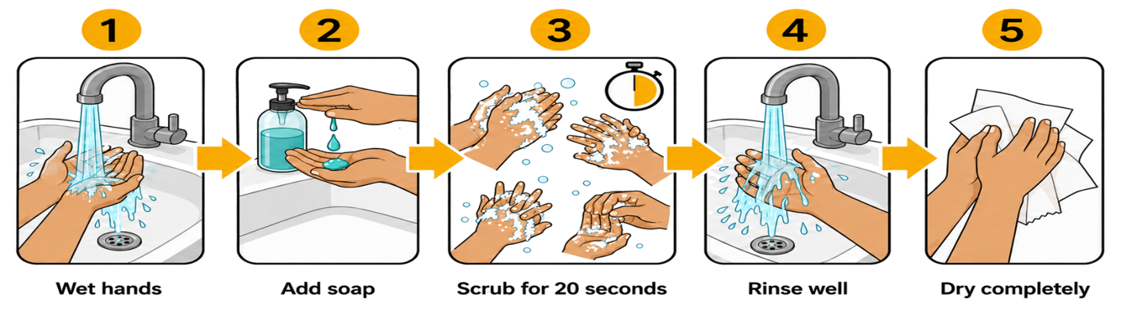
Washing Your Hands
Hands can pick up microorganisms from many places, including phones, door handles, benches, raw food, your face and hair.
Wash your hands thoroughly with warm water and soap for at least 20 seconds, then dry them using a clean paper towel or hand towel.

Slide 10
Sequence the Cleanse
Arrange the standard hand hygiene stages into the correct chronological order:
Vigorously scrub palms, webs and nails for 20 seconds
Wet hands under clean, warm running tap water
Dispense liquid antibacterial soap onto the palms
Rinse lather away completely and dry using single-use paper

Slide 11
Sequence the Cleanse
✅
Arrange the standard hand hygiene stages into the correct chronological order:
Wet hands under clean, warm running tap water
Dispense liquid antibacterial soap onto the palms
Vigorously scrub palms, webs and nails for 20 seconds
Rinse lather away completely and dry using single-use paper

Slide 12
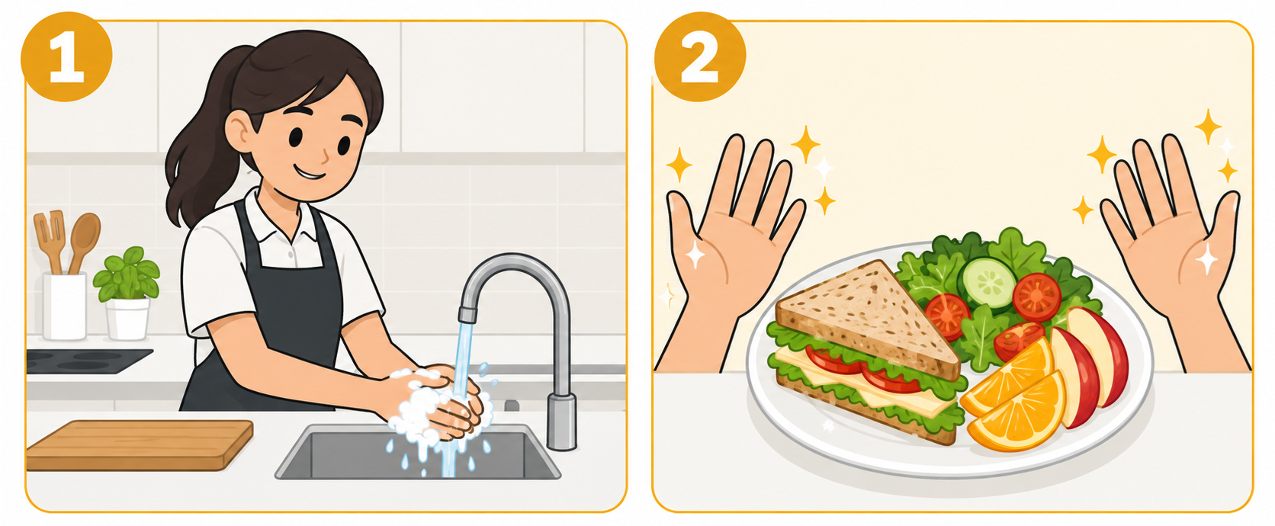
Wash your Hands BEFORE
Wash your hands BEFORE you start cooking foods or touch ready-to-eat foods.

Slide 13
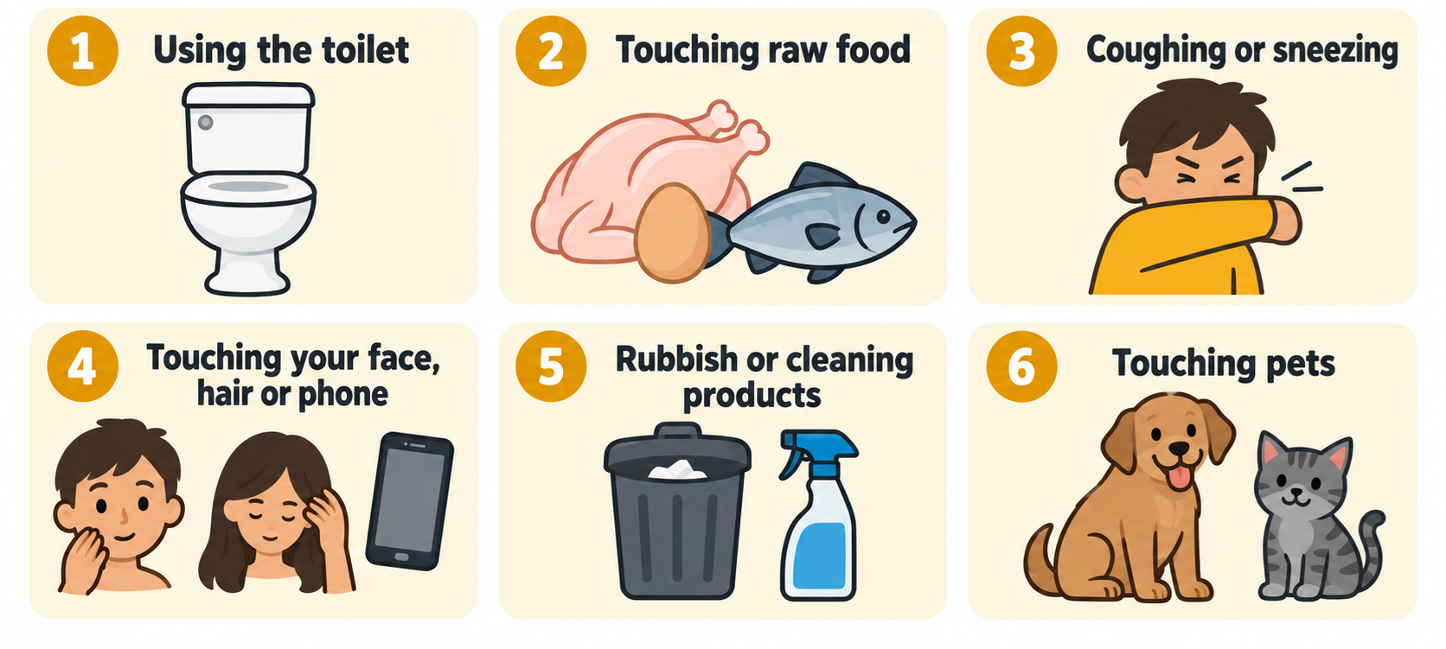
Wash your Hands AFTER
Wash your hands AFTER activities that may transfer microorganisms to food.

Slide 14
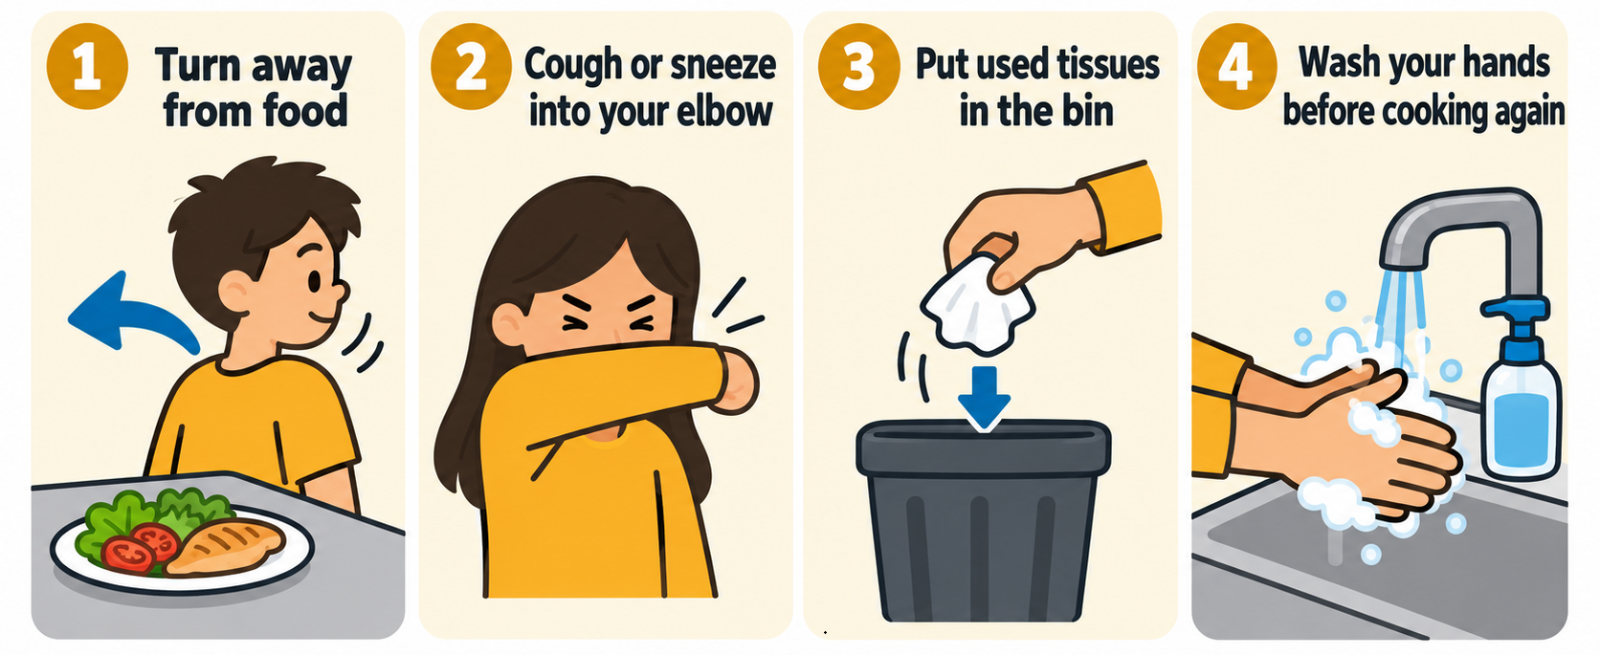
Coughing and Sneezing Safely
Never cough or sneeze over food, equipment or other people.
If you need to cough or sneeze:

Slide 15
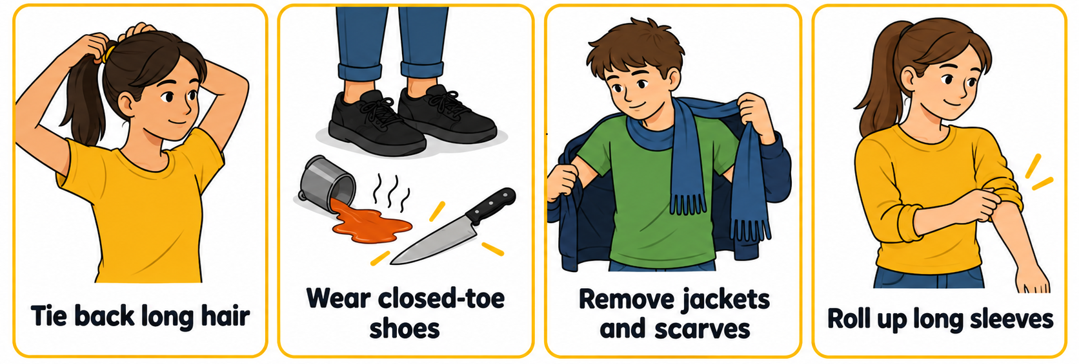
Keeping Yourself Kitchen Ready
Get Ready Before You Start Cooking
This keeps hair and clothing away from food and equipment.

Slide 16
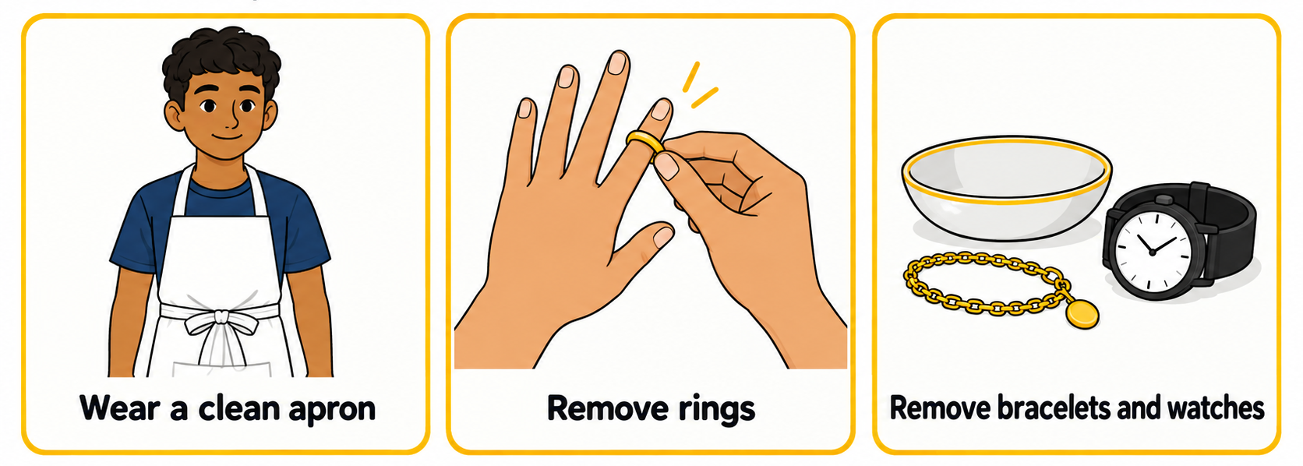
Keep dirt, bacteria and loose items out of food.
Jewellery can trap bacteria and make handwashing less effective.

Slide 17
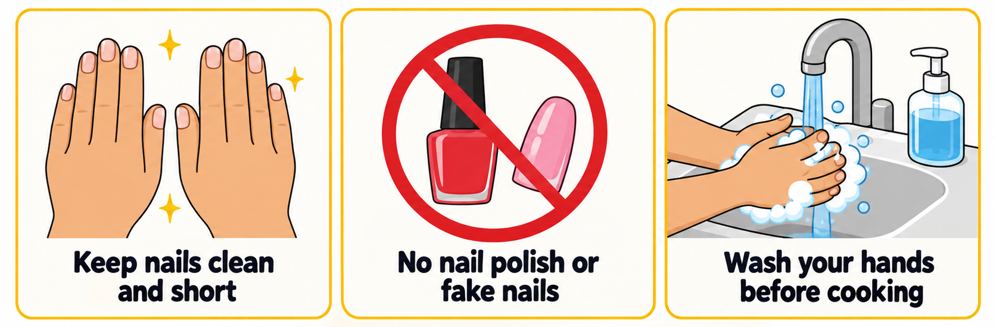
Clean, short nails help keep food safe.
Dirt and bacteria can collect under long, fake or painted nails.

Slide 18

Check Your Thinking
Which of the following attire practices are correct for food preparation? (Select all that apply):
1.
Tying long hair securely back behind the neck
2.
Leaving synthetic cardigan sleeves loose and unrolled near heat
3.
Wearing sturdy closed-toe shoes to prevent burns and crush injuries
4.
Wearing decorative rings and watches while kneading dough

Slide 19
Check Your Thinking
✅
Which of the following attire practices are correct for food preparation? (Select all that apply):
✓
1.
Tying long hair securely back behind the neck
2.
Leaving synthetic cardigan sleeves loose and unrolled near heat
✓
3.
Wearing sturdy closed-toe shoes to prevent burns and crush injuries
4.
Wearing decorative rings and watches while kneading dough

Slide 20
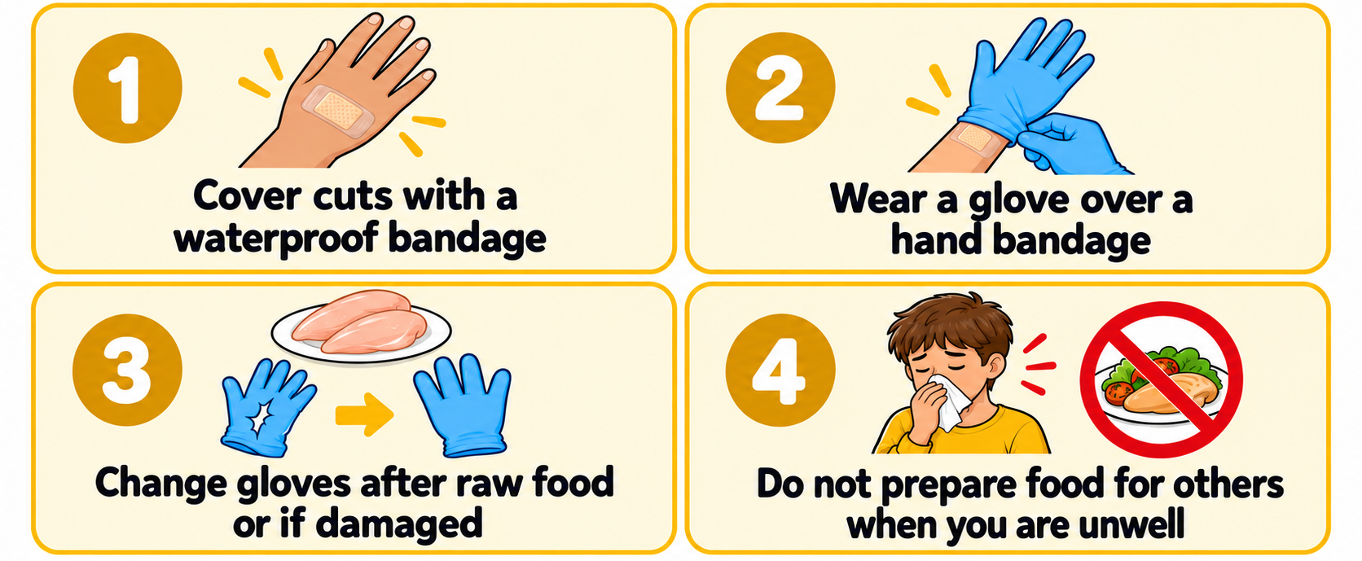
Cuts, Illness and Safe Food Handling
Small actions protect the people who eat the food you prepare.
Clean hands, clean clothing and safe habits prevent food borne illness.

Slide 21
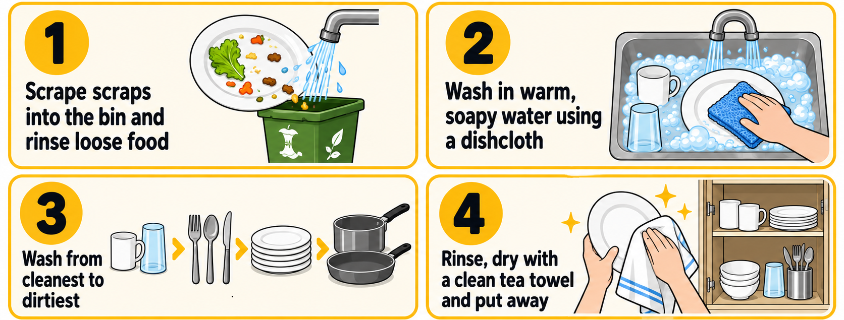
Cleaning up in the Kitchen
Wash, dry and put away every item.
A dishcloth washes dishes and benches. A tea towel dries utensils and equipment.

Slide 22
Check Your Knowledge
Which item should be washed first when cleaning up your kitchen workstation?
1.
Oily baking sheets and roasting trays
2.
Mixing bowls used for sticky dough
3.
Glass tumblers and measuring cups
4.
Greasy saucepans and frying pans

Slide 23
Check Your Knowledge
✅
Which item should be washed first when cleaning up your kitchen workstation?
1.
Oily baking sheets and roasting trays
2.
Mixing bowls used for sticky dough
✅
3.
Glass tumblers and measuring cups
4.
Greasy saucepans and frying pans

Slide 24
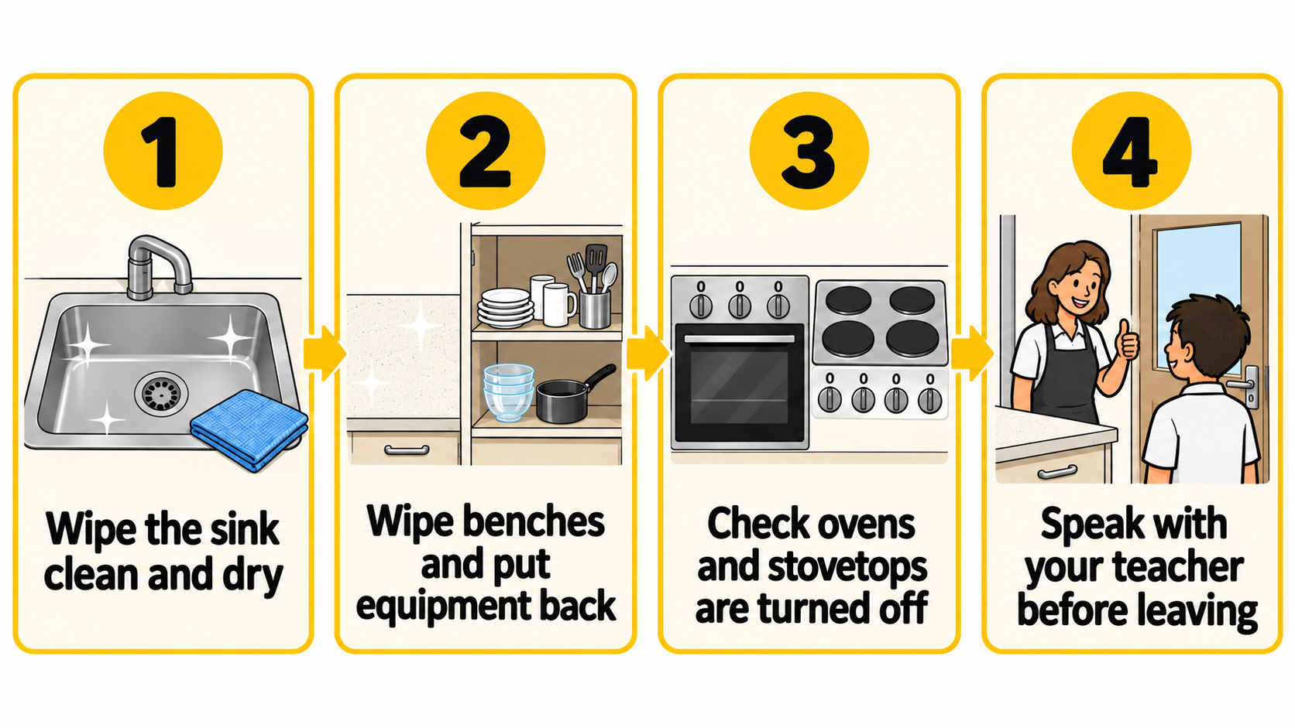
Leave the Kitchen Ready
The next class should find a clean, dry and safe kitchen.
A wet or dirty sink can attract pests such as ants, cockroaches, flies and mice.

Slide 25
Check Your Thinking
Write the best next action for each situation:
1.
Put the phone away and wash hands.
2.
Cover it with a waterproof bandage; add a glove if it is on your hand.
3.
Turn away, cough into your elbow or use a tissue, dispose of it, then wash hands..
4.
Wipe the sink clean and dry.

Slide 26
Check Your Thinking
✅
Write the best next action for each situation:
1.
You touch your phone while preparing a sandwich.
2.
You notice a small cut on your finger.
3.
You cough while measuring ingredients.
4.
You finish washing the dishes, but the sink is still wet.

Slide 27
Key Terminology Check
Match the words with the definitions
Dishcloth
Transfer of harmful microbes from one surface, food or person to another
Cross-contamination
A textured cloth used with warm soapy water to wash dishes and surfaces
Tea towel
Tiny living organisms invisible without a microscope, including bacteria and viruses
Microorganisms
A clean, dry cloth used exclusively for drying washed dishes and utensils

Slide 28
Key Terminology Check
✅
Match the words with the definitions
Dishcloth
Transfer of harmful microbes from one surface, food or person to another
A
Cross-contamination
A textured cloth used with warm soapy water to wash dishes and surfaces
B
Tea towel
Tiny living organisms invisible without a microscope, including bacteria and viruses
C
Microorganisms
A clean, dry cloth used exclusively for drying washed dishes and utensils
D

Slide 29
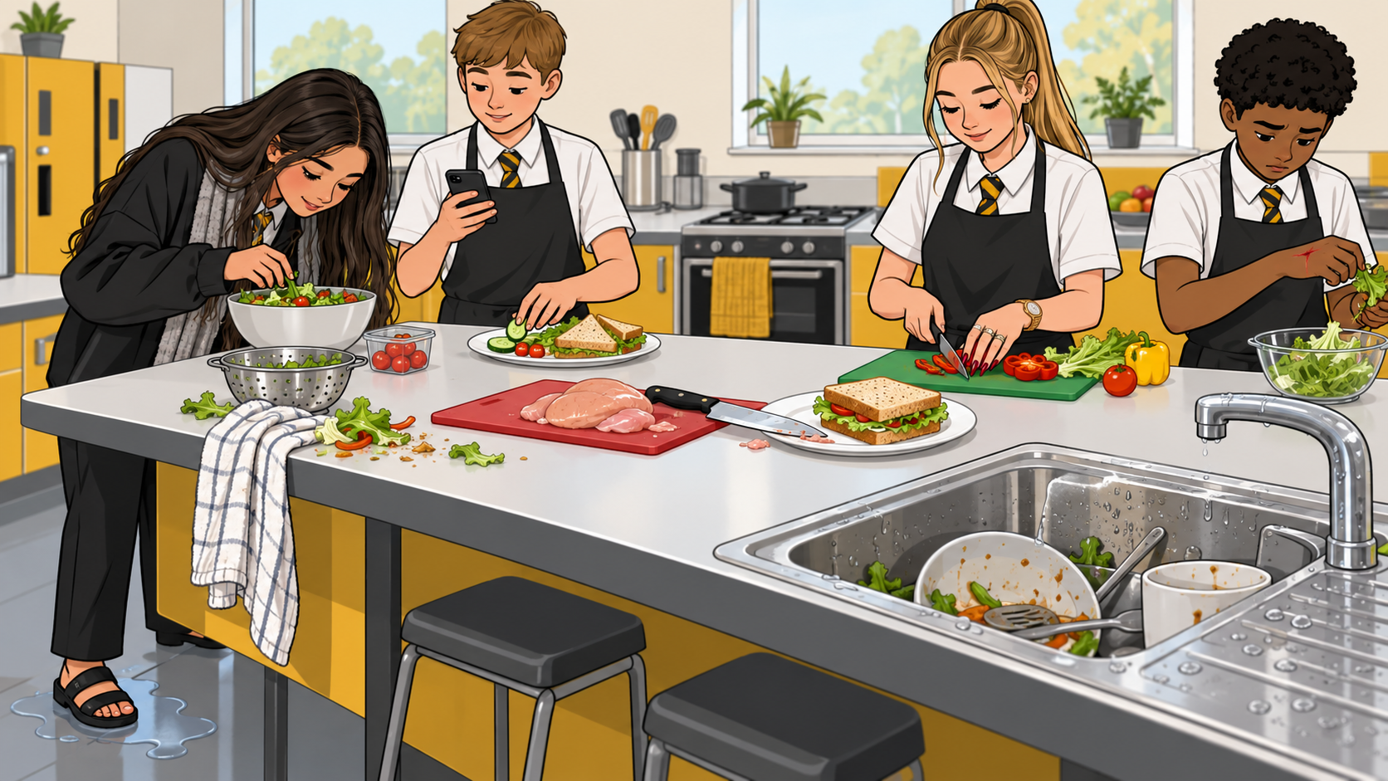
Spot the Hazard Challenge
Imagine entering a food technology kitchen and you observe this scene.
What are the immediate risks, and how should their routine be corrected?

Slide 30
You might have said….
✅
Long hair is loose and could fall into food. Tie it back before cooking.
The student is wearing a jacket and scarf near food. Remove loose clothing before starting.
Open-toe shoes and a wet floor could cause a slip or burn injury. Wear closed-toe shoes and clean up the spill immediately.
A phone can transfer microorganisms to food. Put it away, wash hands, then continue preparing food.
Rings, a watch and painted nails can trap dirt and bacteria. Remove jewellery and avoid nail polish or fake nails.
A cut is uncovered. Cover it with a waterproof bandage and wear a glove if it is on the hand.
Raw chicken and ready-to-eat sandwiches are using the same knife/area. Use separate equipment to prevent cross-contamination.
Food scraps and a tea towel are left on the bench. Clear scraps and keep tea towels away from food.
The sink is dirty and wet. Wash it, dry it and leave it ready for the next group.

Slide 31

Mastery Review Quiz
Question 1:
How long must hands be scrubbed with soap and warm water during washing?
Question 2:
What must be placed over a cut on your hand before touching food?
Question 3:
Why must the sink be wiped clean and completely dry before leaving the kitchen?

Slide 32
Mastery Review Quiz
✅
Answer 1:
At least 20 seconds.
Answer 2:
A clean waterproof bandage covered by a disposable glove.
Answer 3:
To prevent standing water from breeding bacteria, attracting pests, and causing foul odours.

